Slide 1

Walking the Wises Track
October 1st 2021
And happy birthday to Kate Everingham

Slide 2
As we had out, after noting the points below, close your eyes and imagine …..
The calls of a Golden Whistler
The soft cheeps of a flock of Silvereyes
The somewhat raucous sounds of a flock of Yellow-tailed Black Cockatoos
The soft melodies of the Grey Shrike-thrush
The happy chirruping of the Grey Fantail
They are out background as we look down and marvel at what is on offer

Slide 3
Dampiera stricta

Slide 5
Philotheca

Slide 6
Patersonia glabrata

Slide 7
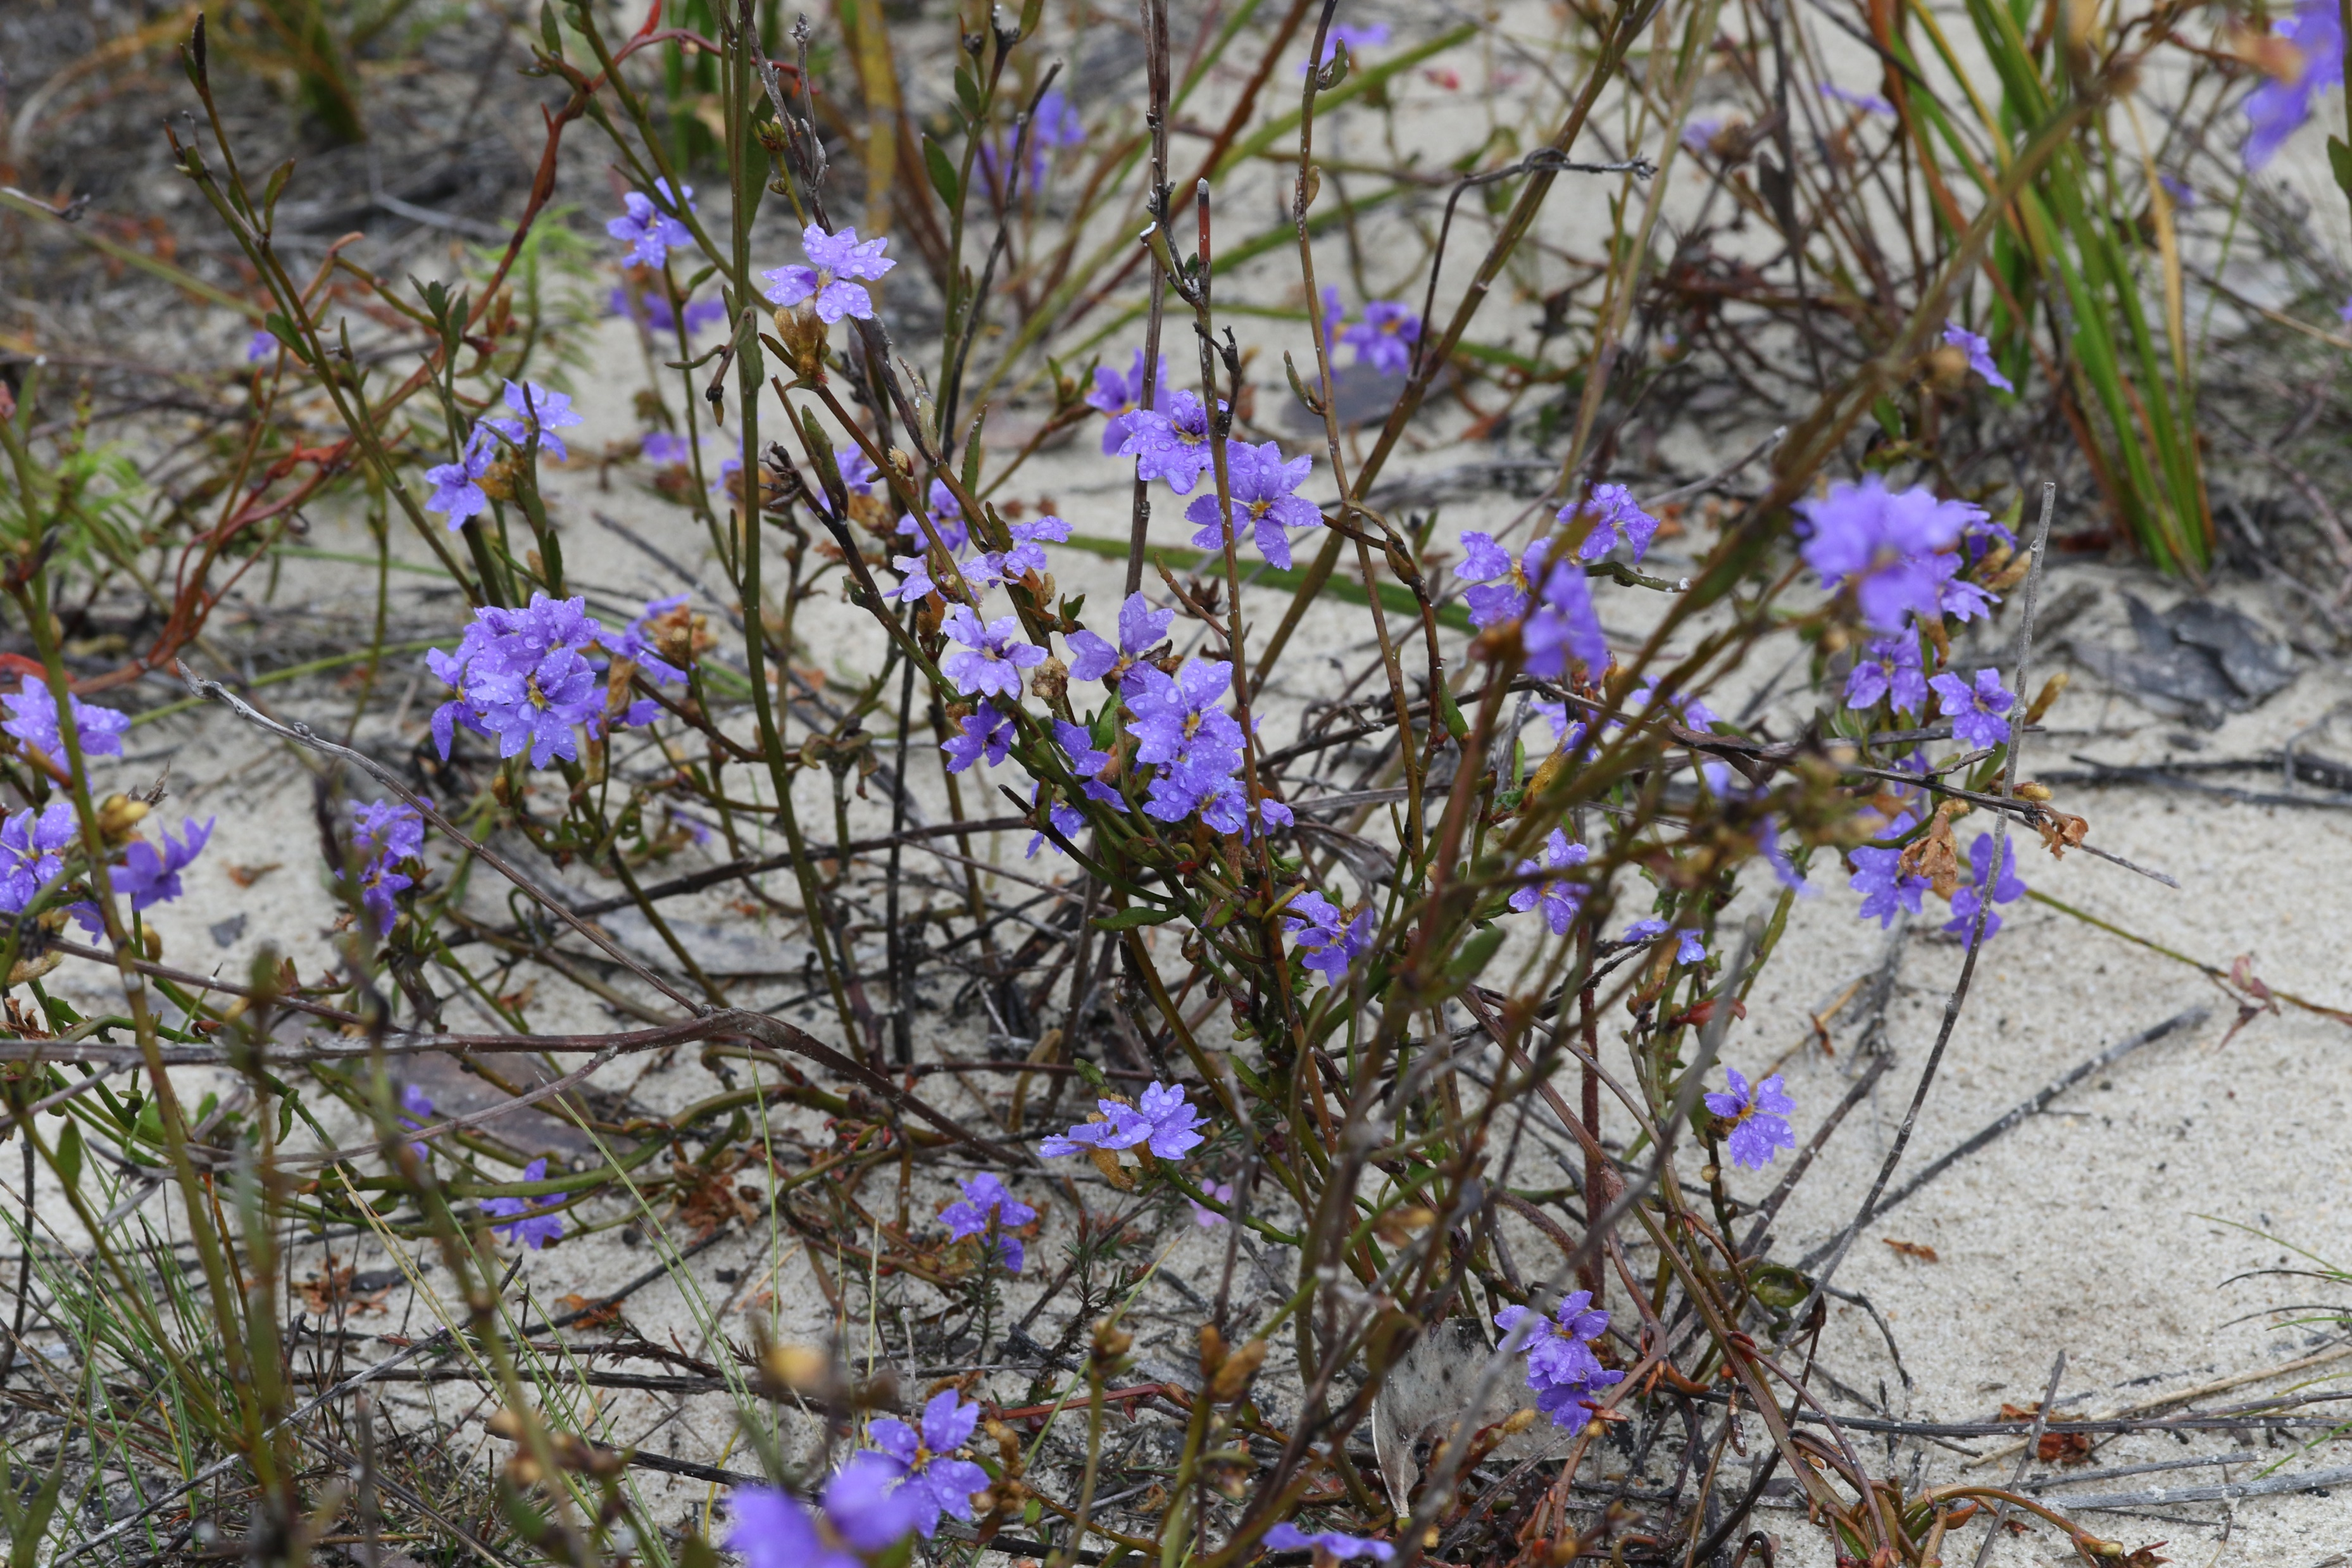

Slide 8
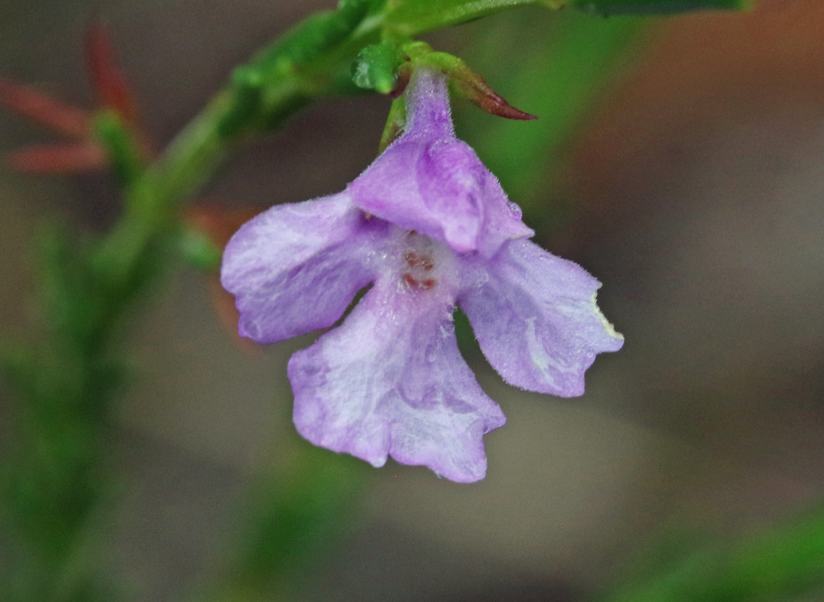
Hemigenia purpurea

Slide 9
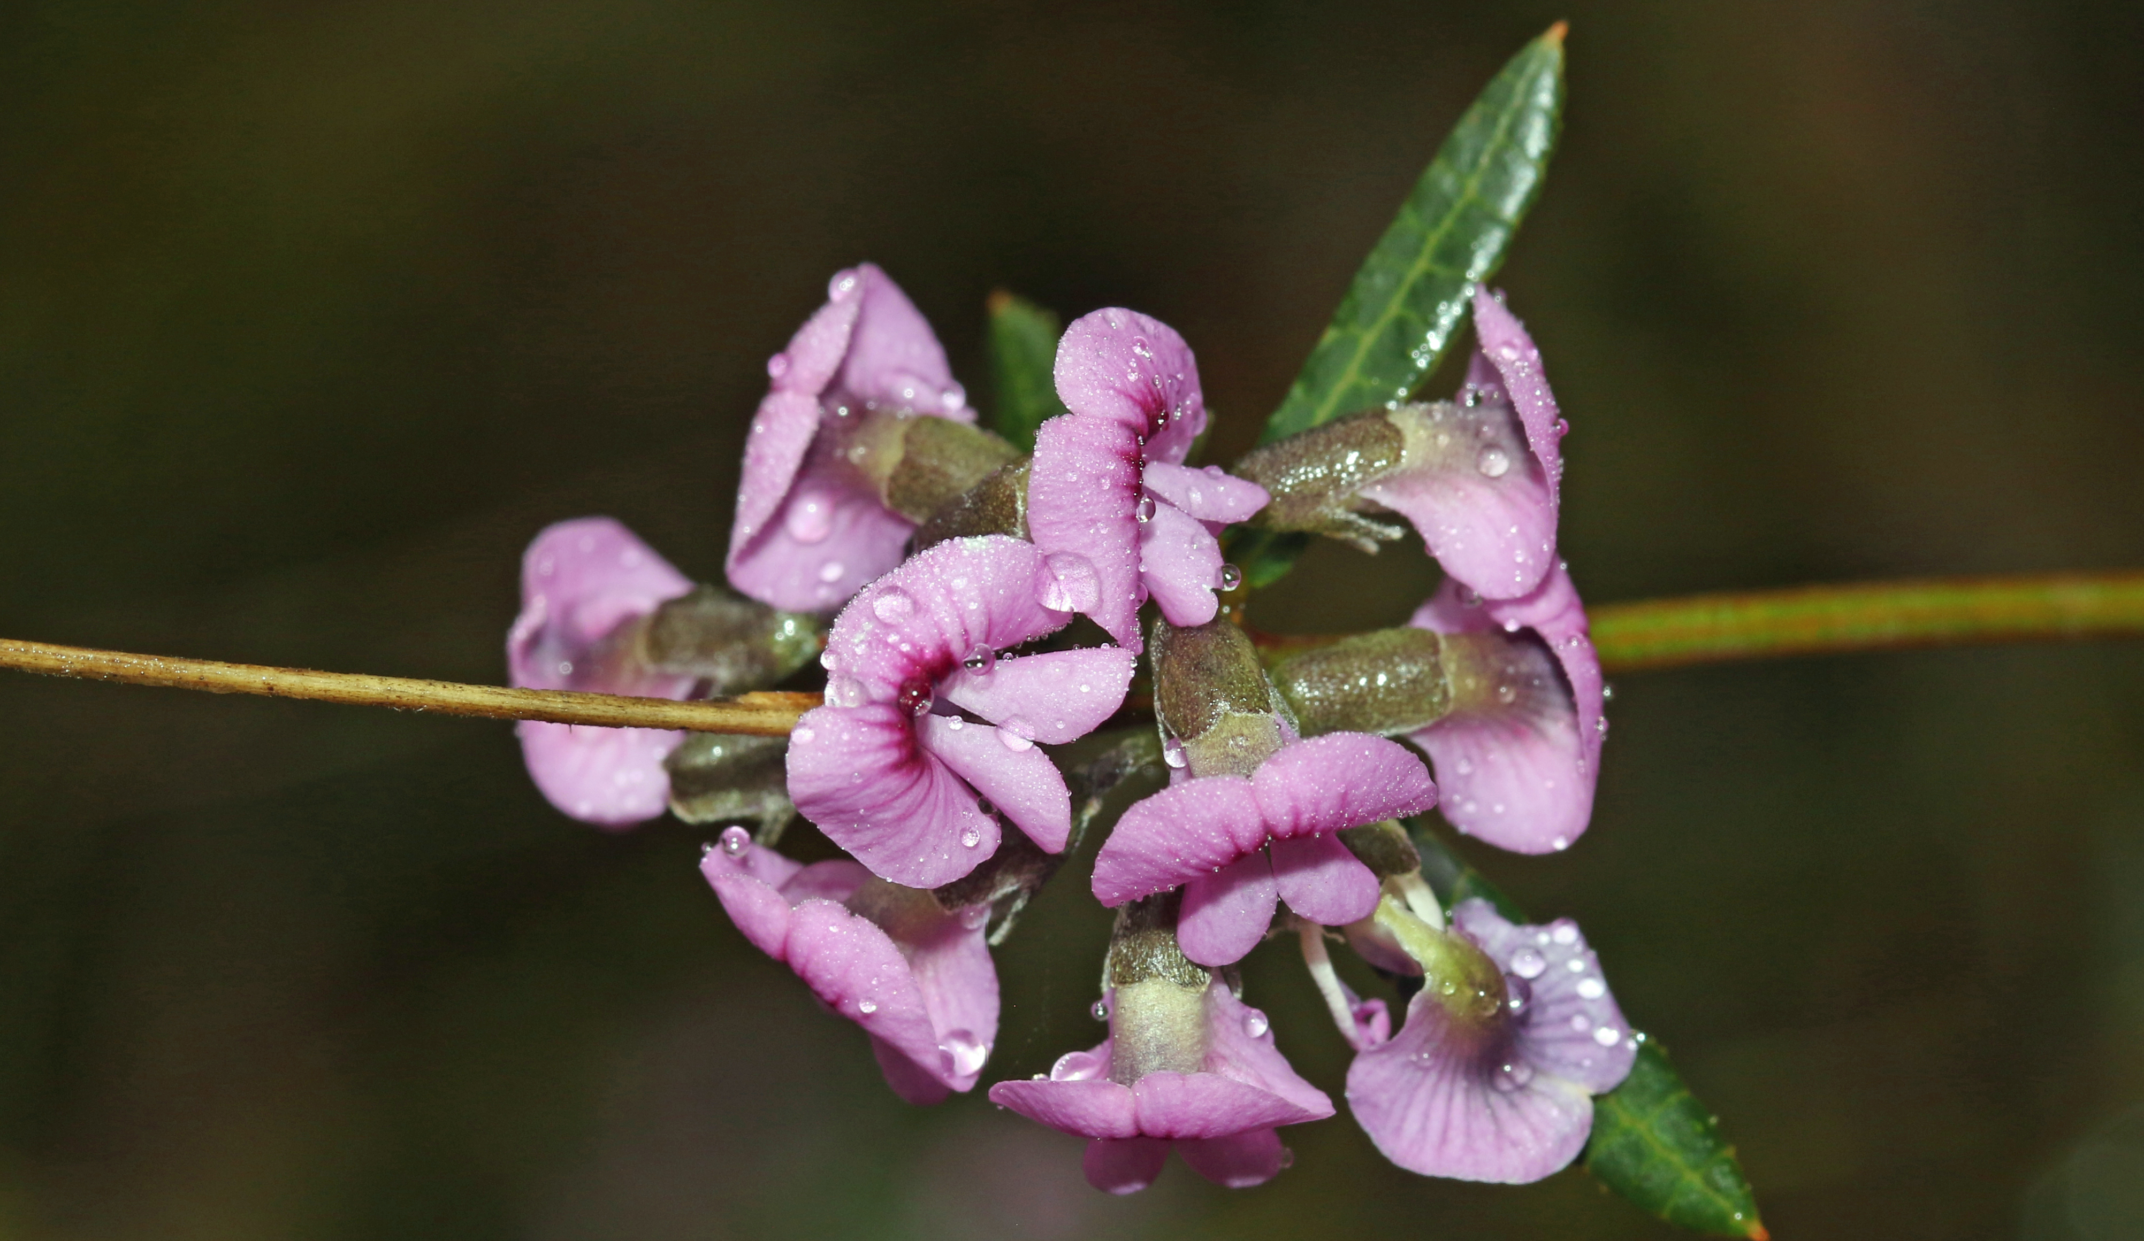

Slide 10
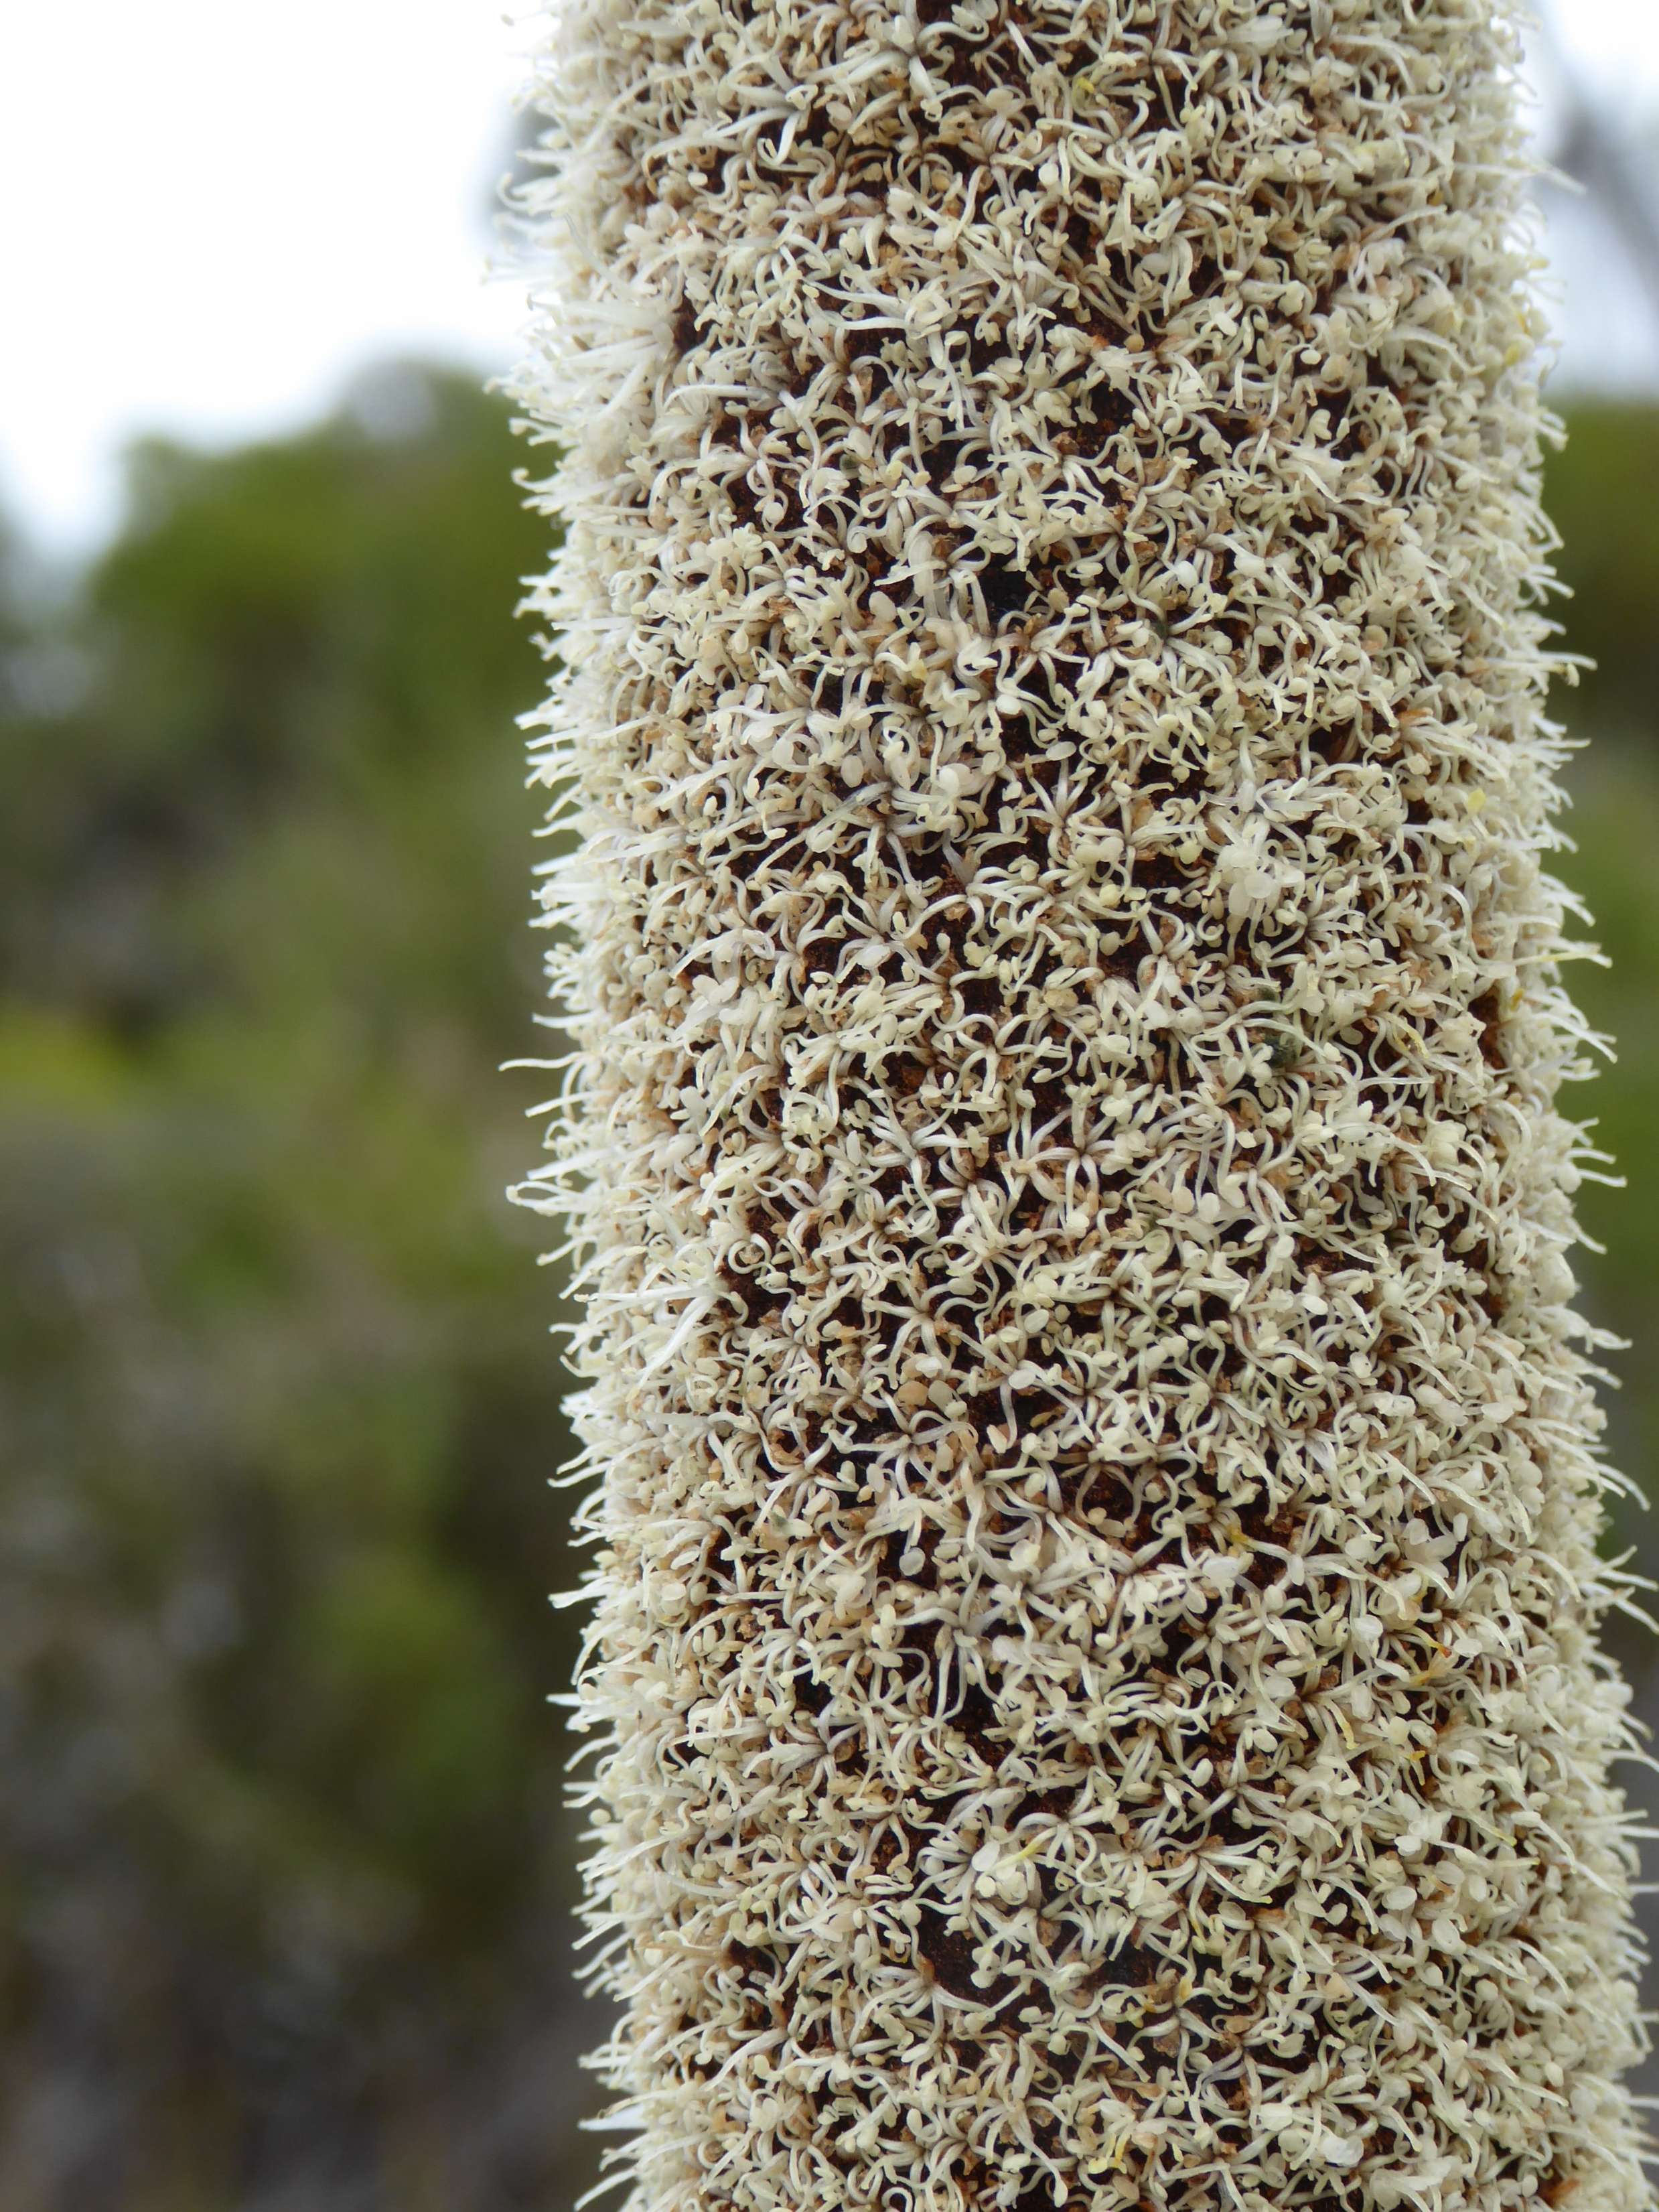

Slide 11
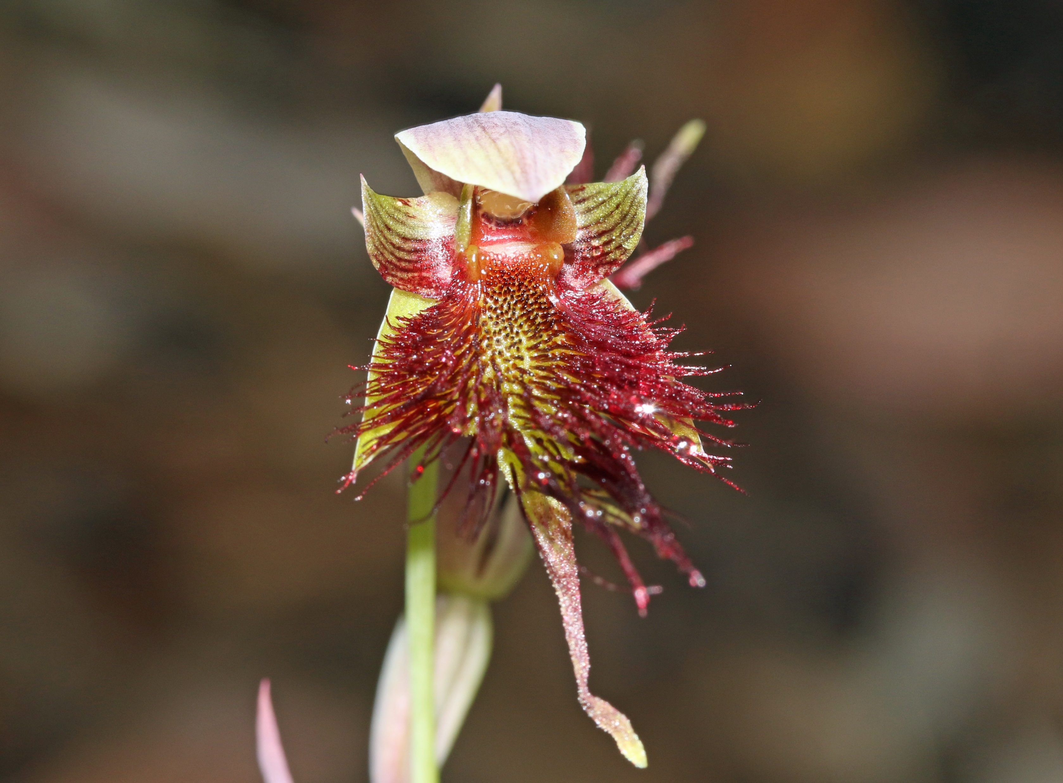

Slide 12
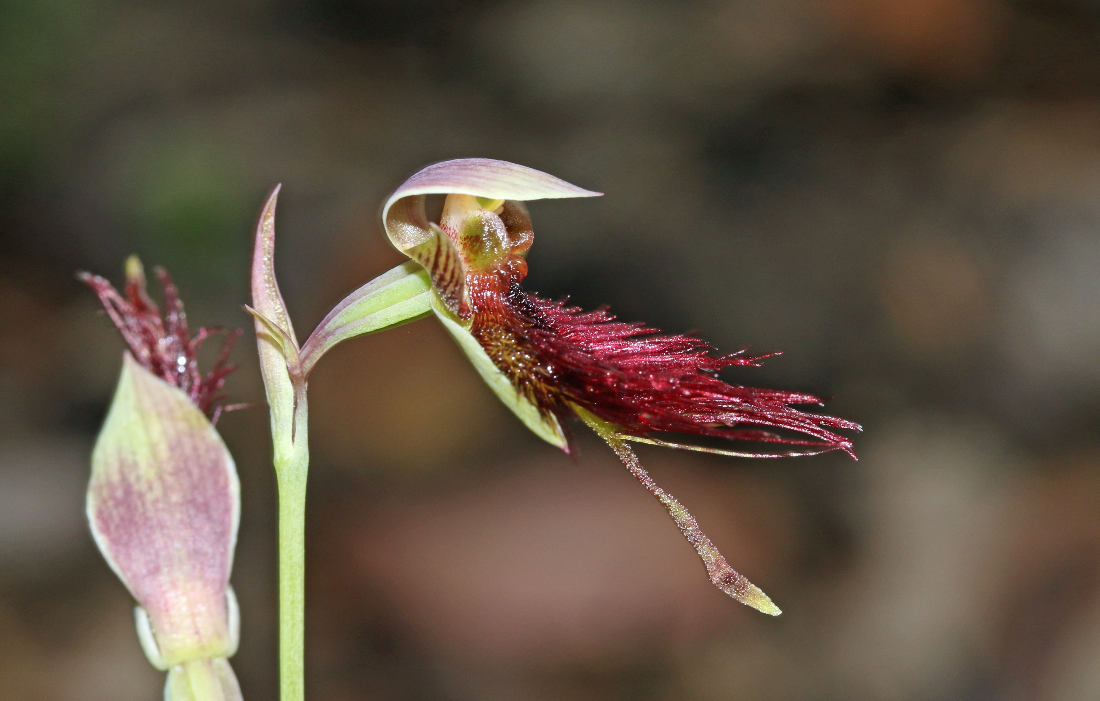

Slide 13
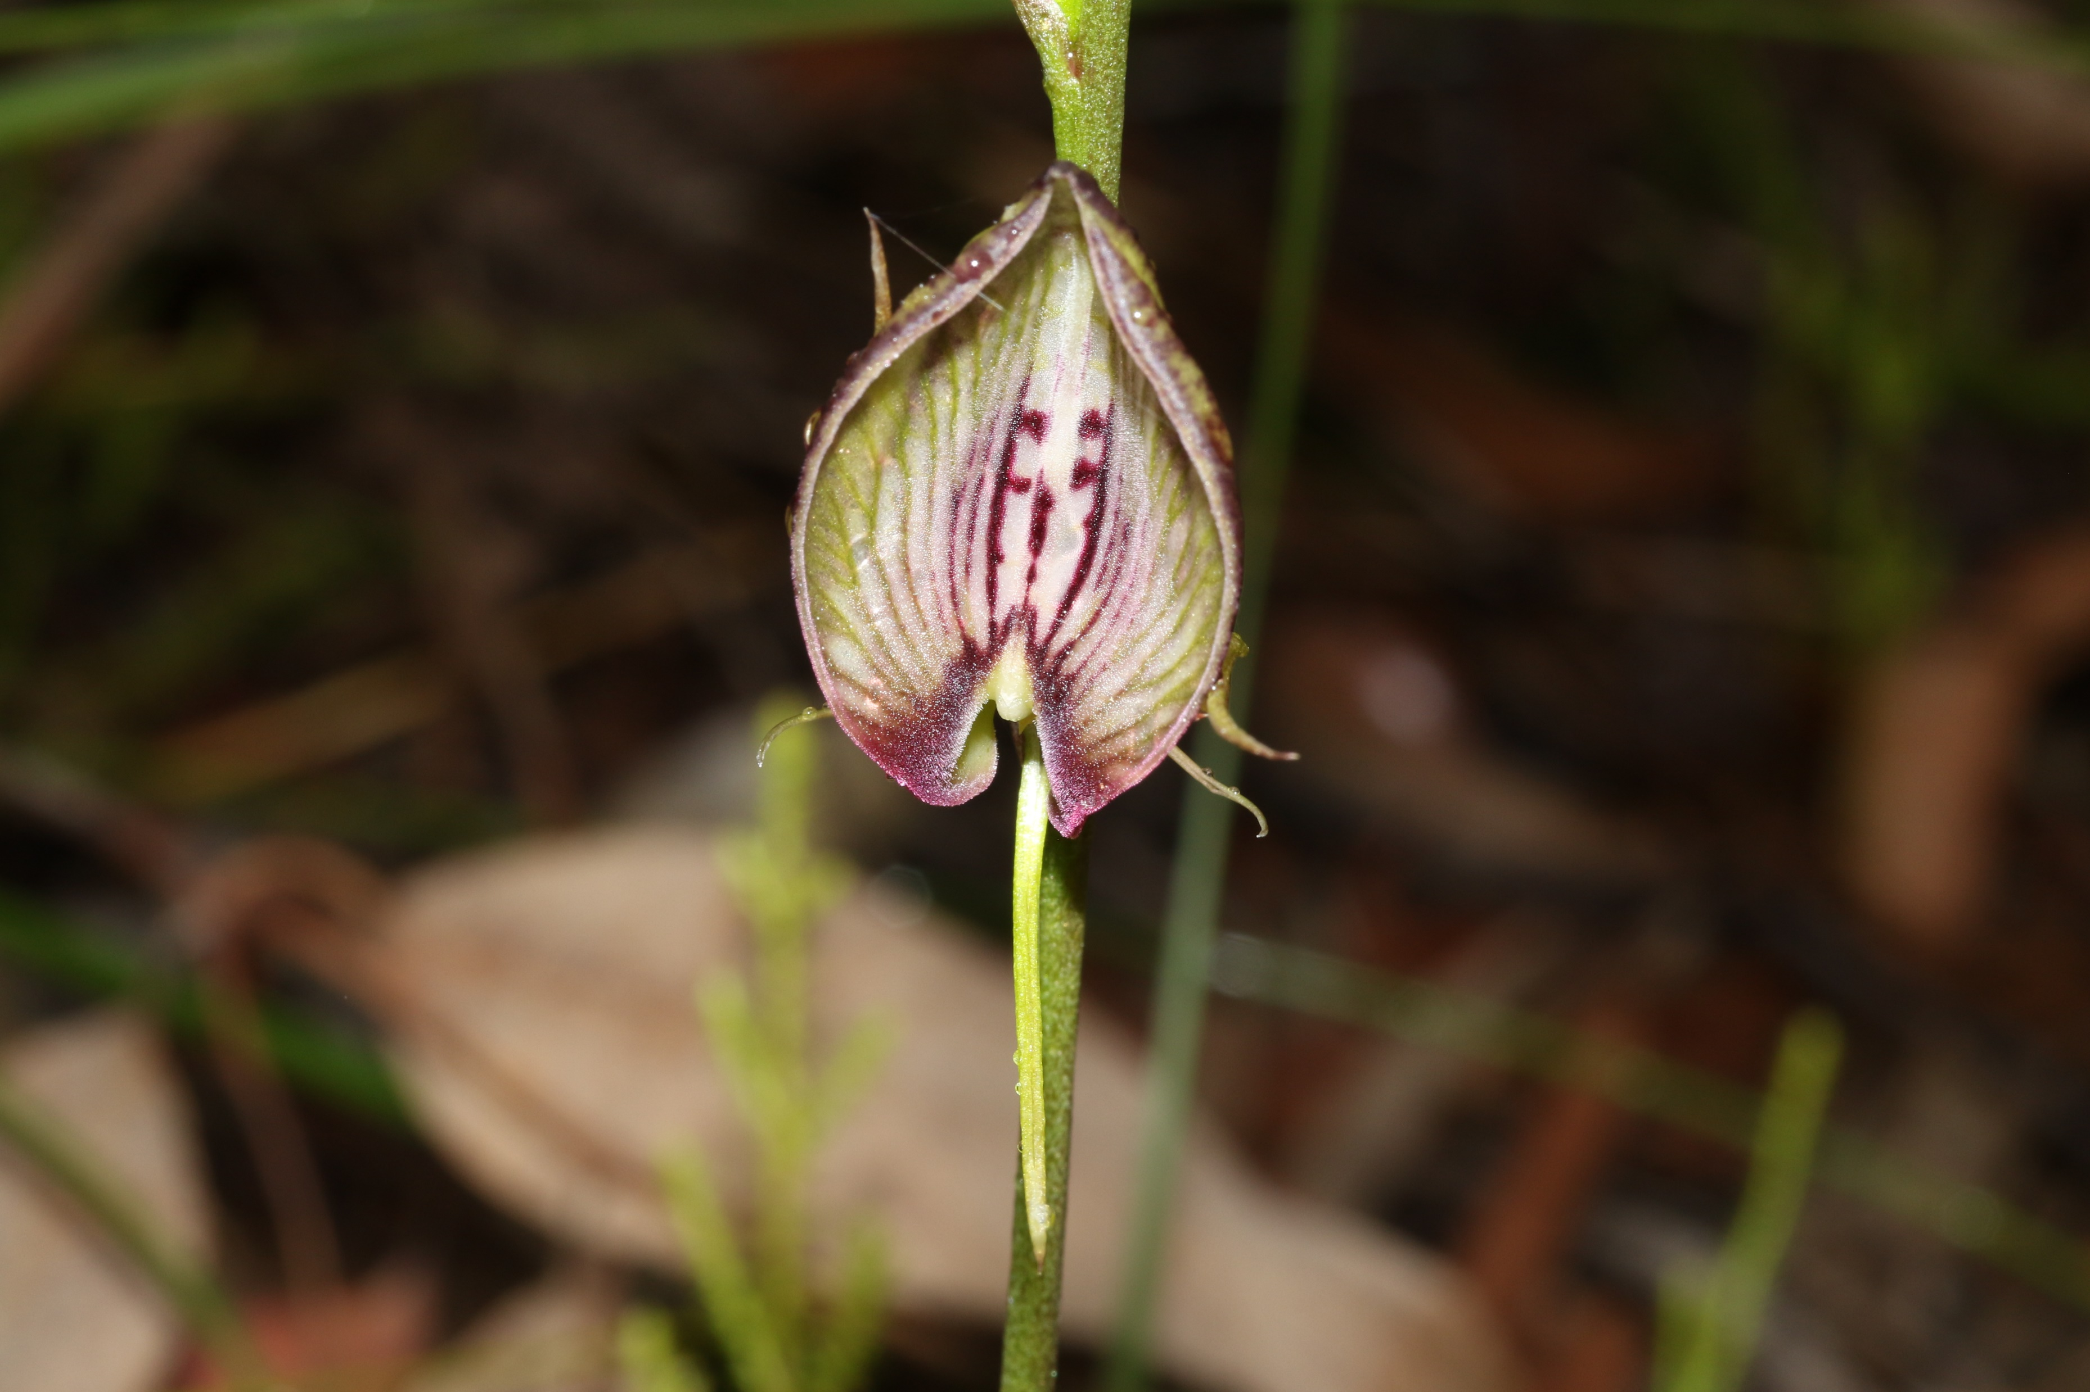

Slide 14
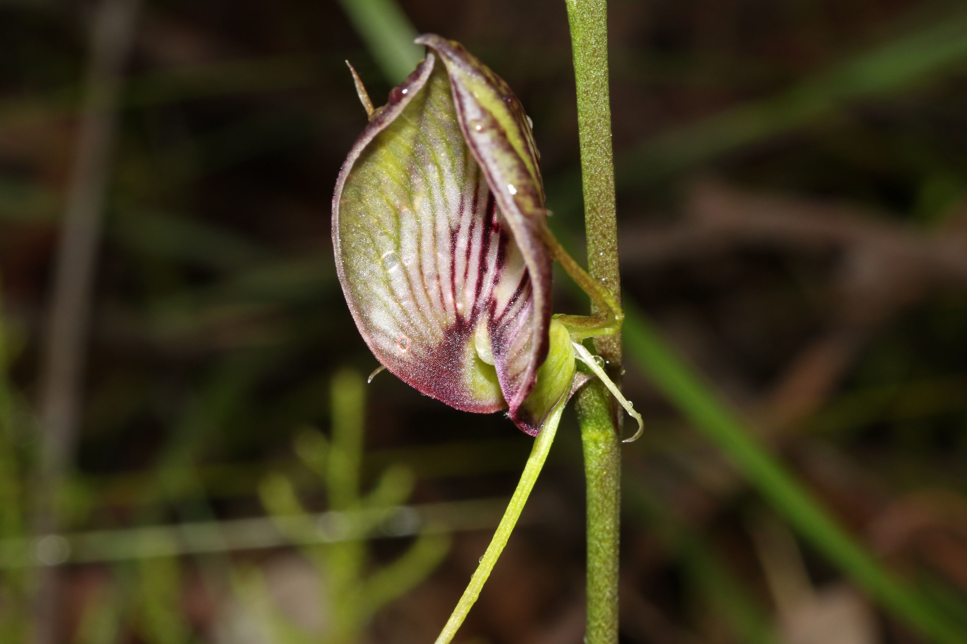
Cryptostylis erecta – Bonnet Orchid

Slide 15
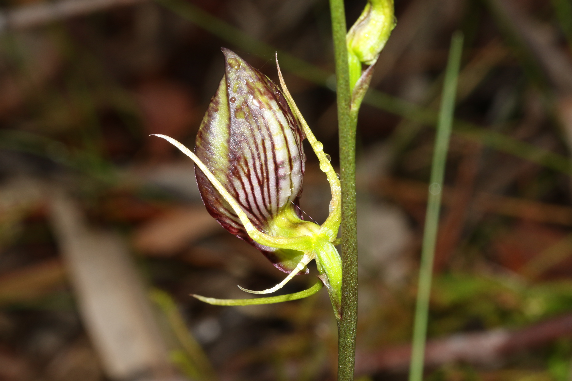

Slide 16
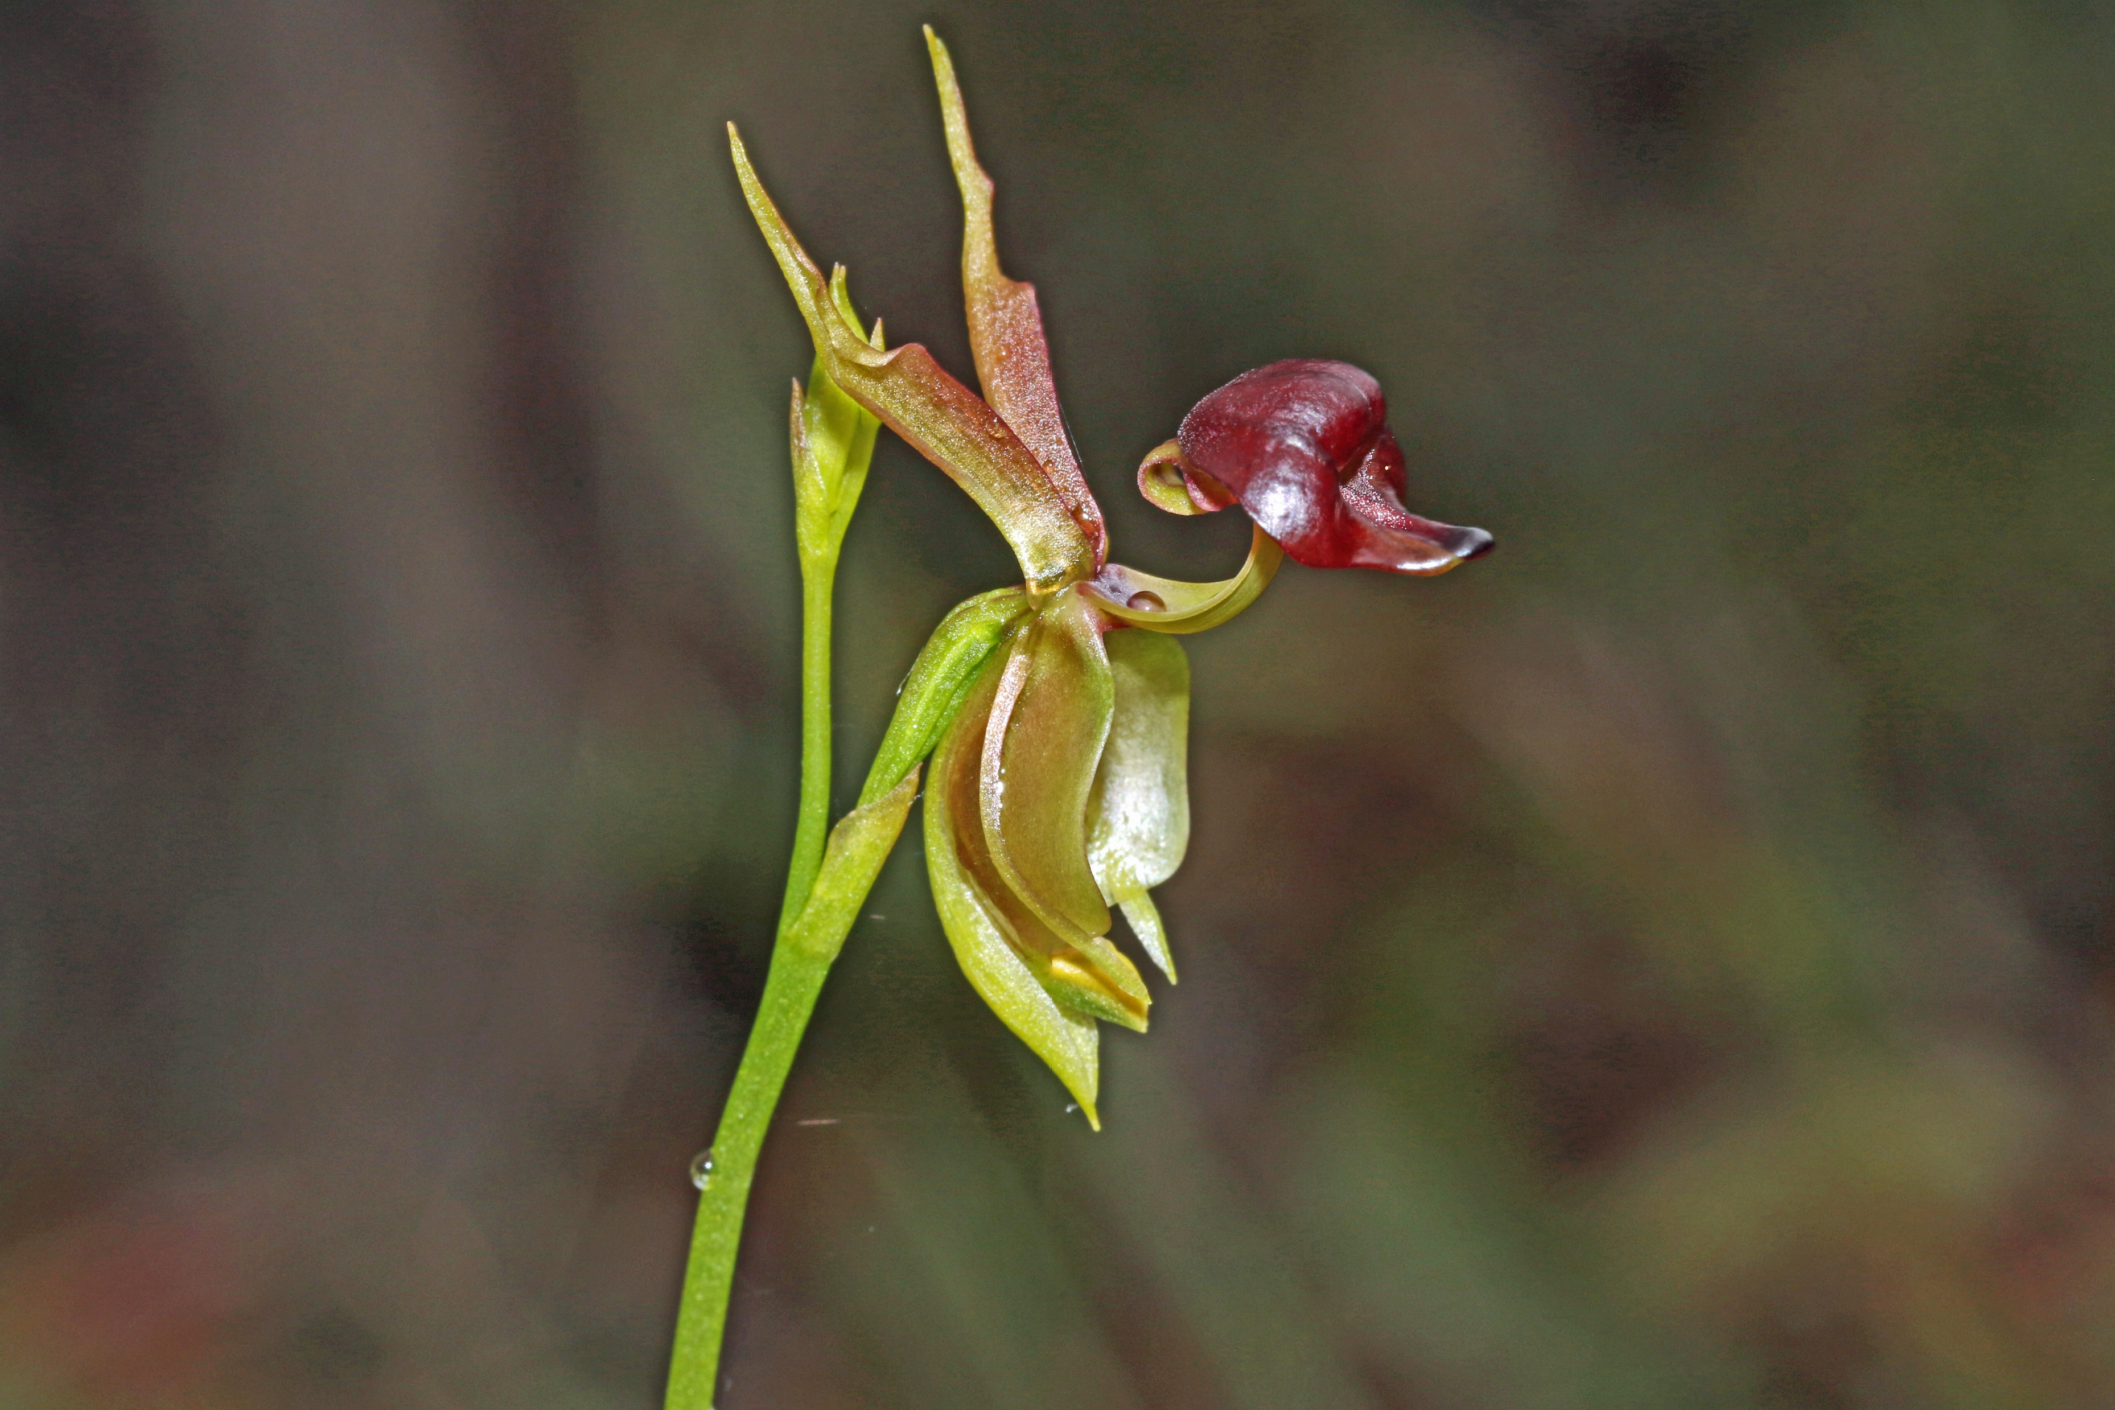
Caleana major

Slide 17
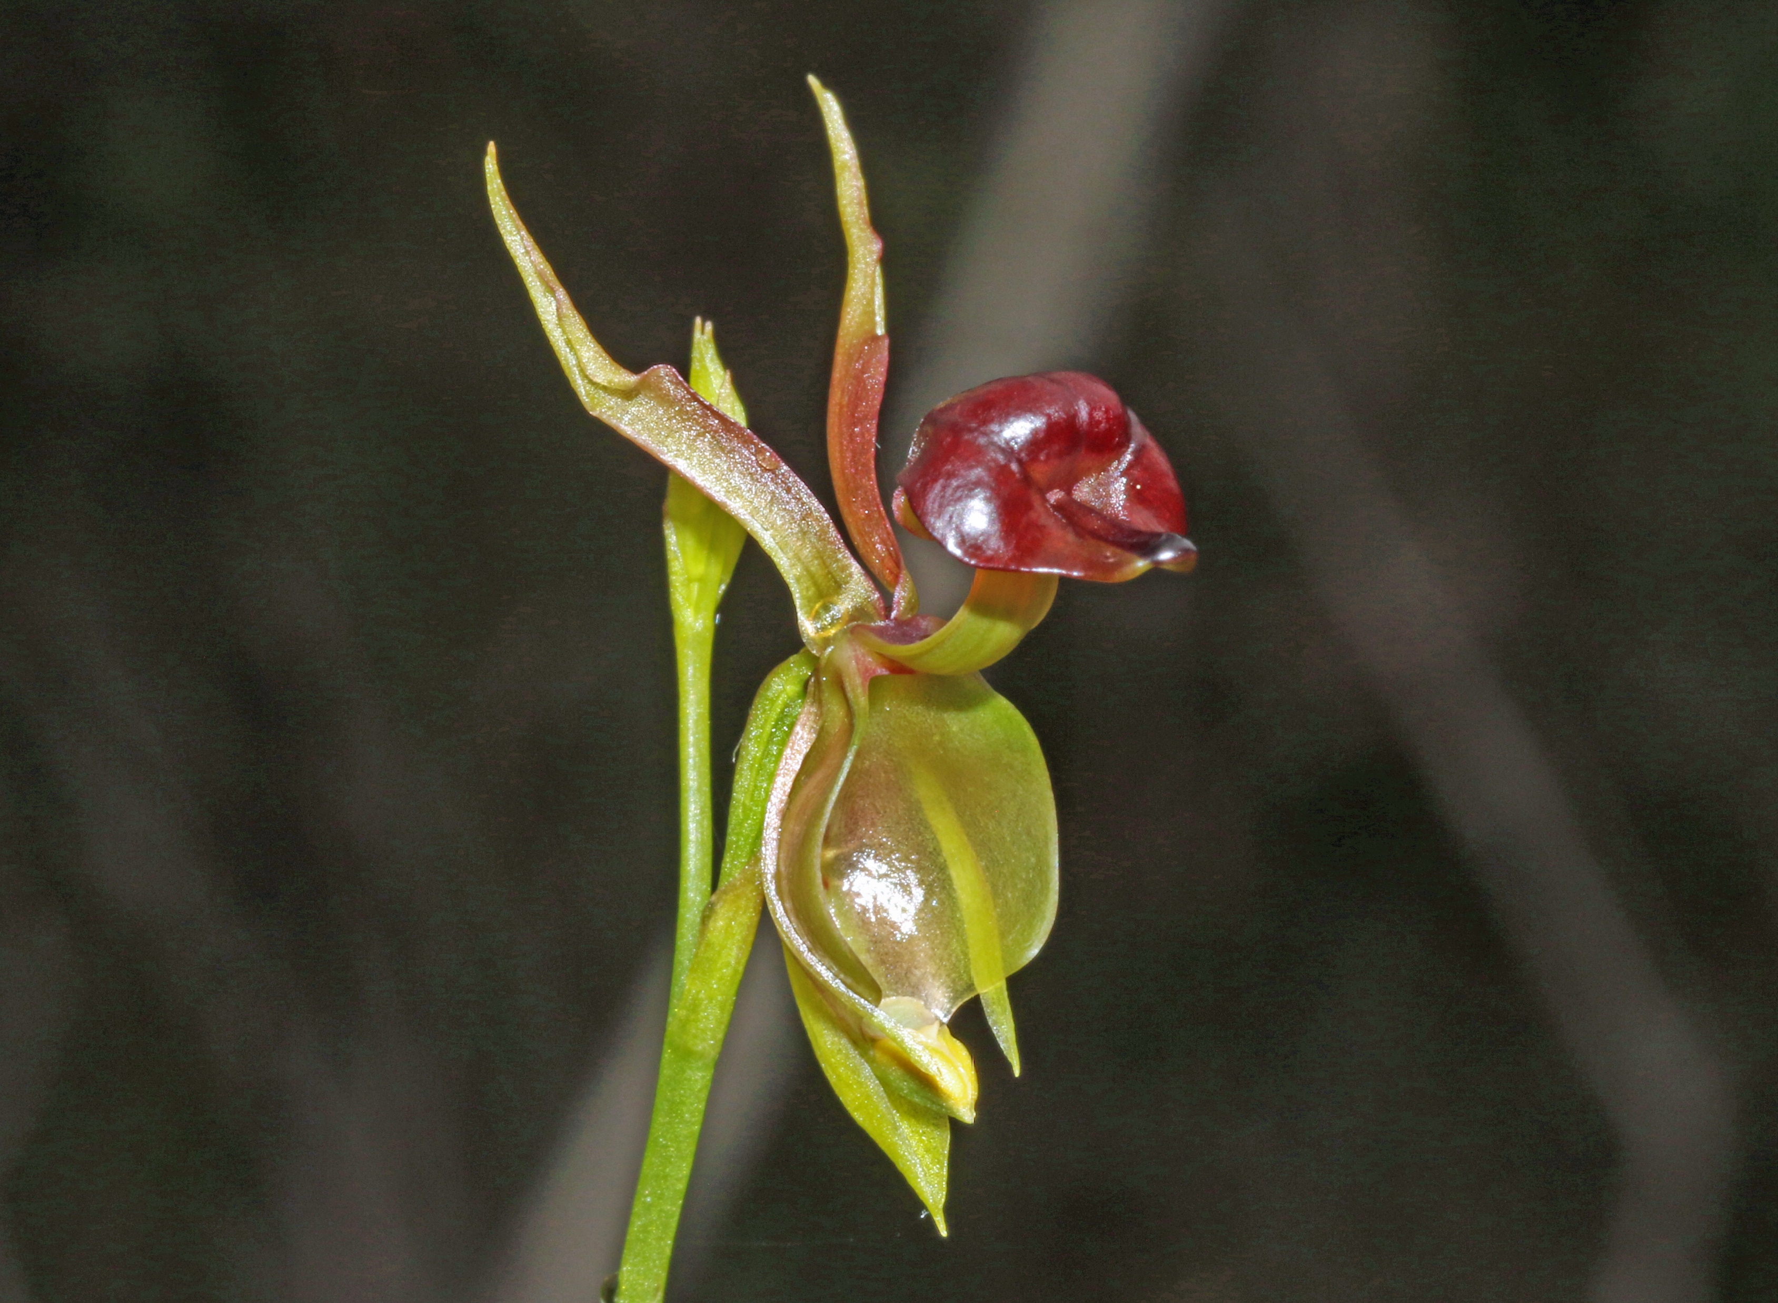

Slide 18
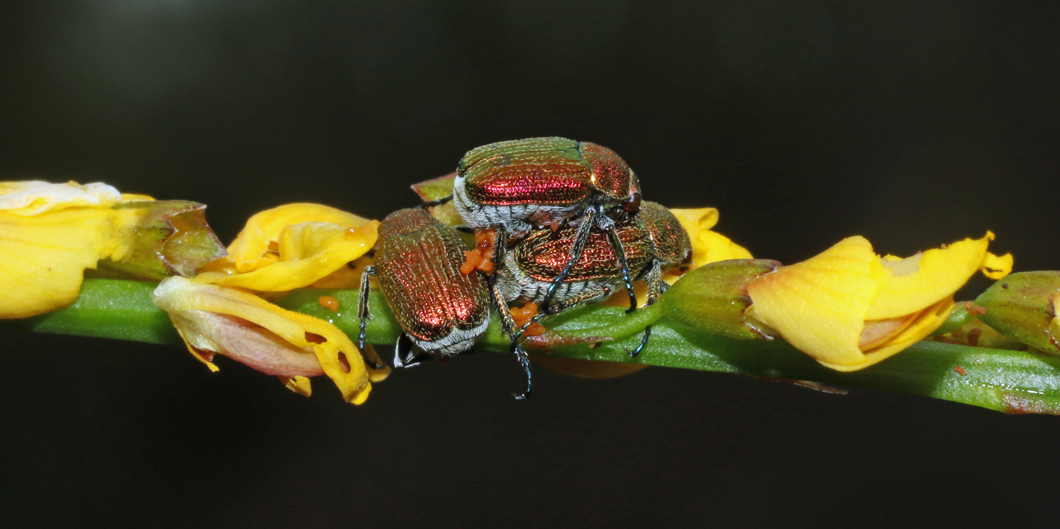

Slide 19
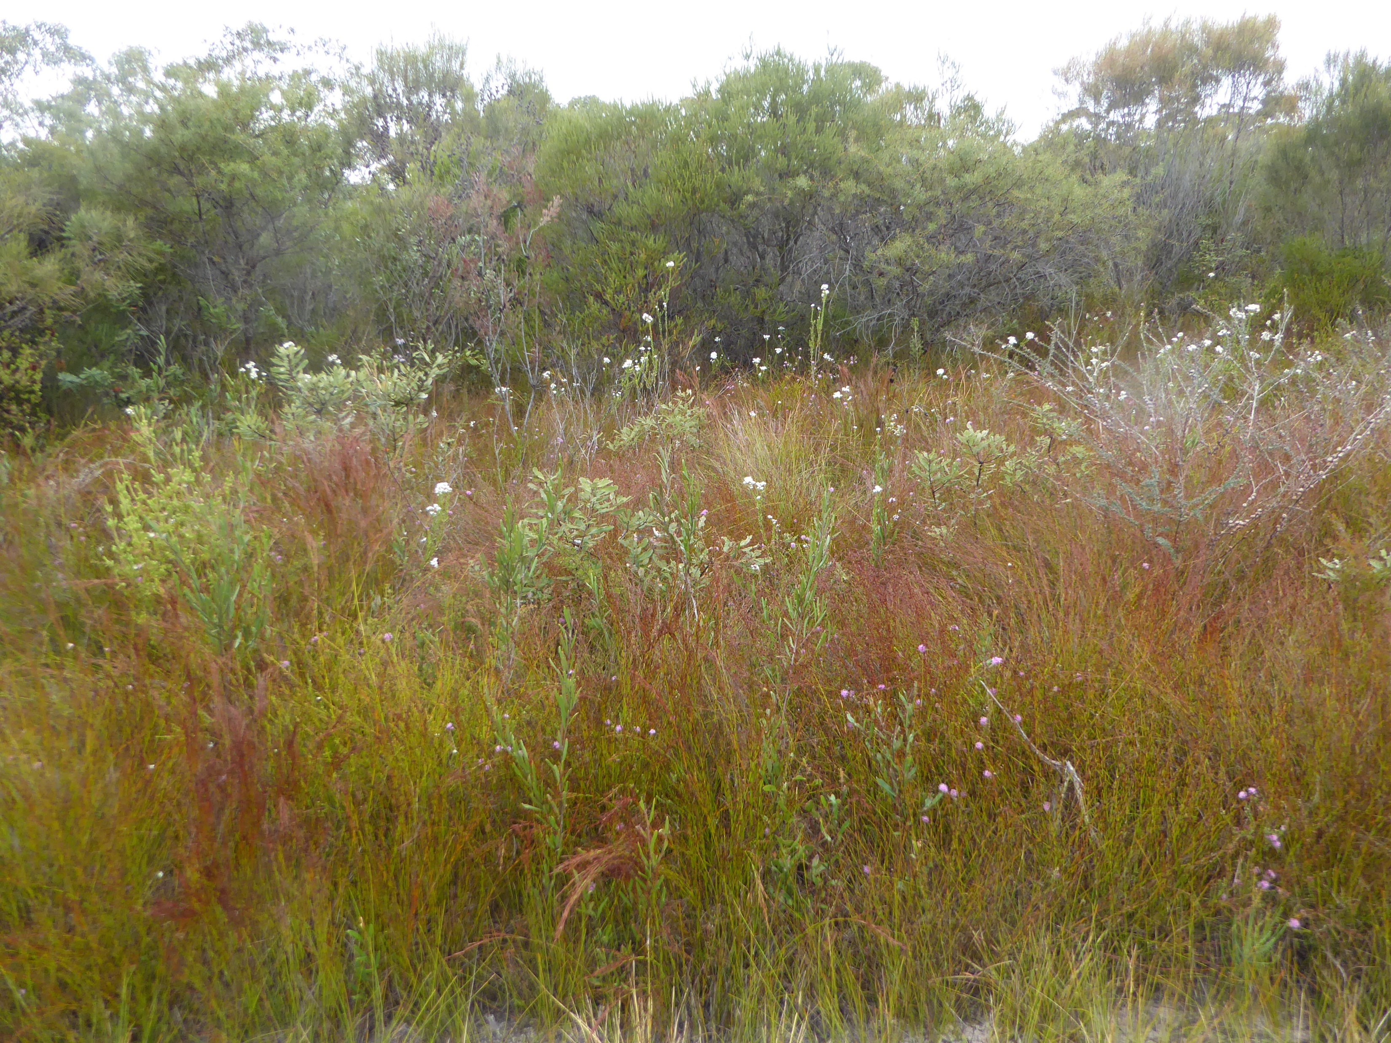

Slide 20
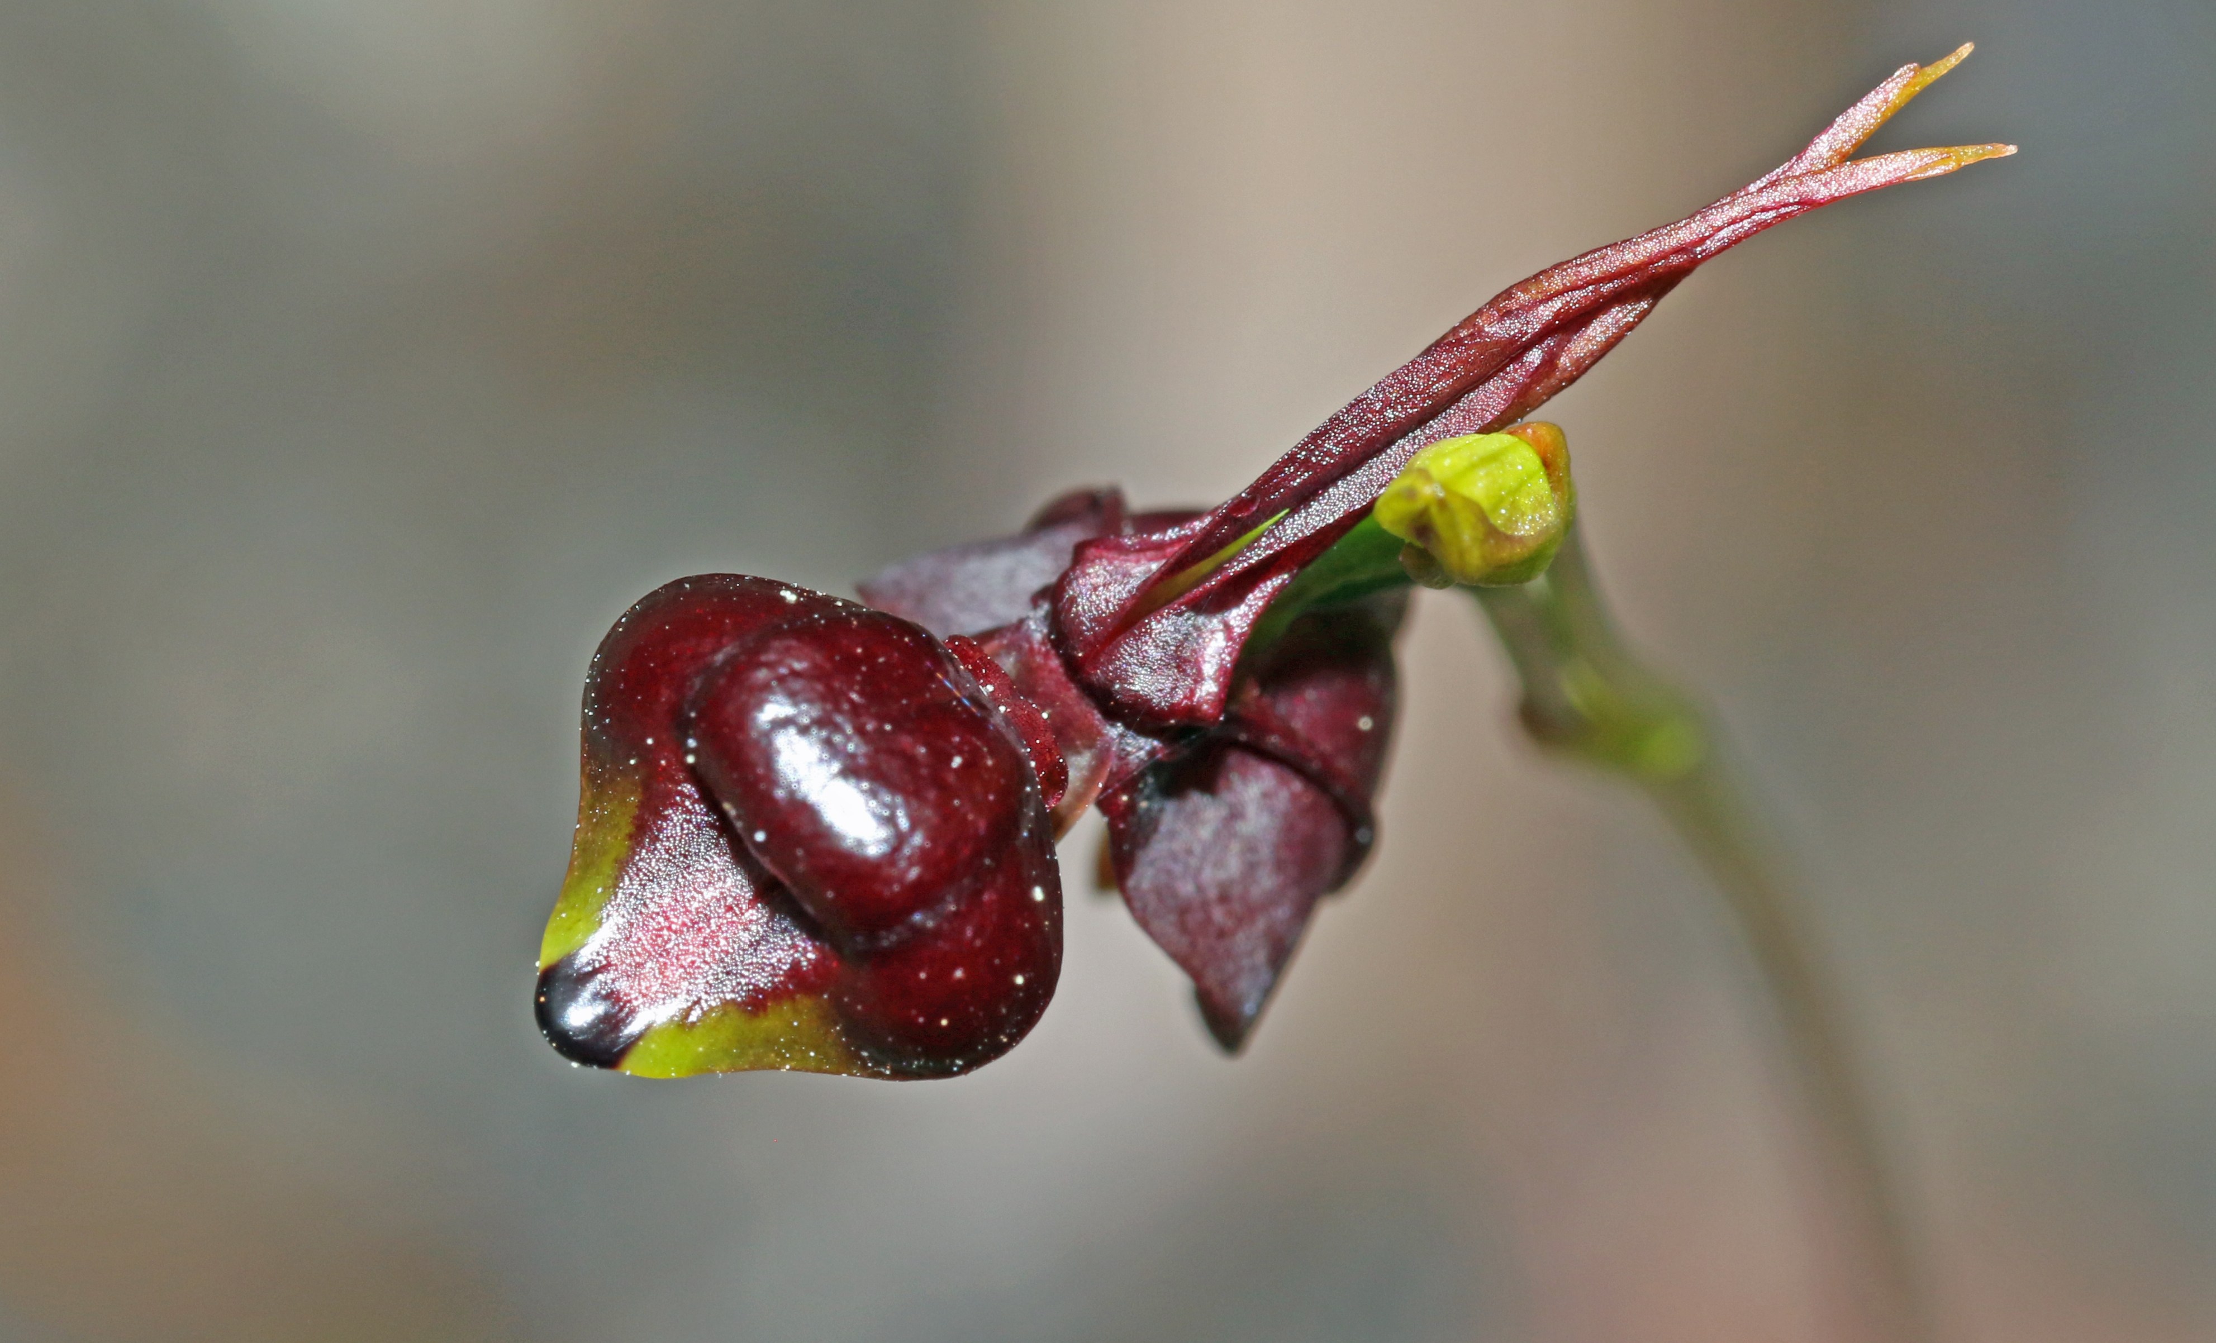

Slide 21
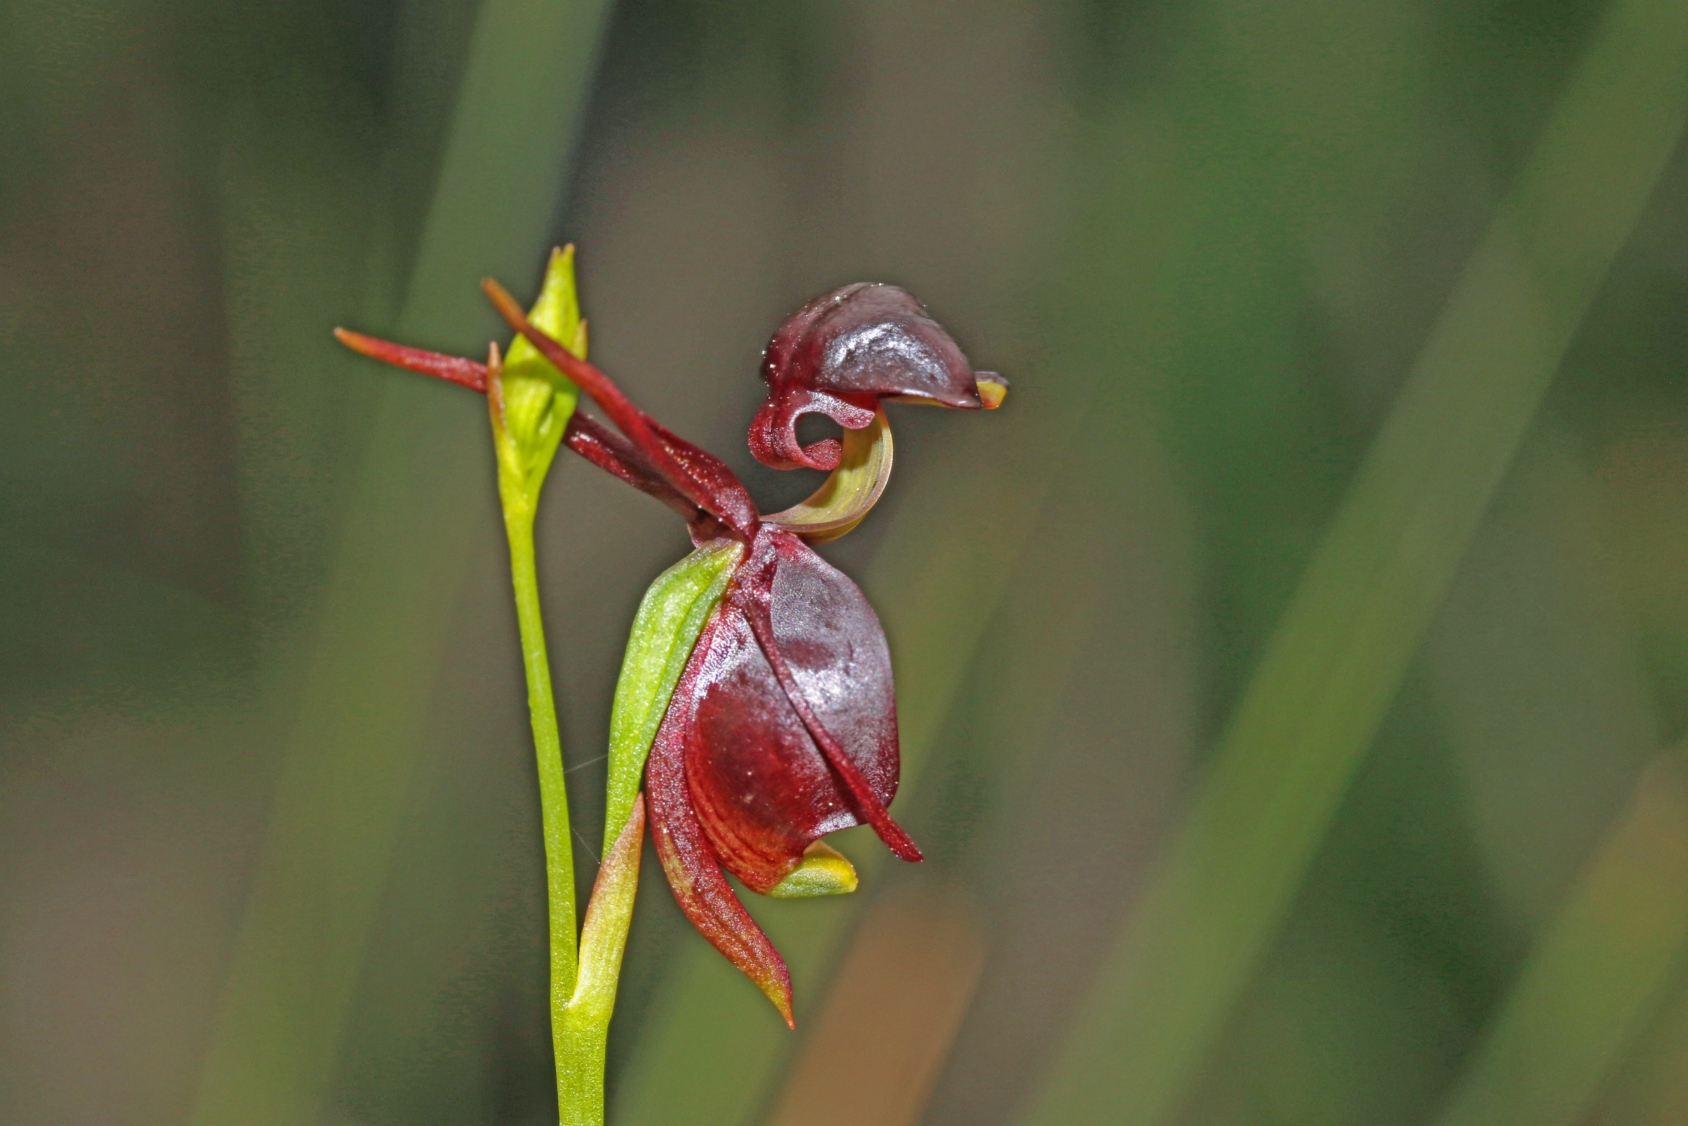

Slide 22
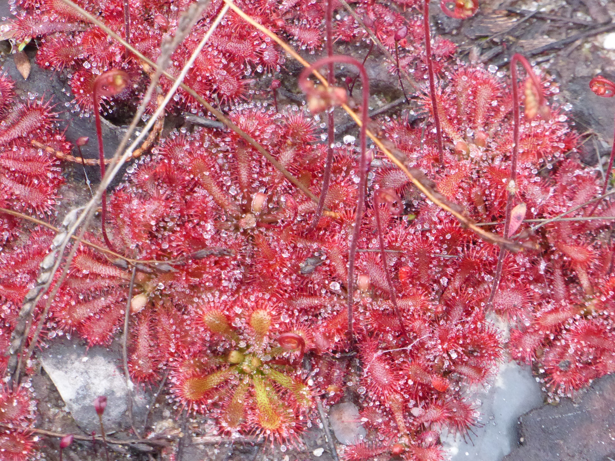

Slide 23
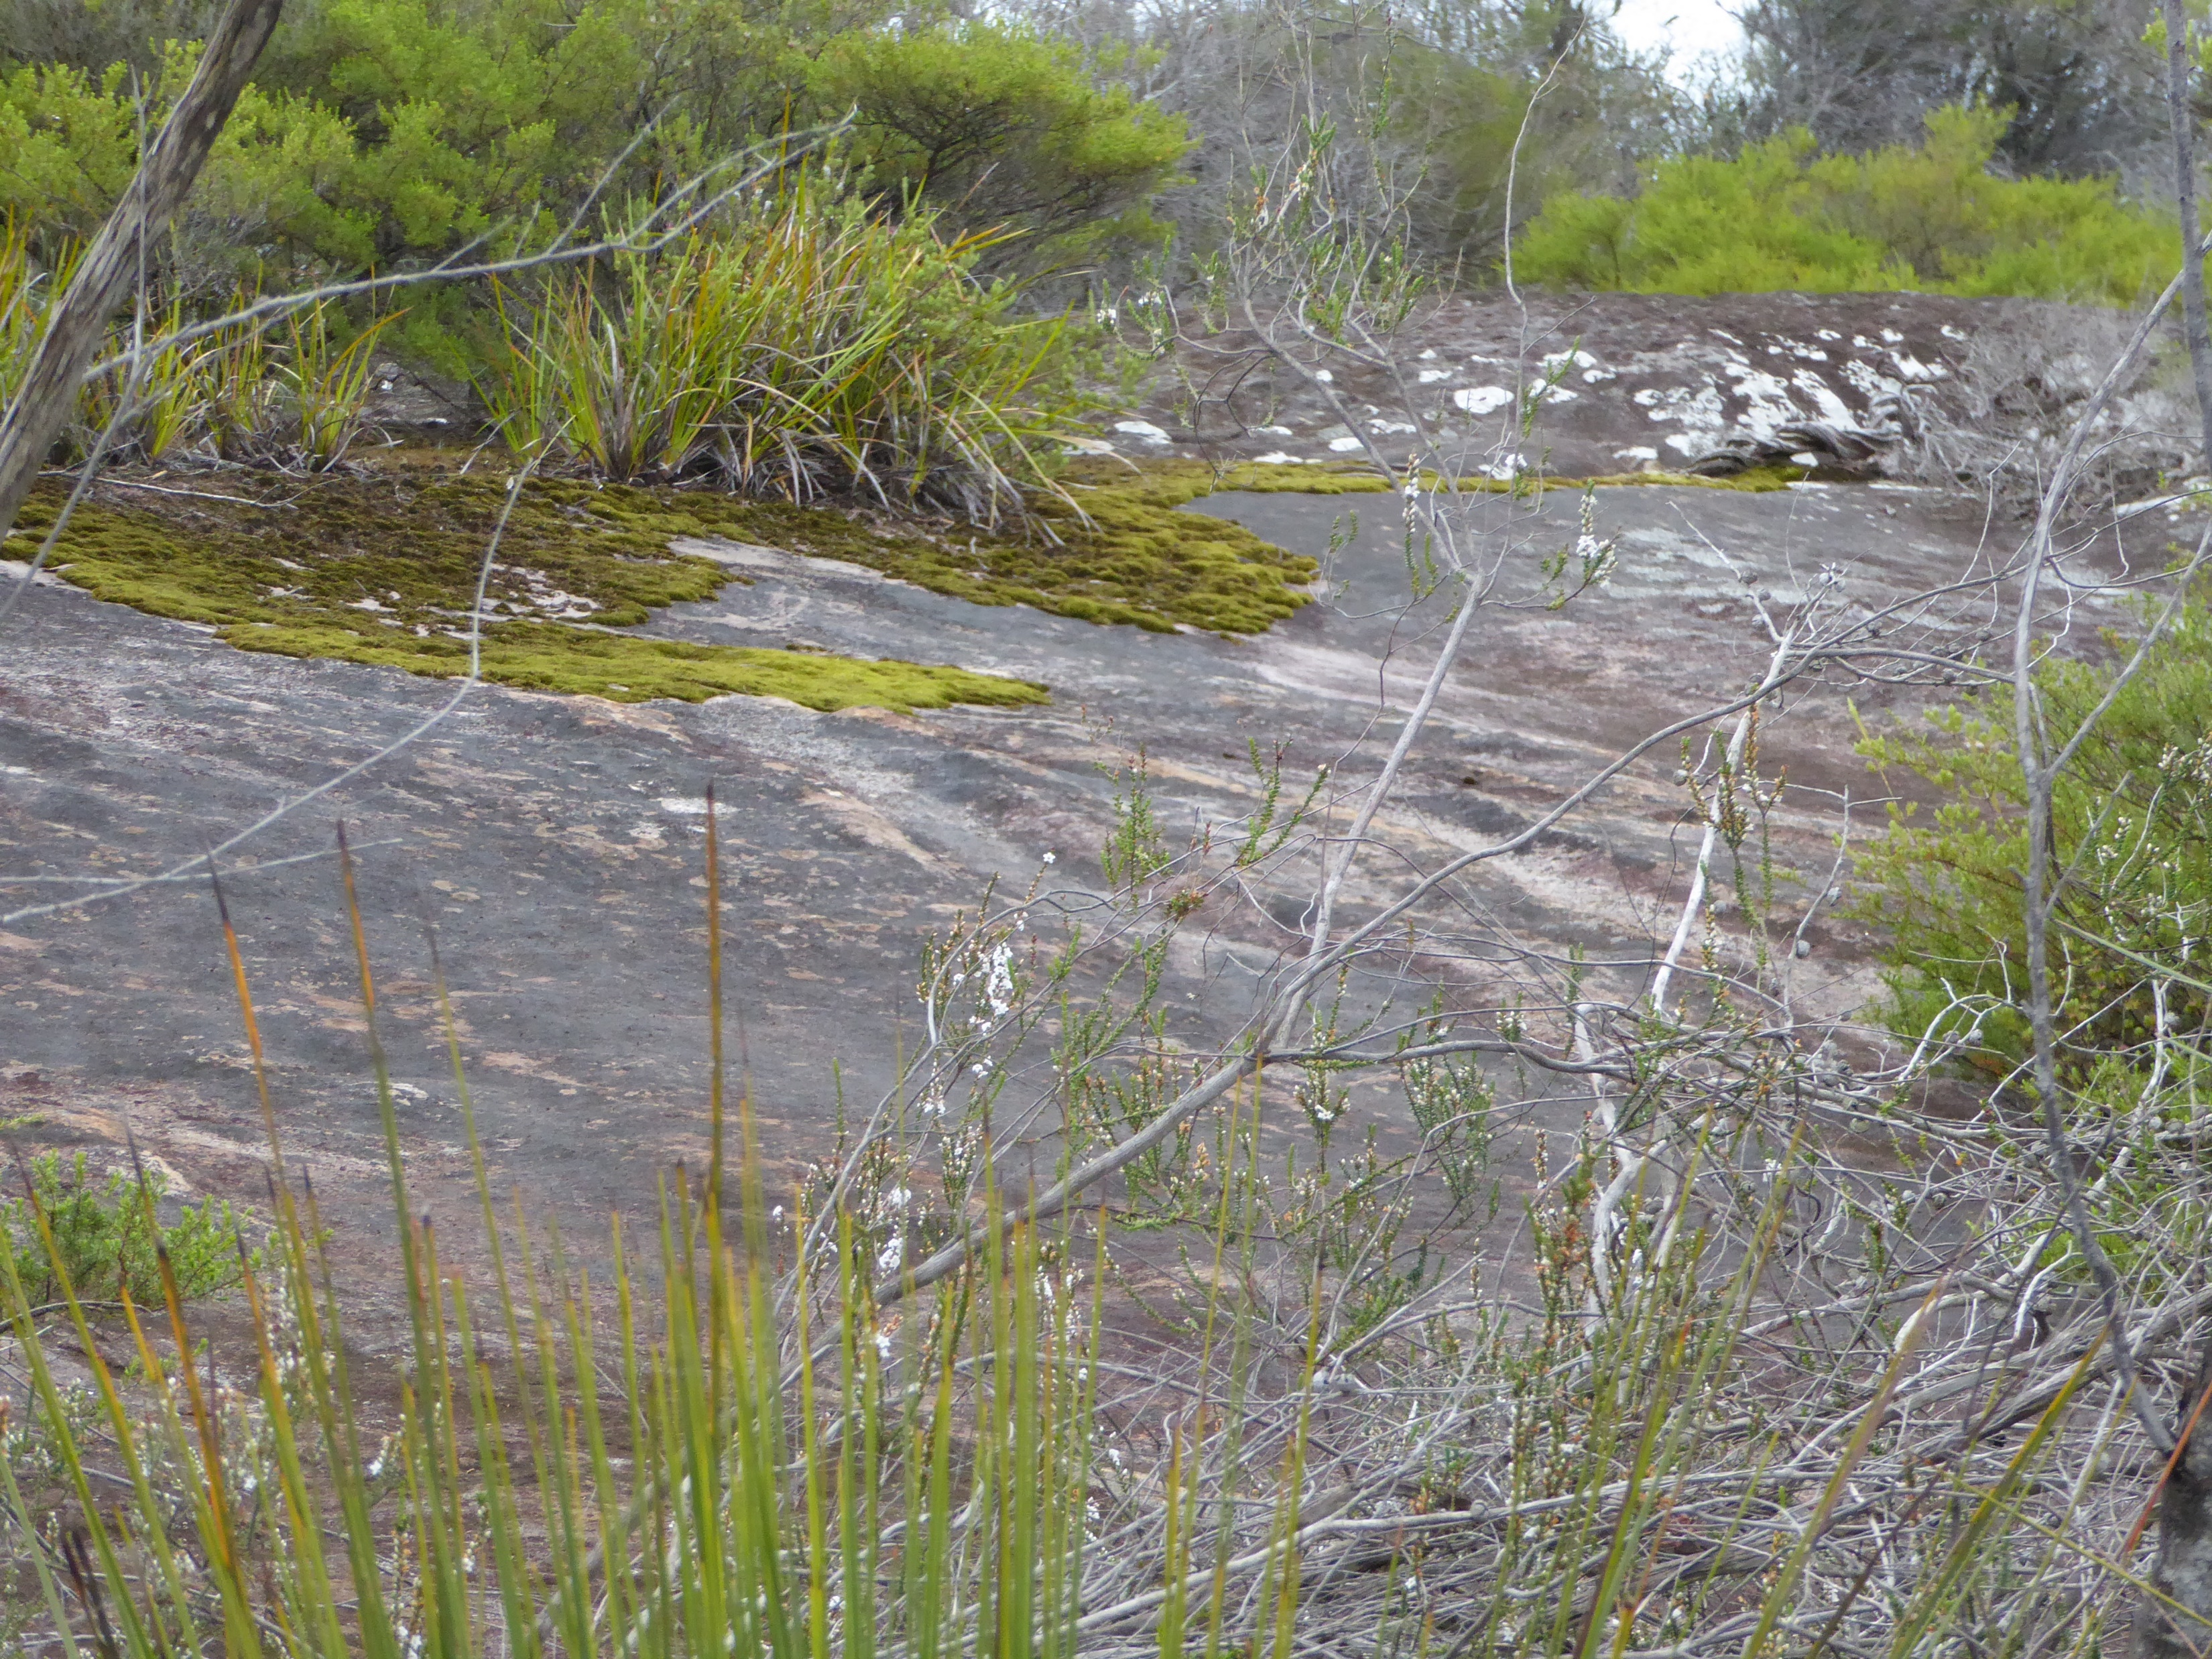

Slide 24
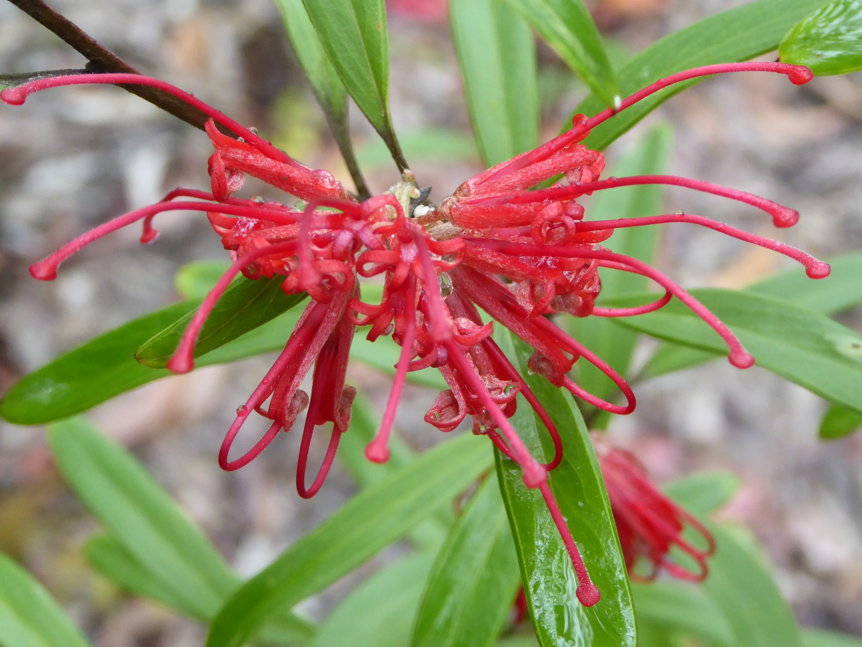

Slide 25
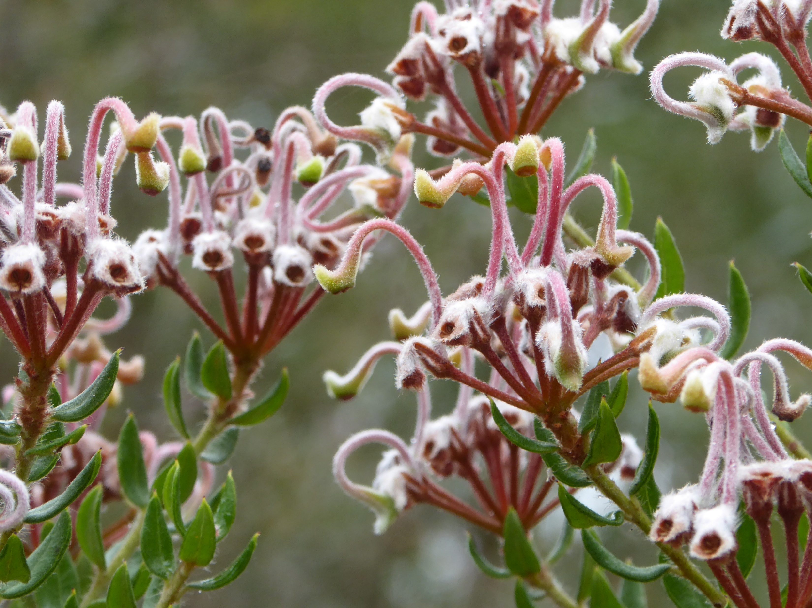

Slide 26
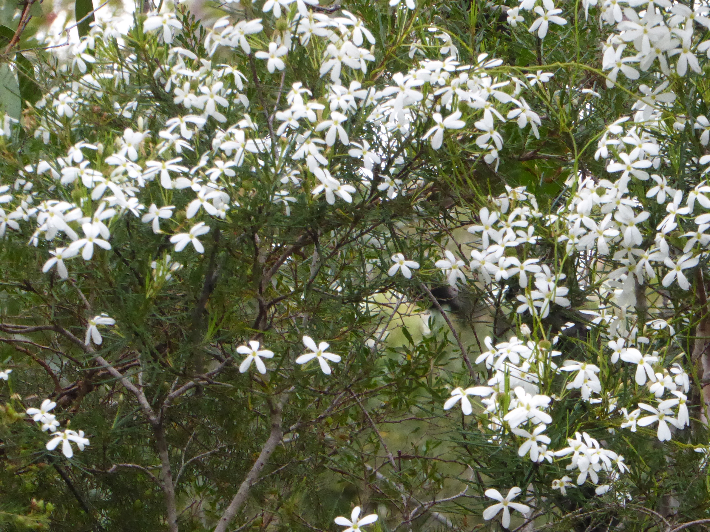

Slide 28
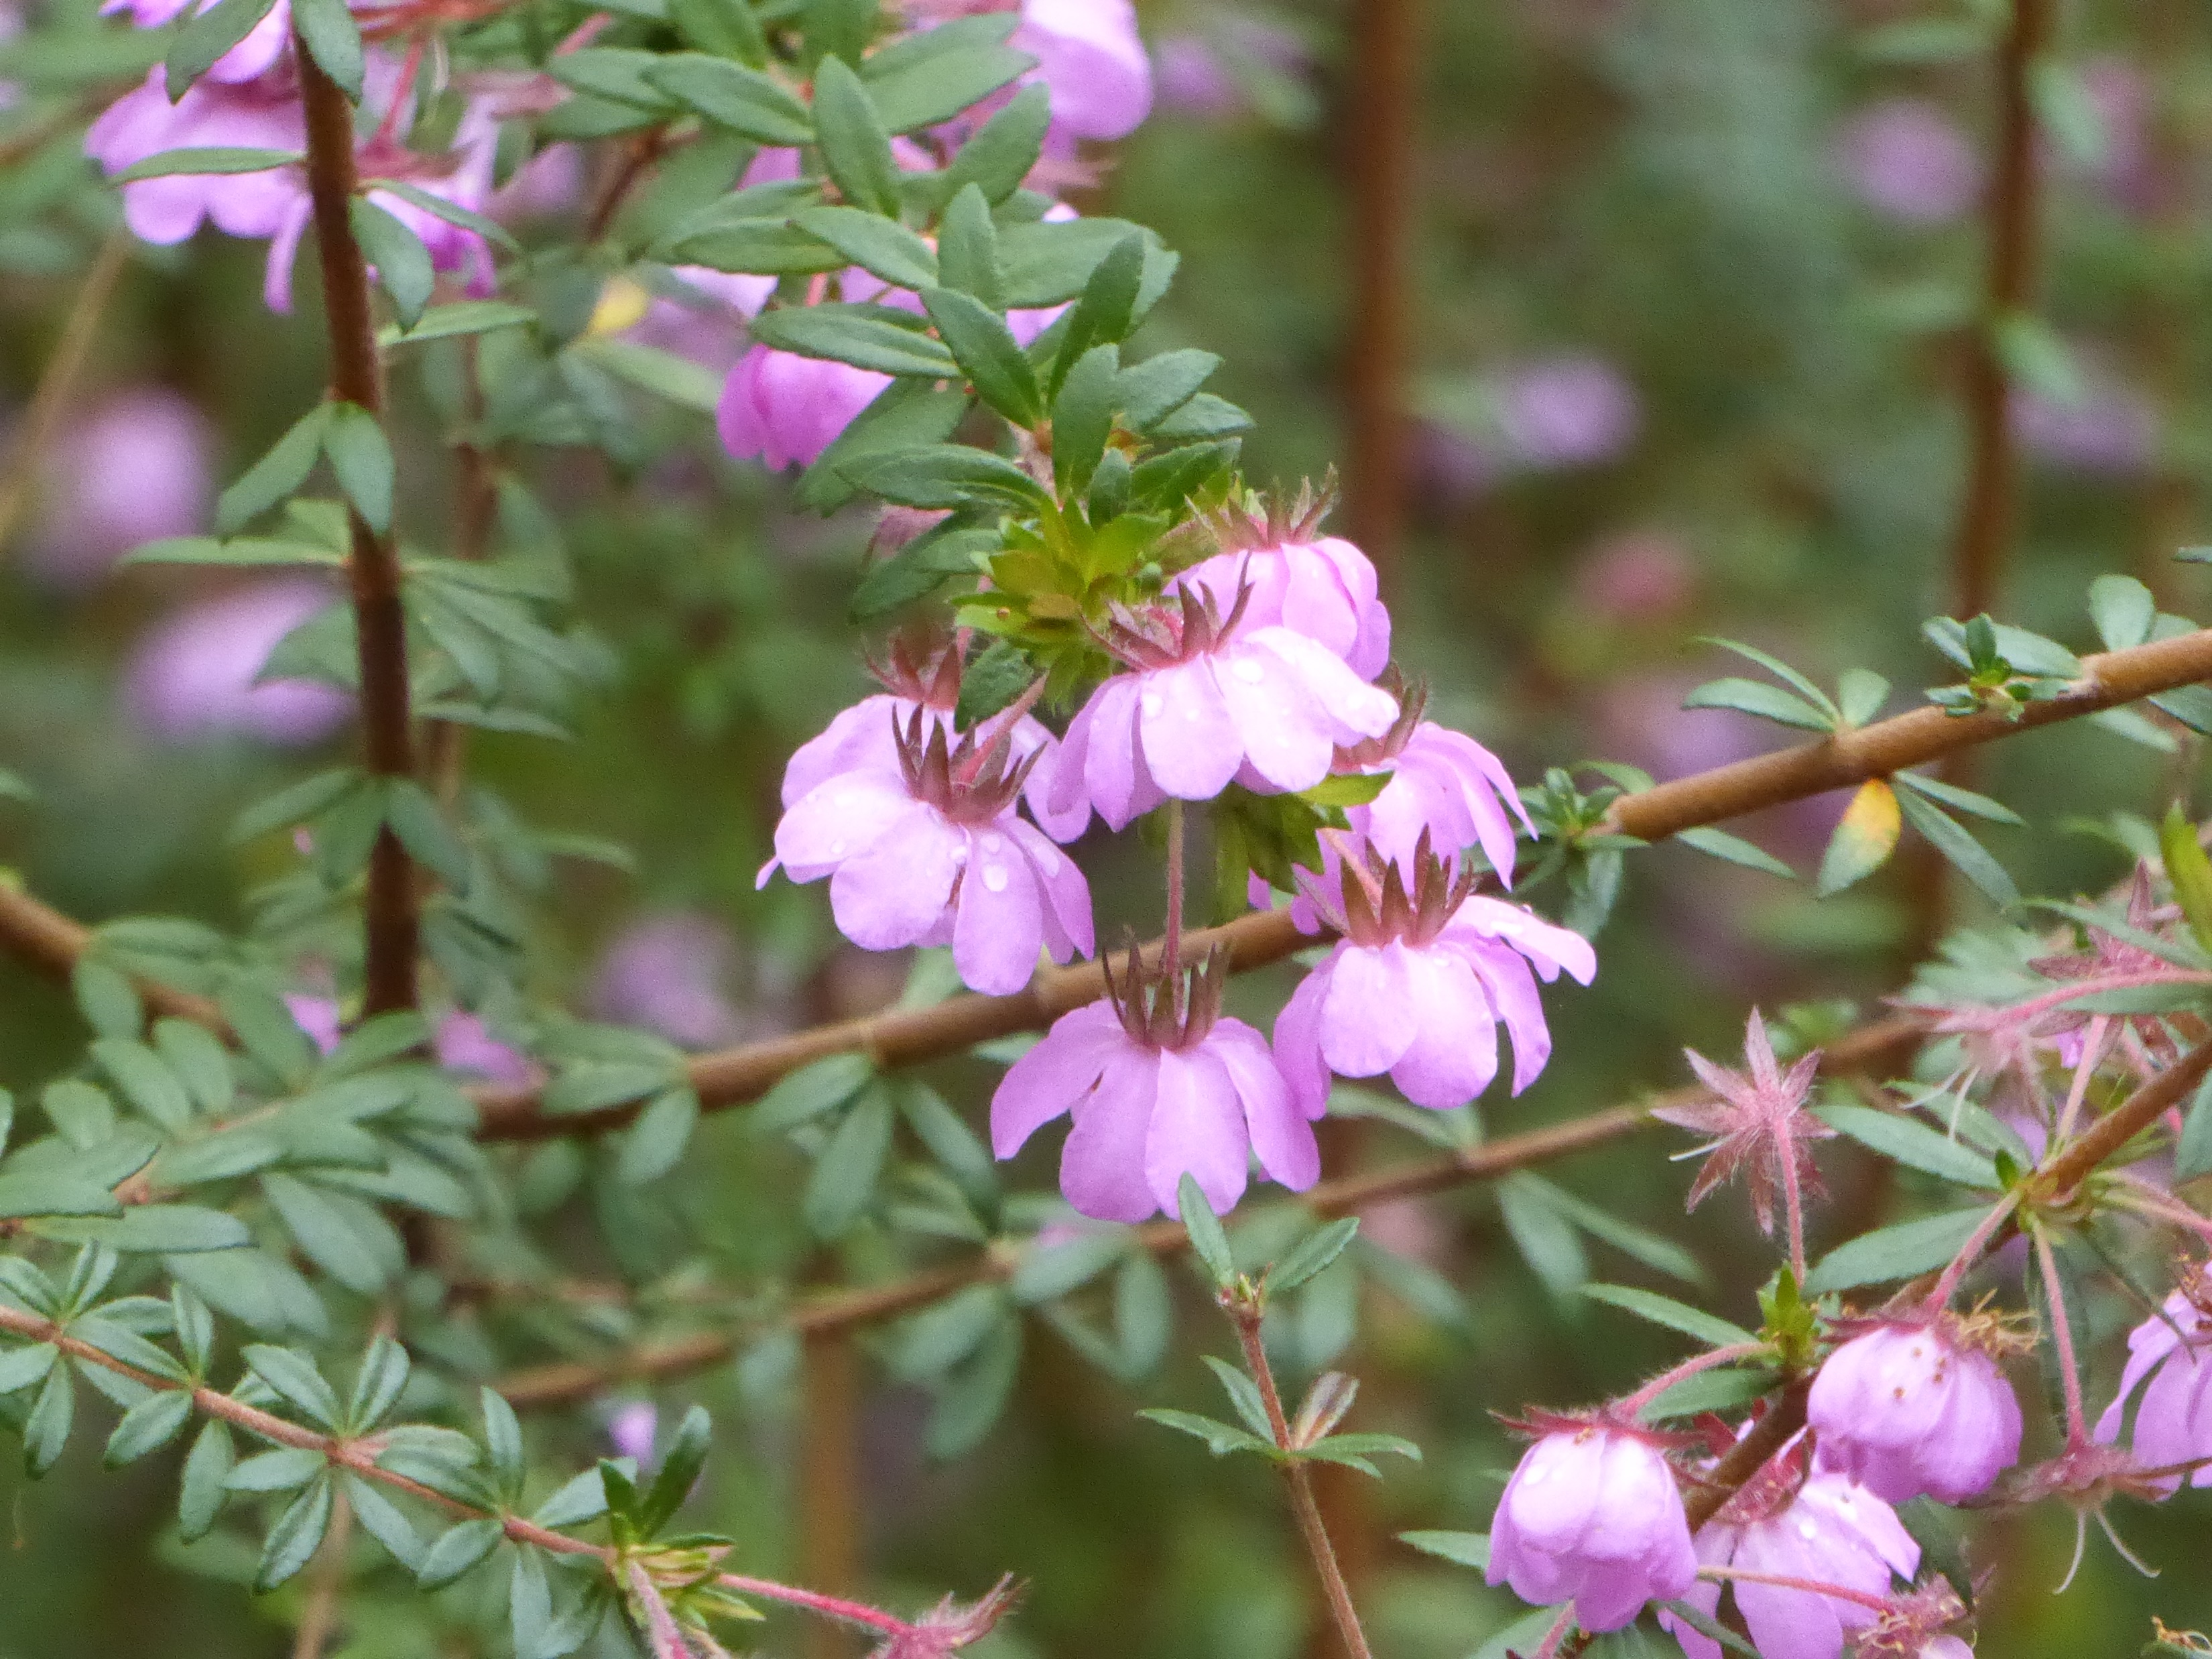

Slide 29
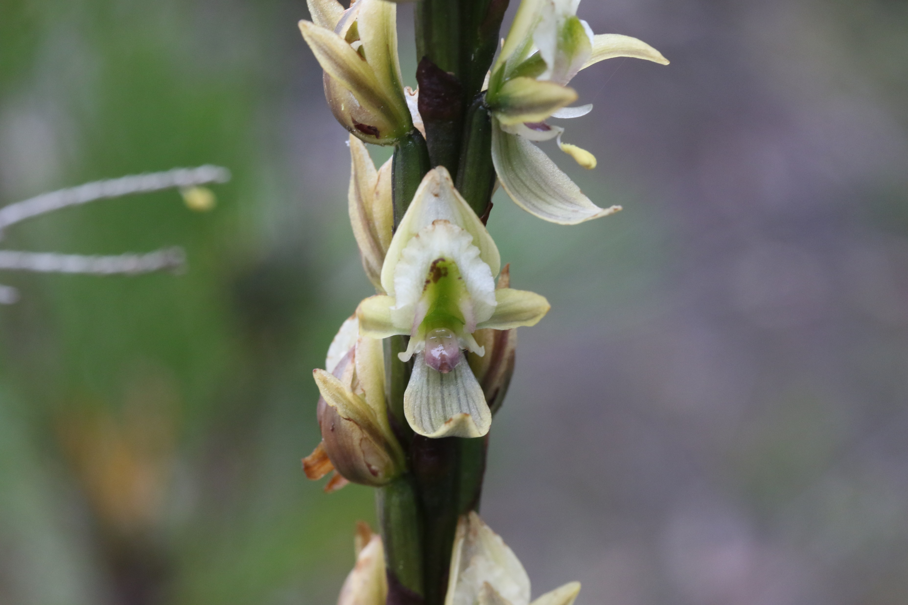
Prasophyllum elatum

Slide 30
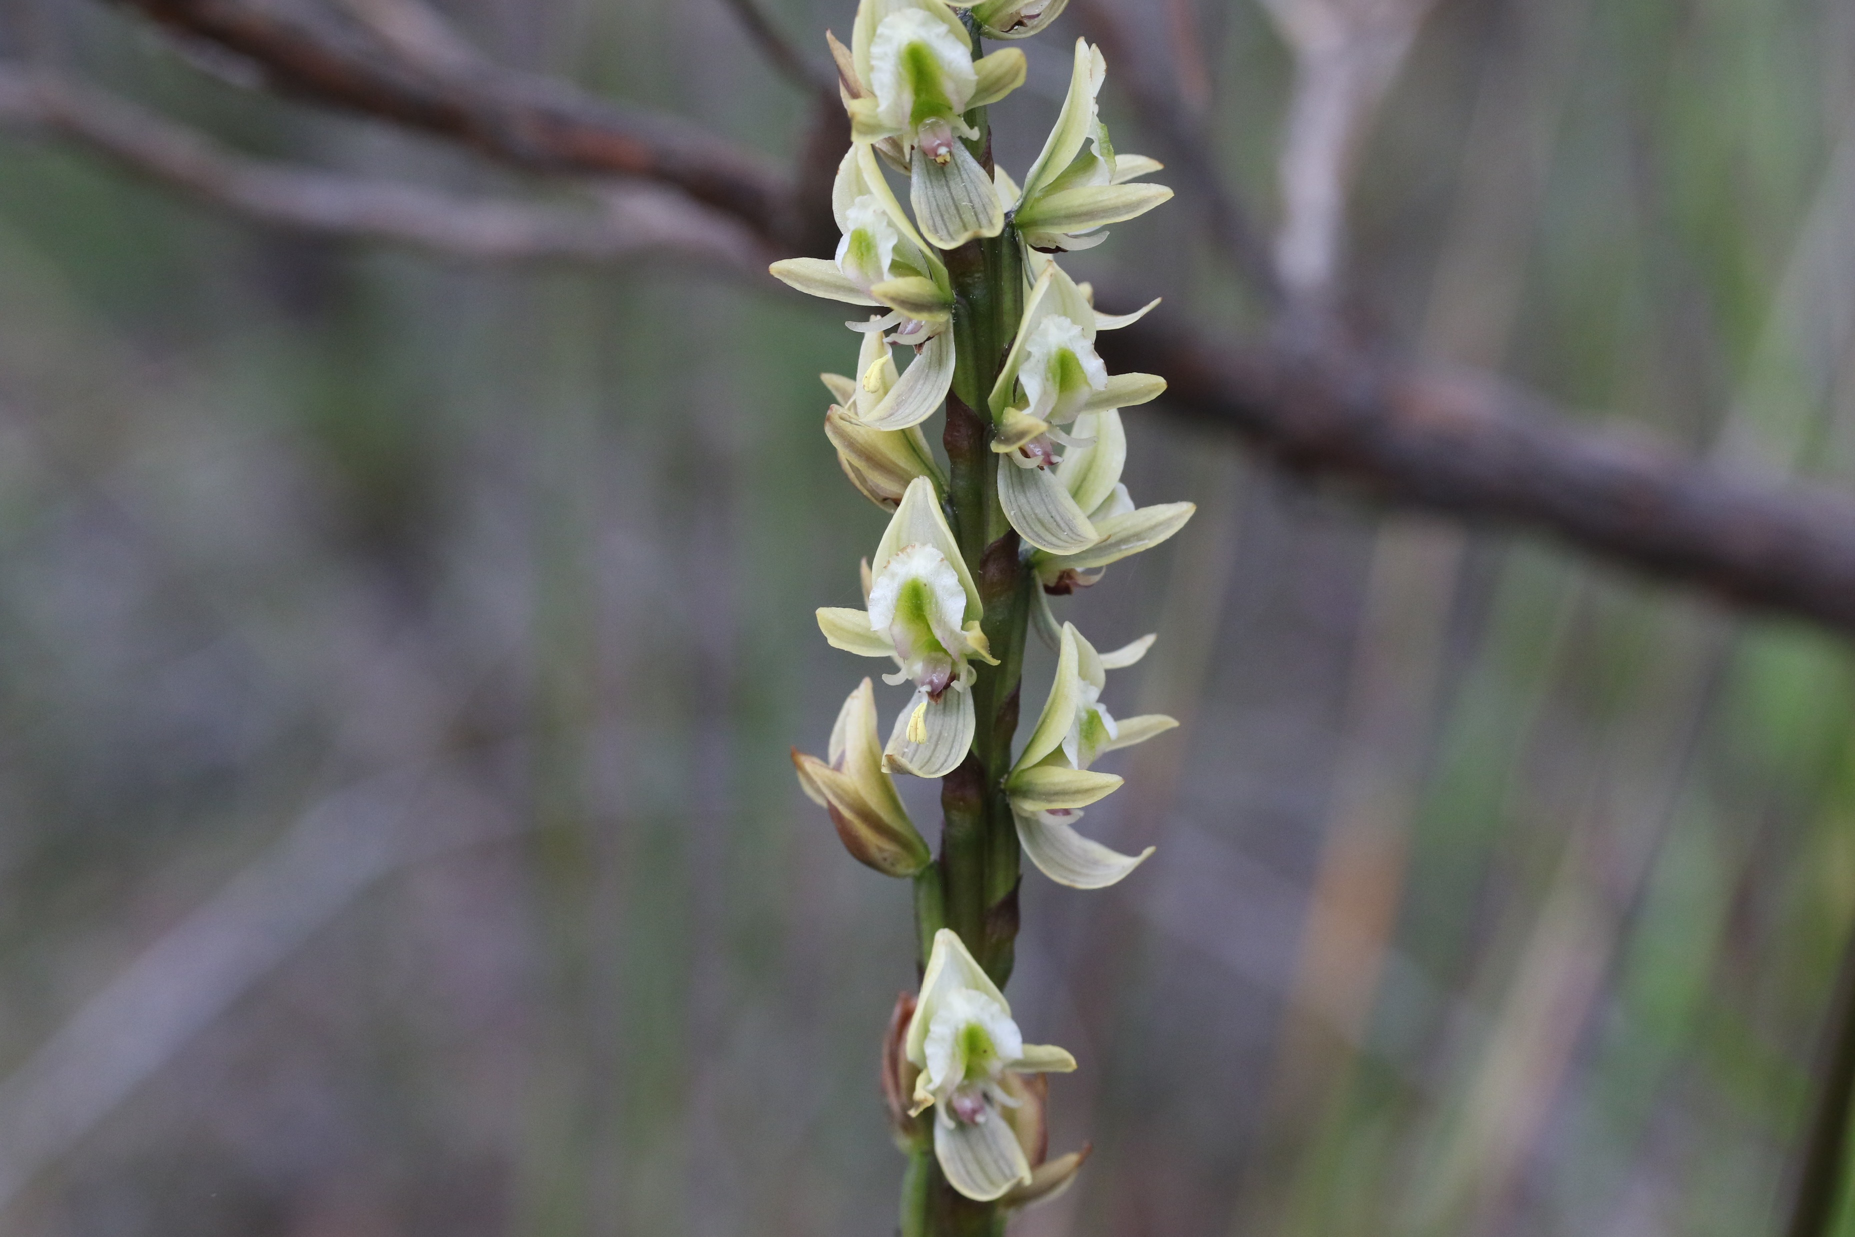

Slide 31
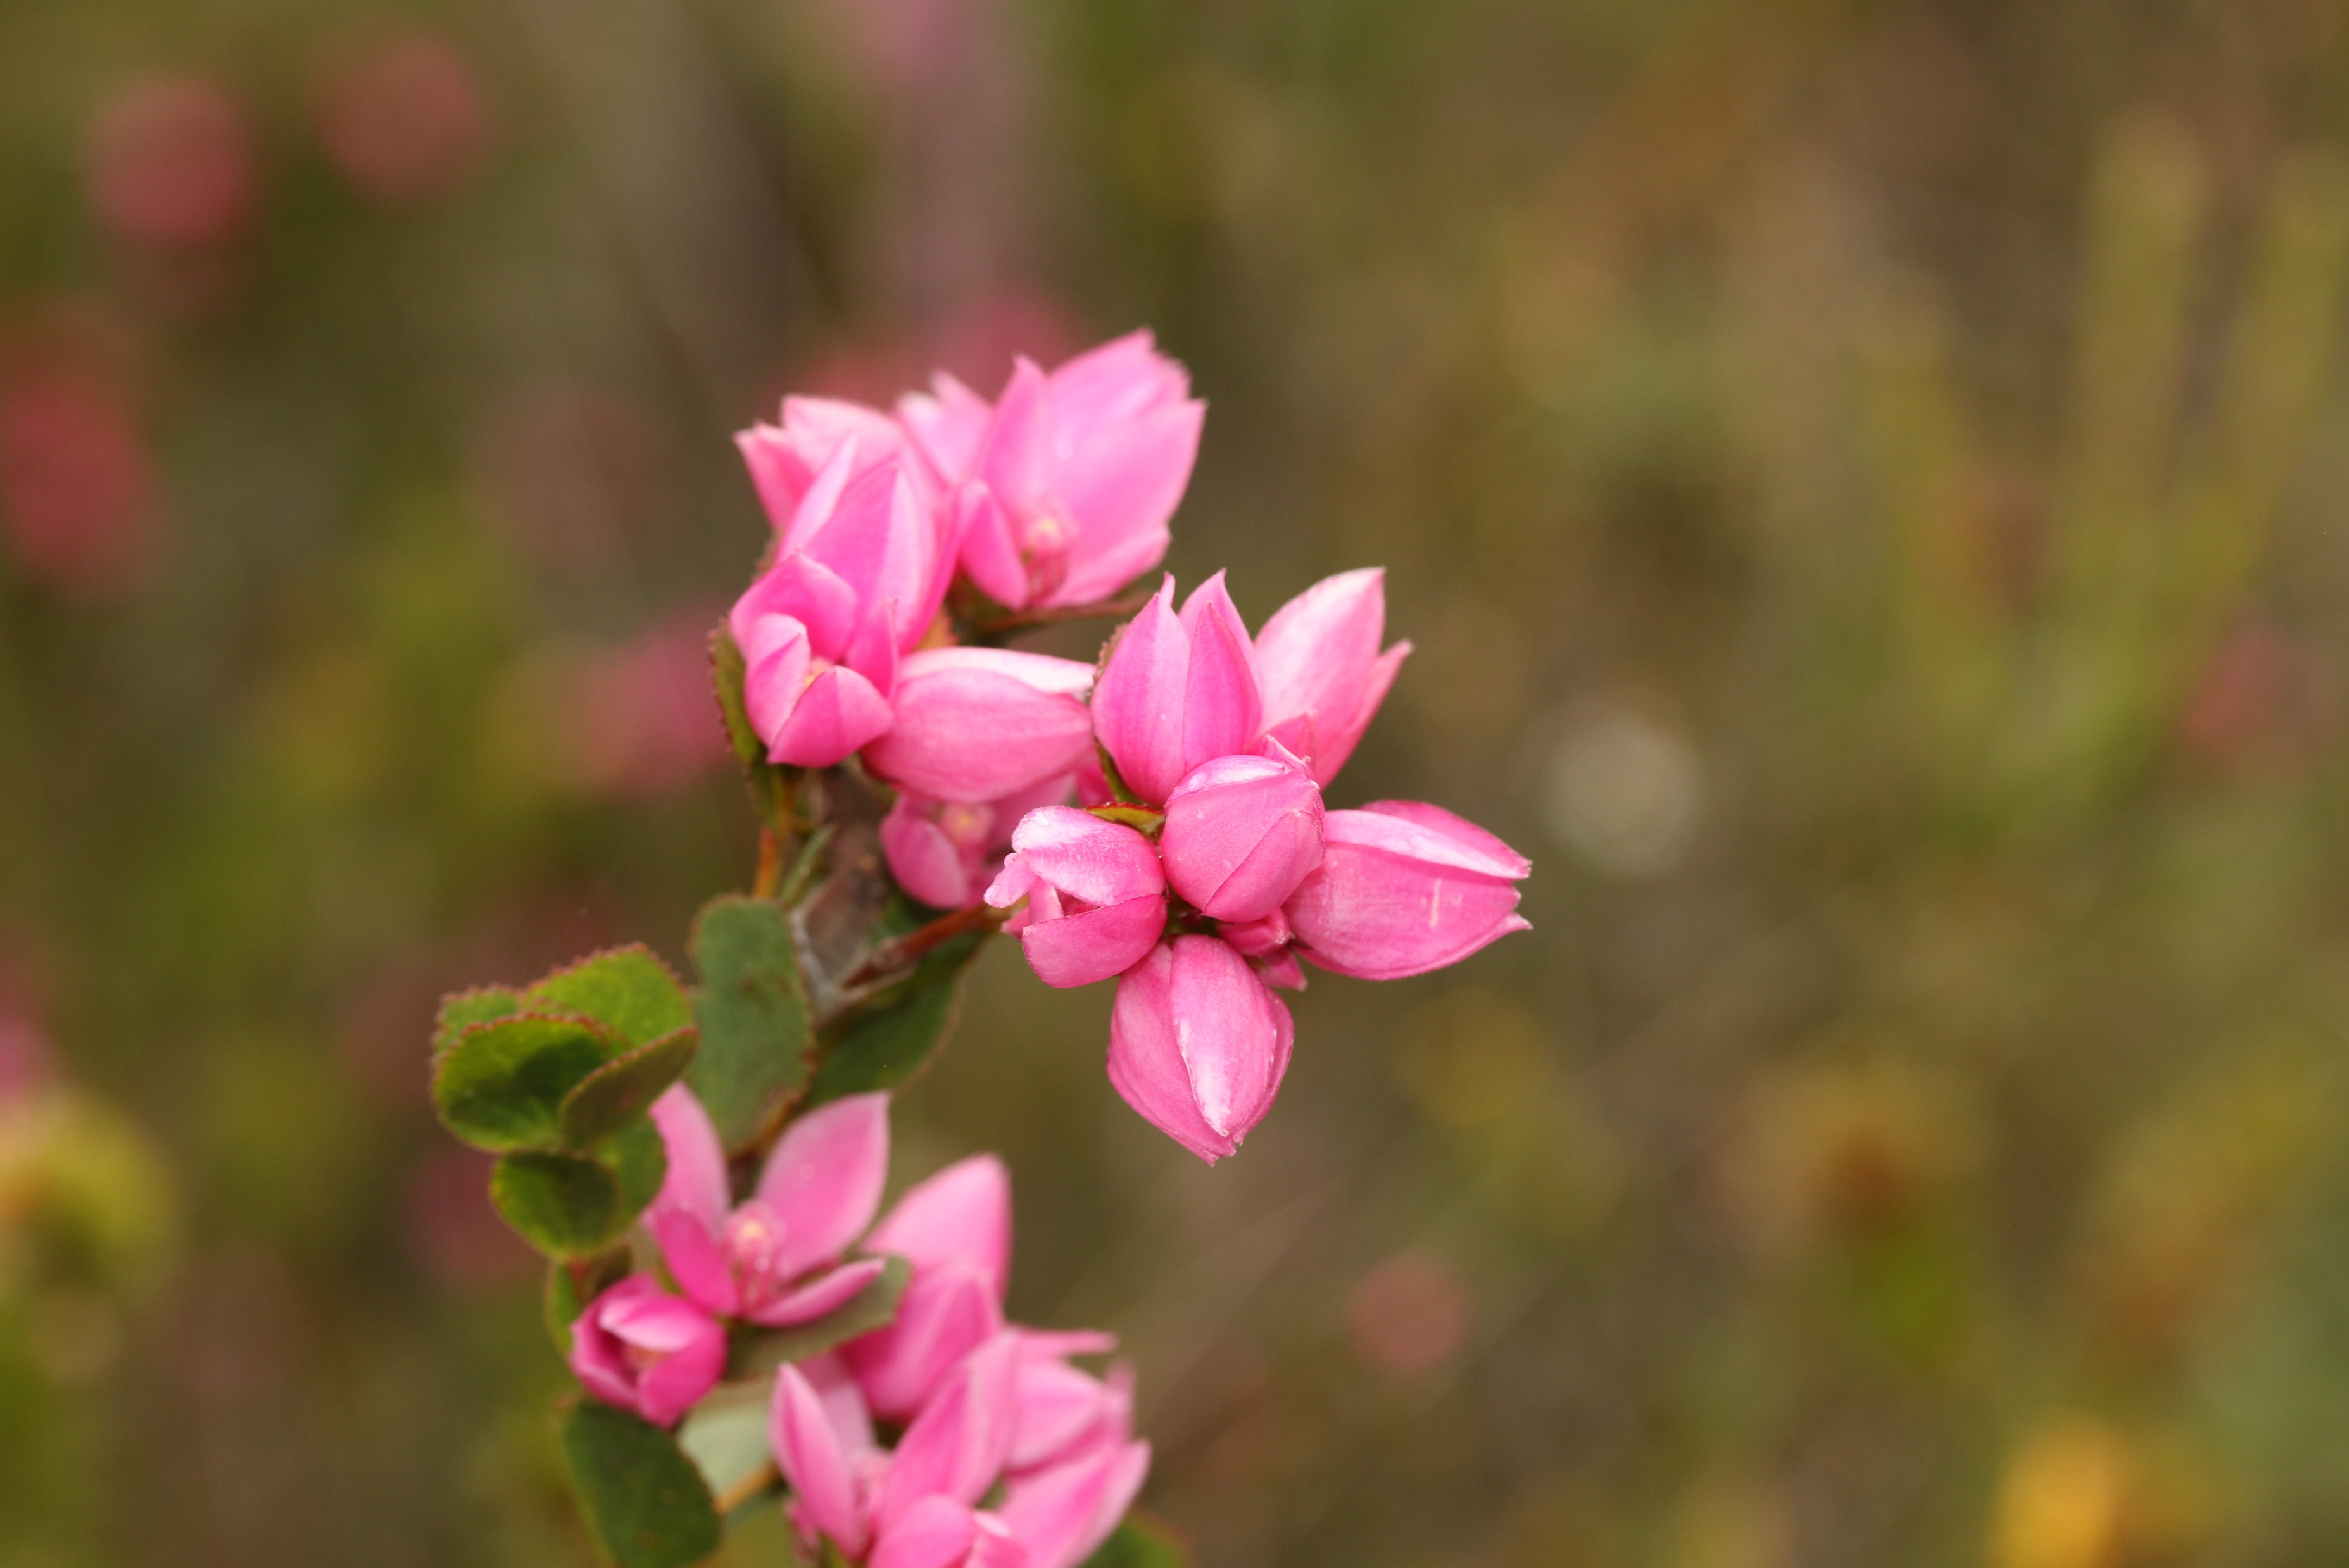

Slide 32
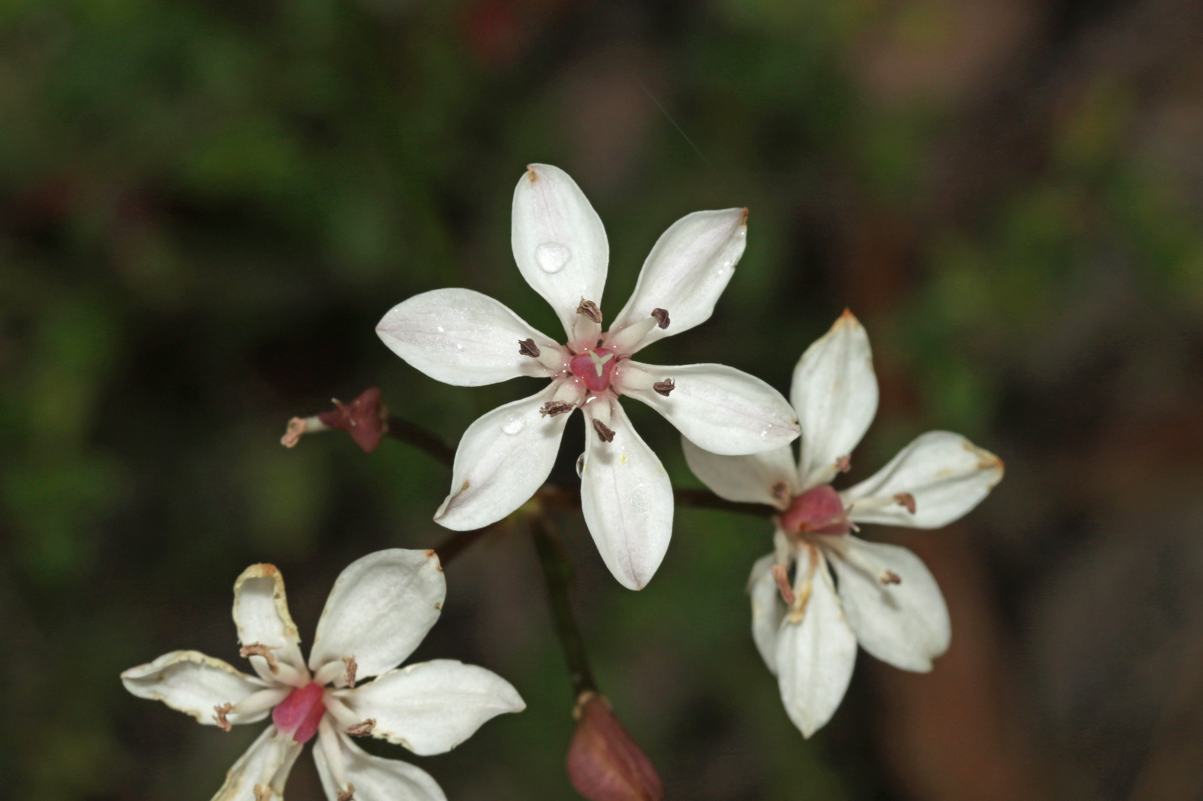

Slide 33
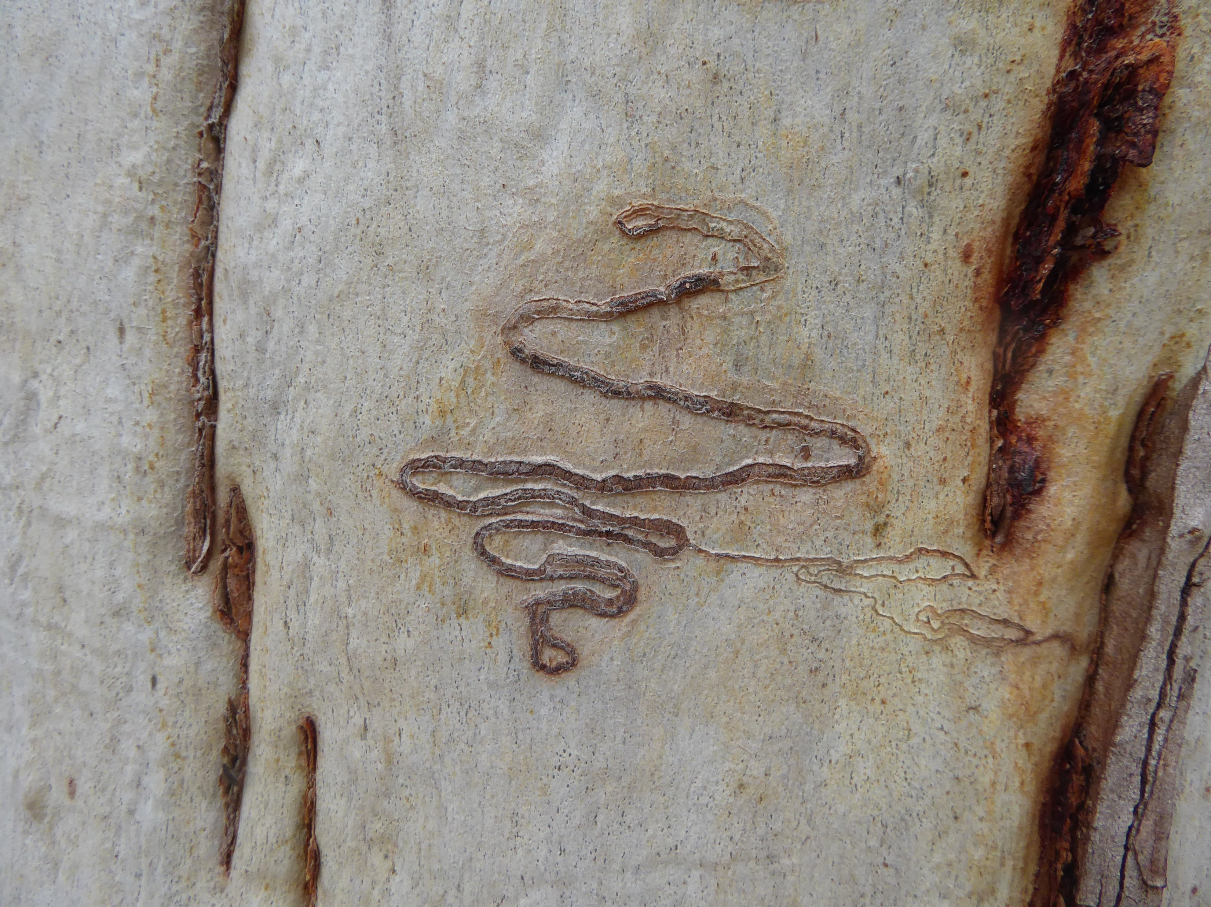
The End

