Slide 1
Orchids in my Corner of the World
Sutherland Shire during lockdown 2021
With thanks to the many experts in the Australian Native Orchid Facebook page who helped teach me so much in the course of the past two years… special thanks to Lachlan Copeland, Greg Steenbeeke and Mark Carrington
These photos were all taken by Brian Everingham, appear in sequence through our lockdown, were all within the Sutherland Shire LGA (except for the slides 50-52, which show what’s to come.. They were taken in 2020.

Slide 2
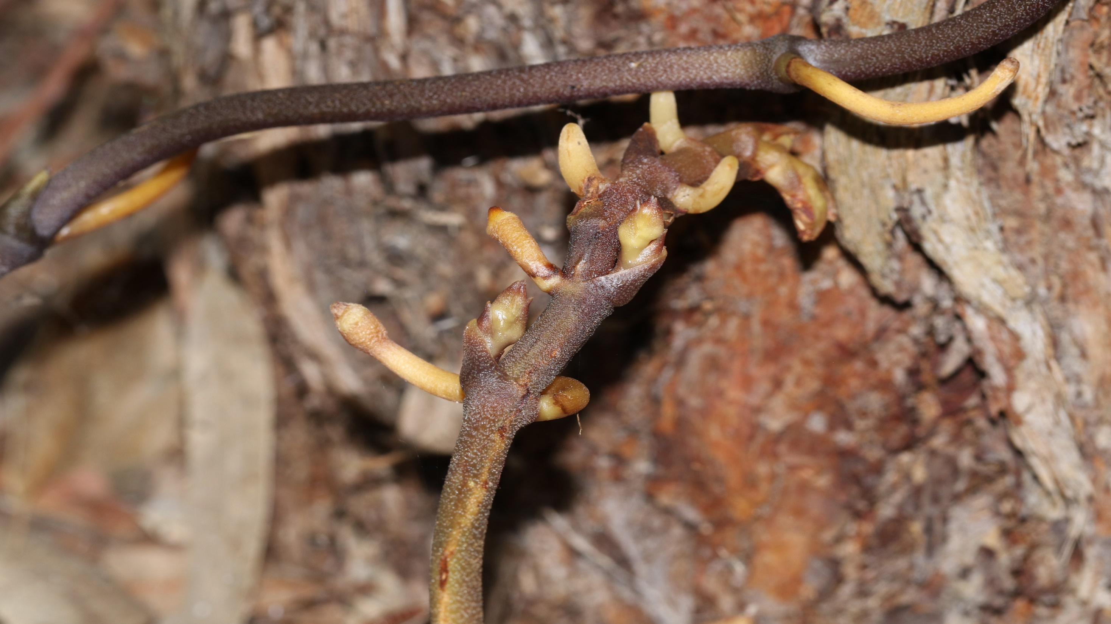
May 2021 – the Black Bootlace orchid reaches for the tree trunk
Woronora Cemetery
Erythrorchis cassythoides

Slide 3
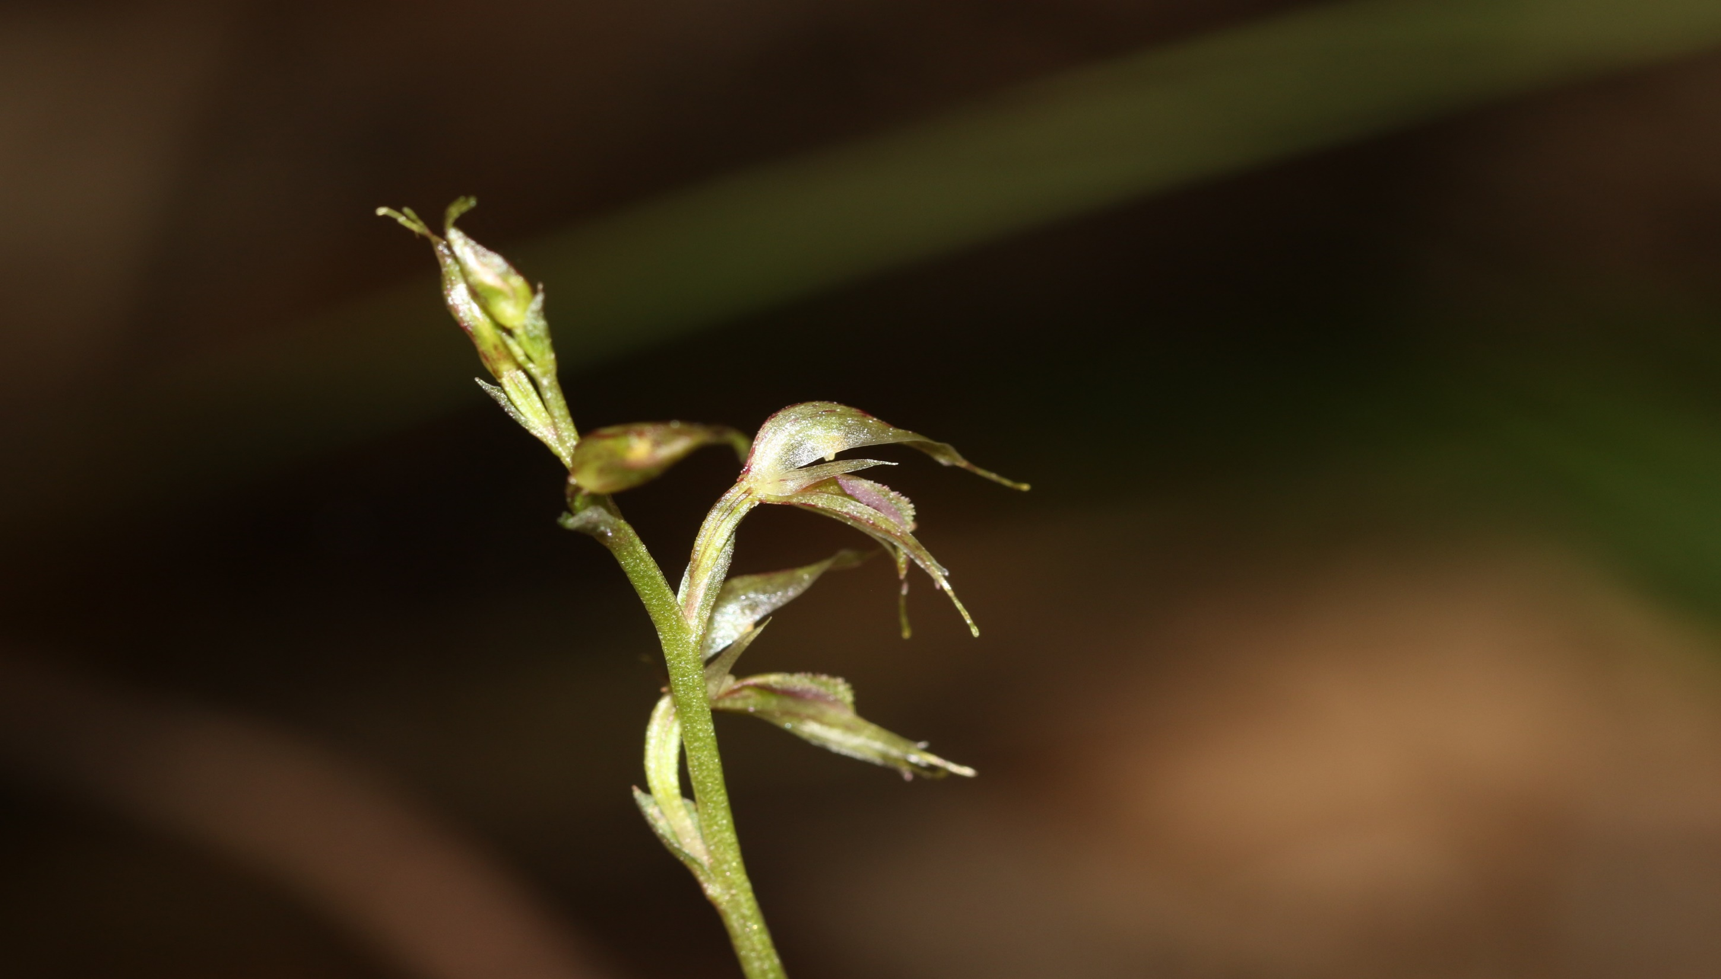
Acianthus fornicatus – Kamay-Botany Bay NP
May 2021

Slide 4
So What is an Orchid?
You may notice they come in all shapes, sizes and colours
There are about 30,000 species worldwide but taxonomy is changing all the time and take that figure with a grain of salt
They are divided into more than 750 genera
The one common characteristic is apparently the fusion of the male portion of the flower (stamen) and female portion (pistil) into one structure called the column—often visible protruding from the centre.
The flower has bilateral symmetry (ie two roughly mirror image left and right halves)

Slide 5
So What is an Orchid 2?
The flower of a typical plant in the orchid family Orchidaceae has three sepals and three petals.
One petal, called the labellum, "lip" or "tongue", is typically quite different from the other two. It usually functions to attract an insect pollinator.
Charles Darwin suggested that having the labellum on the lower part of the flower aids pollination by providing a landing place for visiting insects
All orchids are perennial herbs that lack any permanent woody structure.

Slide 6
So What is an Orchid 3?
Orchids can be terrestrial or epiphytic
Some orchids have single flowers, but most have a racemose inflorescence, sometimes with a large number of flowers.
And some of their behaviours in attracting pollinators borders on the outright kinky
But why not just head to this YouTube video on he anatomy of an orchid flower: https://www.youtube.com/watch?v=j17NYcH-k20

Slide 7
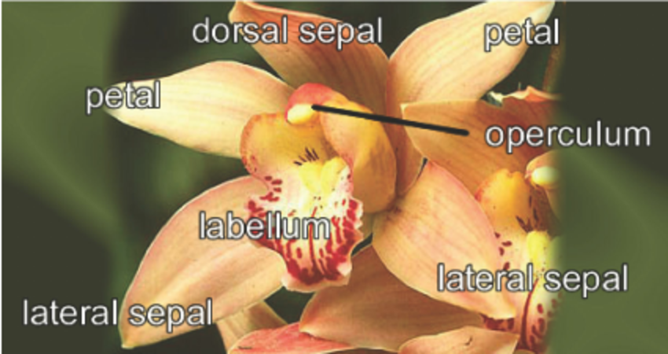
https://www.researchgate.net/figure/The-prominent-parts-of-an-orchid-flower_fig1_220868910

Slide 8
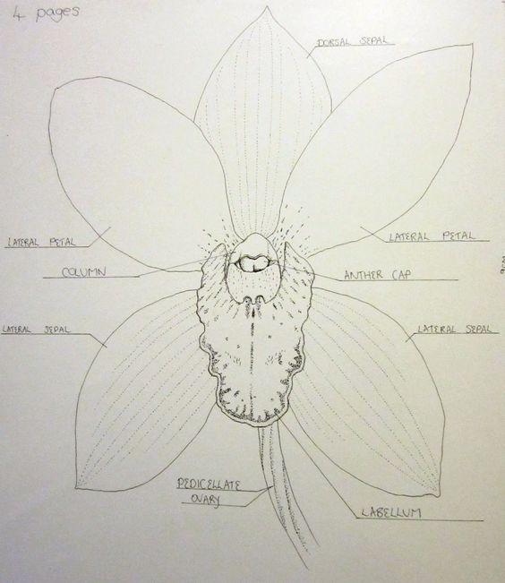
https://www.pinterest.com.au/pin/528328600018004772/

Slide 9
The Sex Life of Orchids
Danielle Clode’s book, The Wasp and the Orchid, had me transfixed.
Even the word orchid originates from the Greek word for testicle.
English botanist John Lindley coined the word “orchid” after the Orchis genus, one of several in the Orchidaceae family. It turns out that some species in Orchis genus have a pair of twin tubers that are shaped like, well, testicles.
Botanists recognized orchids' visual mimicry first, but lately they've uncovered even more interesting scent-based mimicry. Basically, the orchids emit chemicals that smell, to a male insect, just like the sex pheromones emitted by the female of his species.

Slide 10
The Sex Life of Orchids 2
For the orchid, the relationship with pollinators is all about sex; but for the pollinators, sometimes it's about food. Apparently a Chinese orchid mimic the scent of a honeybee's distress signal—a scent that attracts honeybee-eating hornets.
Species in the Cryptostylis genus have flowers that so closely resemble the female dupe wasps that male wasps are fooled into mating with the flower — to the point of ejaculation
A male wasp that wastes its sperm mating with a flower has less left over for the ladies, so more eggs go unfertilized, which produces more male wasps to help pollinate the next generation of flowers.

Slide 11
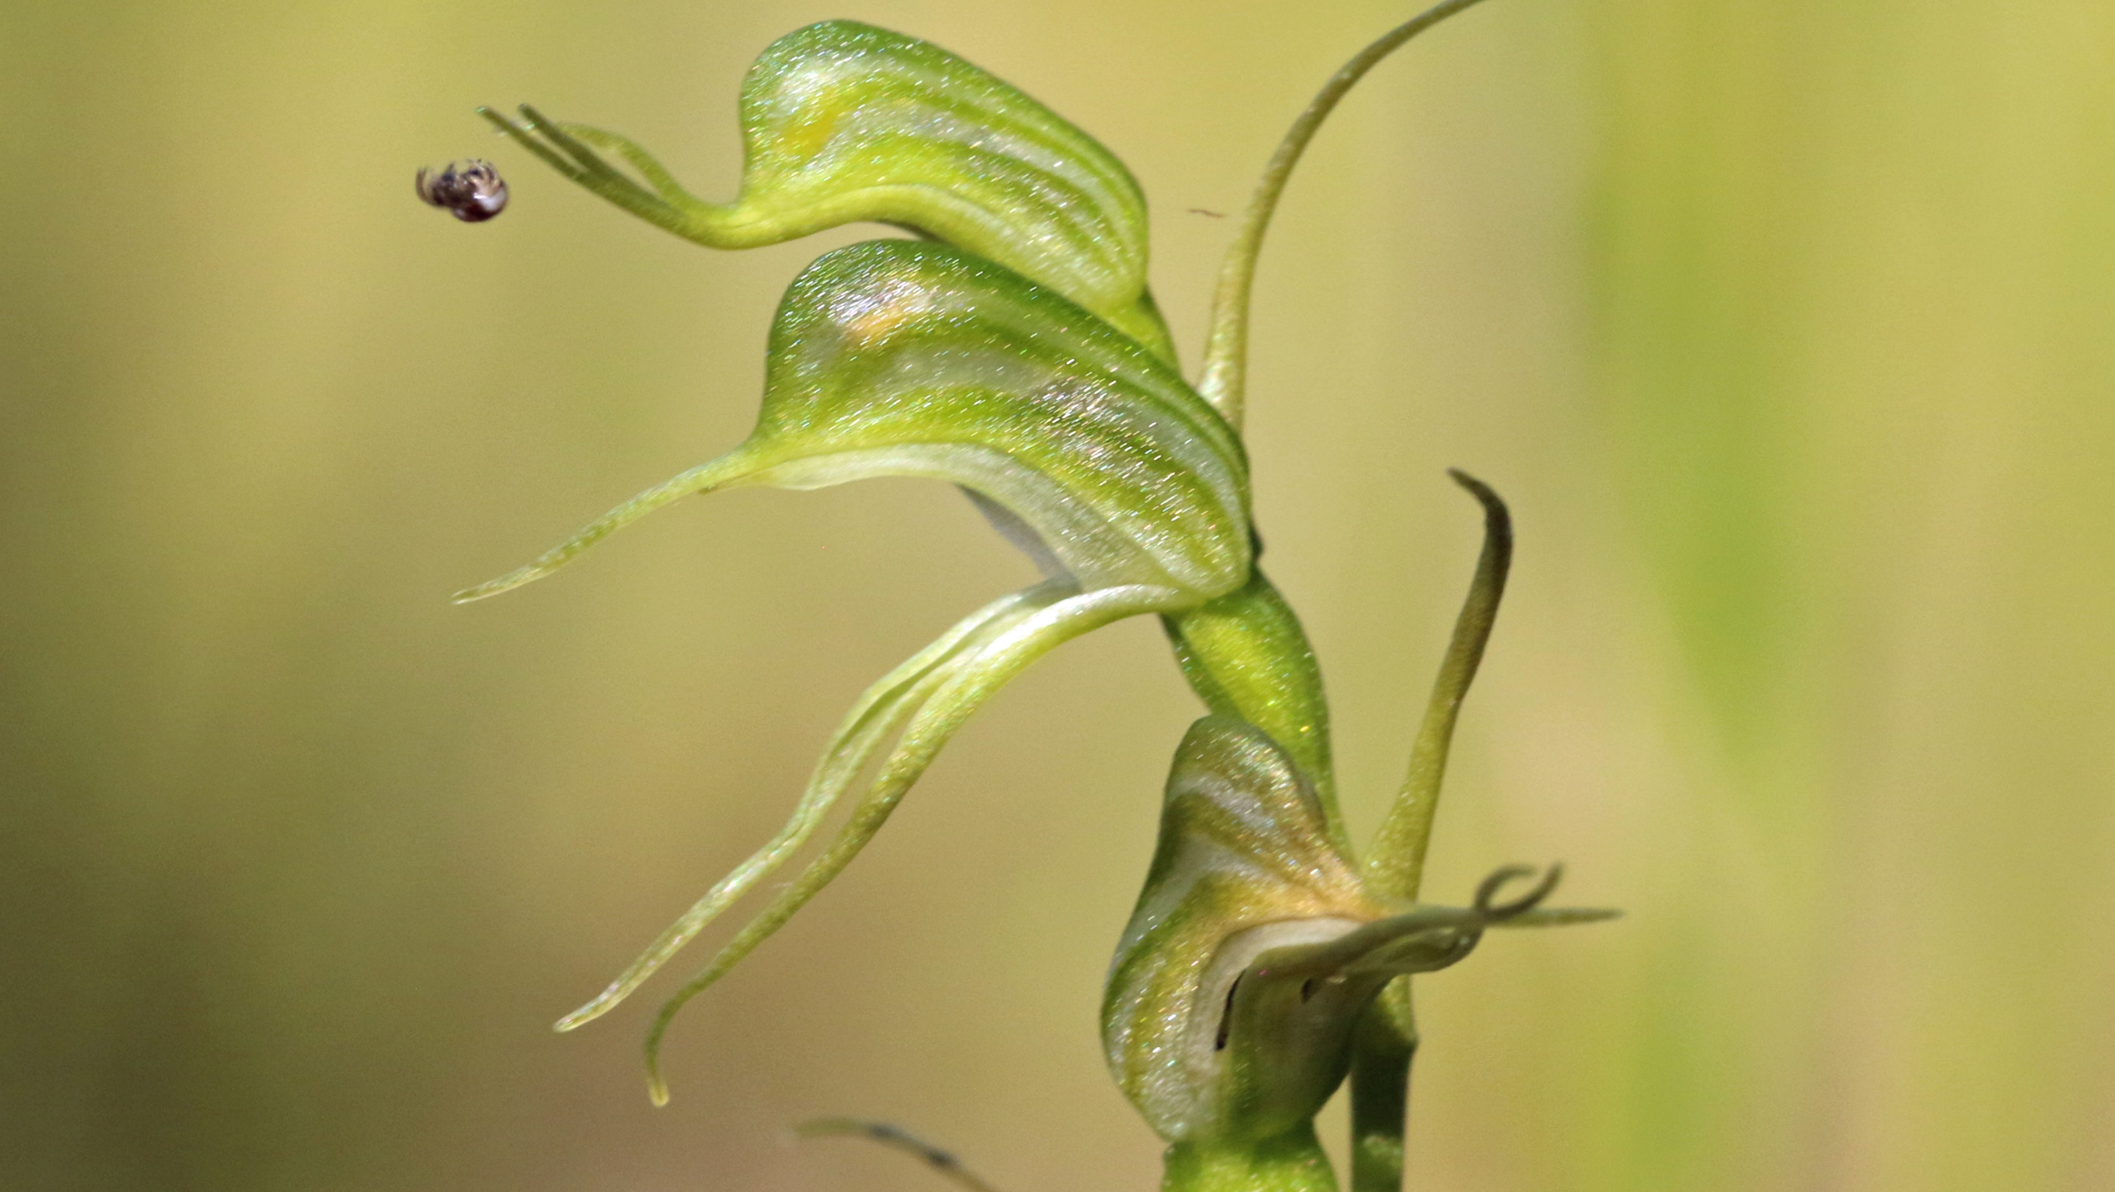
Pterostylis daintreana
Wises Track, Royal National Park
May 2021

Slide 12
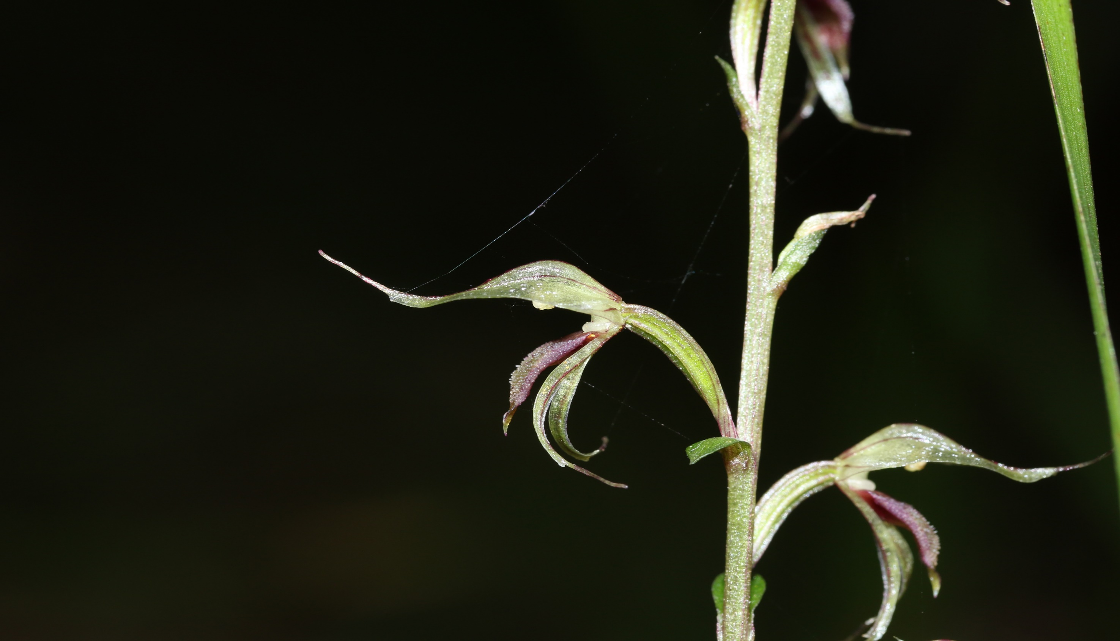
Acianthus fornicatus
The Forest Path, Royal National Park
June 2021

Slide 13
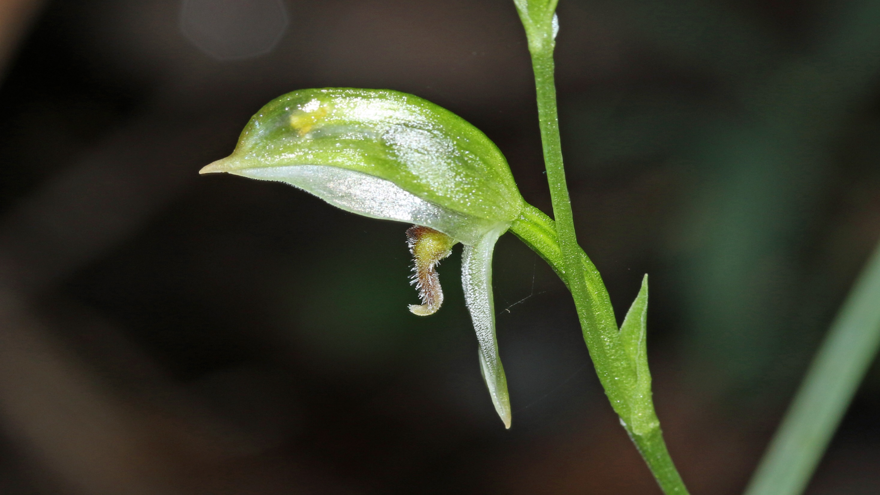
Pterostylis longifolia
The Forest Path
June 2021

Slide 14
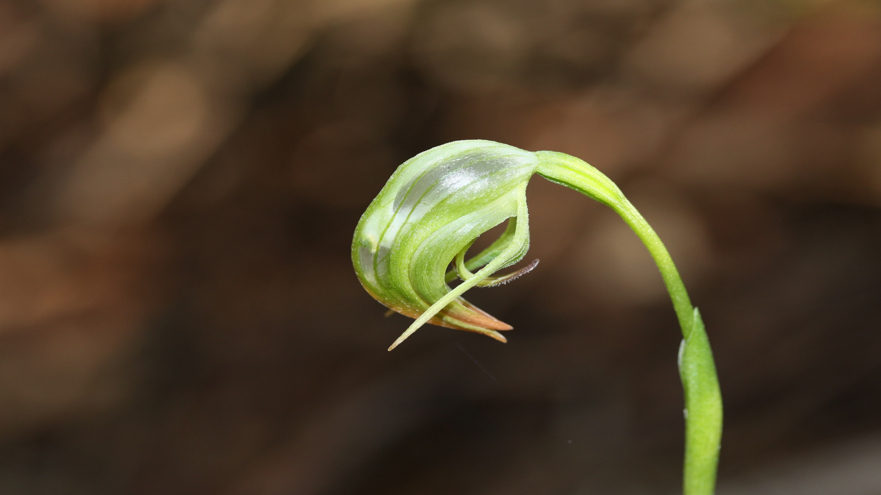
Pterostylis nutans
Royal National Park
June 2021

Slide 15
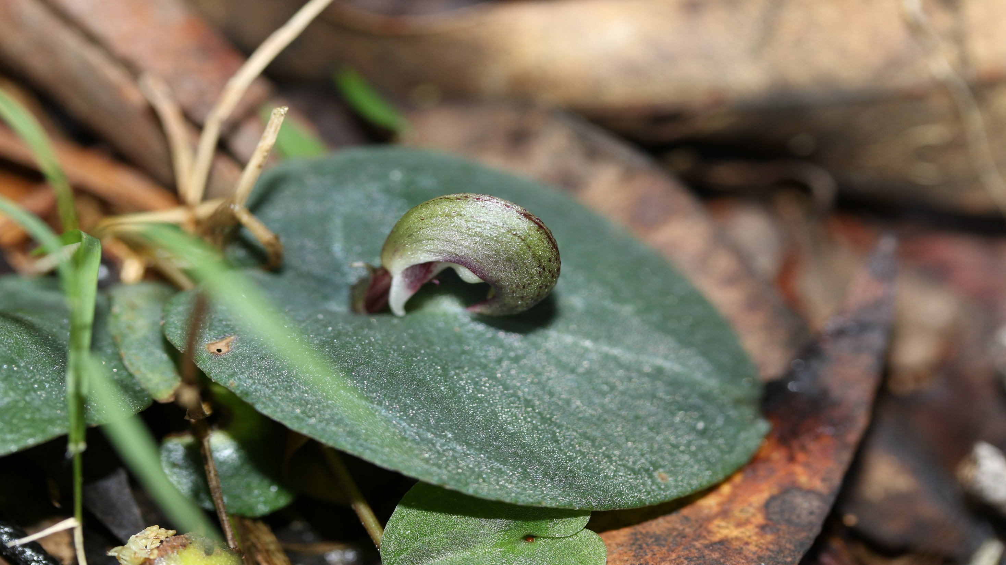
Corybas aconitiflorus
A Helmet Orchid
Royal National Park
June 2021

Slide 16
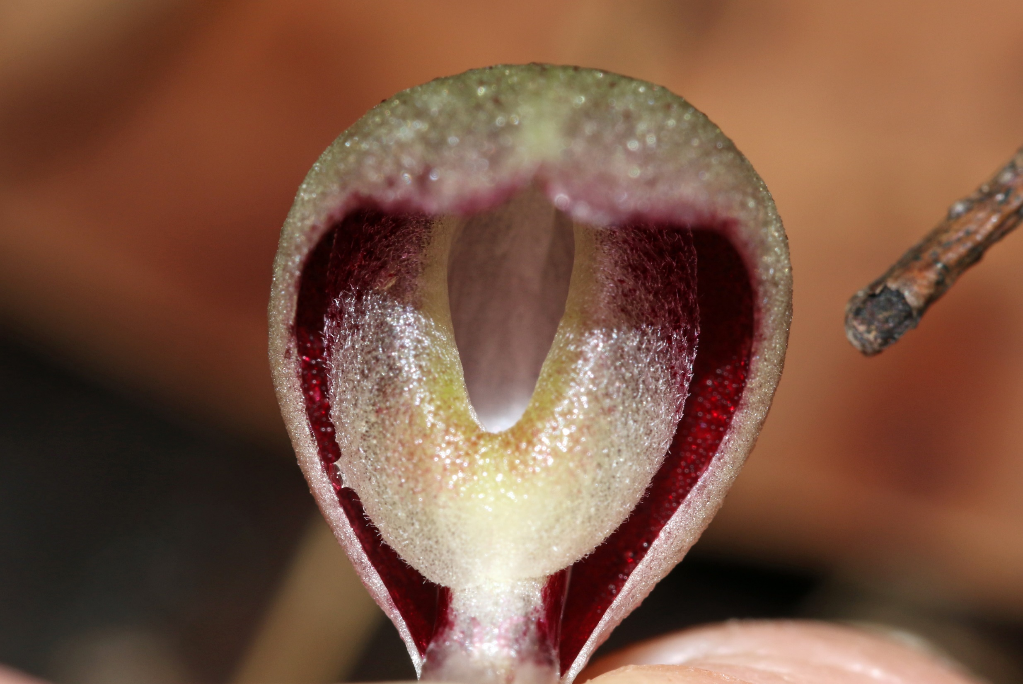

Slide 17
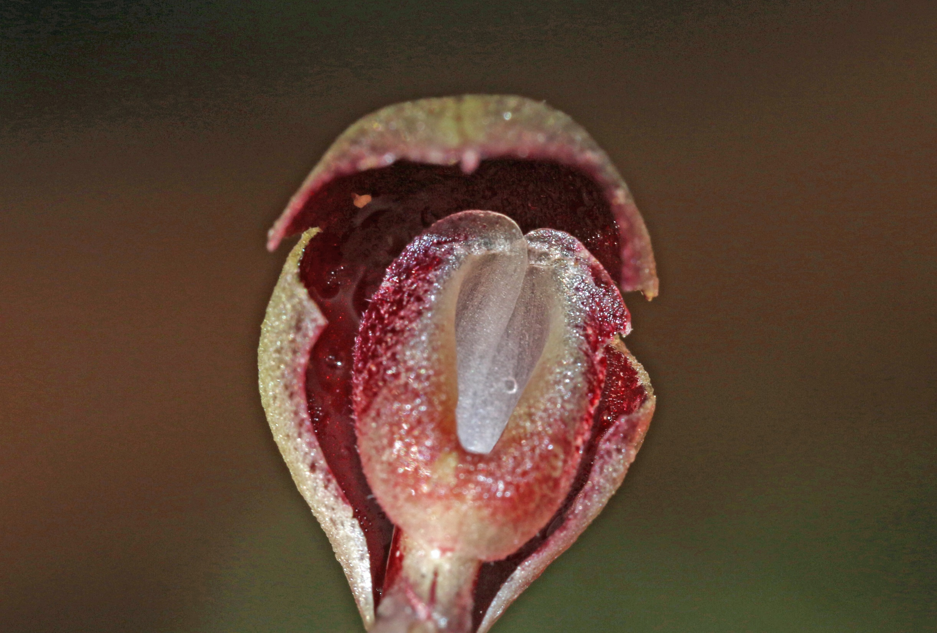

Slide 18
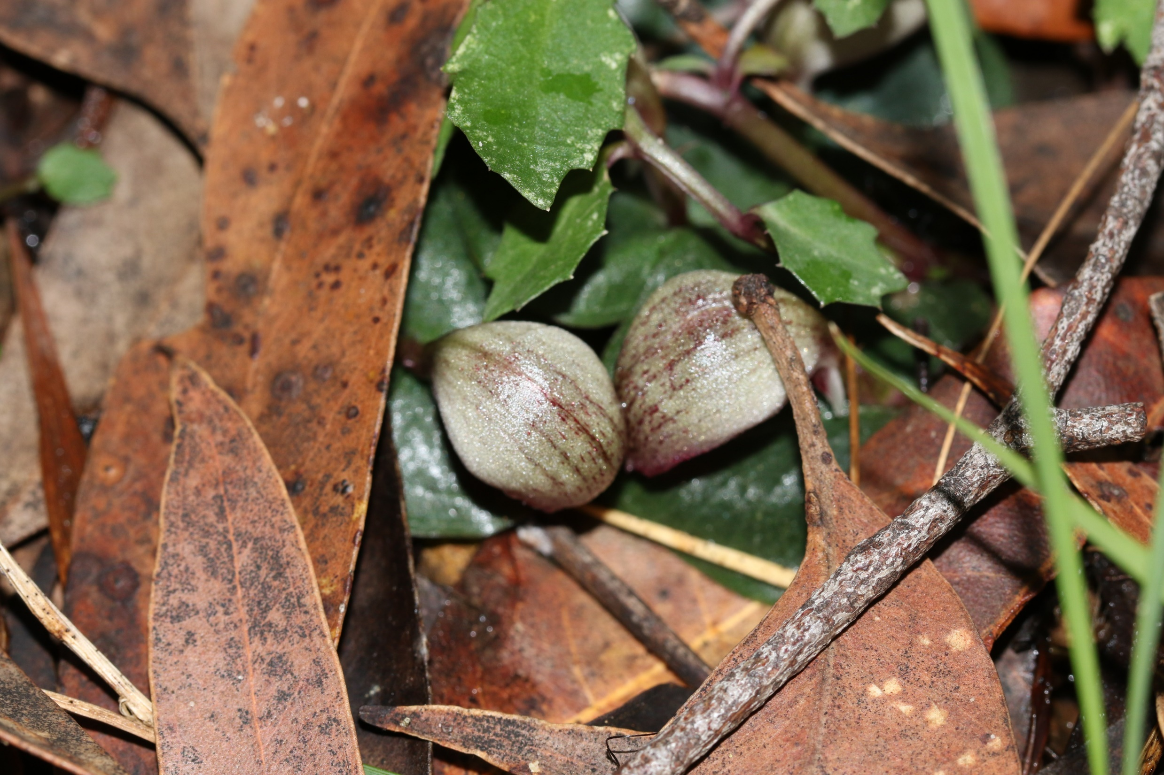

Slide 19
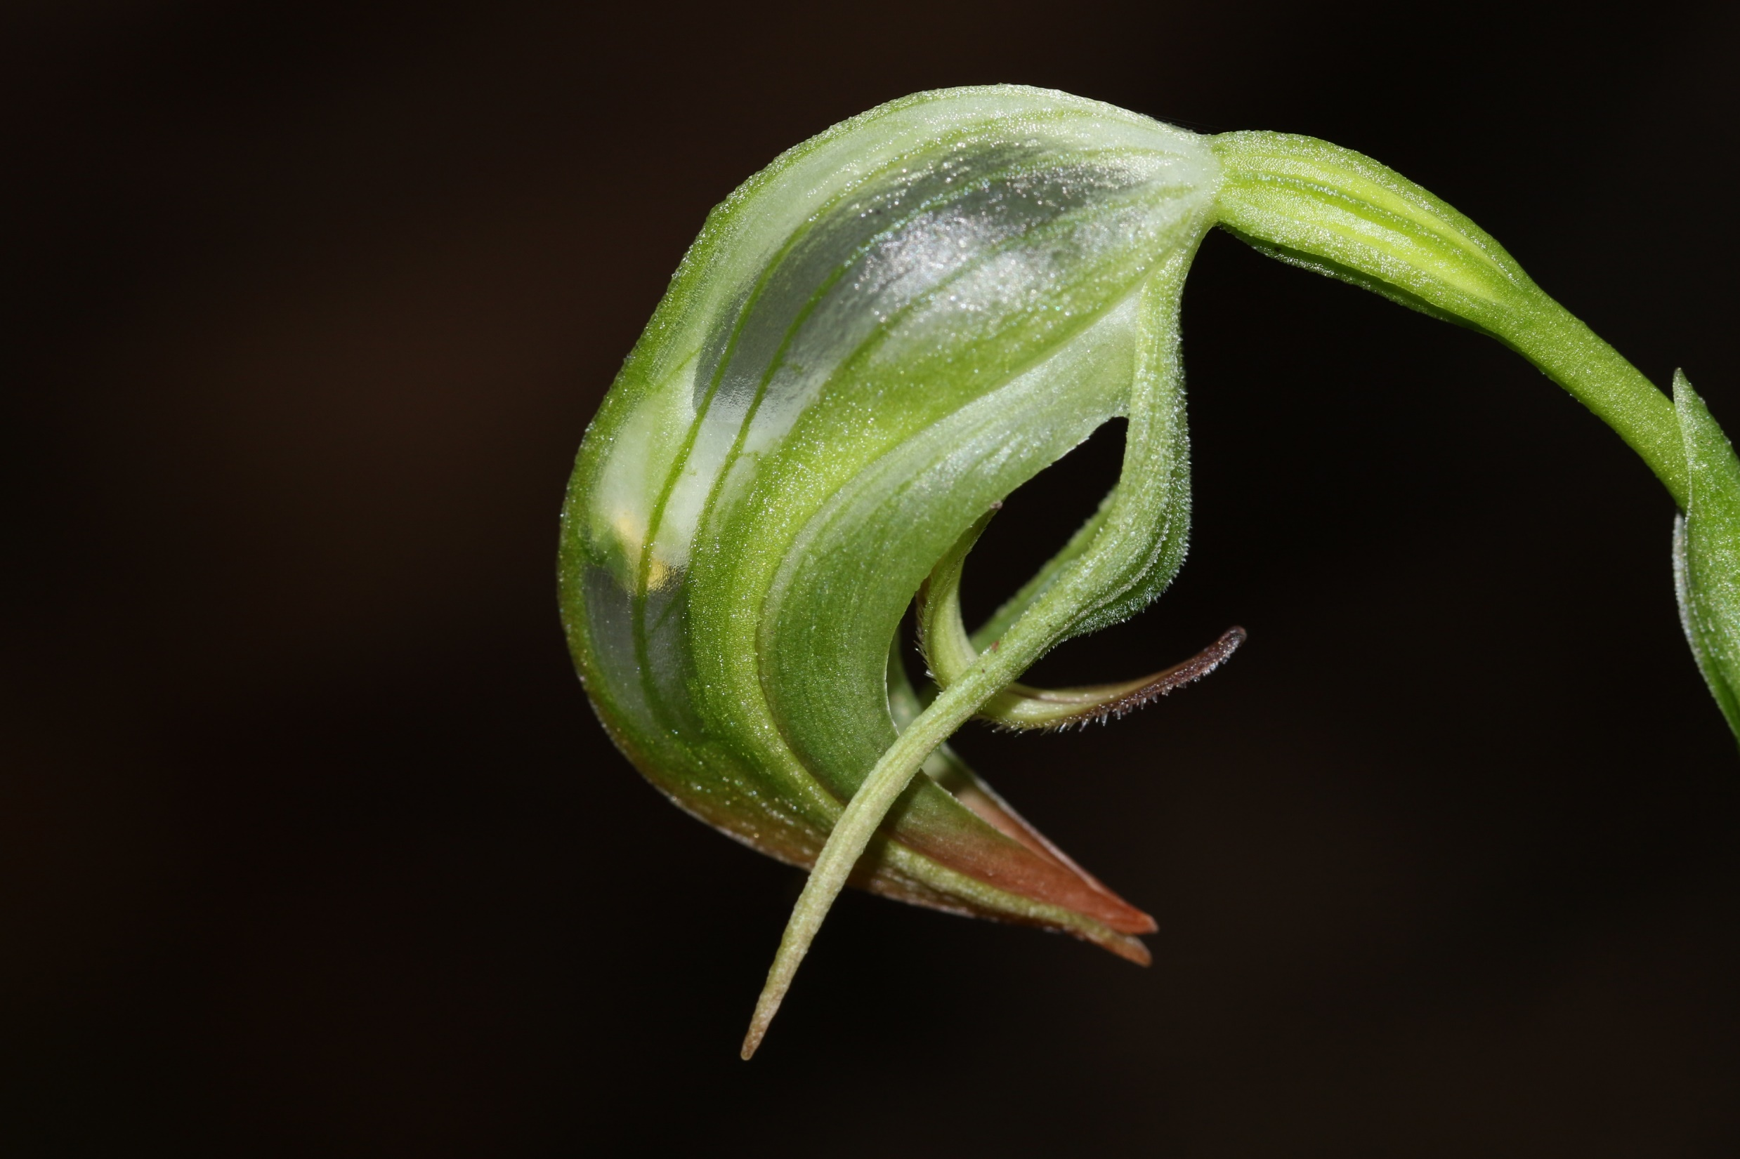

Slide 20
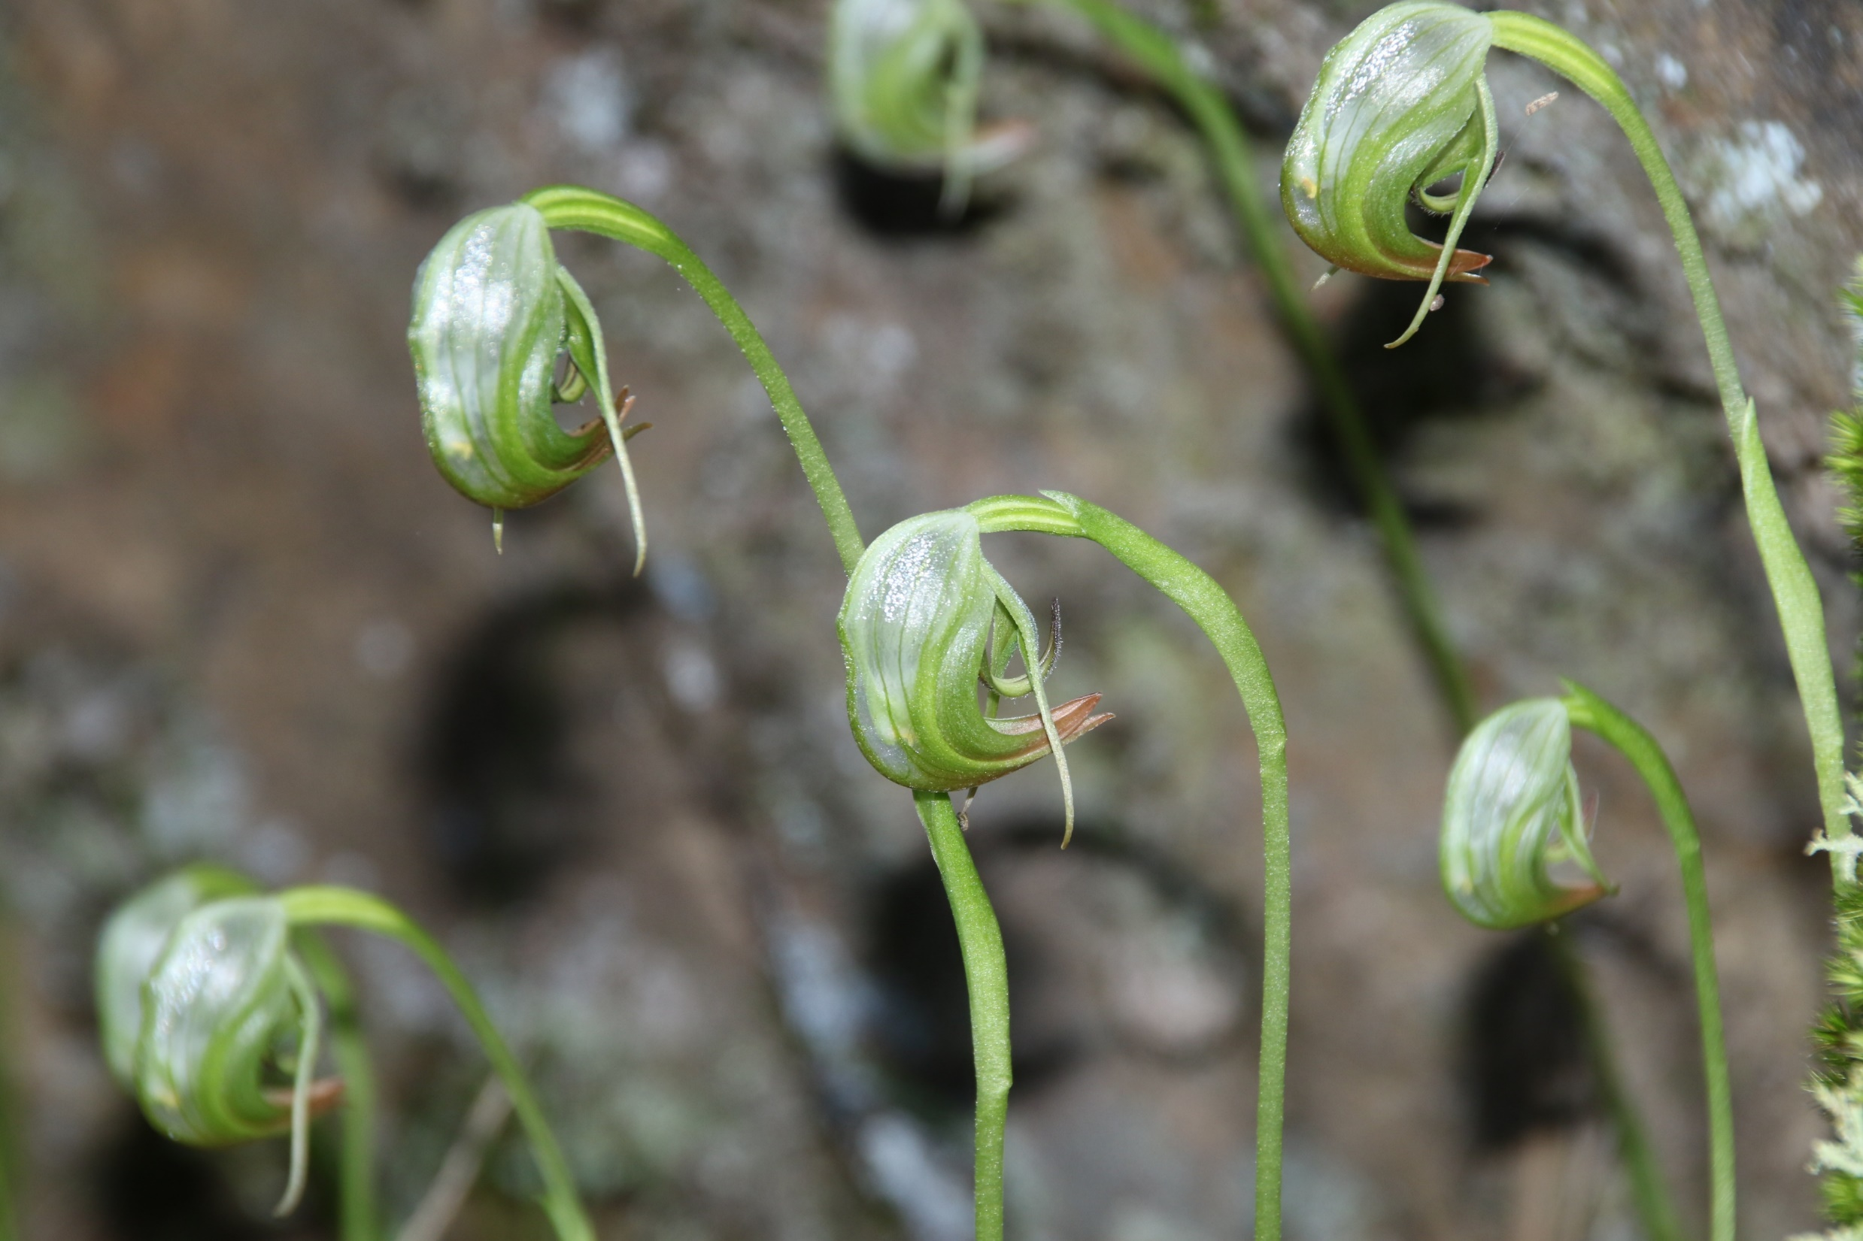

Slide 21
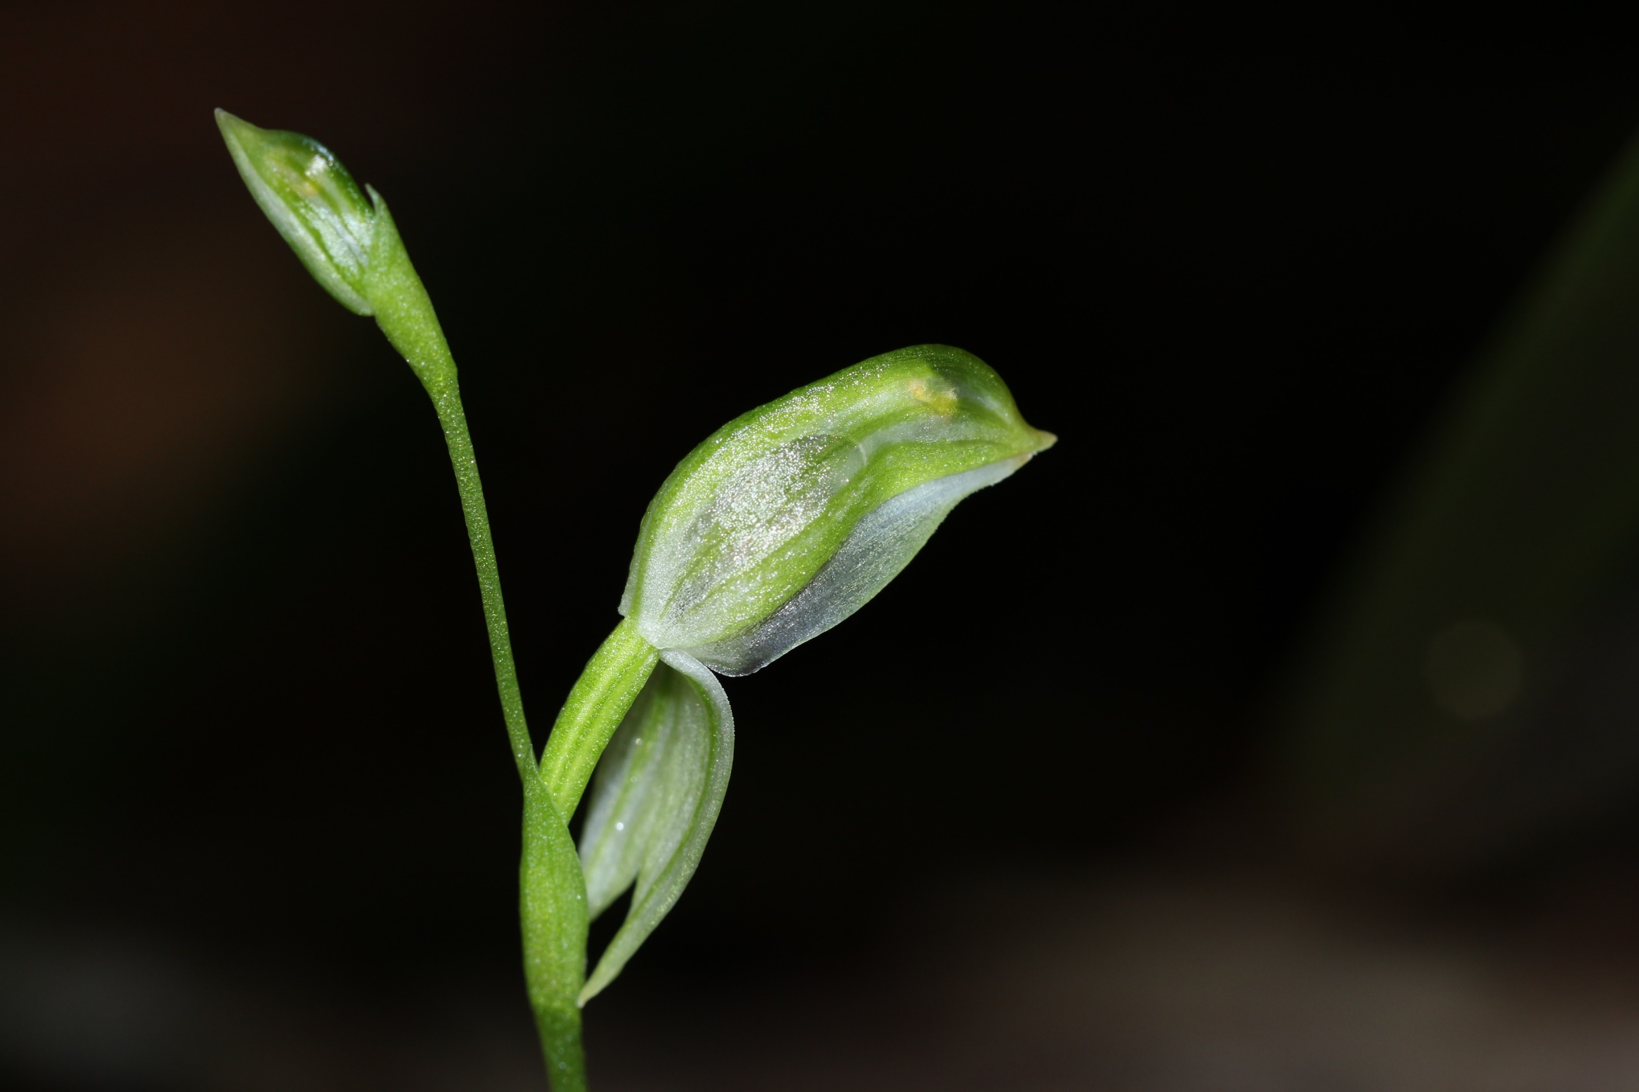

Slide 22
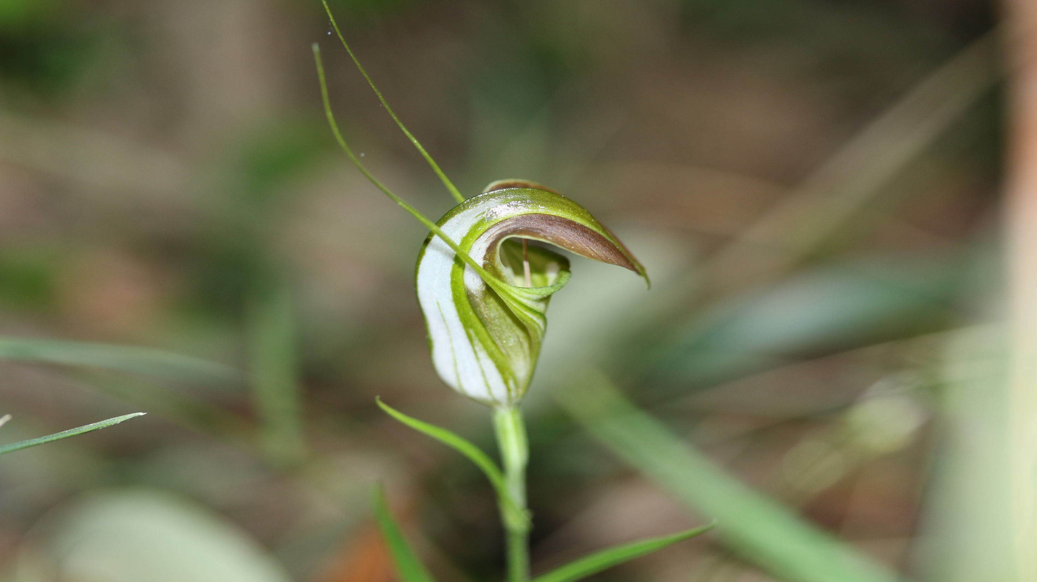
Pterostylis grandiflora
Garawarra Farm
July 2021

Slide 23
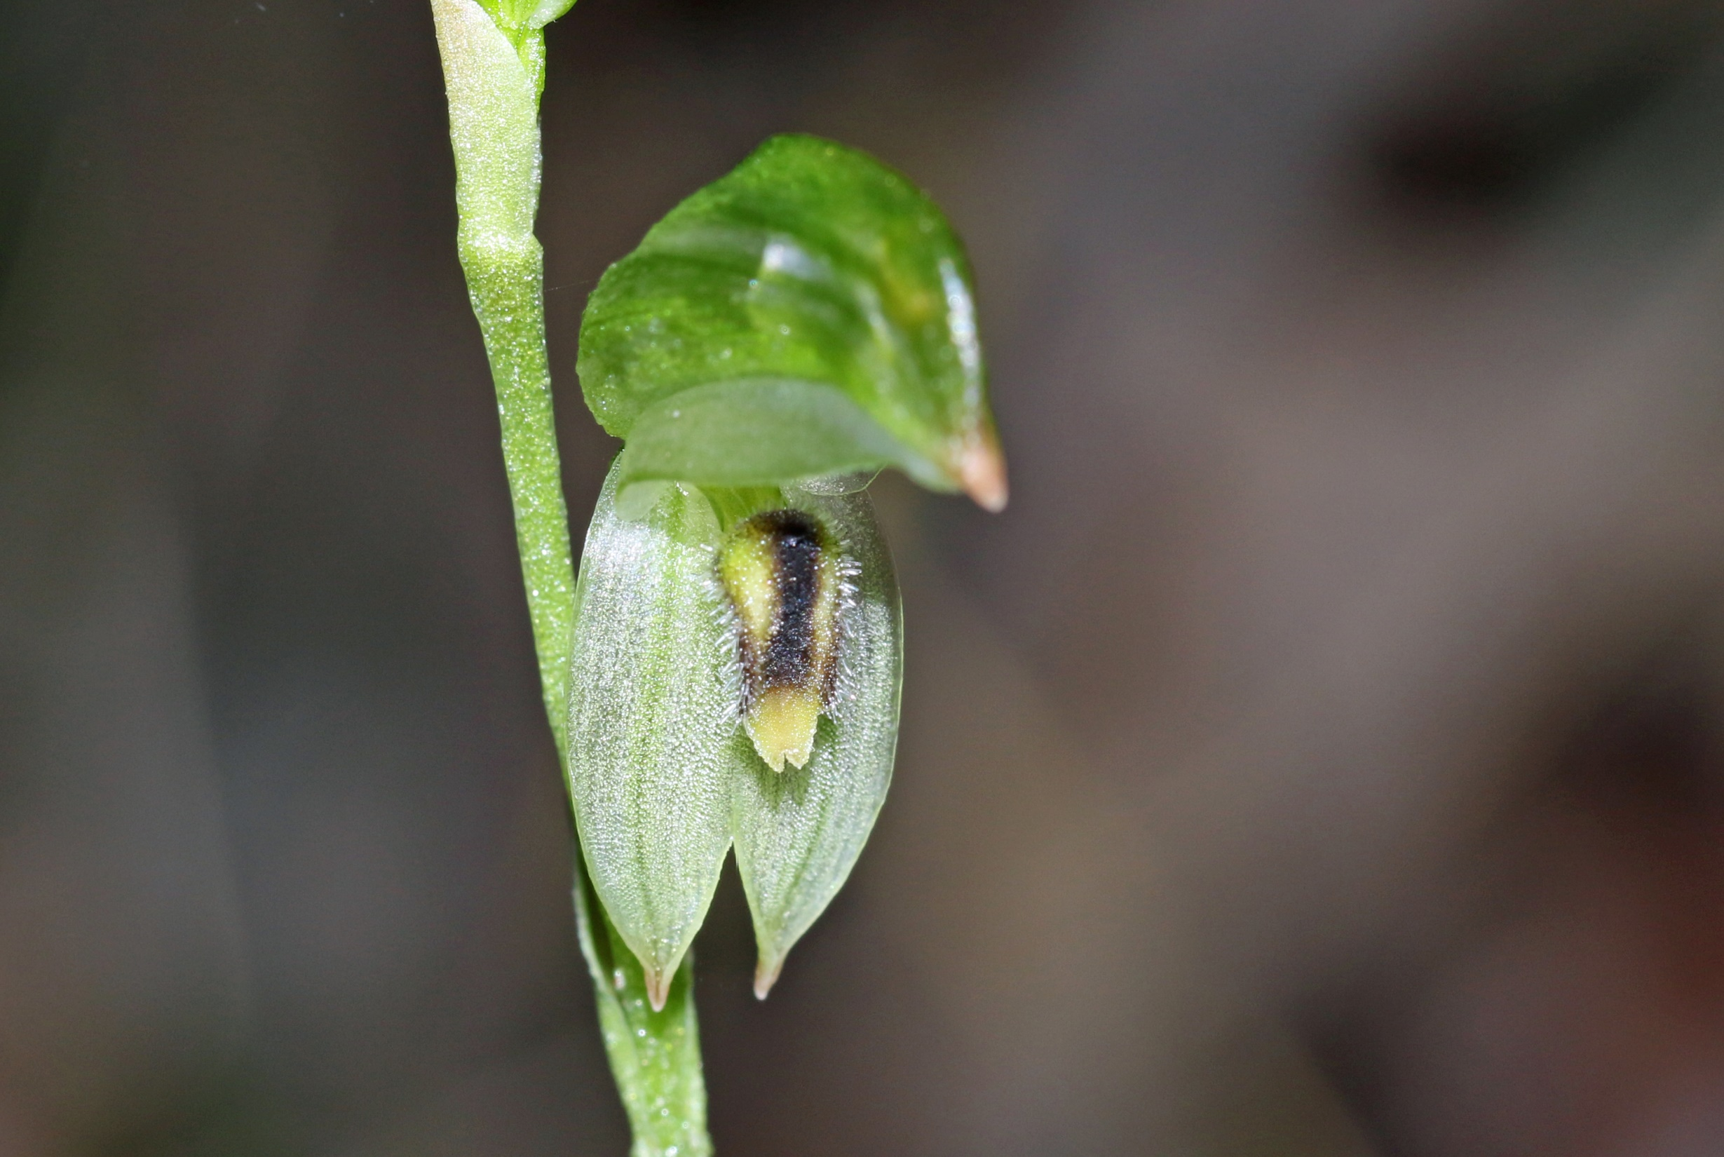

Slide 24
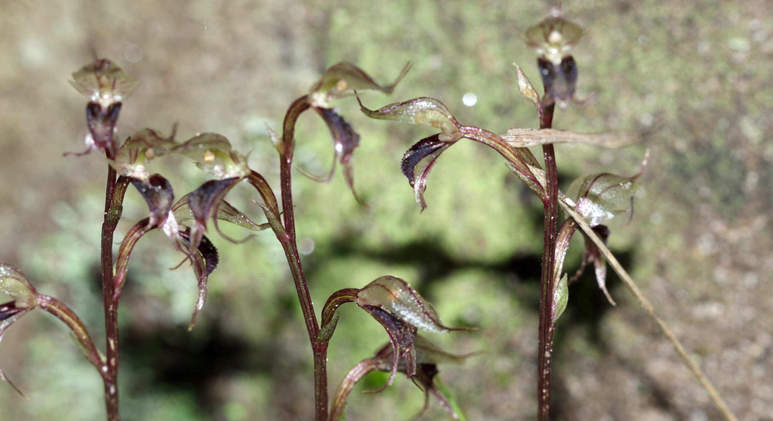

Slide 25
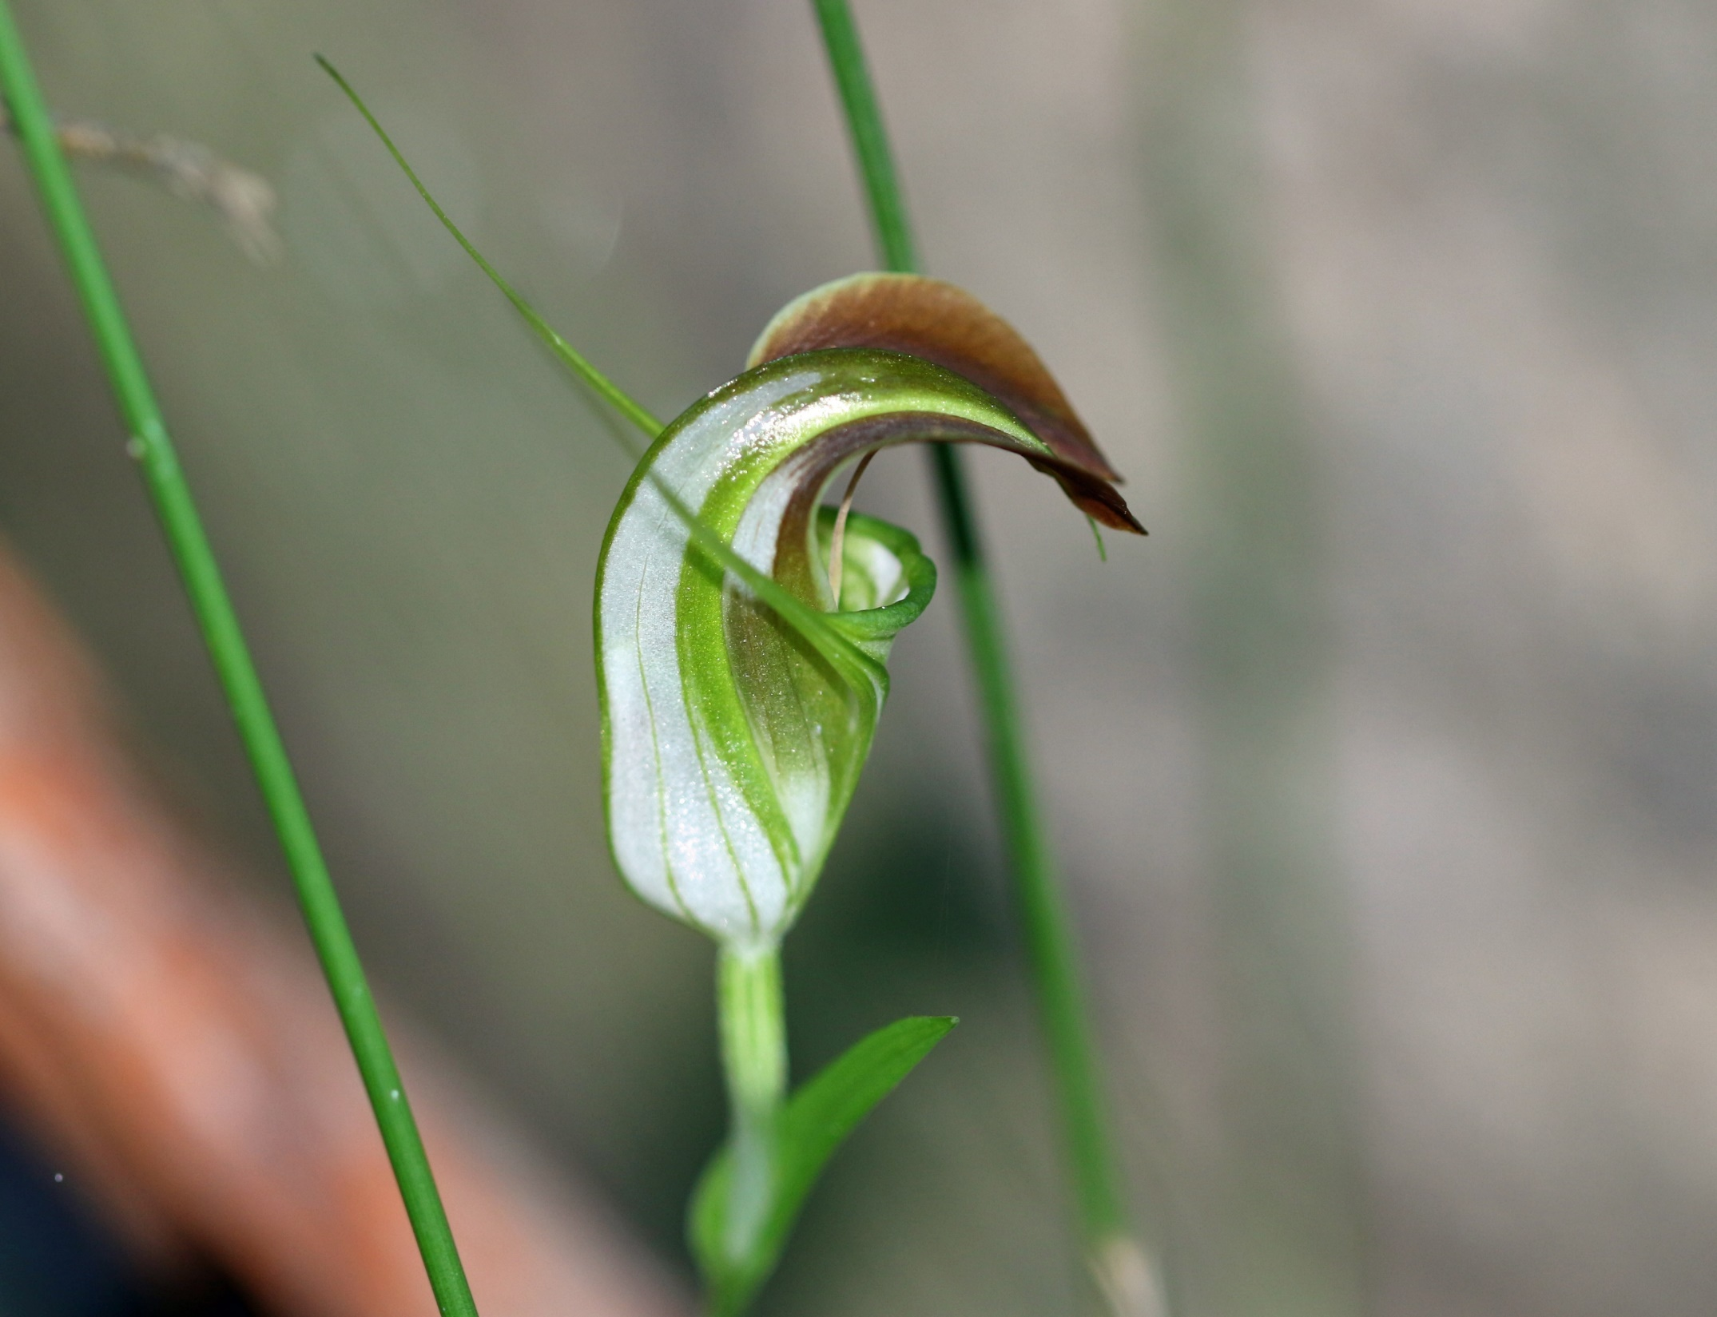

Slide 26
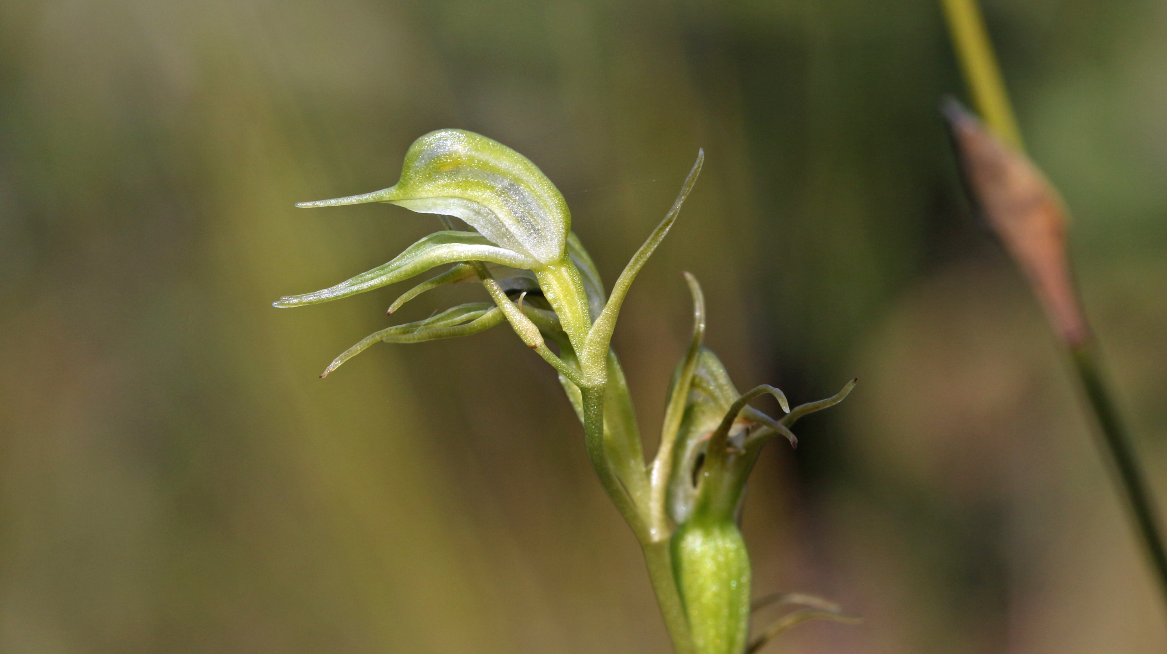
Pterostylis daintreana
Karani Ridge
July 2021

Slide 27
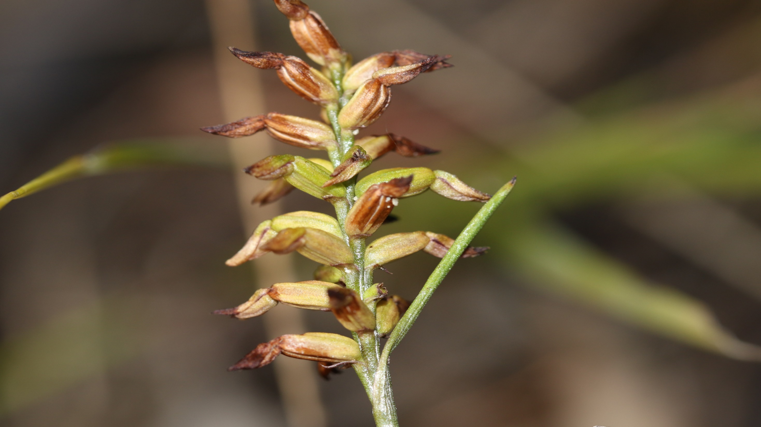
The end of flowering for this Corunastylis fimbriata
Wises Track
July 2021

Slide 28
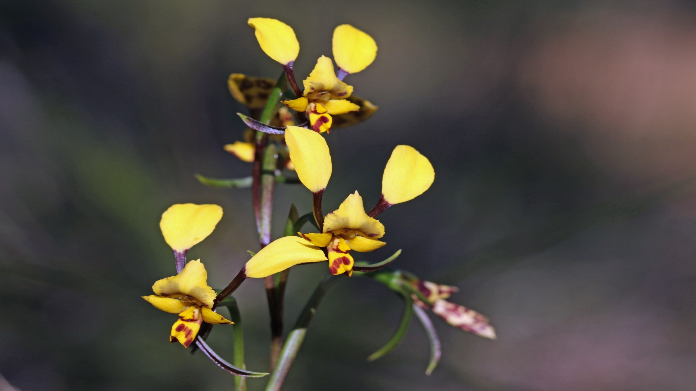
Diuris maculata
Royal National Park
August 2021

Slide 29
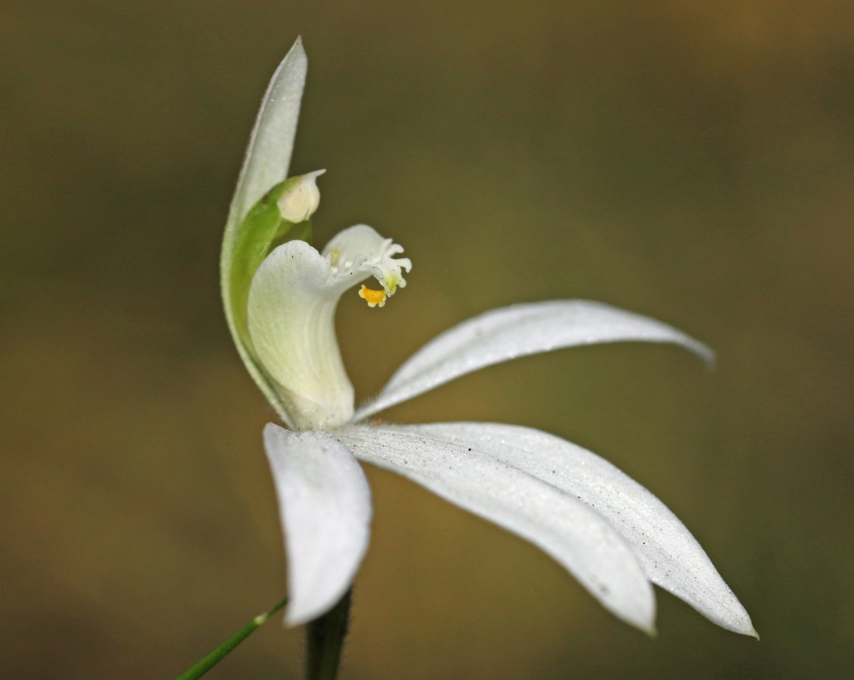
Caladenia catenata
Royal National Park
August 2021

Slide 30
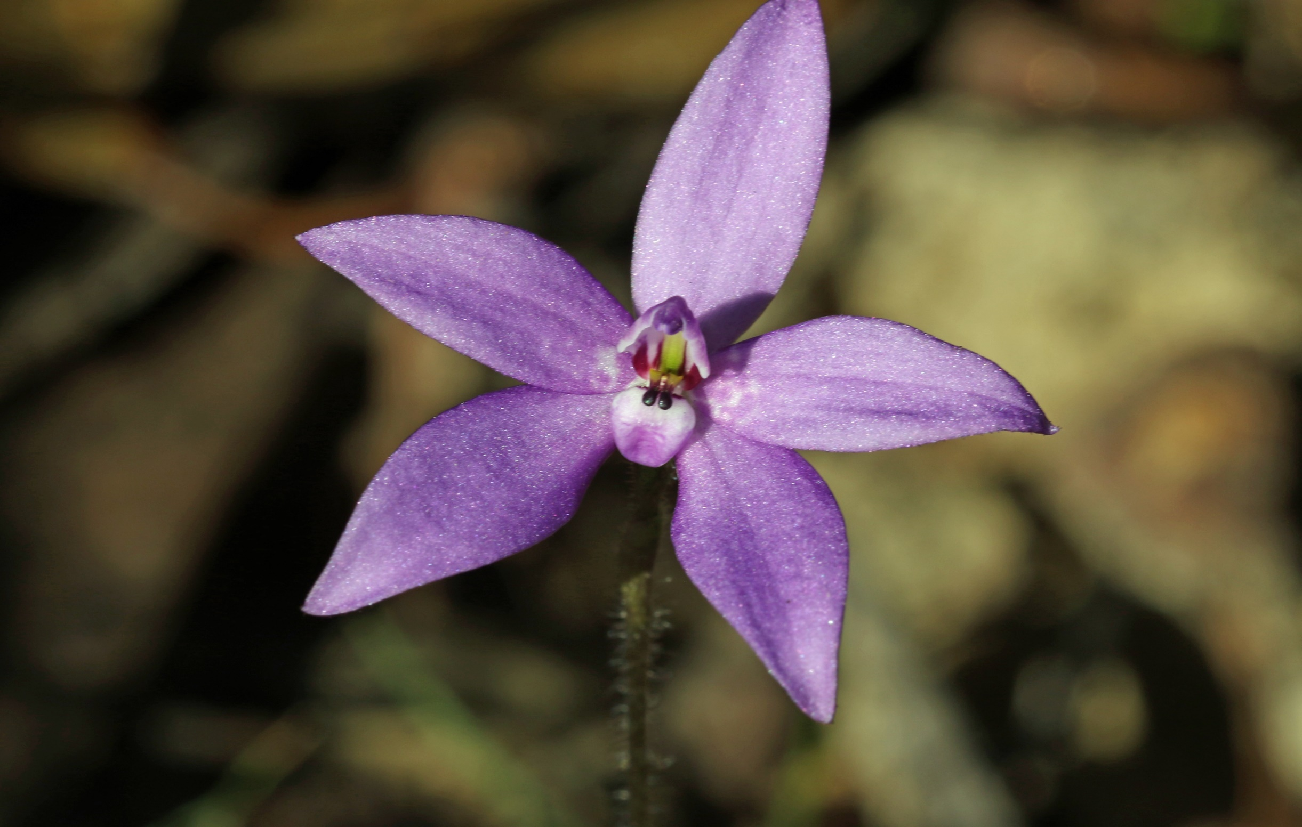
Glossodia minor
Royal National Park
August

Slide 31
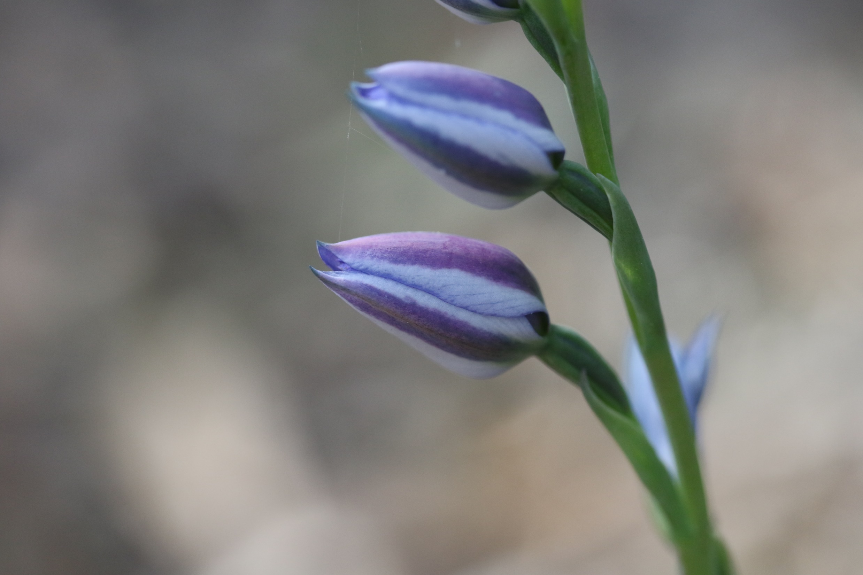
Budding
Thelymitra ixioides
August 2021

Slide 32
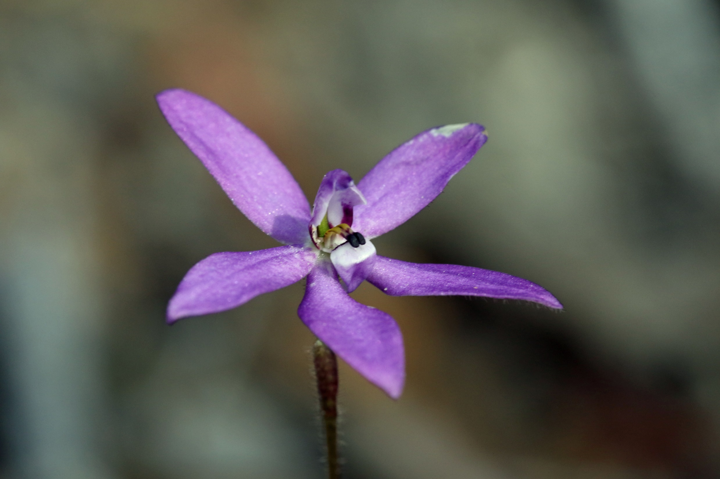

Slide 33
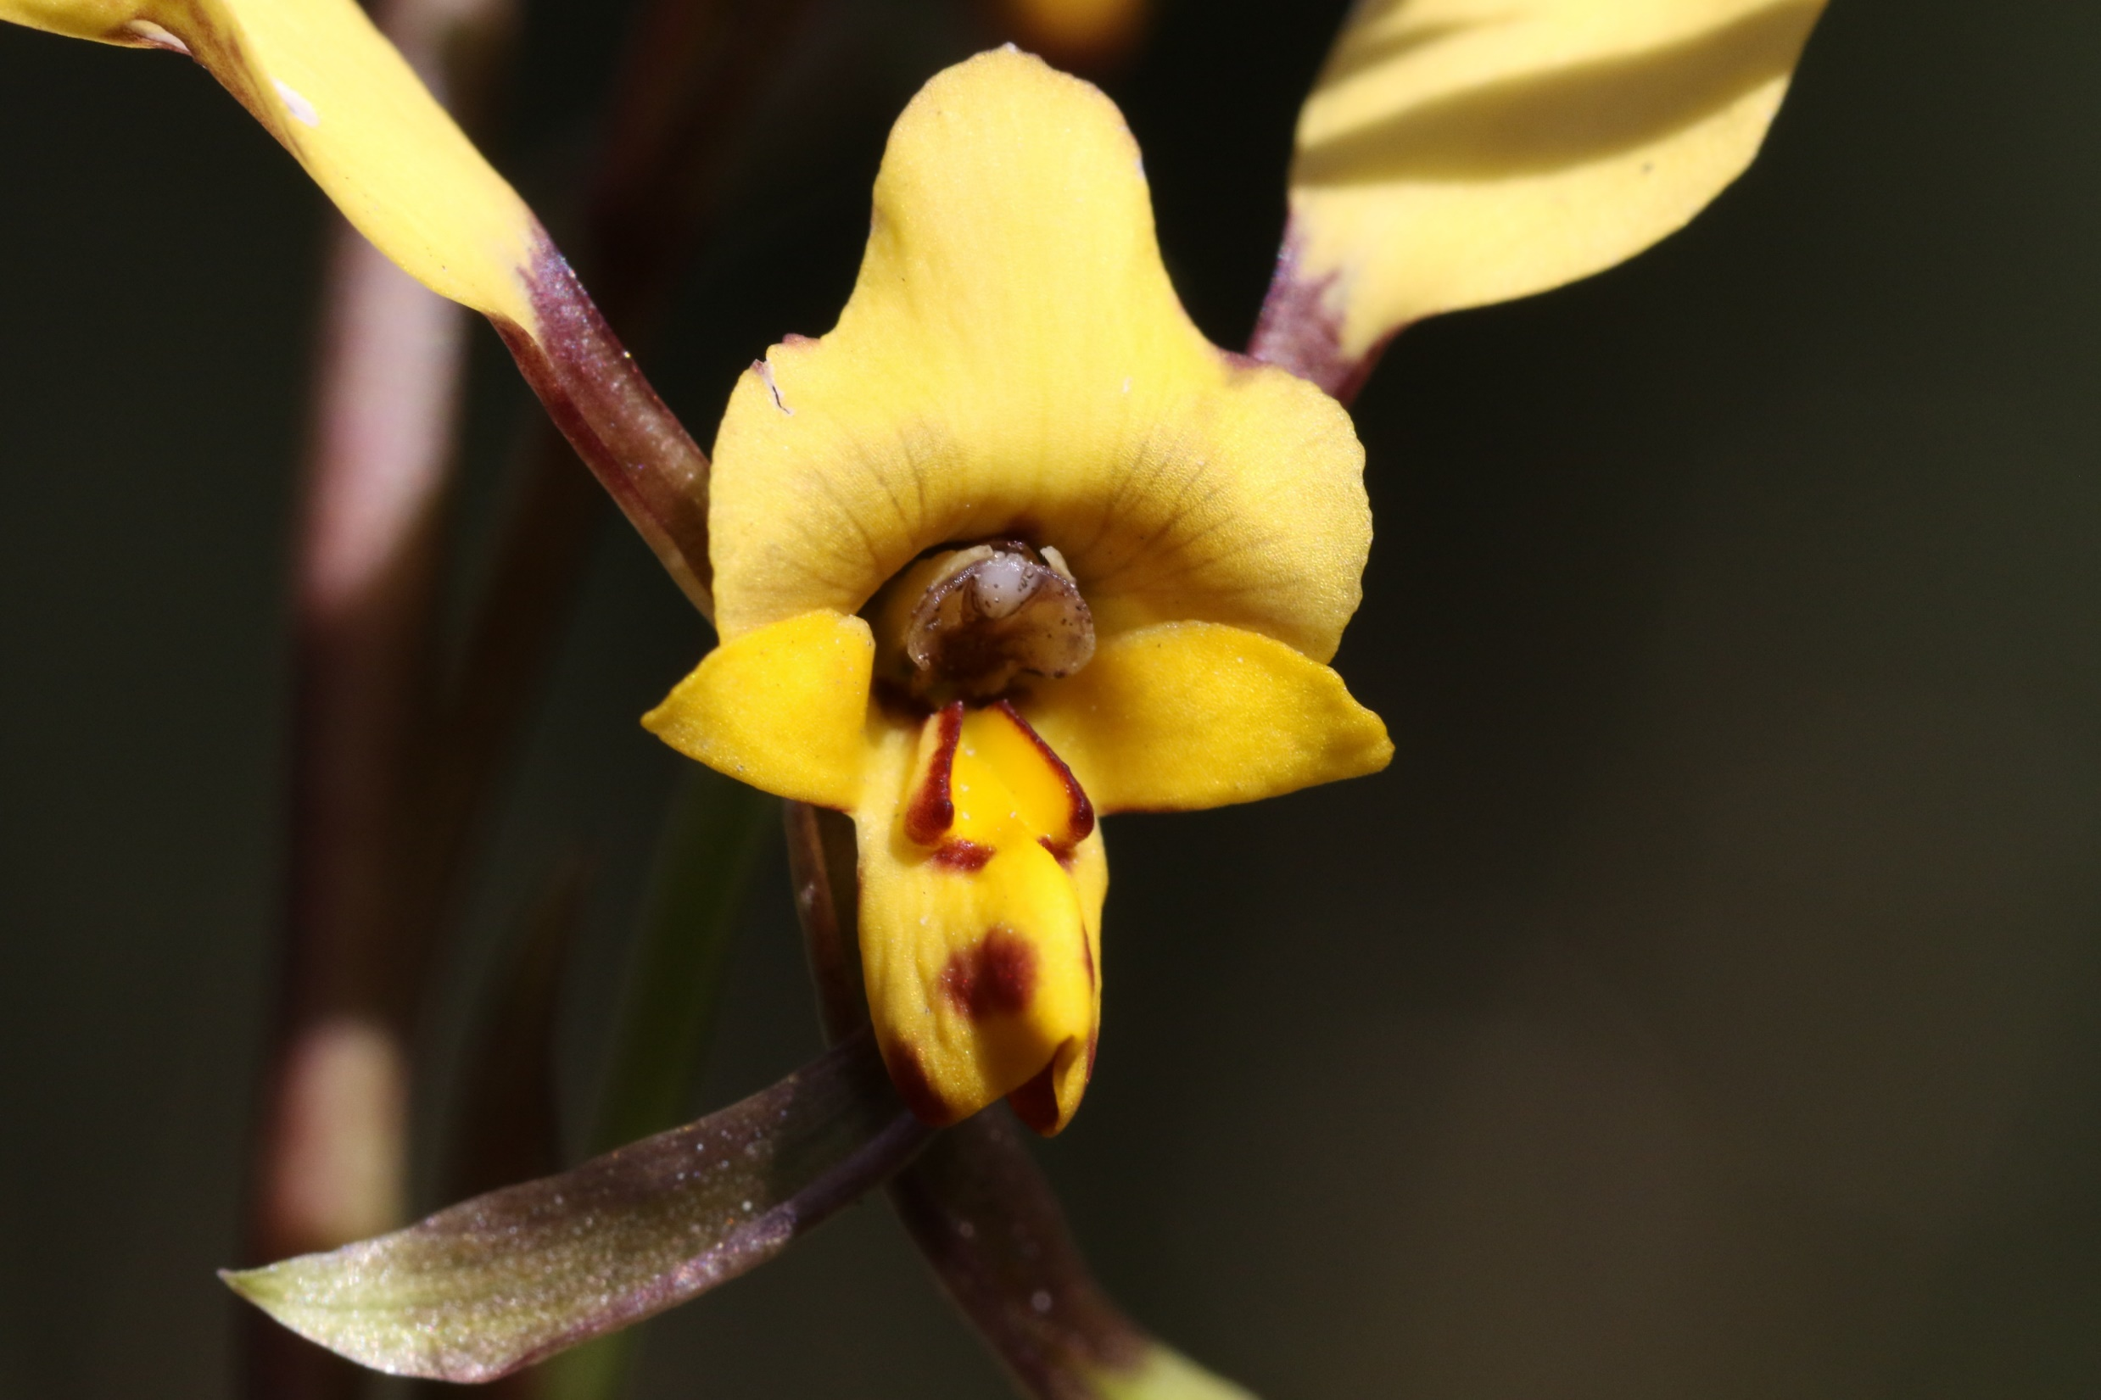

Slide 34
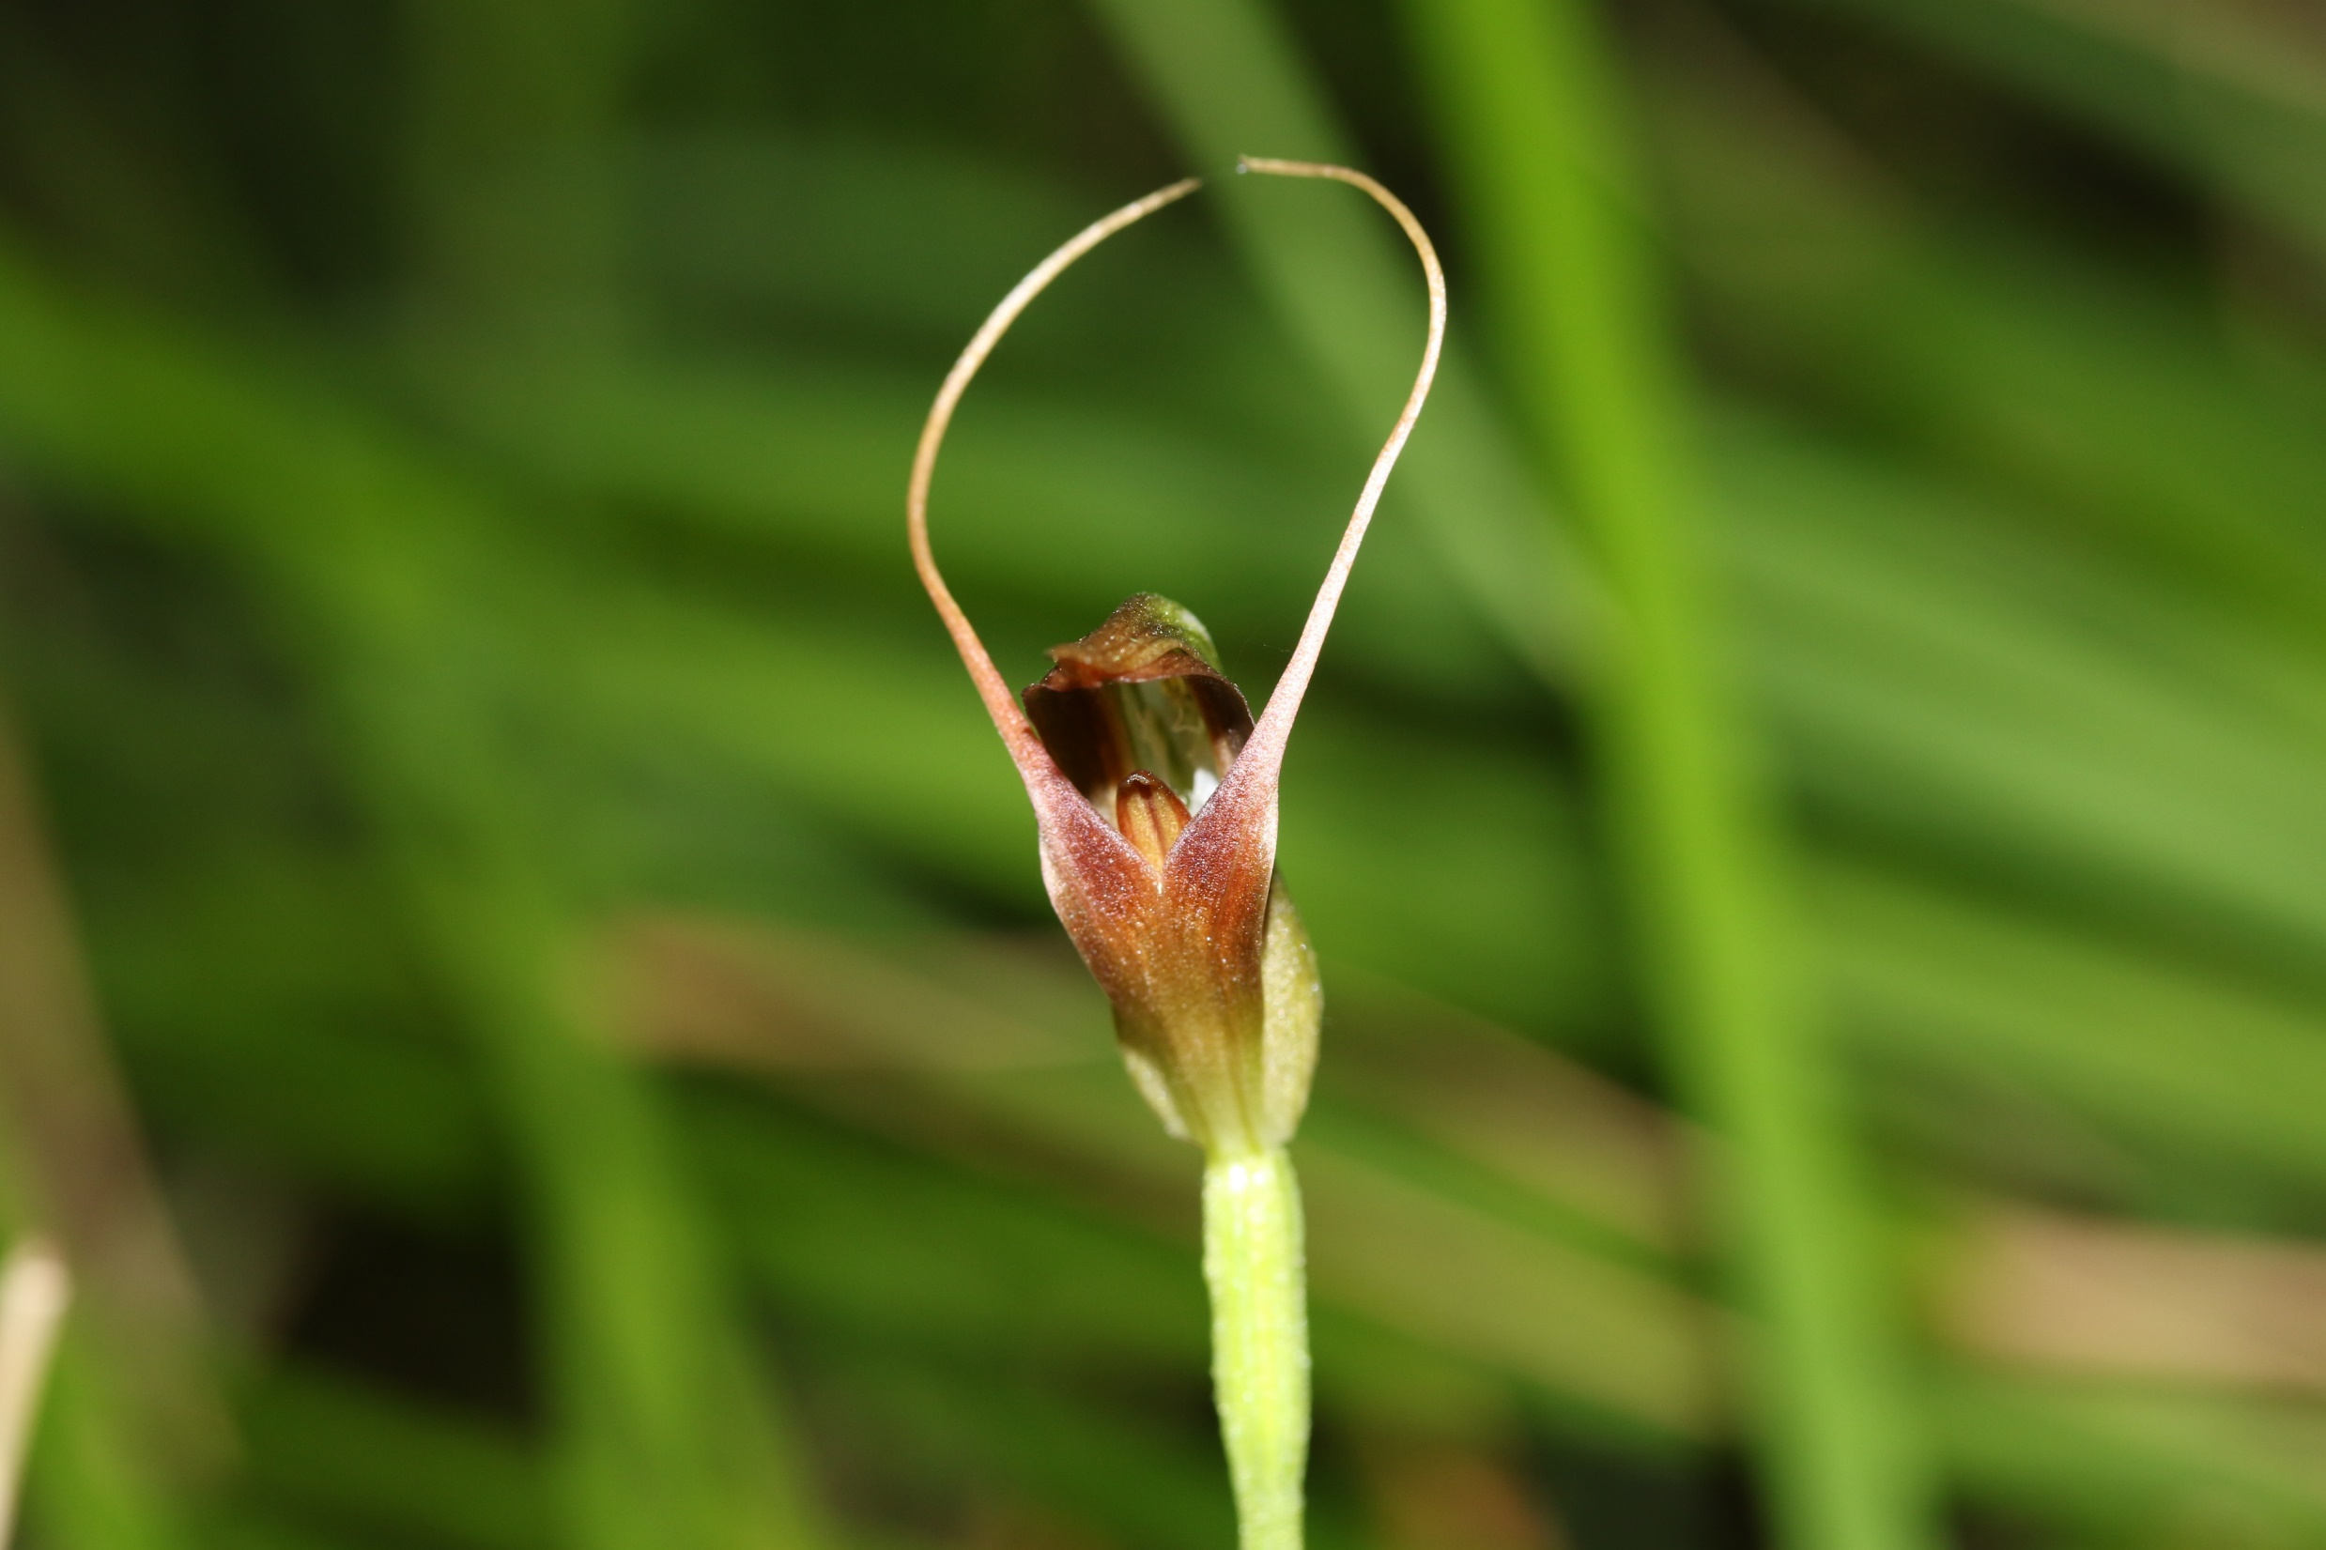
Pterostylis pedunculata
Little Red Riding Hood
The Forest Path
RNP
August 2021

Slide 35
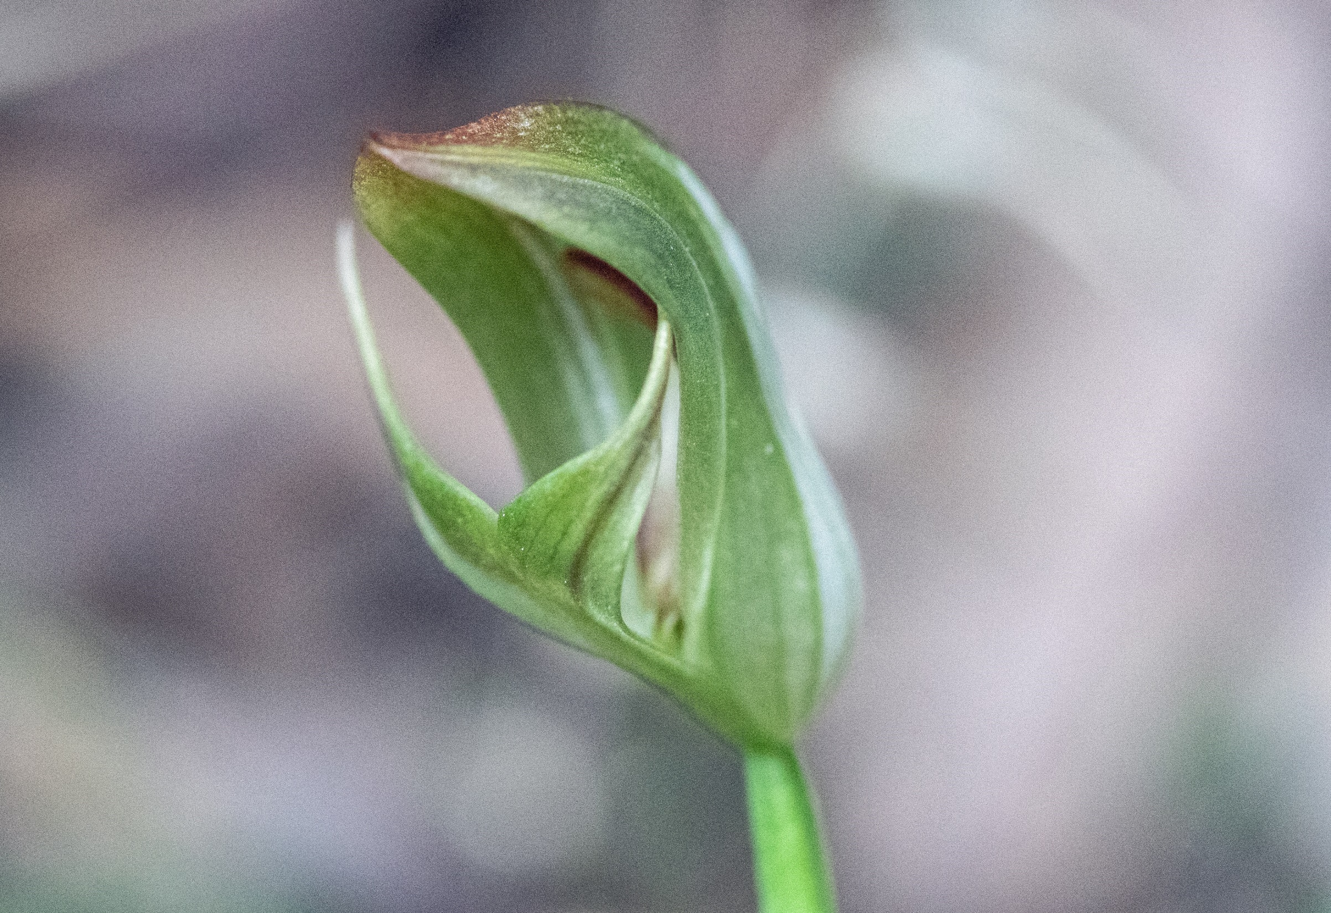
Pterostylis curta
The Forest Path
August 2021

Slide 36
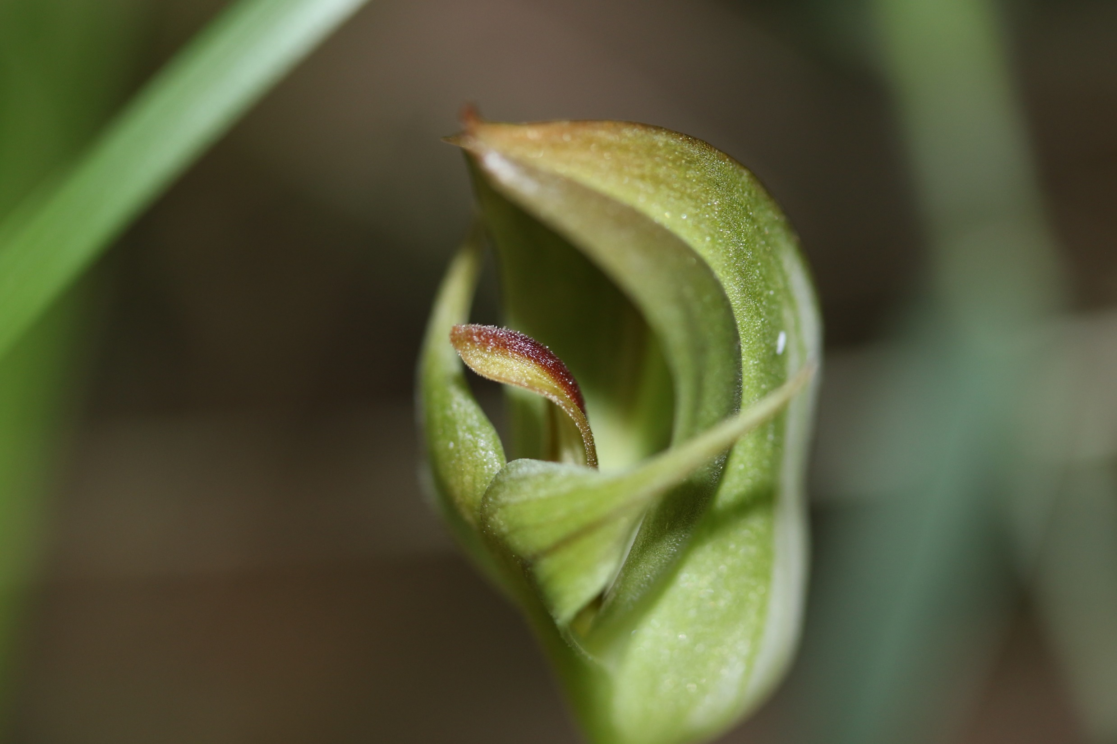

Slide 37
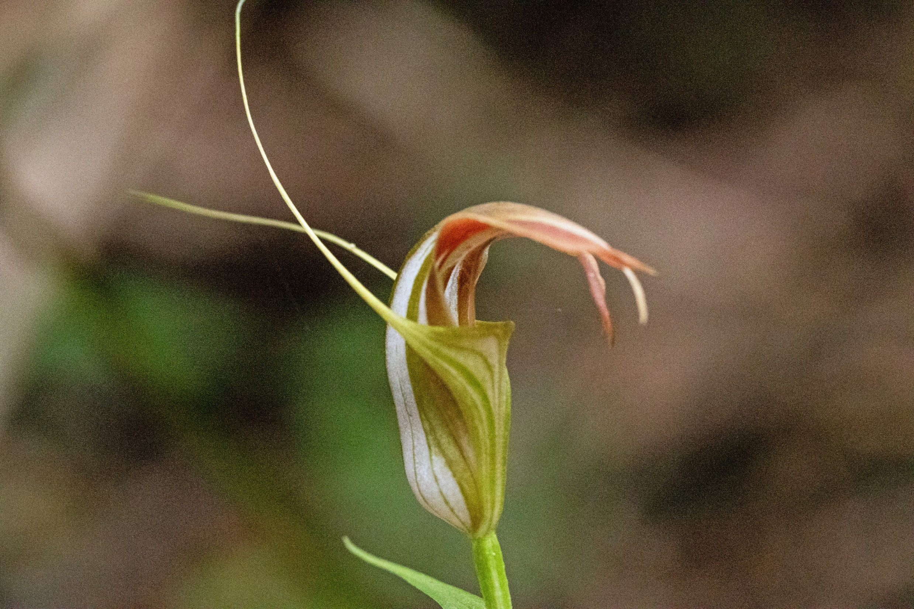

Slide 38
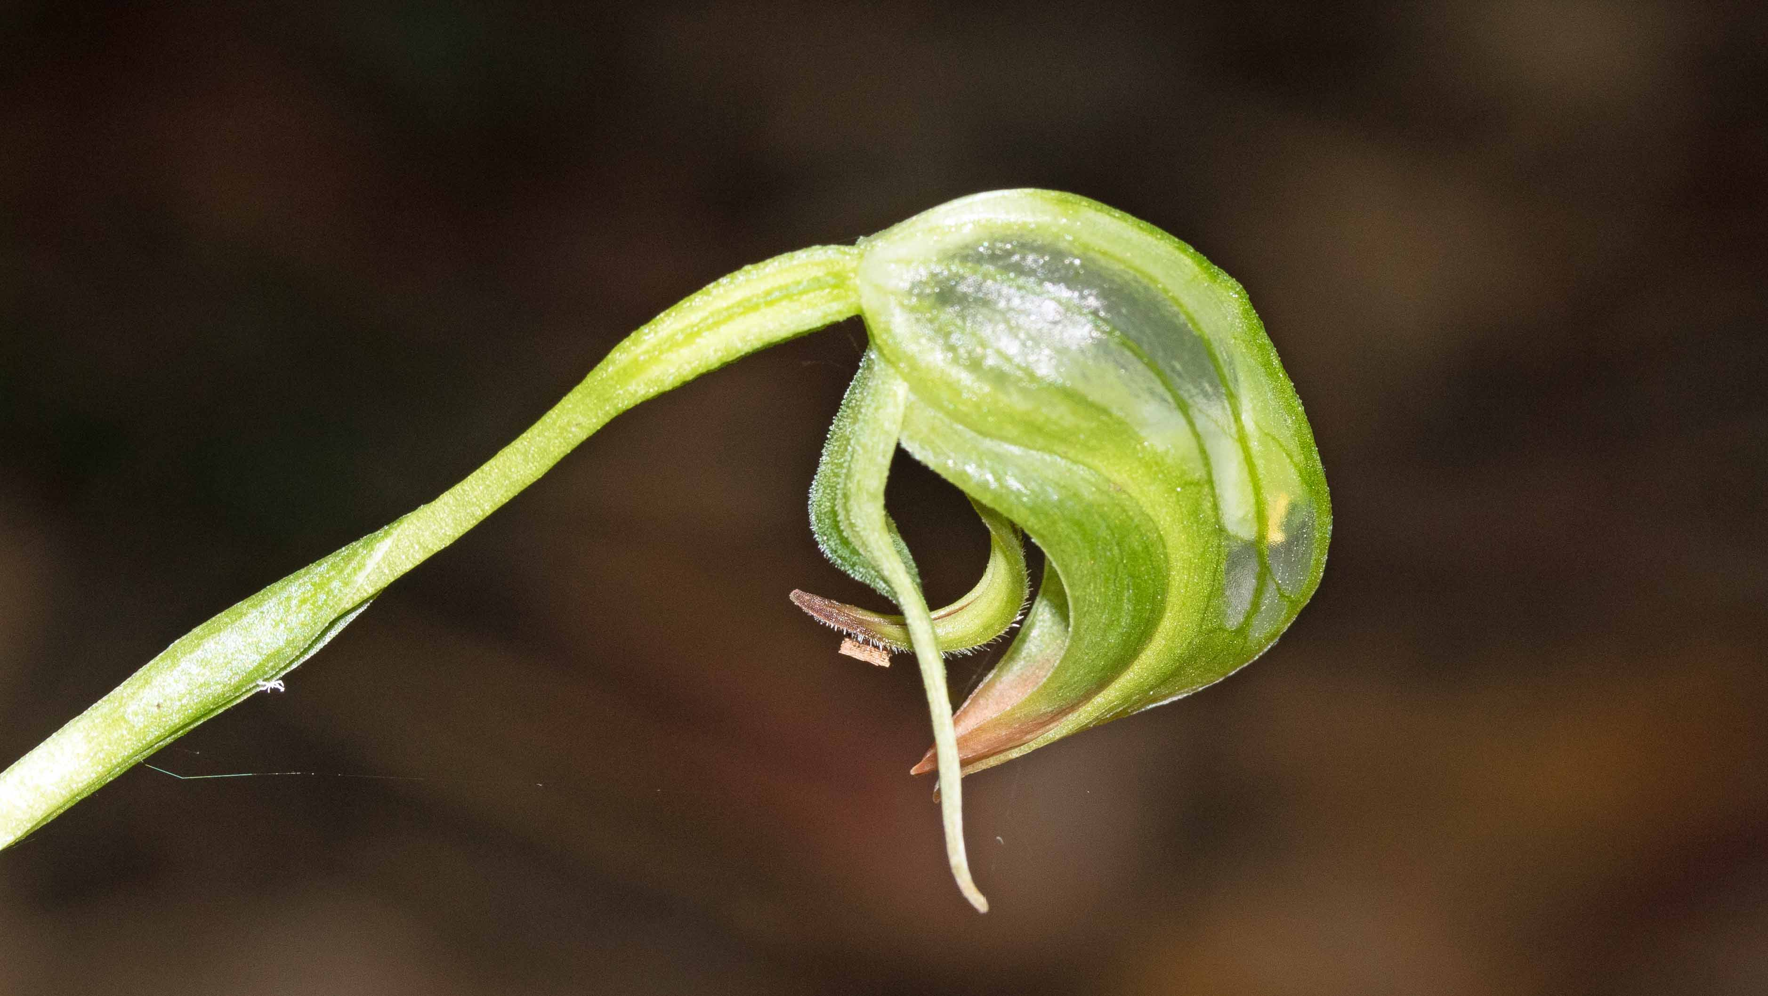

Slide 39
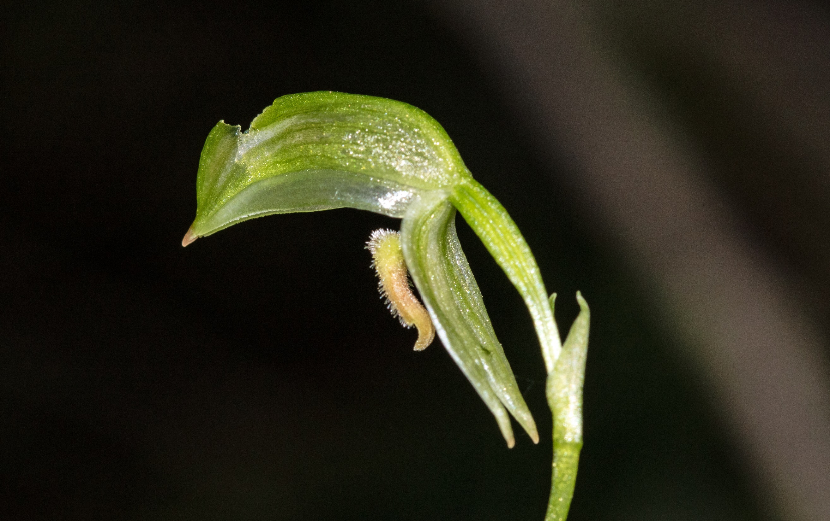

Slide 40
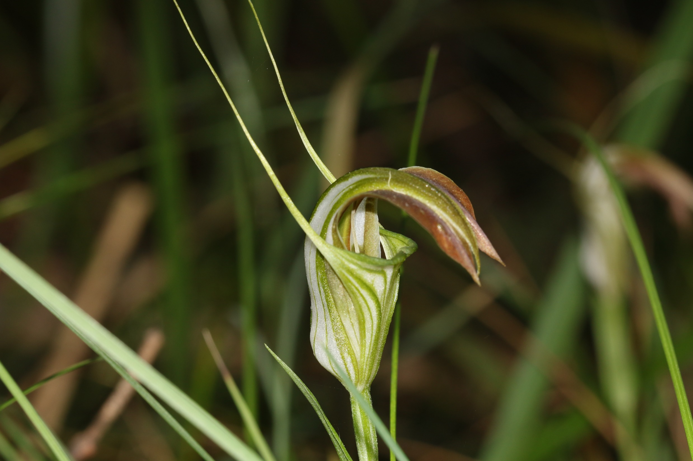

Slide 41
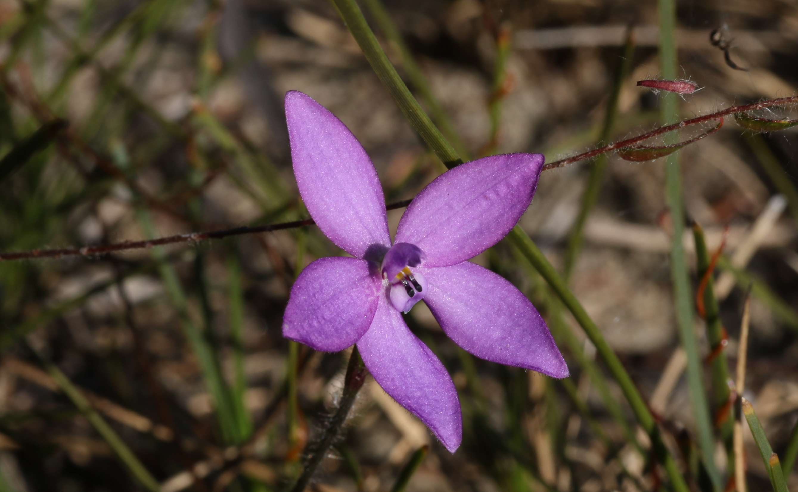

Slide 42
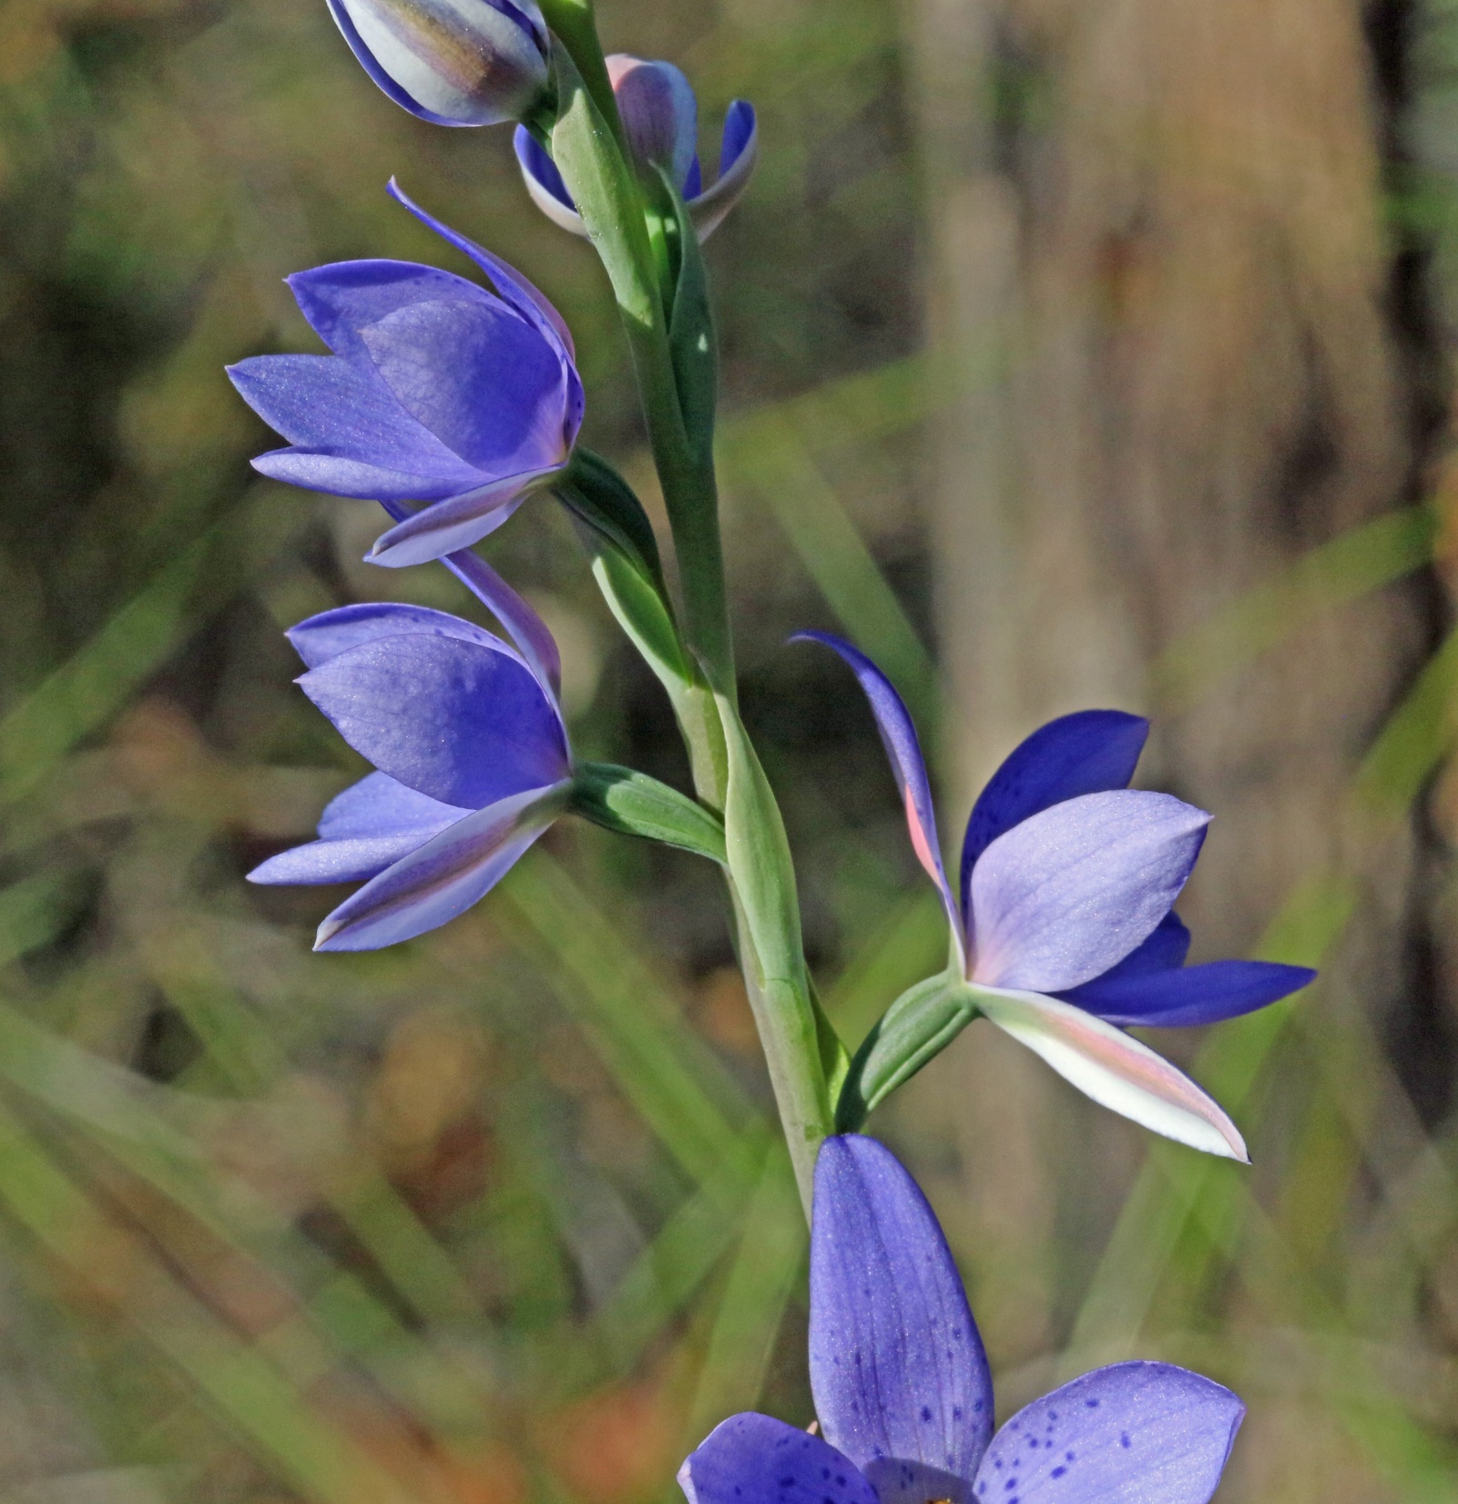
Thelymitra ixioides
Royal National Park
August 2021

Slide 43
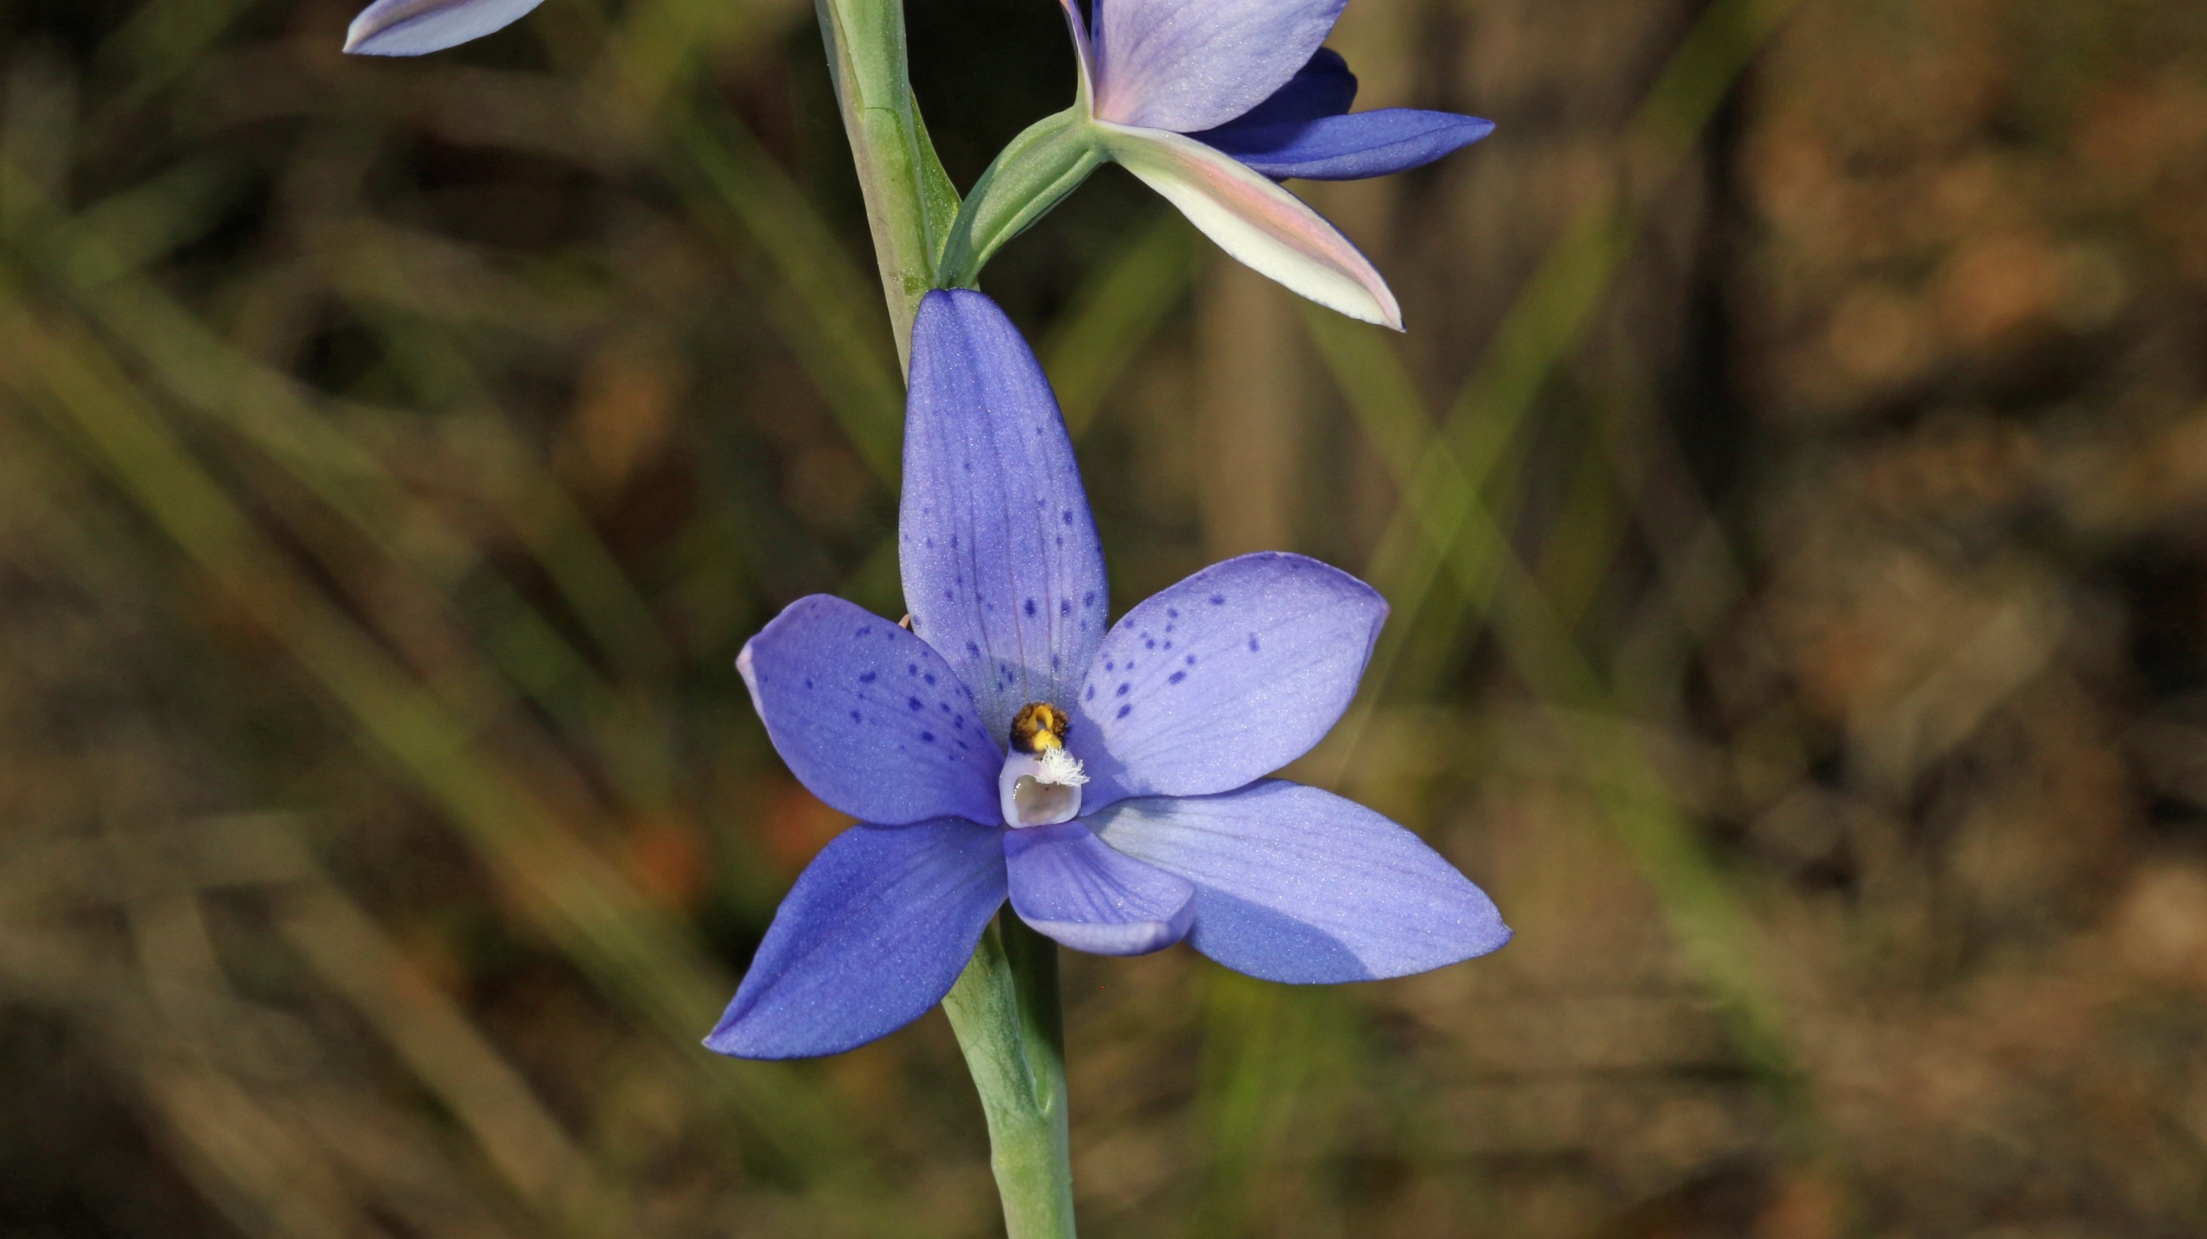

Slide 44
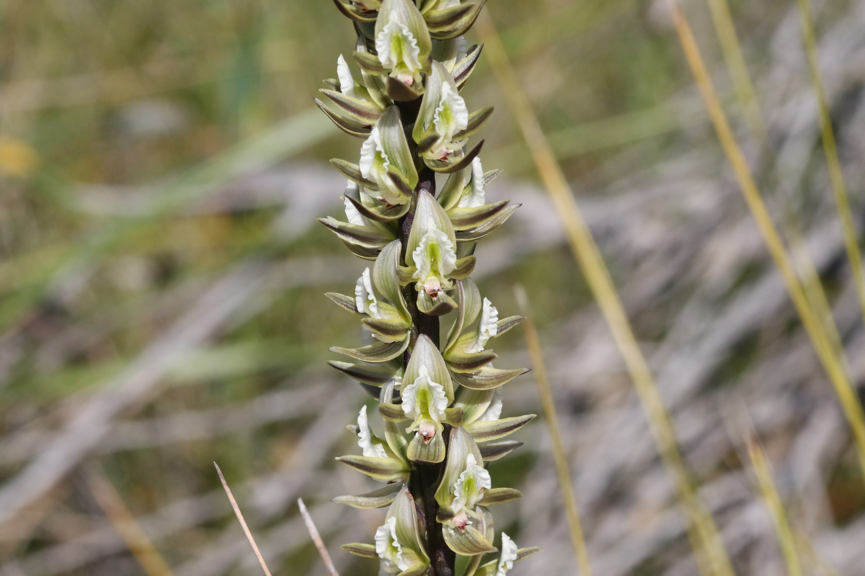
Prasophyllum elatum
Tall Leek Orchid
Curra Moors Fire Trail
September 2021

Slide 45
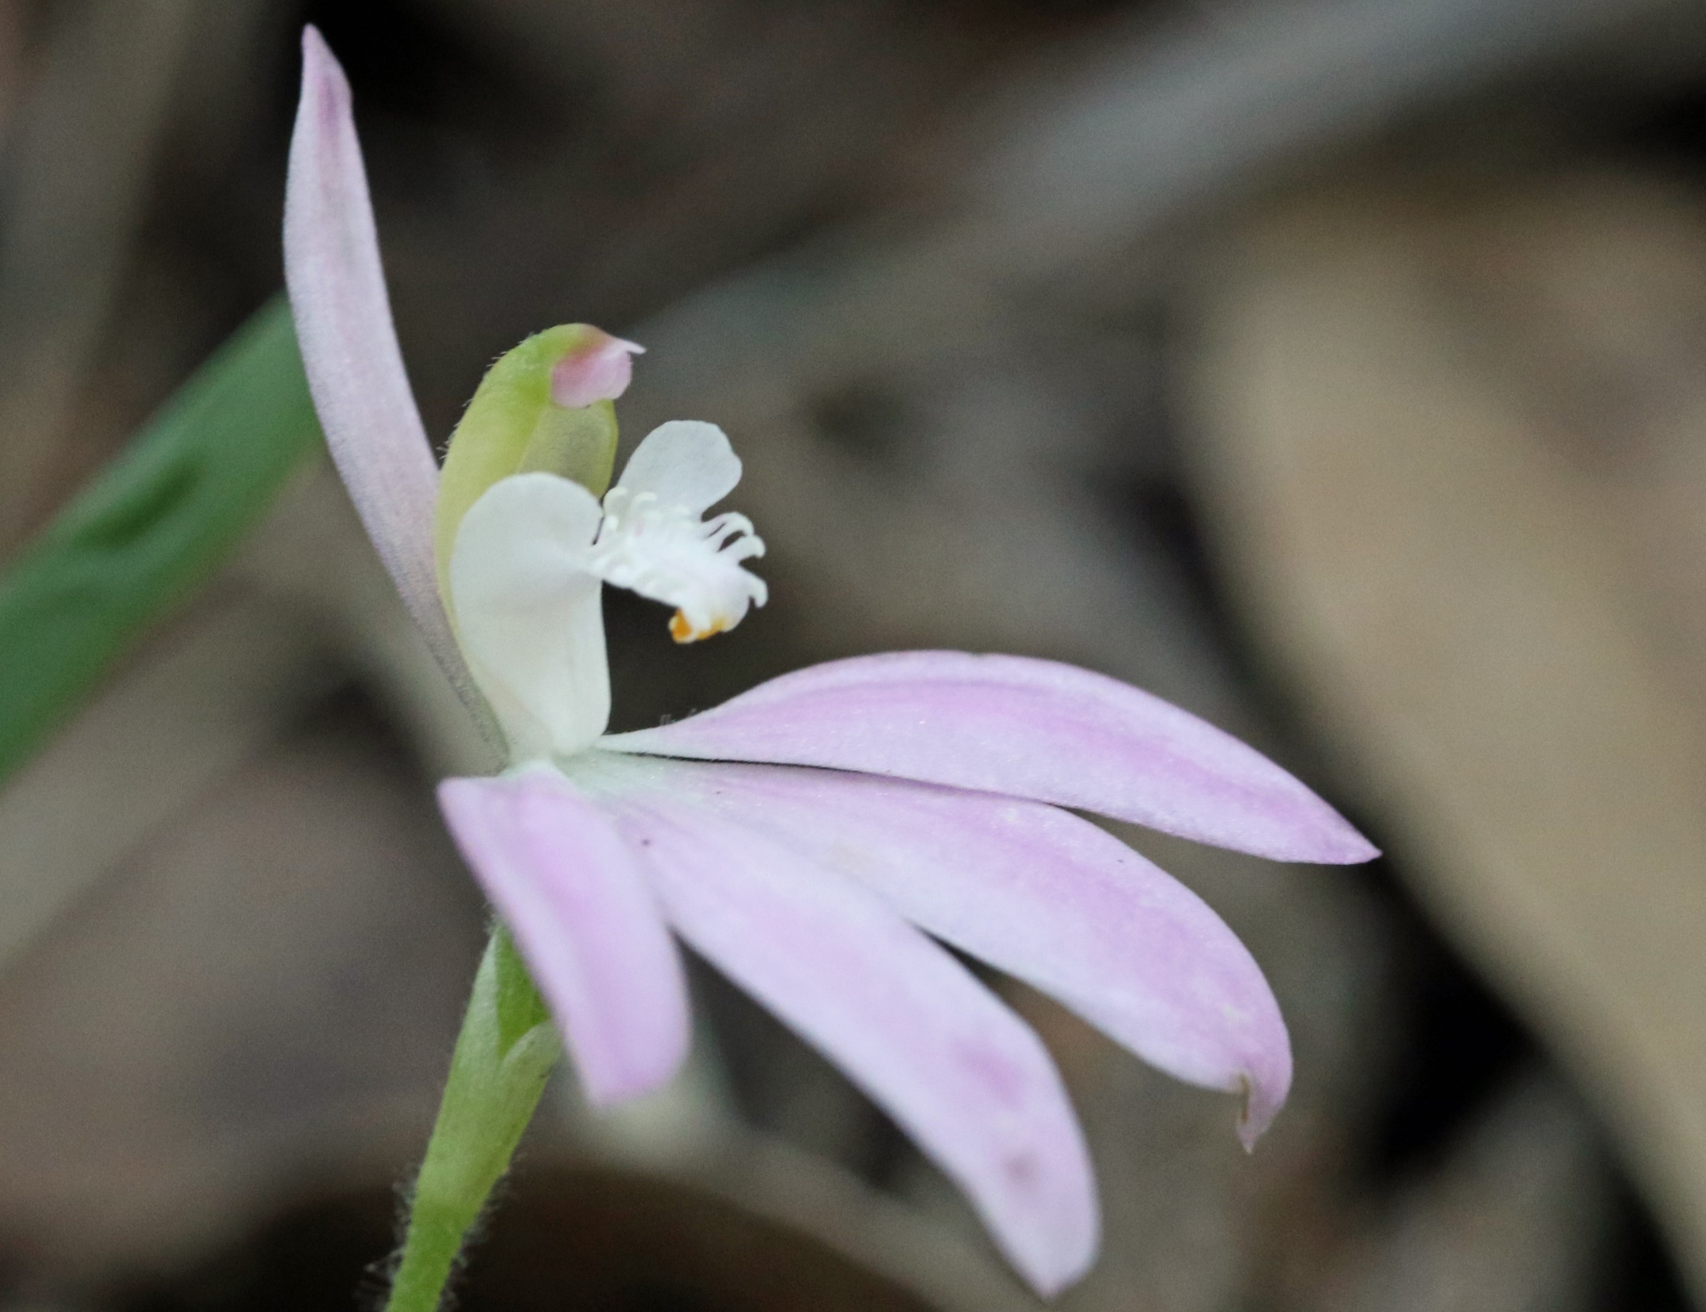

Slide 46
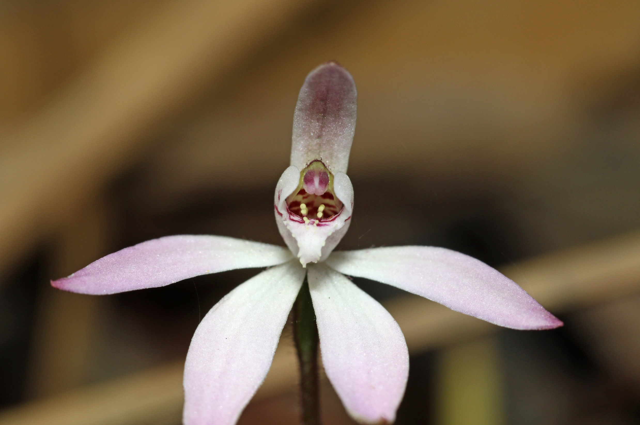
Caladenia carnea
Uloola Falls Fire Trail
August 2021

Slide 47
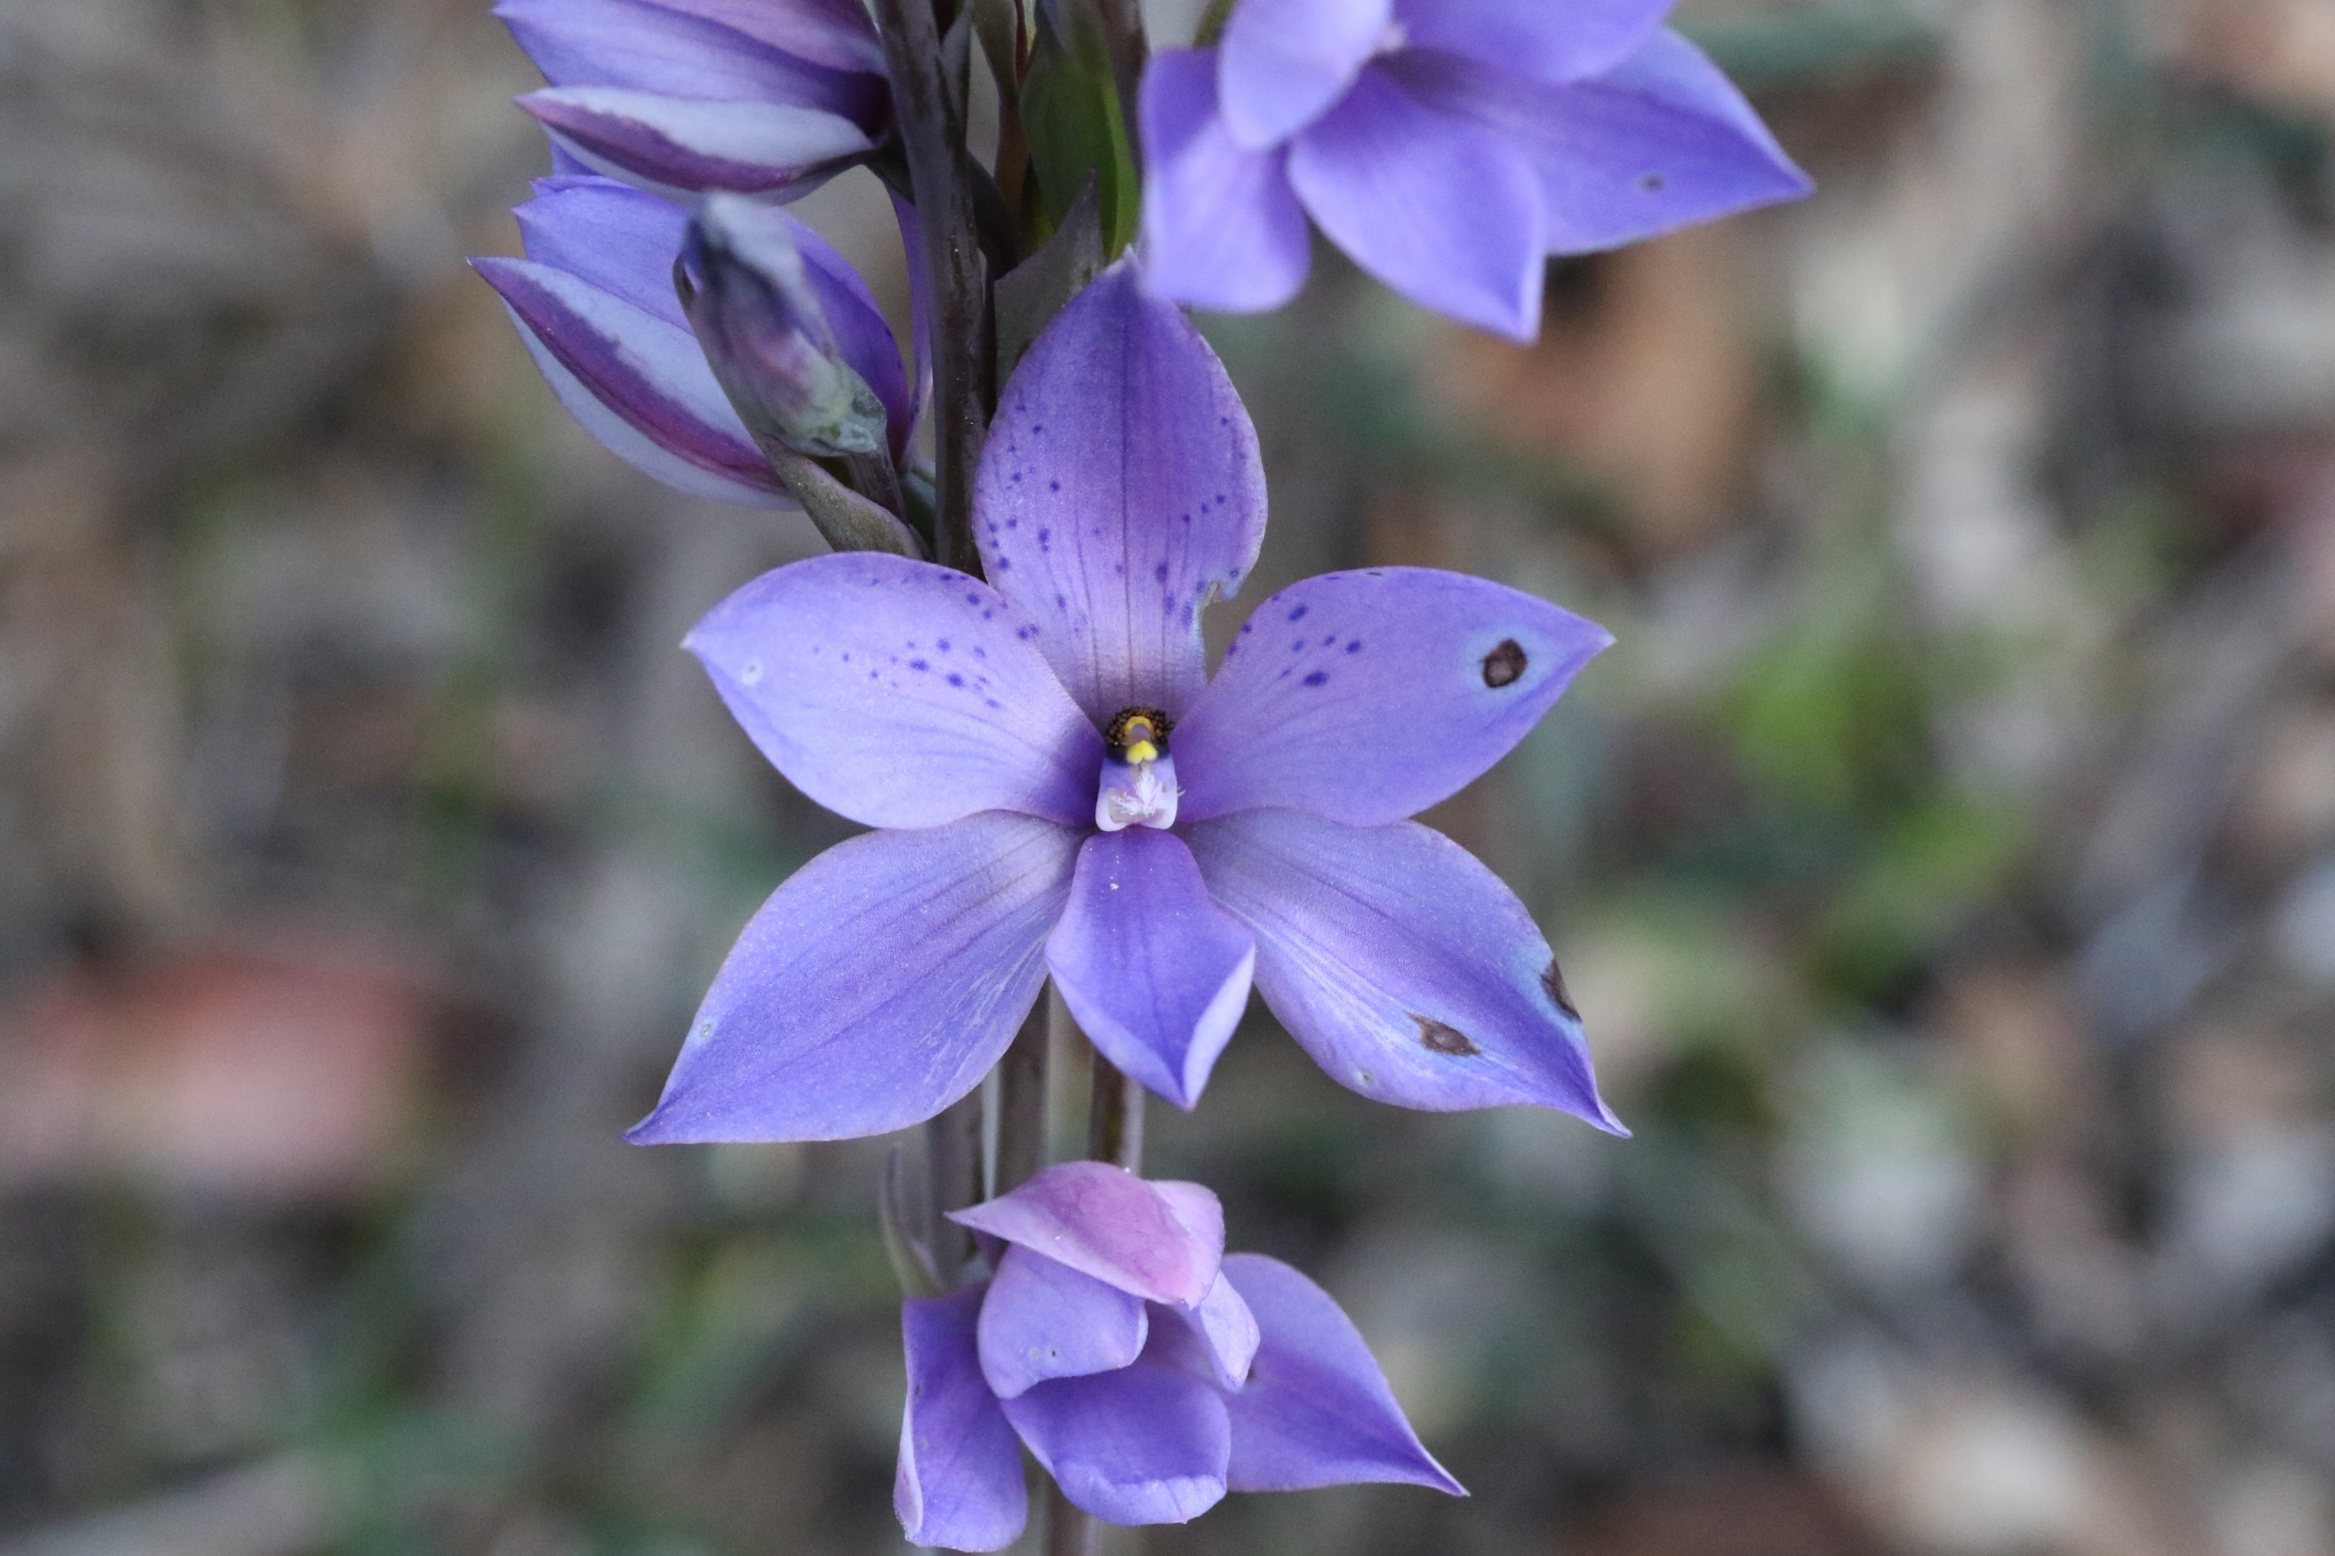

Slide 48
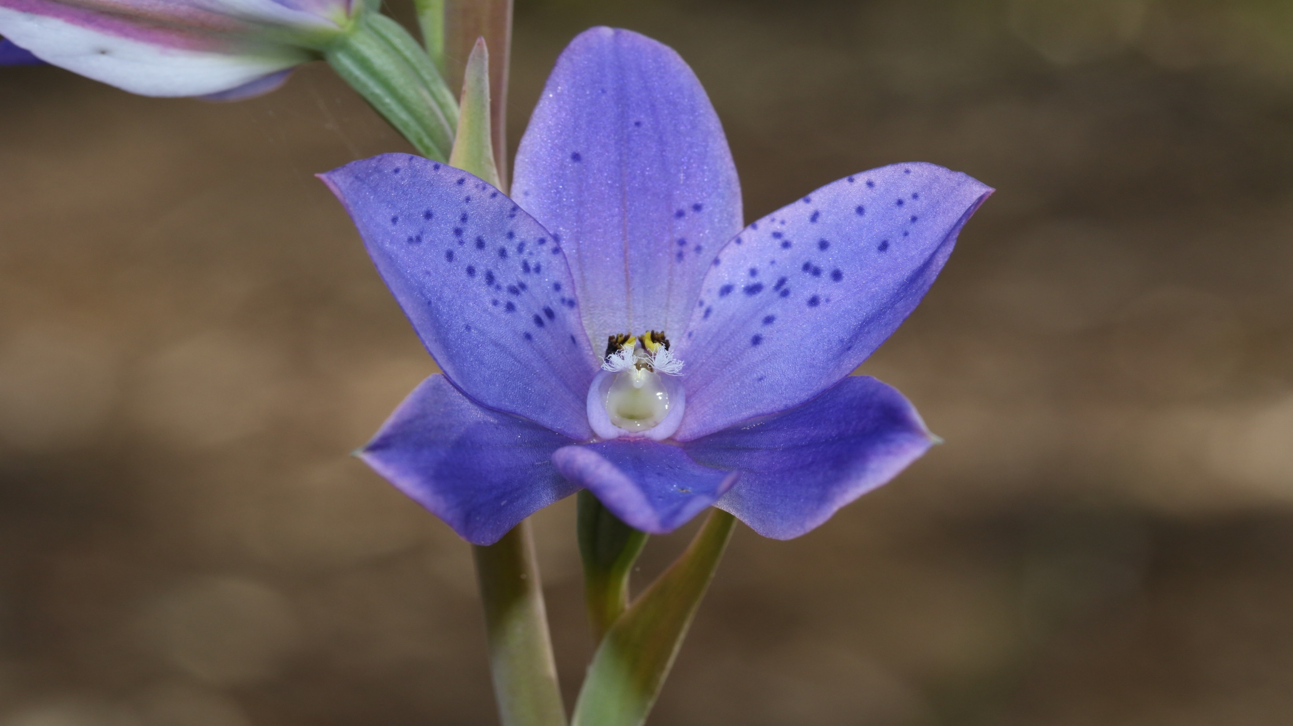

Slide 49
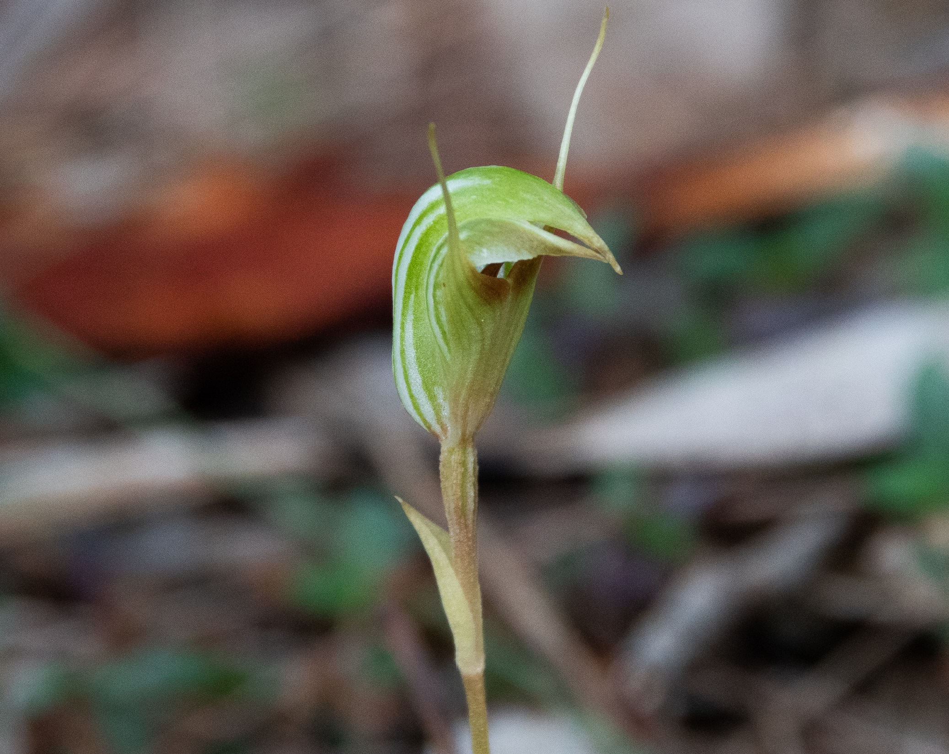
Pterostylis concinna
Weemalah
Royal National Park
August 2021

Slide 50
Caladenia alata
Bungoona Path
Royal National Park
September 2021

Slide 52
Erythrorchis cassythoides
September 2021

Slide 54
Calochilus paludosus
Red Bear Orchid
September 2021
Royal National Park

Slide 56
Calochilus campestris
Royal National Park
September 15th 2021

Slide 57
Everyone’s favourite
The Flying Duck Orchid
Caleana major

Slide 58
The flower is an attractant to insects, such as male sawflies which pollinate the flower in a process known as pseudocopulation. When the insect lands on the labellum our duck lowers its head, traps the insect and only lets it out after the insect has “finished” his business.
The pollinia come loose and get stuck to his back. He continues to “copulate” with the flower to the point of ejaculation. Eventually, he flies away, visits other orchids, unwittingly pollinates them, and thus helps the orchids reproduce.
Caleana major
Royal National Park
September 17 2021

Slide 59
Thelymitra carnea
September 2021
Royal National Park

Slide 62
Thelymitra longiloba

Slide 63
Caladenia carnea
Still out, October 5th

Slide 66
Dockrillia striolata
Streaked Rock Orchid
October 5th

Slide 69
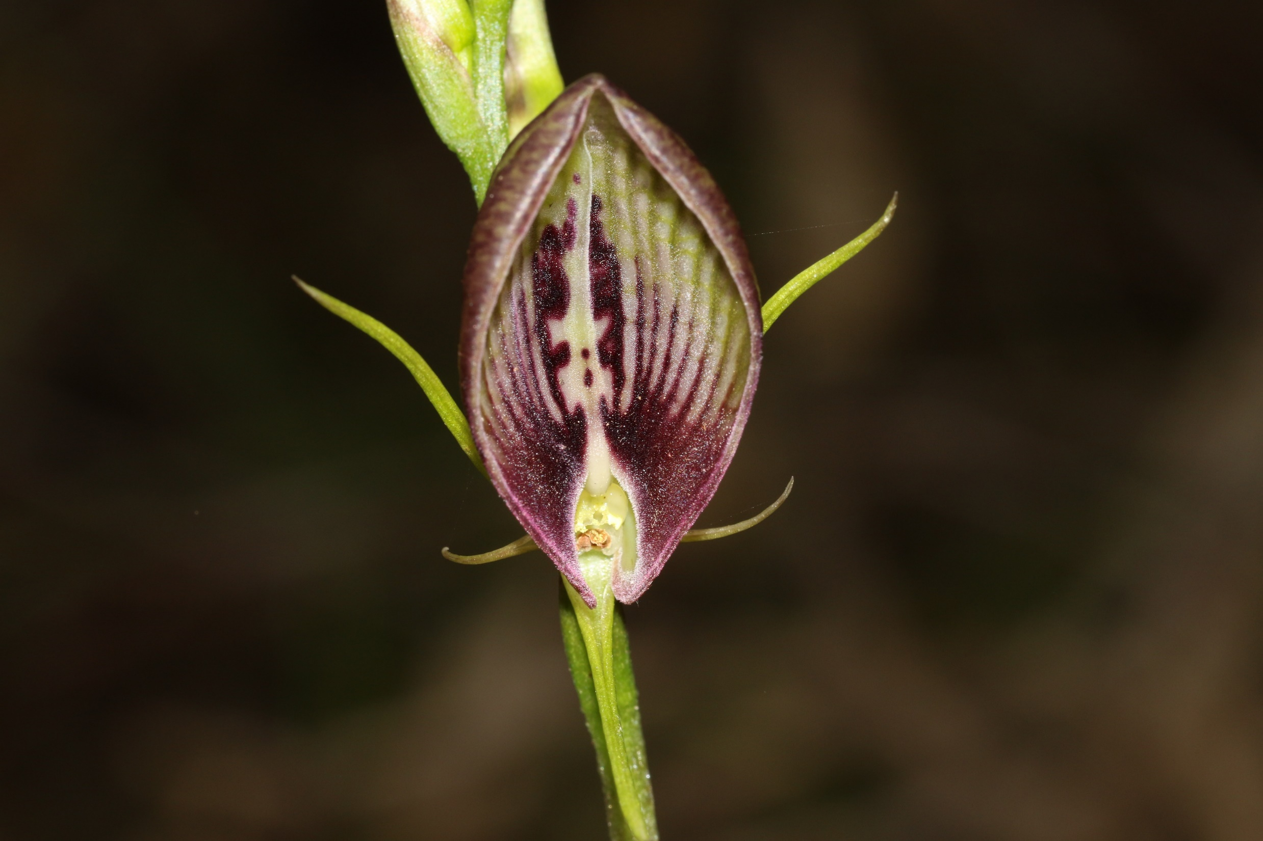
Cryptostylis erecta

Slide 70
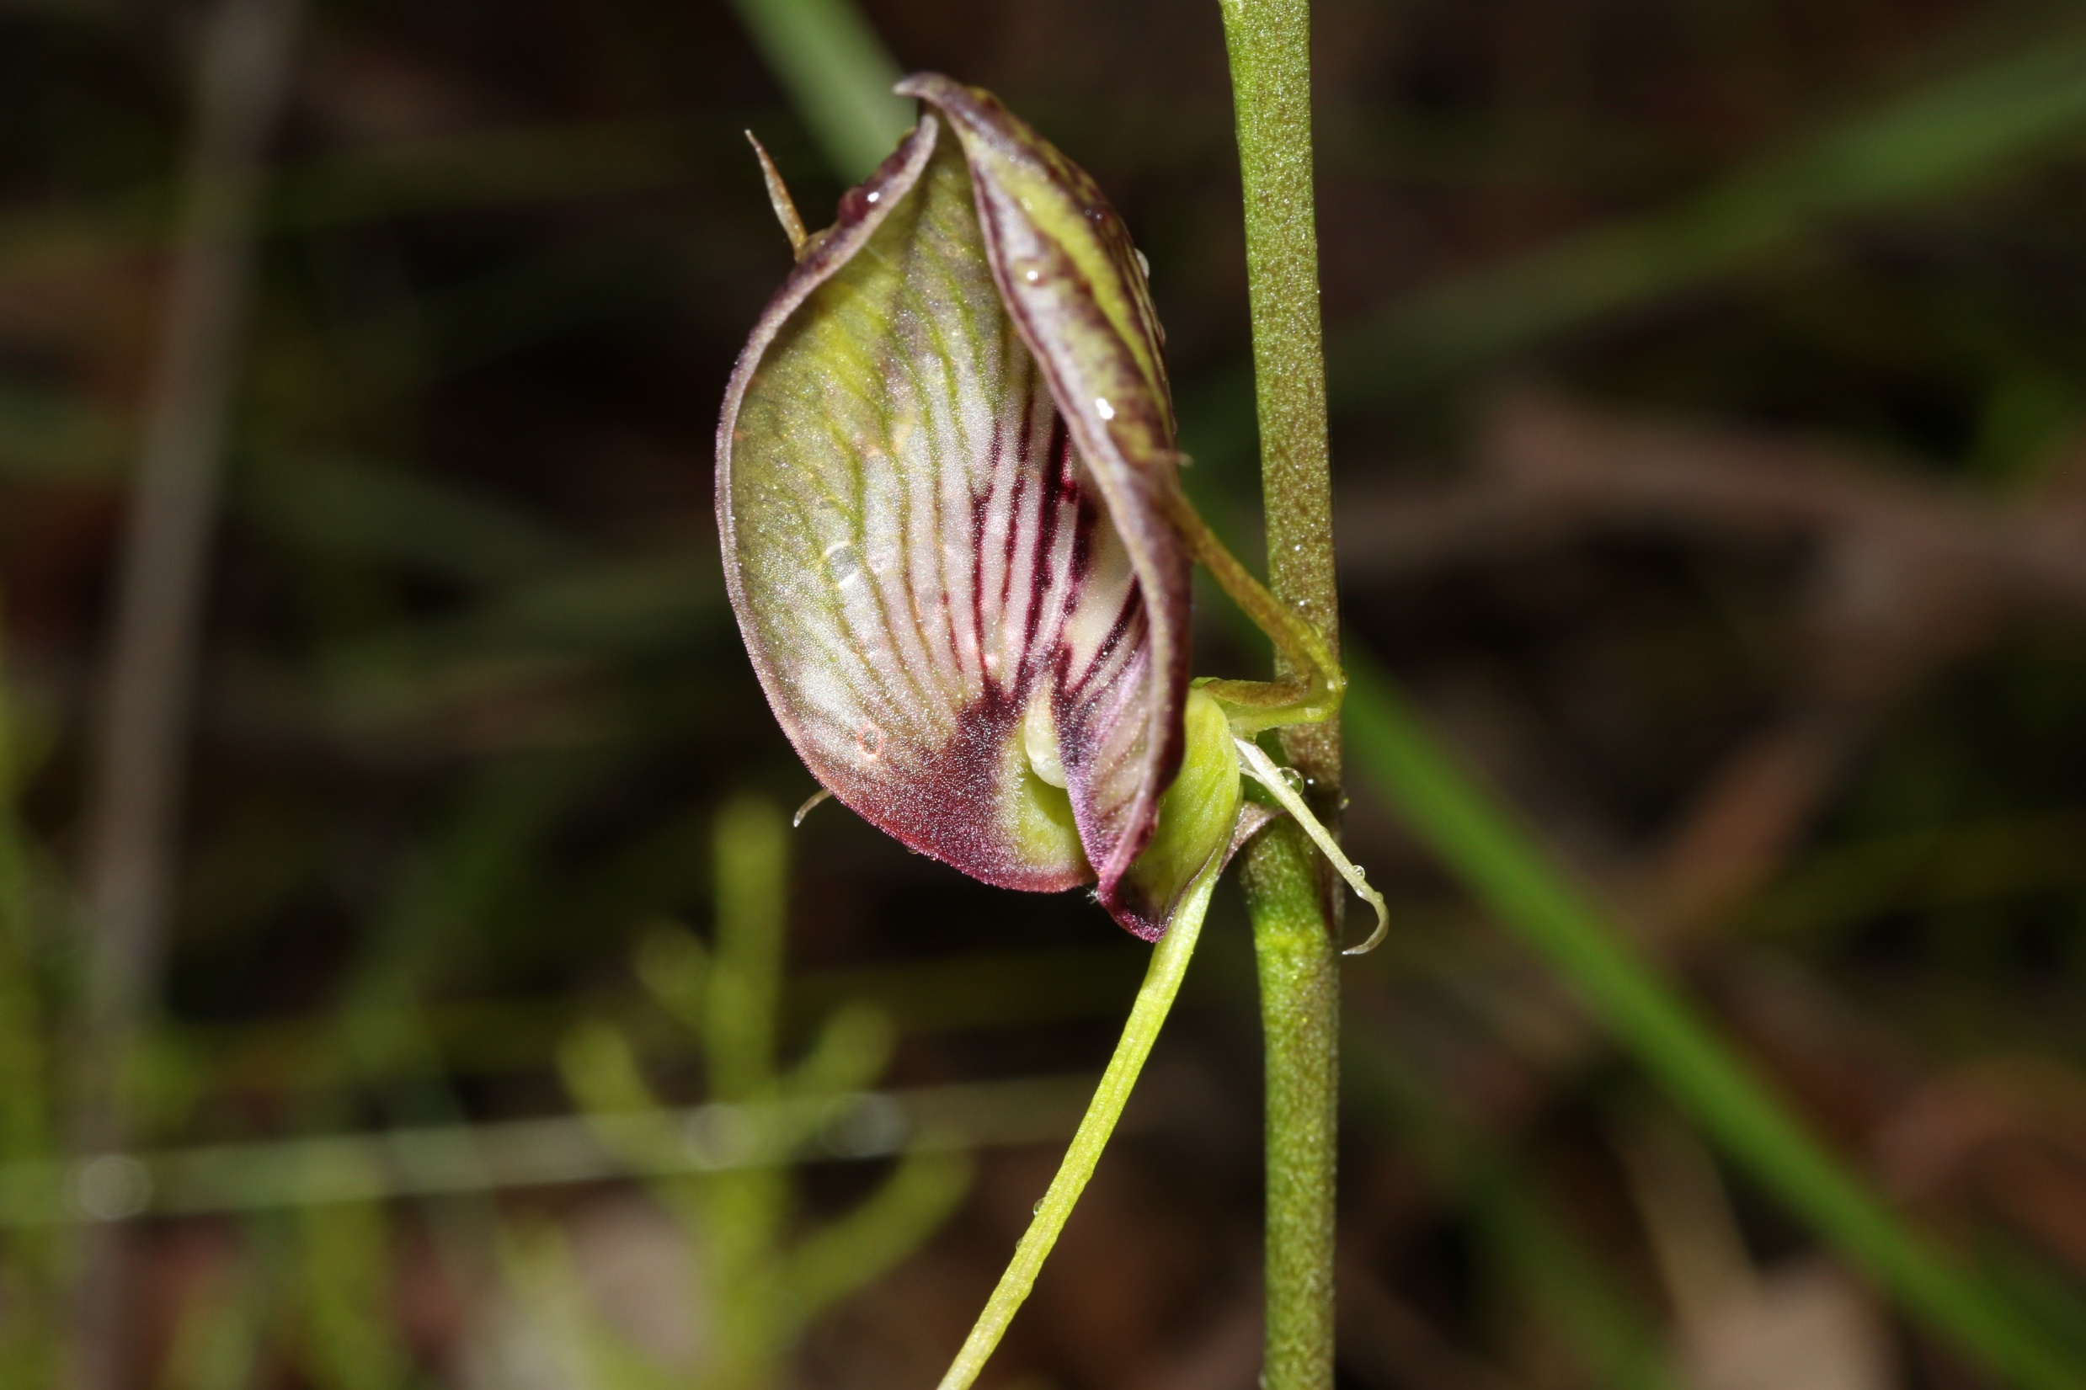

Slide 71
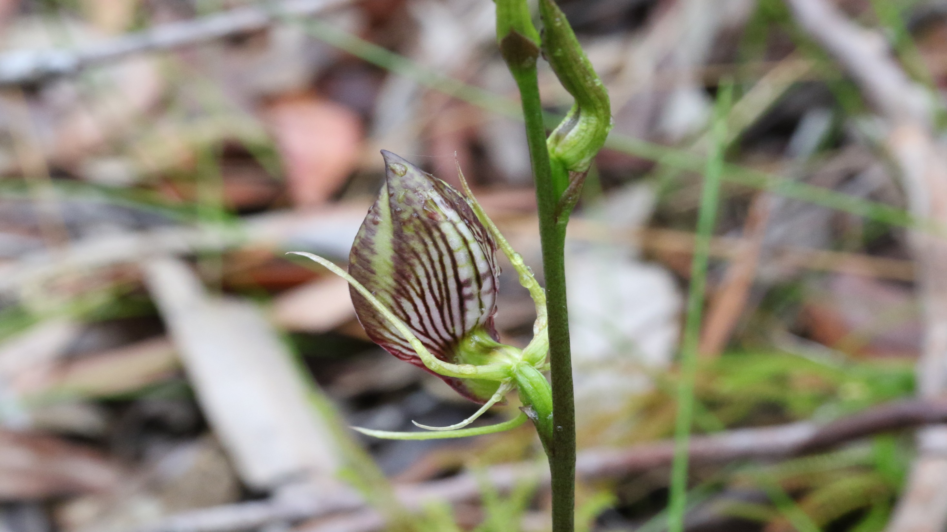

Slide 72
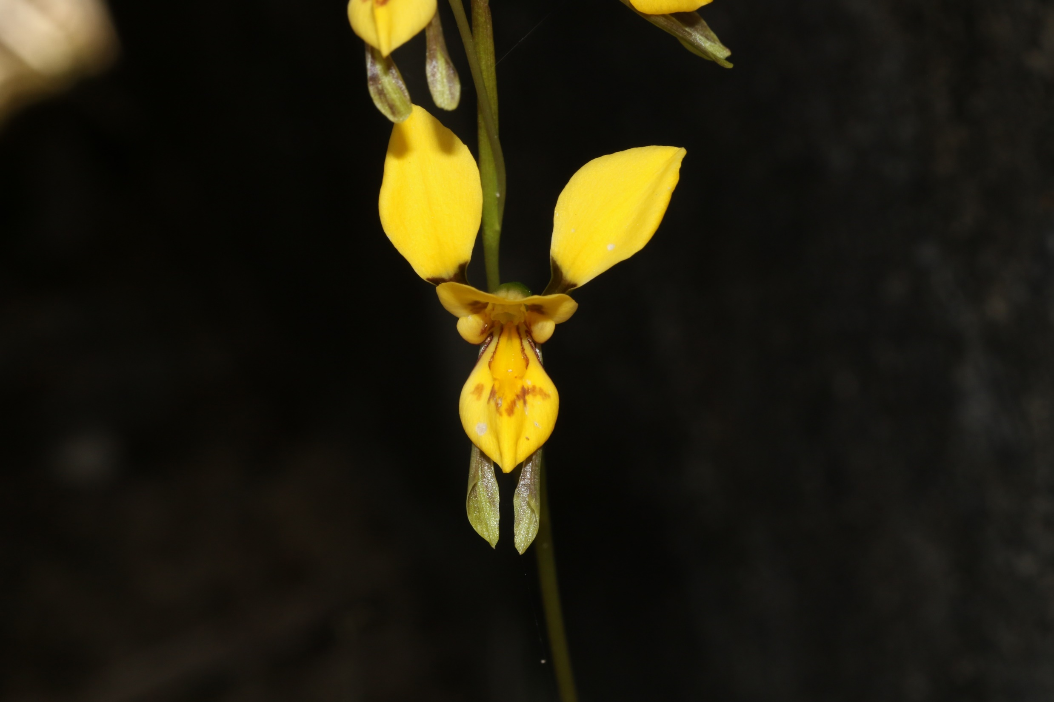

Slide 73
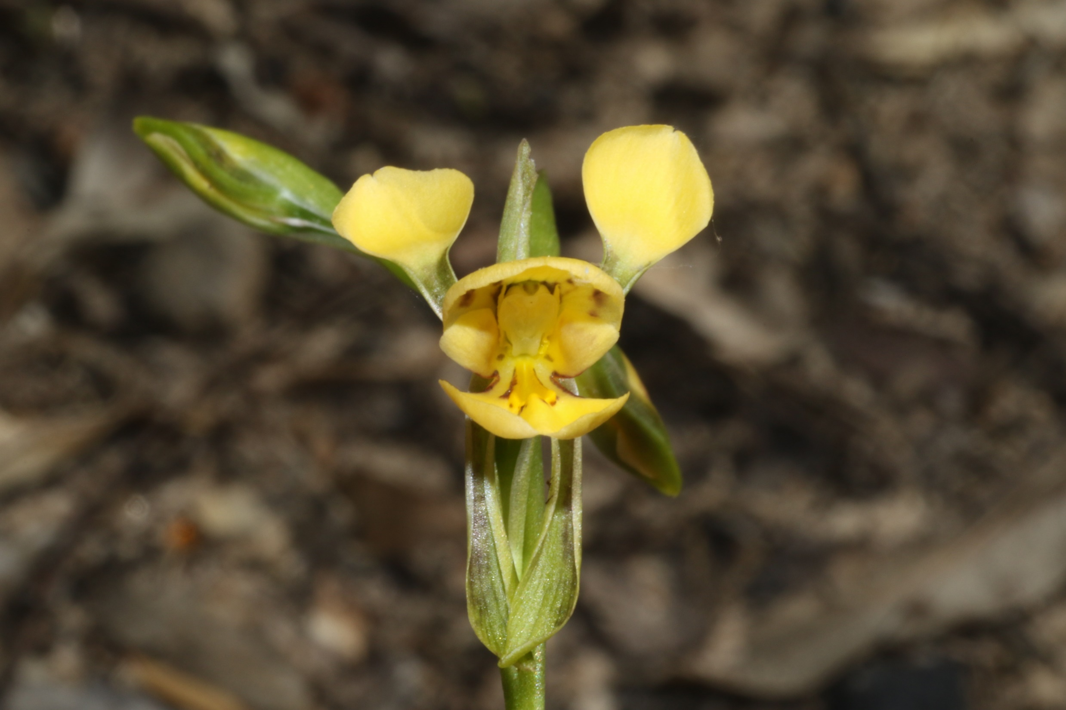
Diuris aurea
October 6th
Engadine

Slide 74
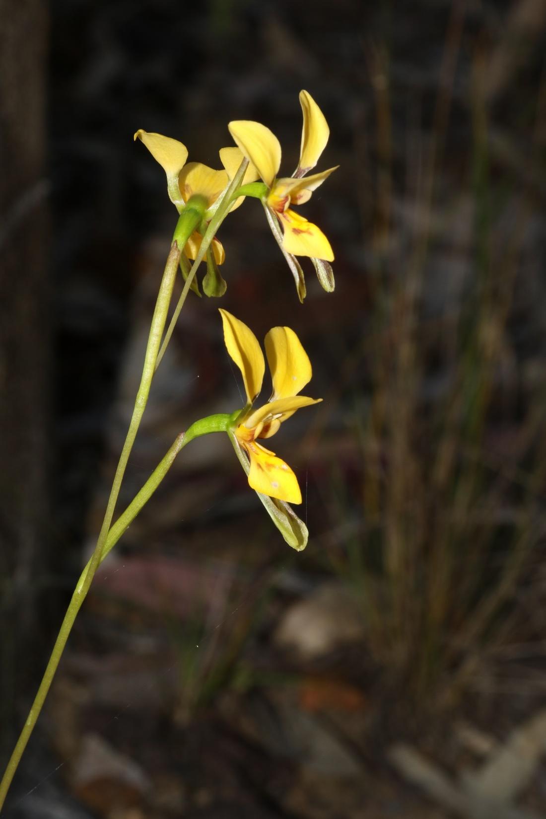

Slide 75
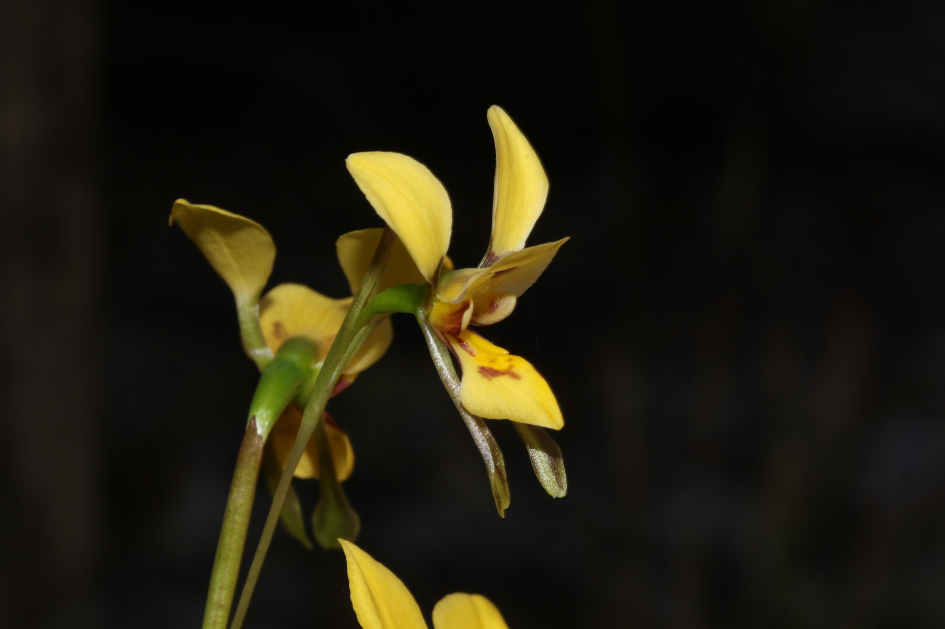

Slide 76

Microtis parviflora
Onion Orchid
October 6th
Engadine

Slide 77


Slide 78

Dockrillia linguiformis
Engadine
October 6

Slide 79
Cryptostylis leptochila
Small Tongue Orchid
Coming in November

Slide 80
Cryptostylis subulata
Large Tongue Orchid
Another to come

Slide 81

Thanks for coming folks
And remember that even in Lock Down there are many, many beautiful things out there for us to enjoy.
For more slices shows and/or PDF reports on the magic of our natural world go to:
https://wordpress.com/home/ournaturalworldsite.wordpress.com
Brian Everingham

