Slide 1
Curra Moors
A virtual walk

Slide 2
A 9km loop walk in Royal National Park
begins about 1km north of the turn-off to Garie on the Sir Bertram Stevens Drive
Includes a section of forest that can be wet and boggy after rain
Includes delightful heath and coastal cliffs and waterfalls
And a photographer's delight
Track notes can be accessed at https://www.wildwalks.com/wildwalks_custom/walk_pdfs/saved/Curra%20Moors%20Loop%20(nsw-royalnp-cml).pdf

Slide 3
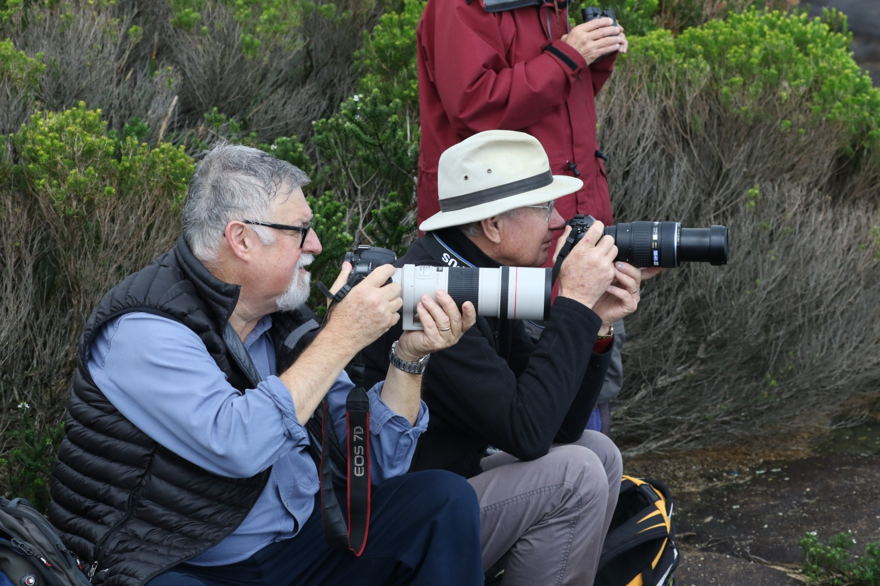
Keenly awaiting

Slide 4
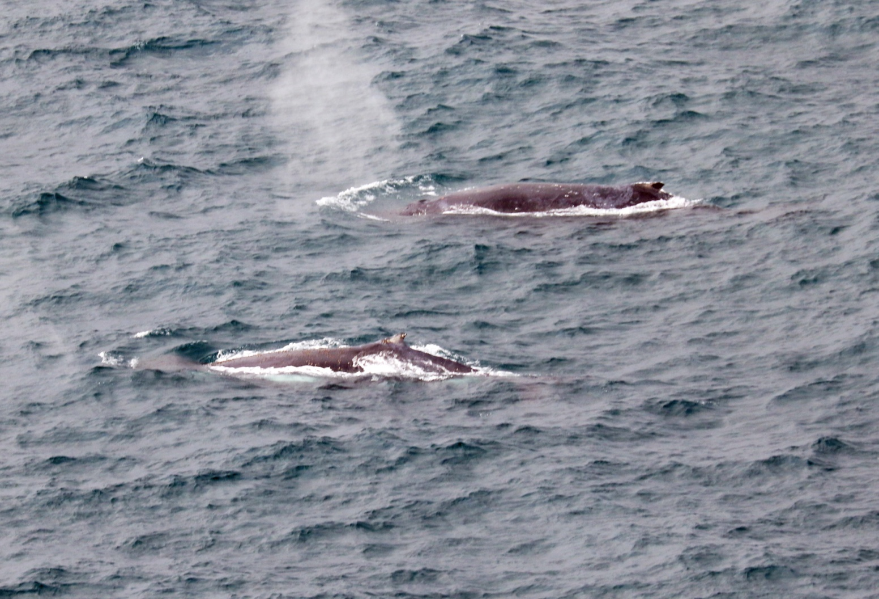
Perhaps the migration of the humpback whales

Slide 5
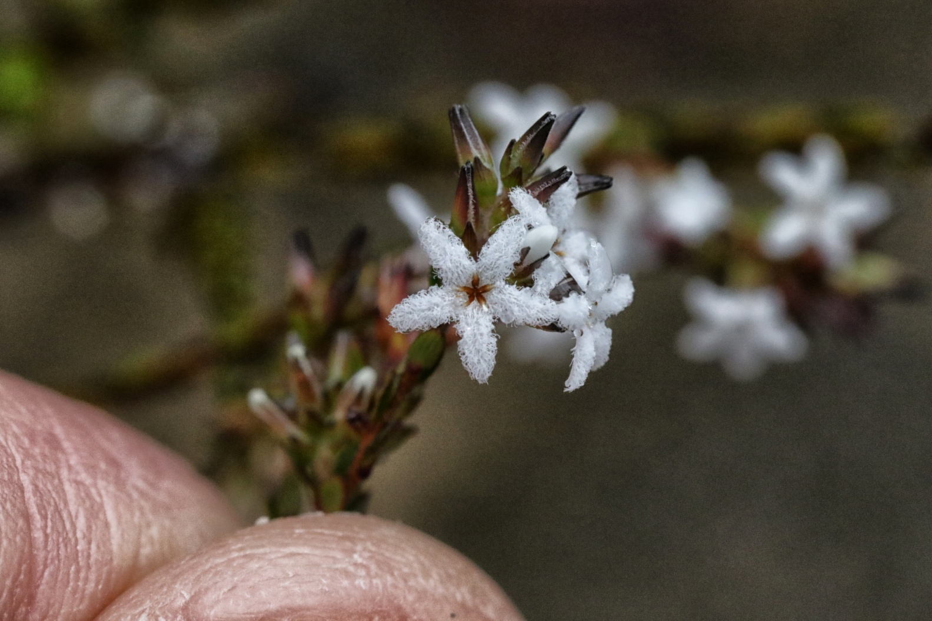
Equally loved for its wildflowers

Slide 6
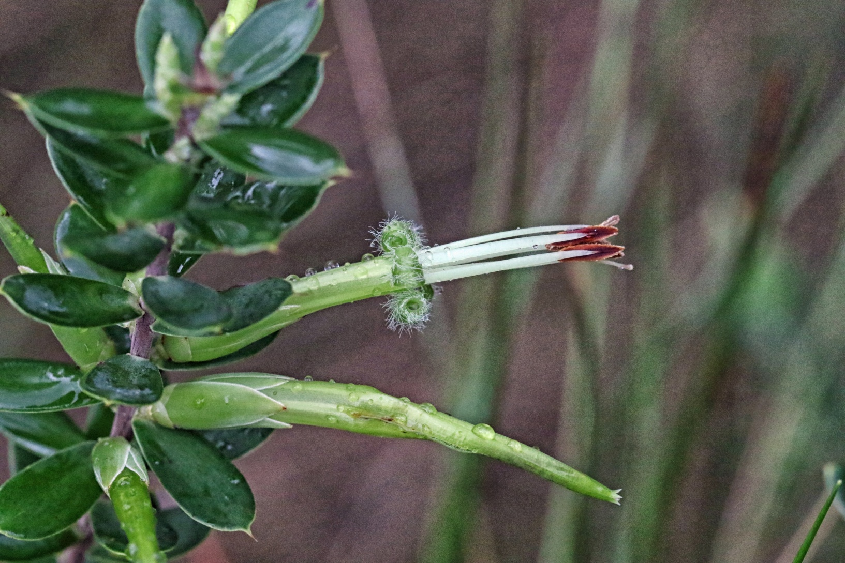
Styphelia viridis

Slide 7
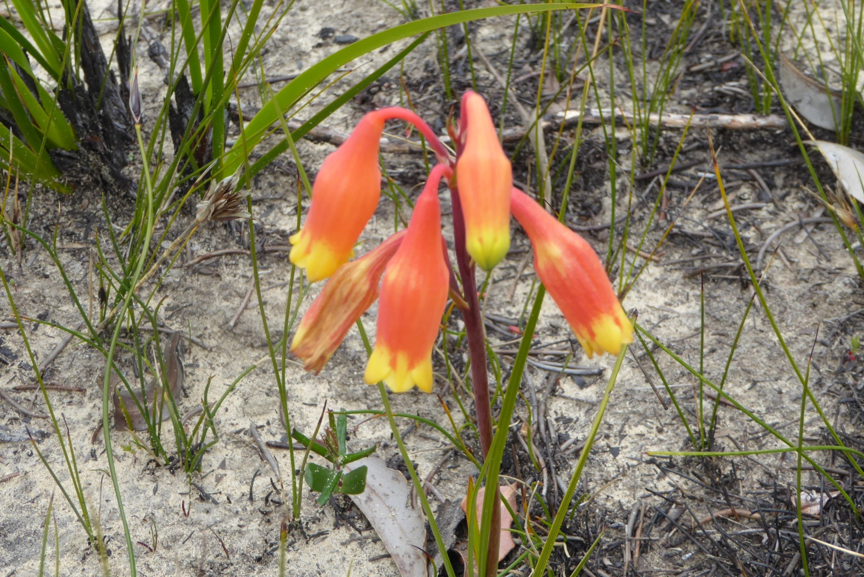
Blandfordia nobilis

Slide 8
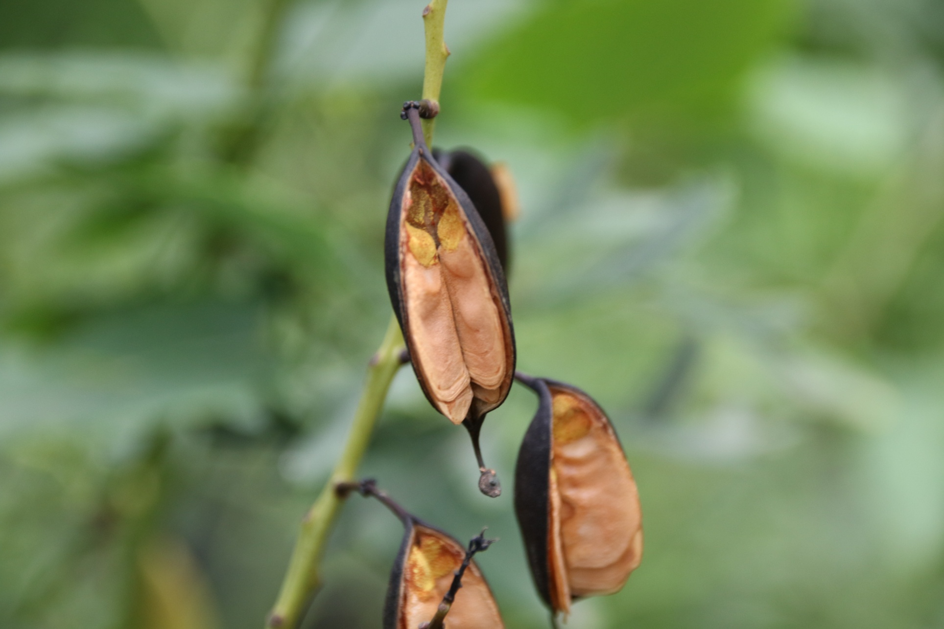

Slide 9
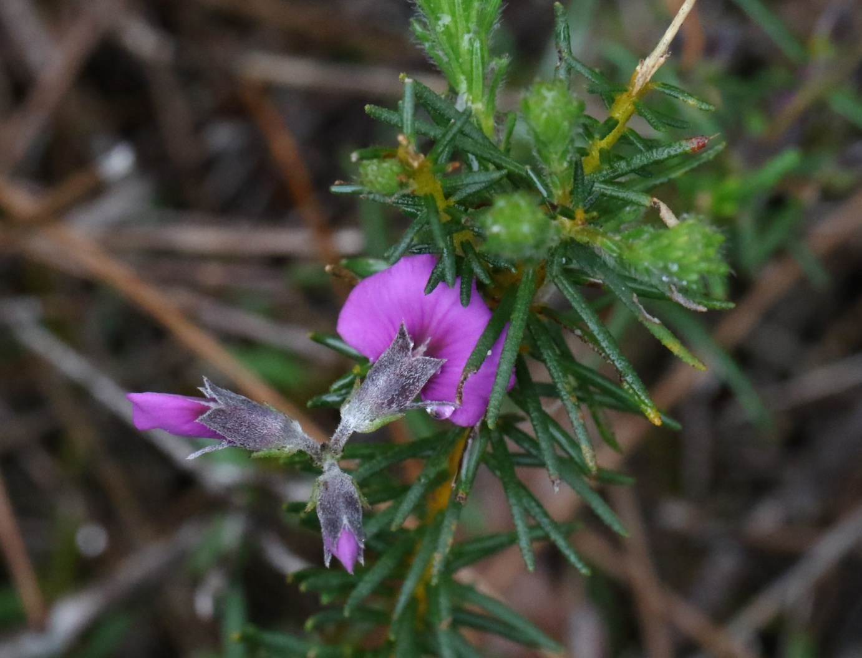
Mirbelia species

Slide 10
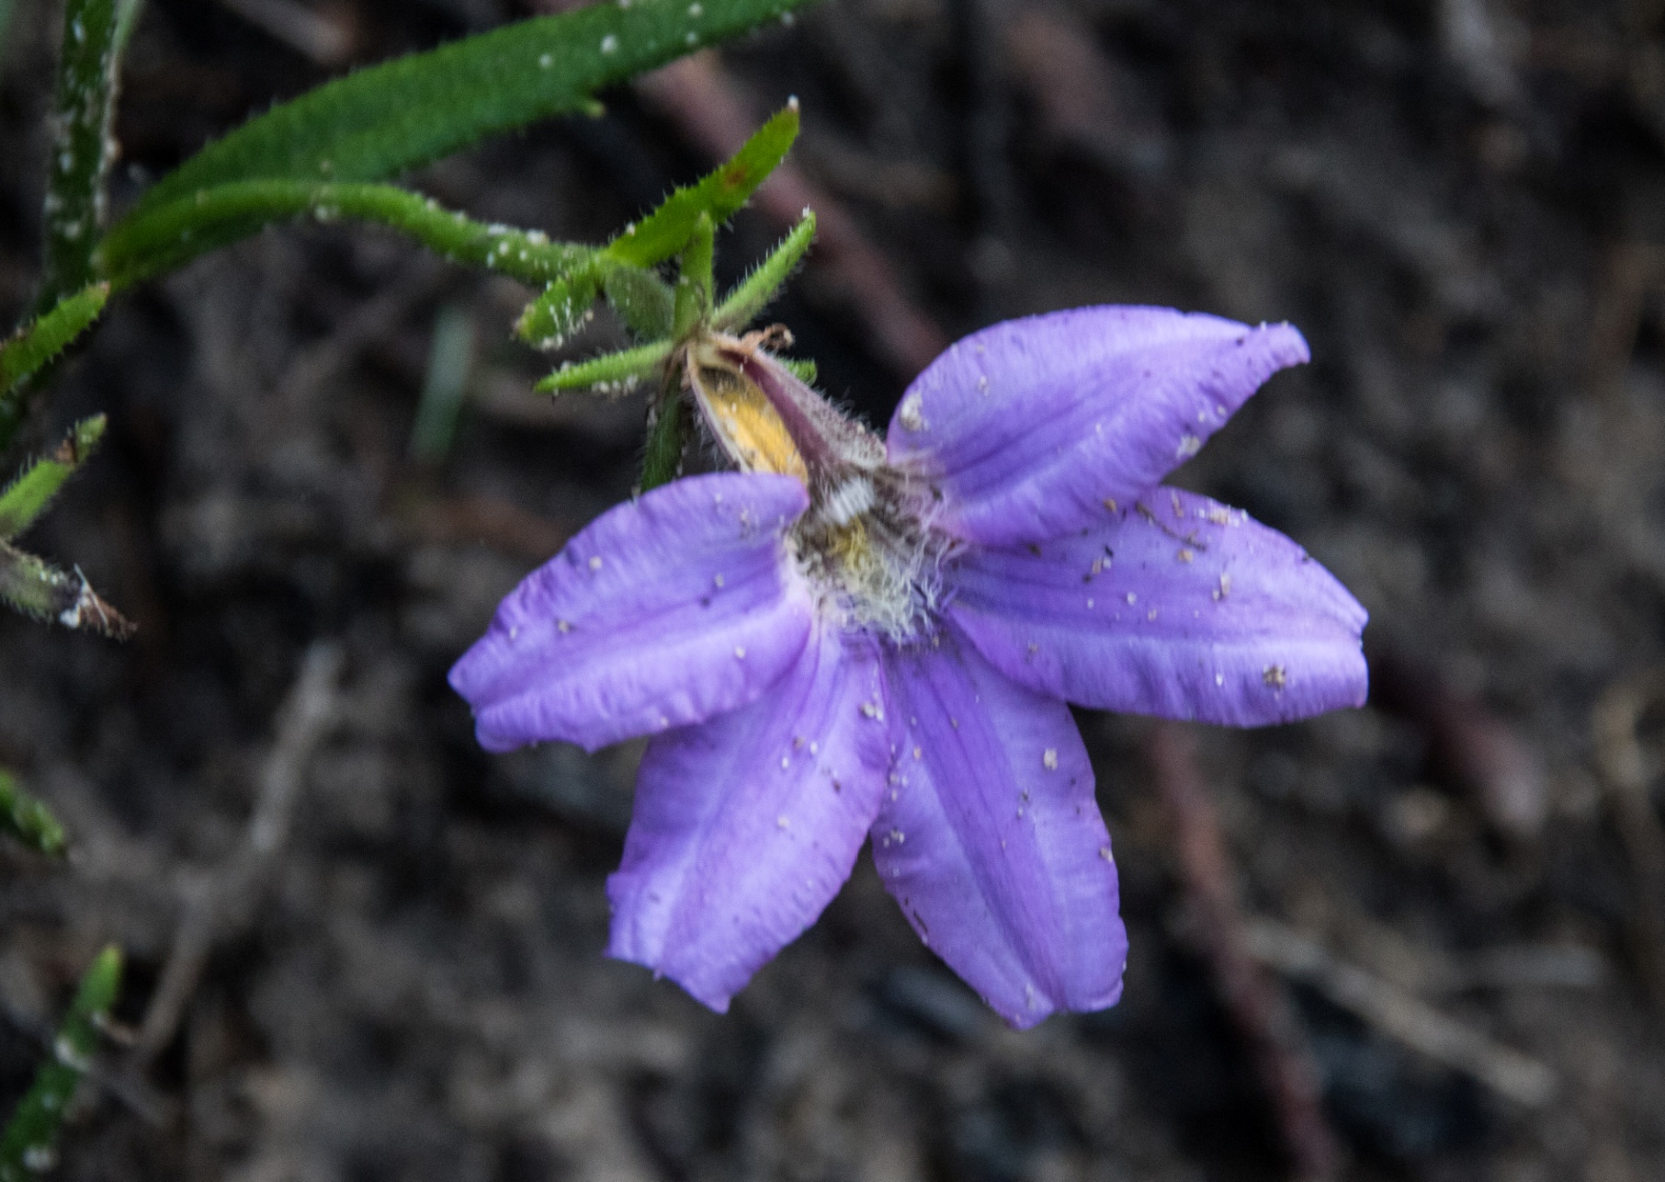

Slide 11
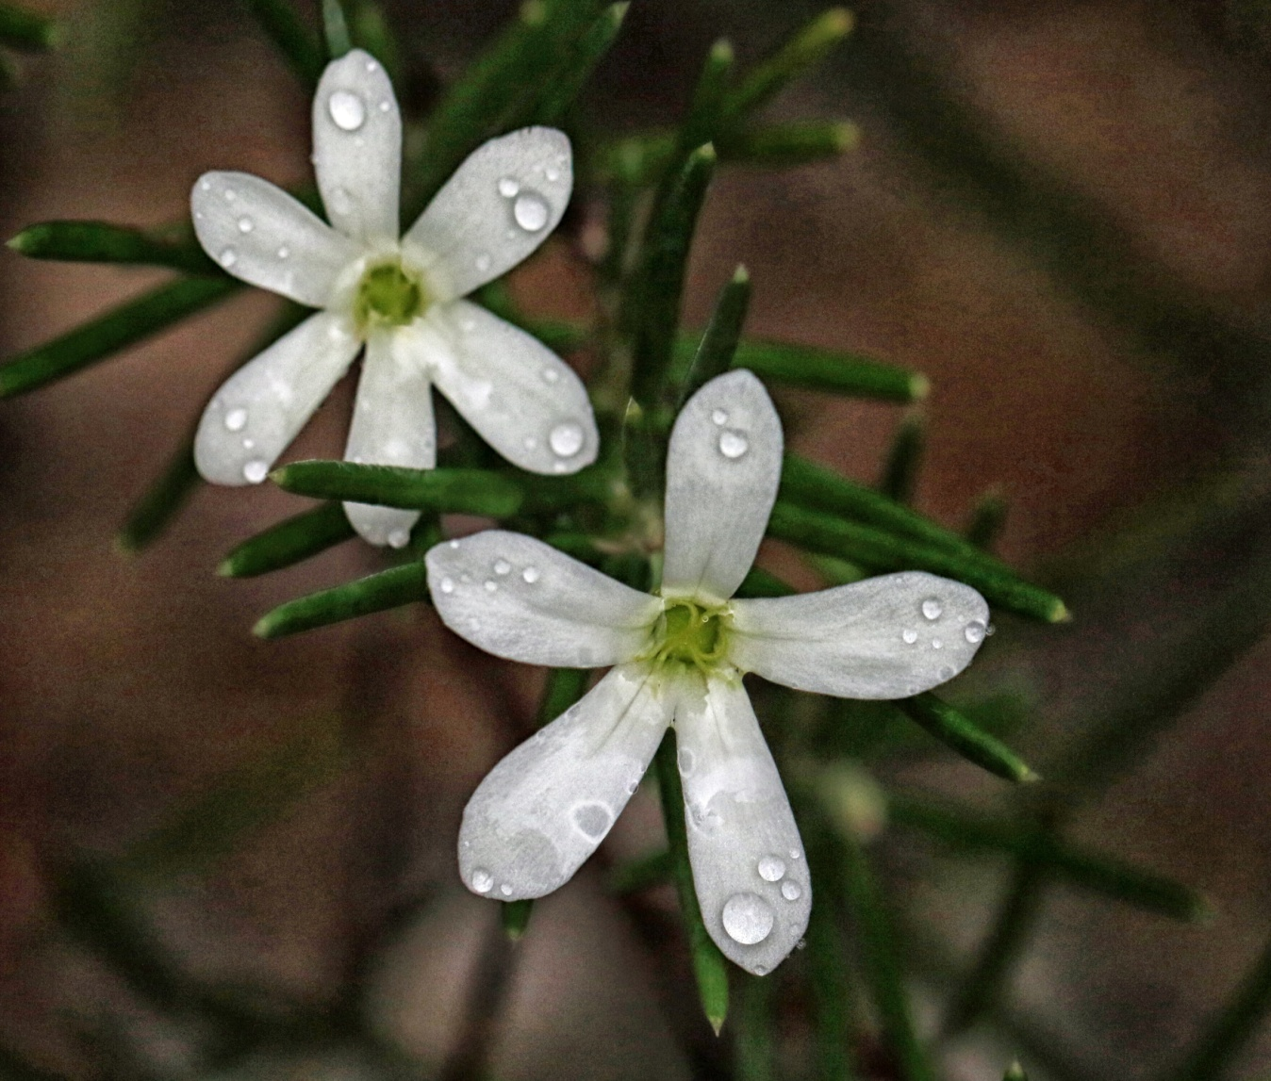
Wedding Bush – Ricinocarpos pinofolius

Slide 12
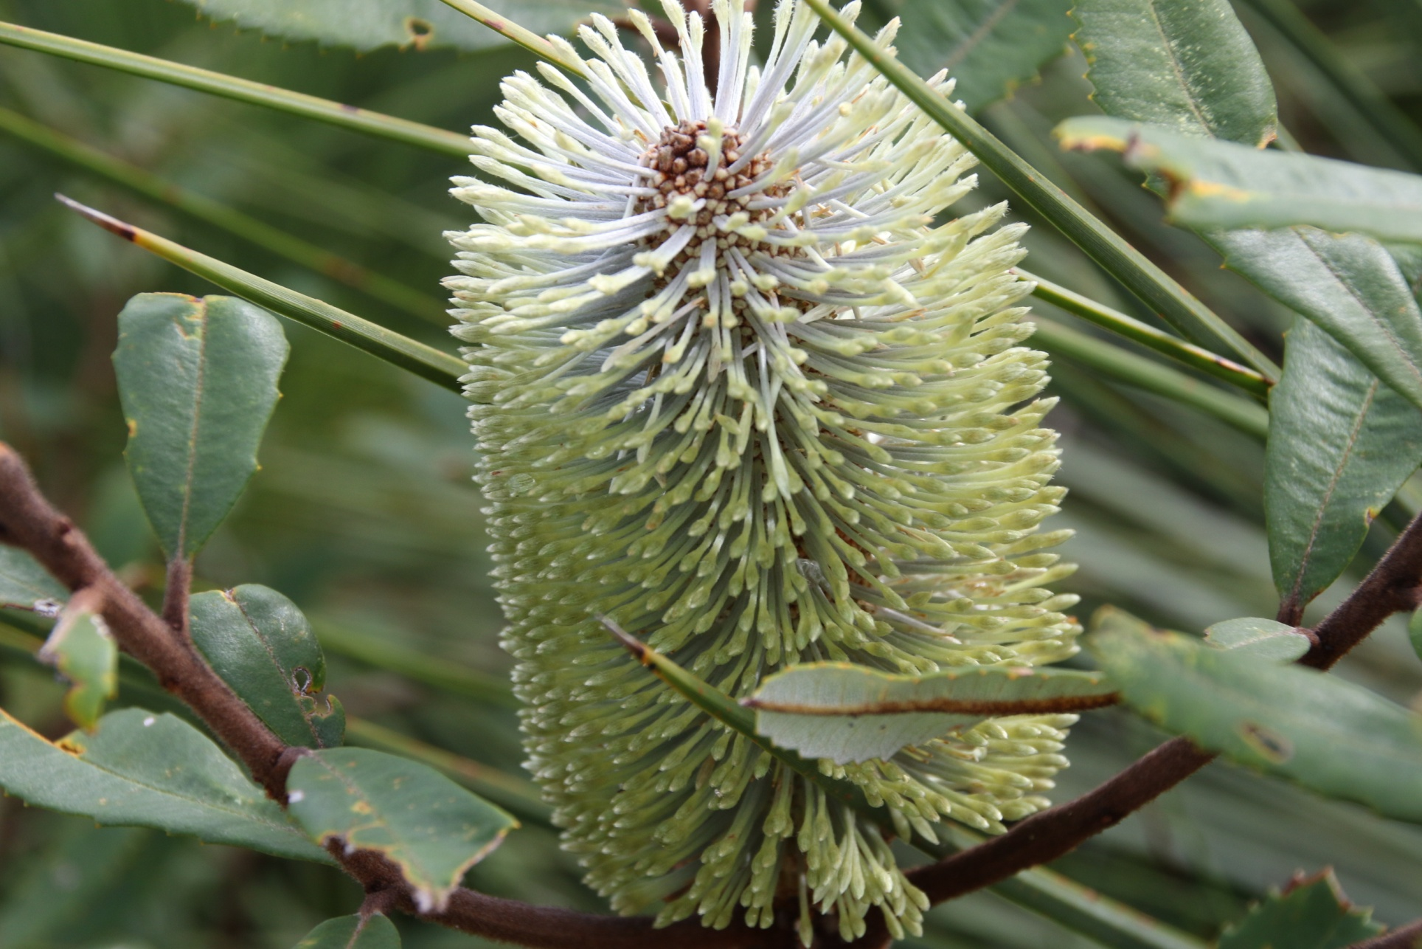

Slide 13
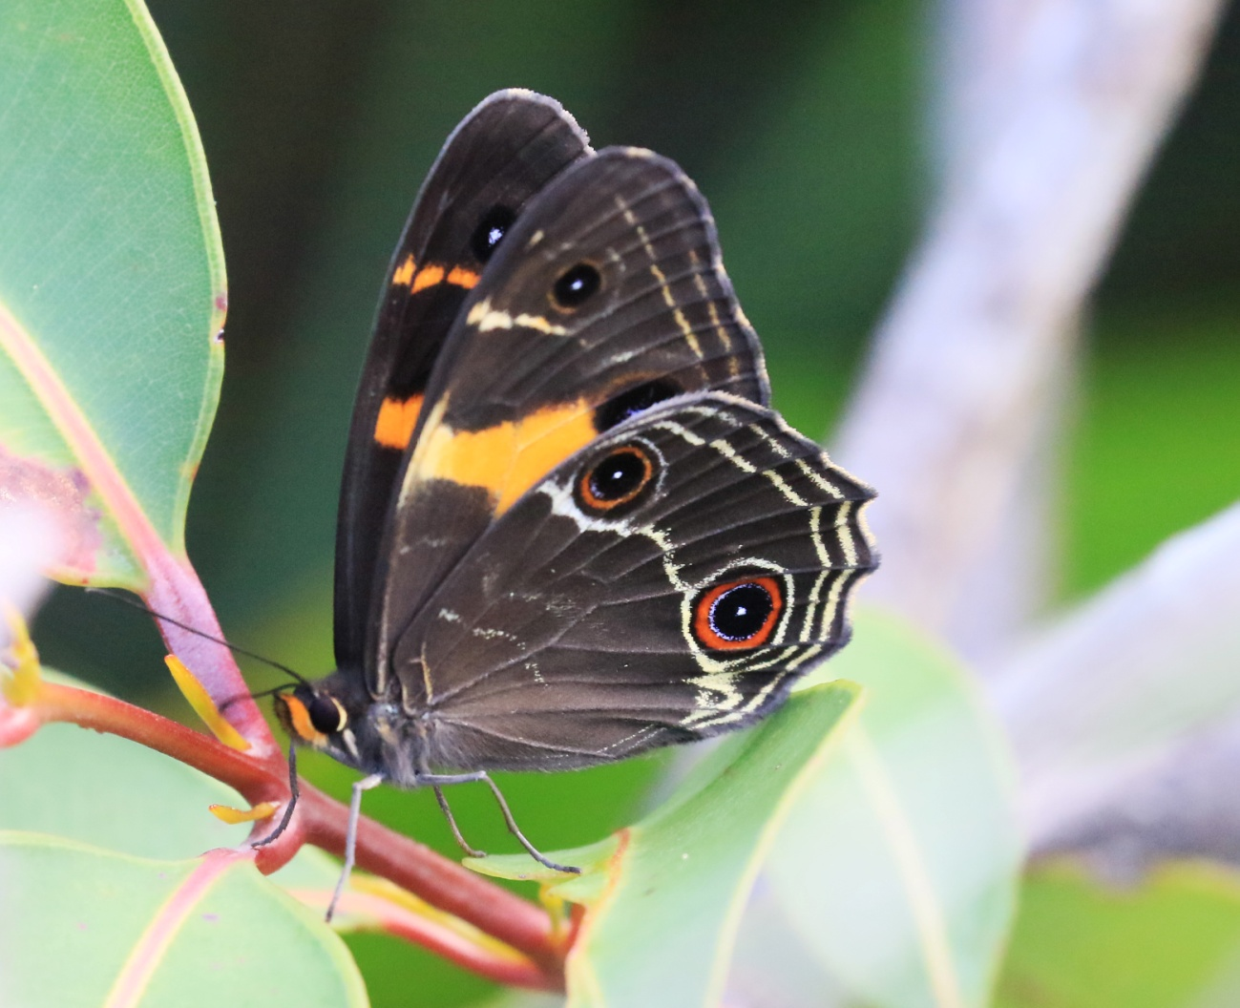
And for its butterflies- in this case the Variable Sword-grass Brown

Slide 14
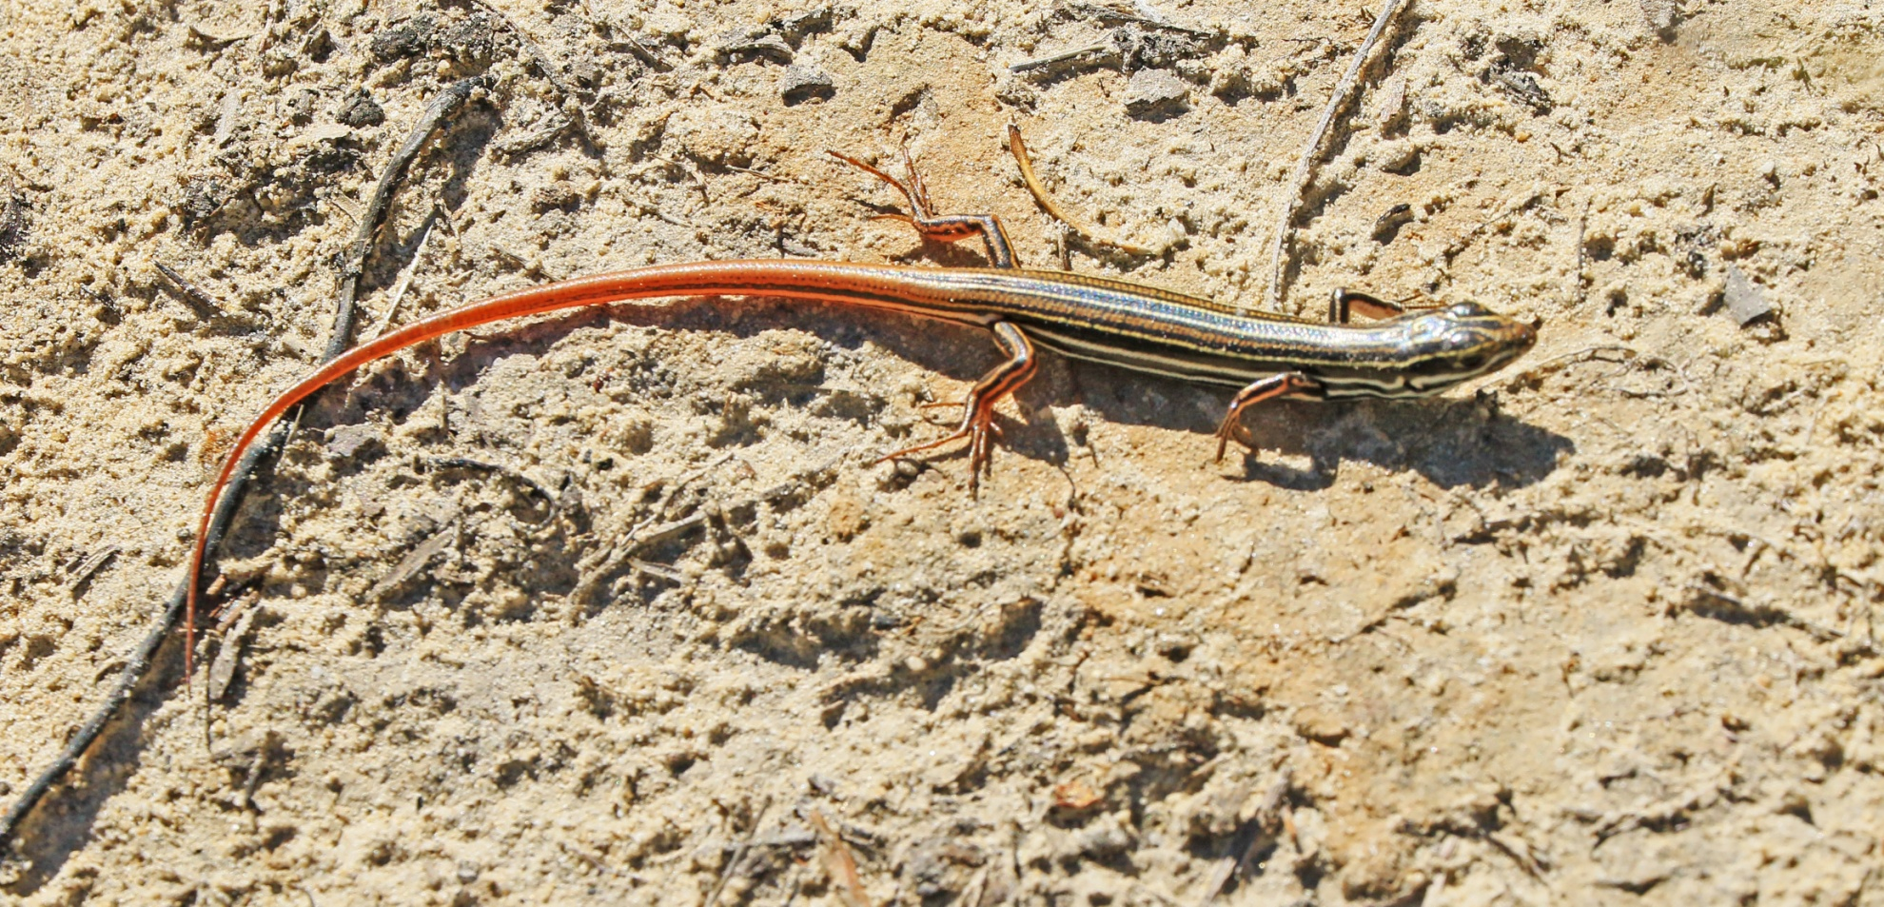
Or its reptiles – a Copper-tailed Skink

Slide 15
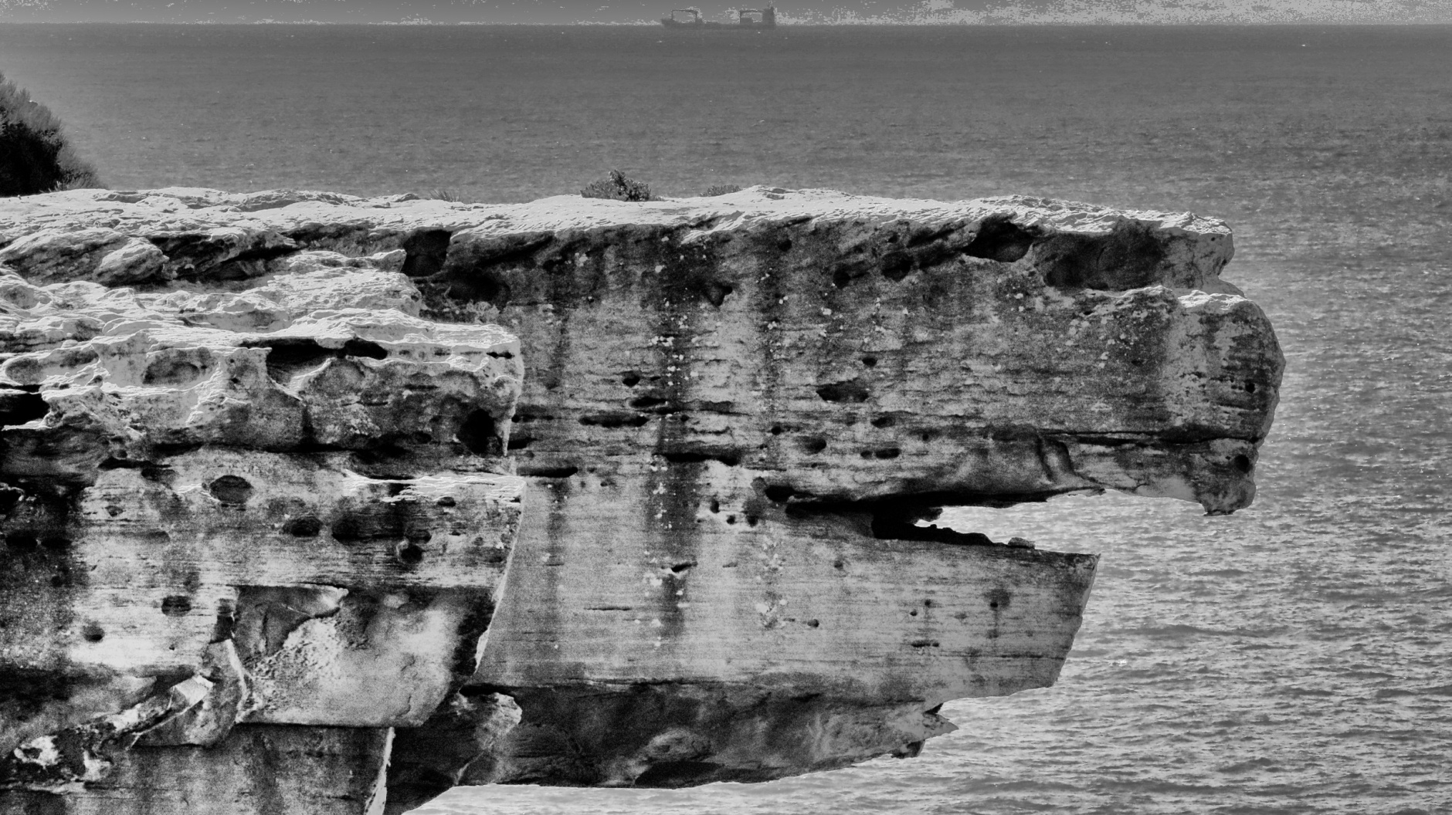
But some just revel in the scenery

Slide 16
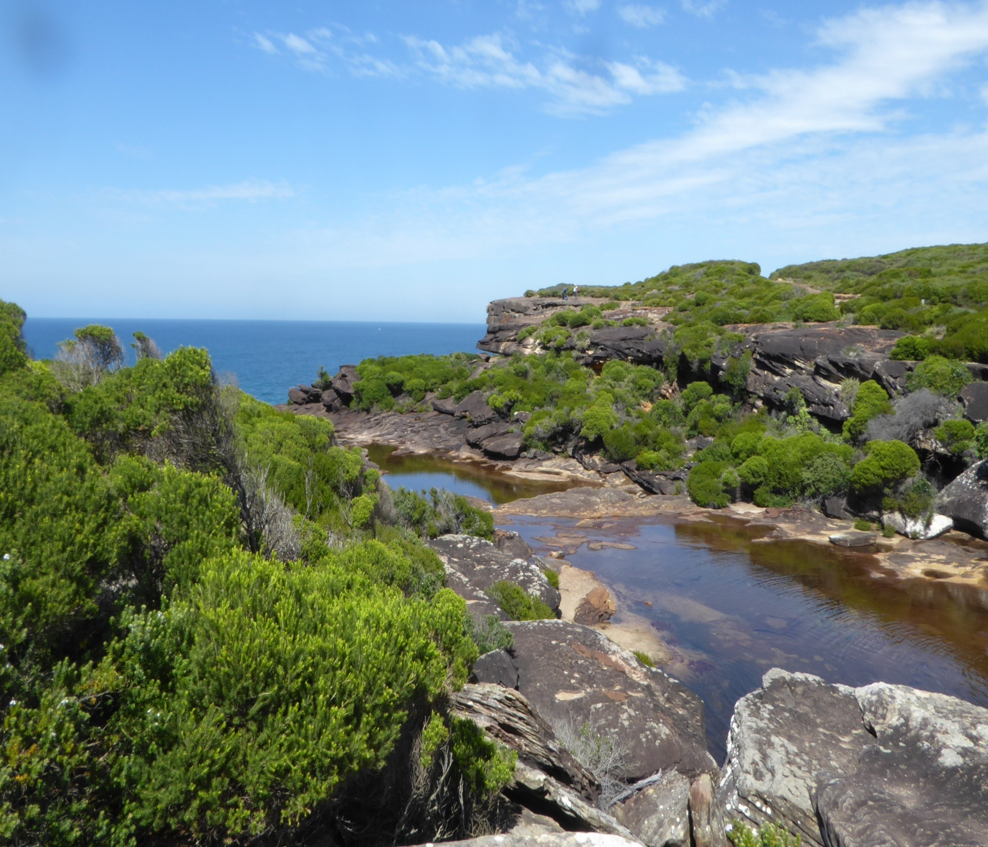

Slide 17
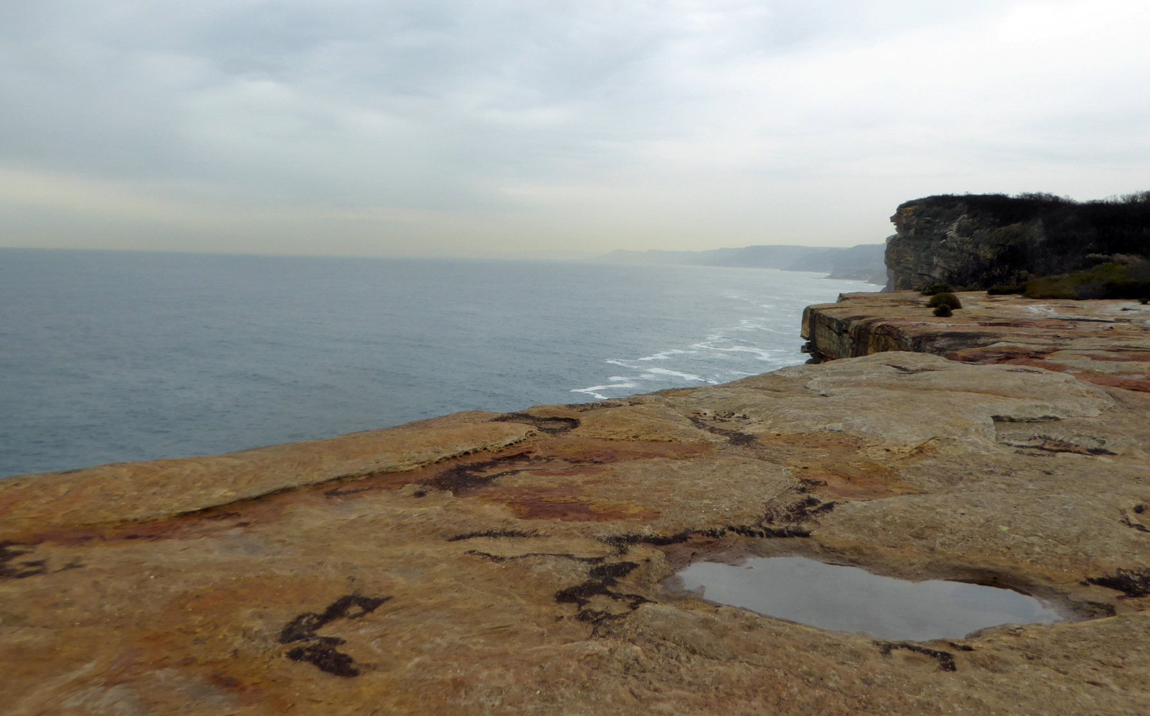

Slide 18

And the wild seas

Slide 19
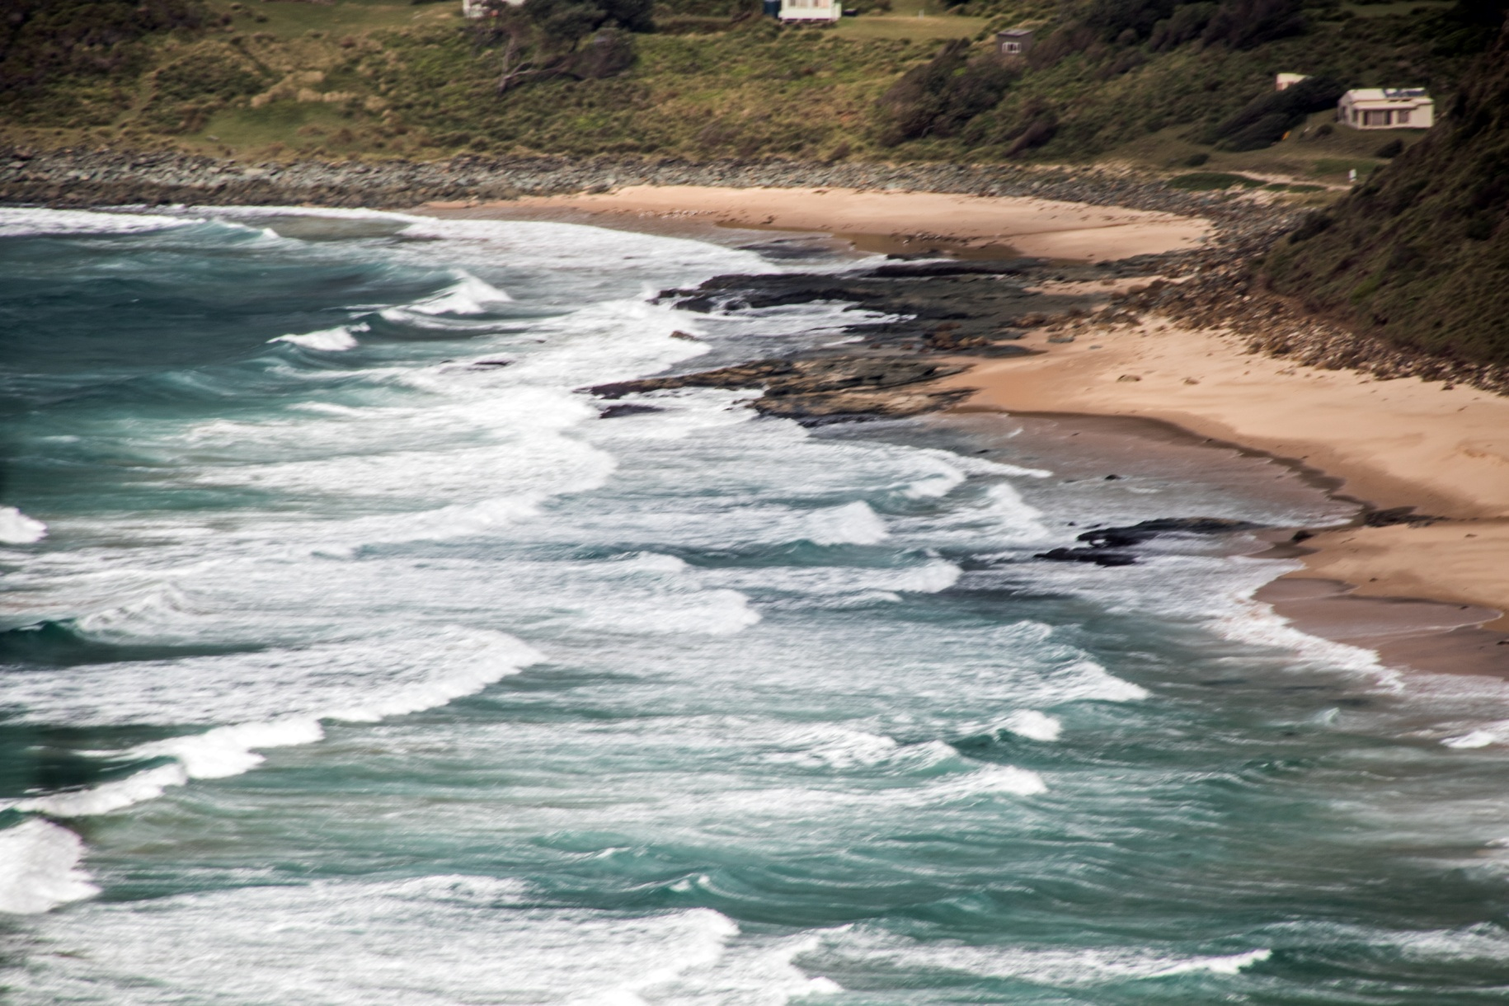

Slide 20
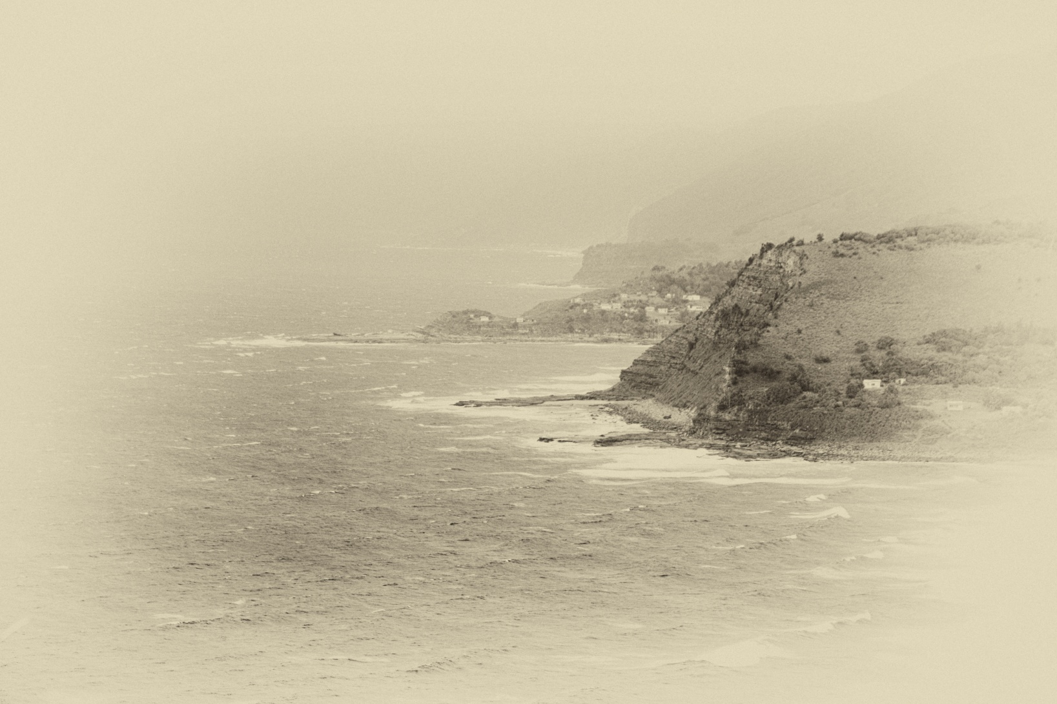

Slide 21
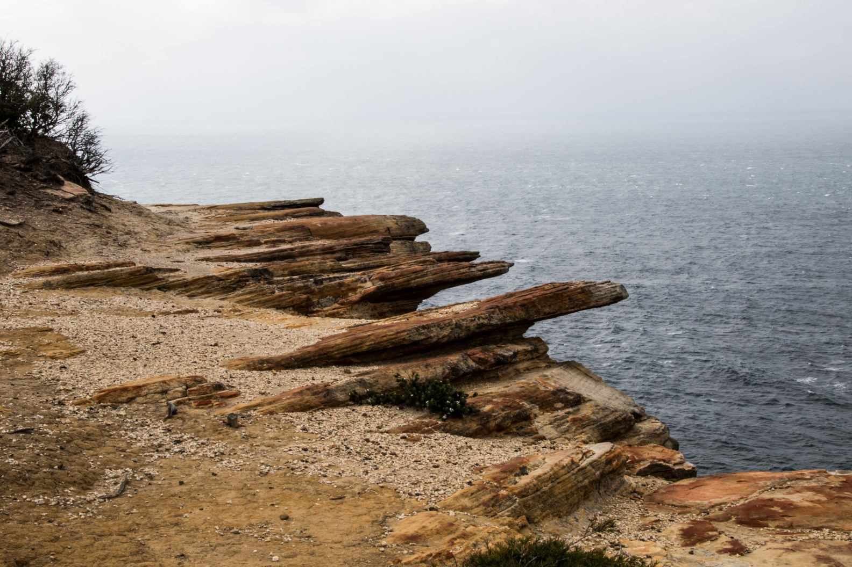
And some just enjoy being

Slide 22
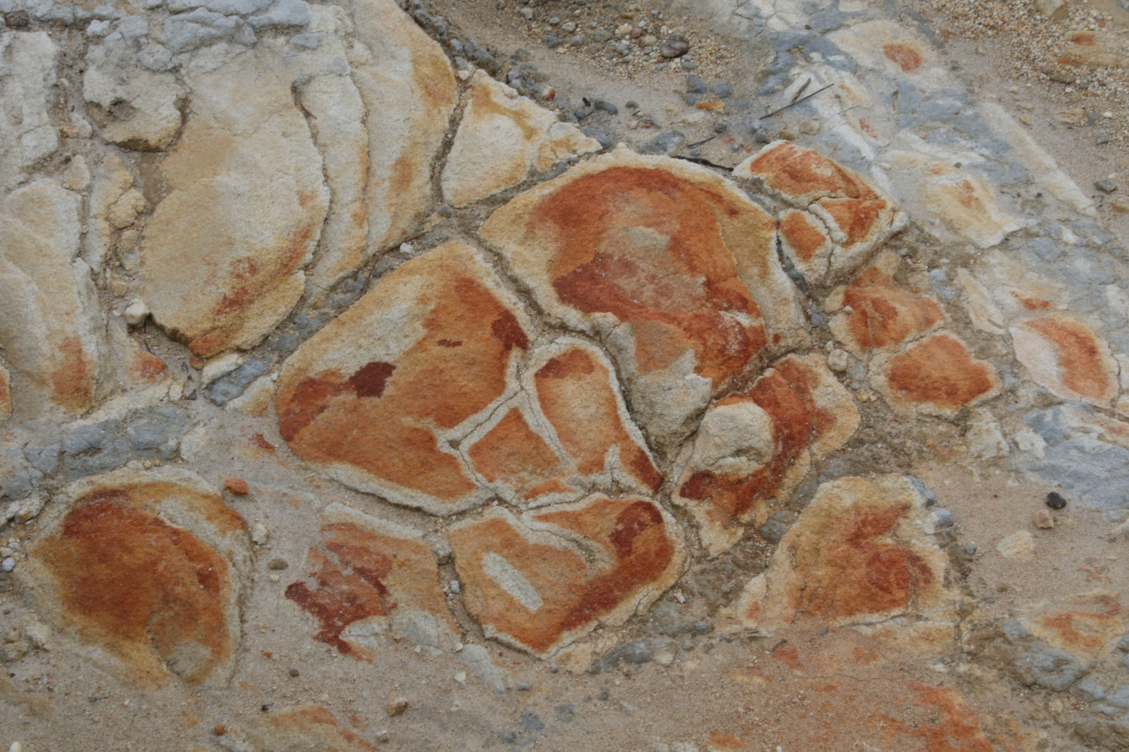
And the rock patterns

Slide 23
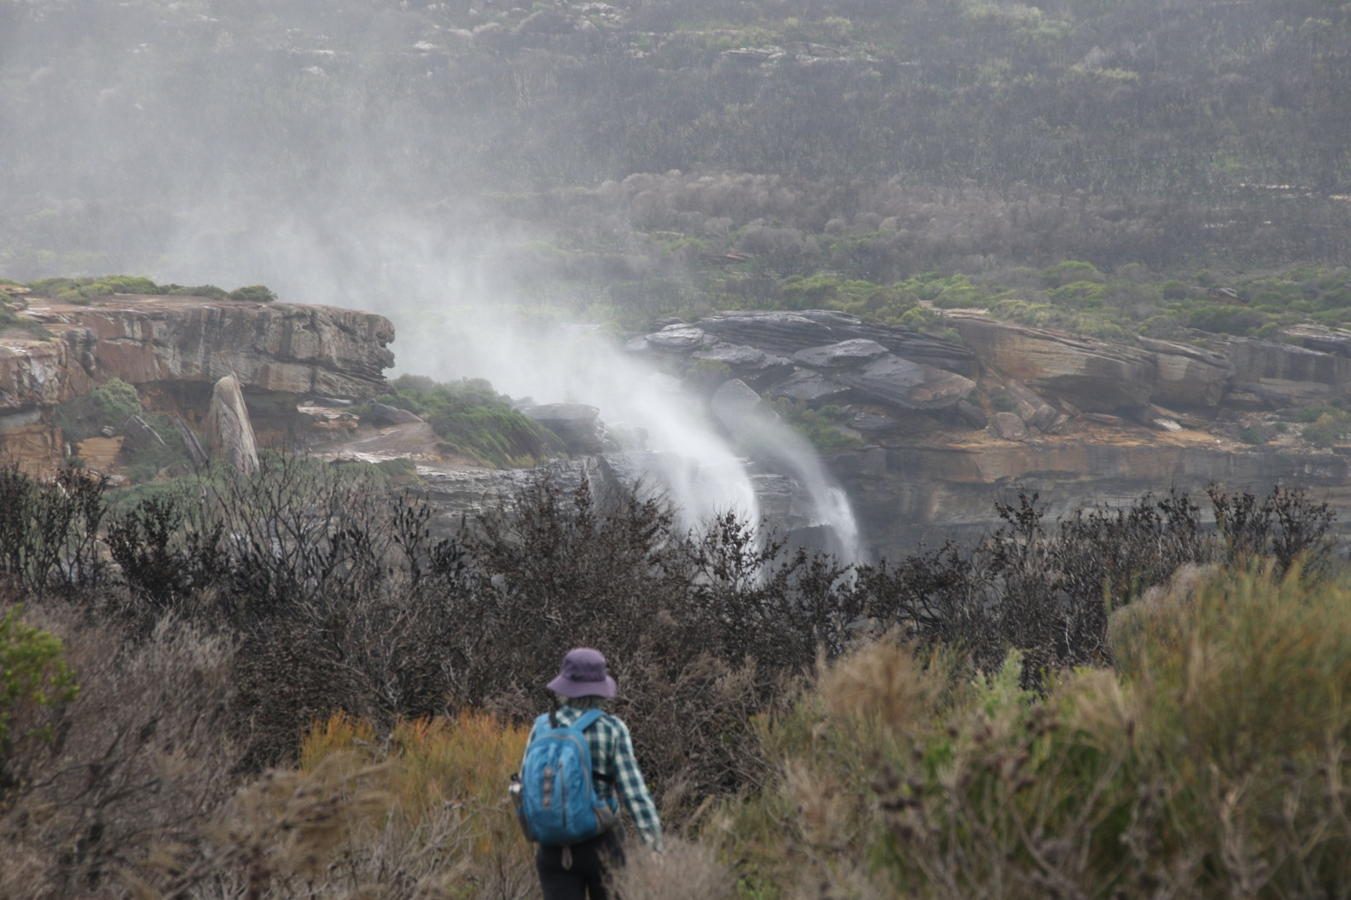
Wild windy weather has its charms

Slide 24
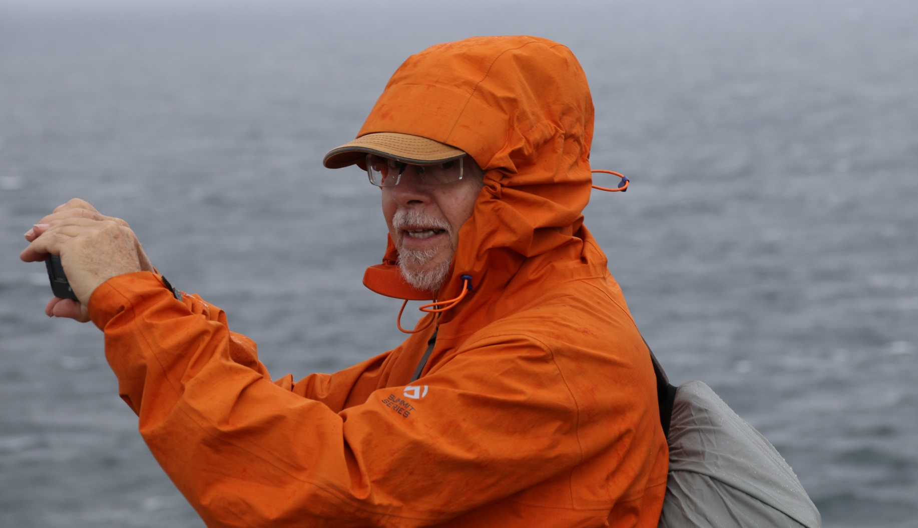
And who can blame him for being rugged up

Slide 25
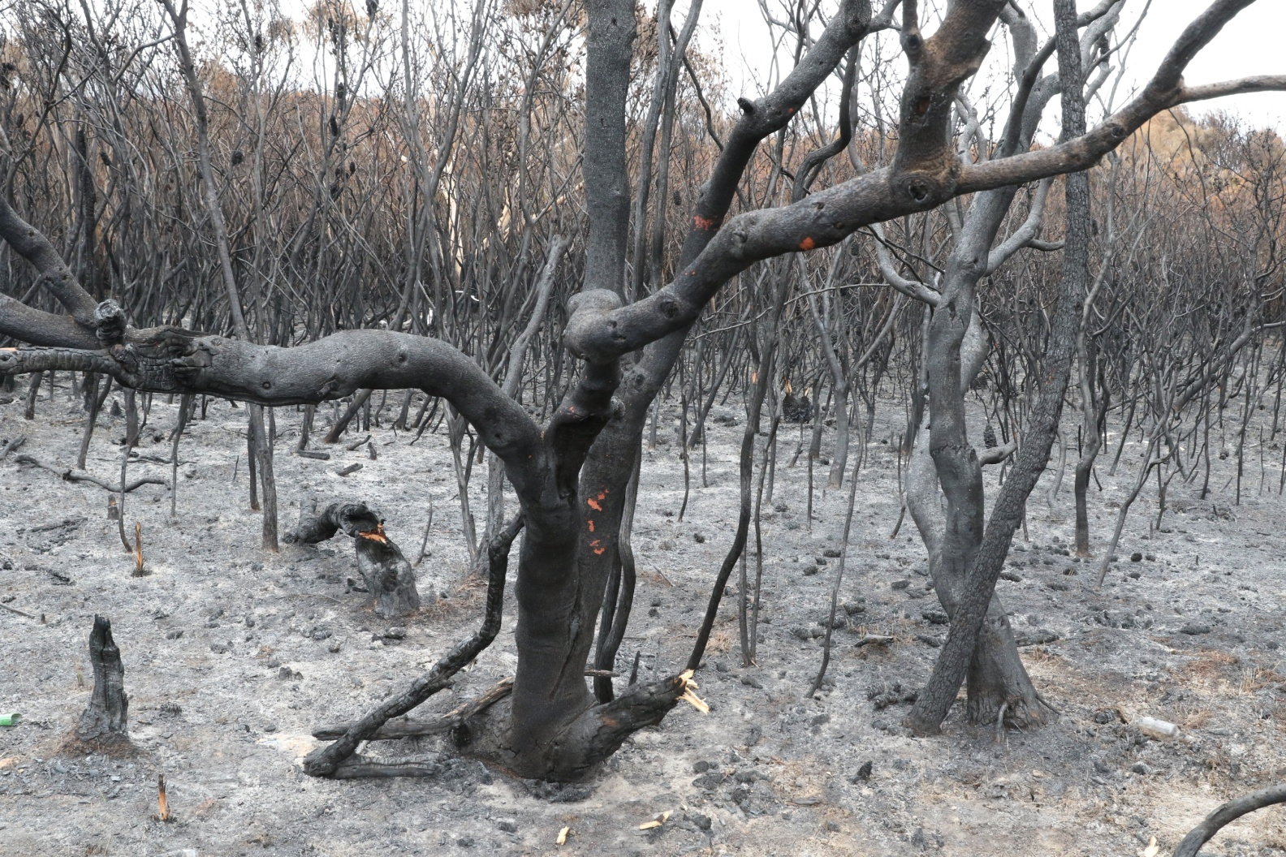
But do remember that in January 2018 there was a fire that swept through this landscape

Slide 26
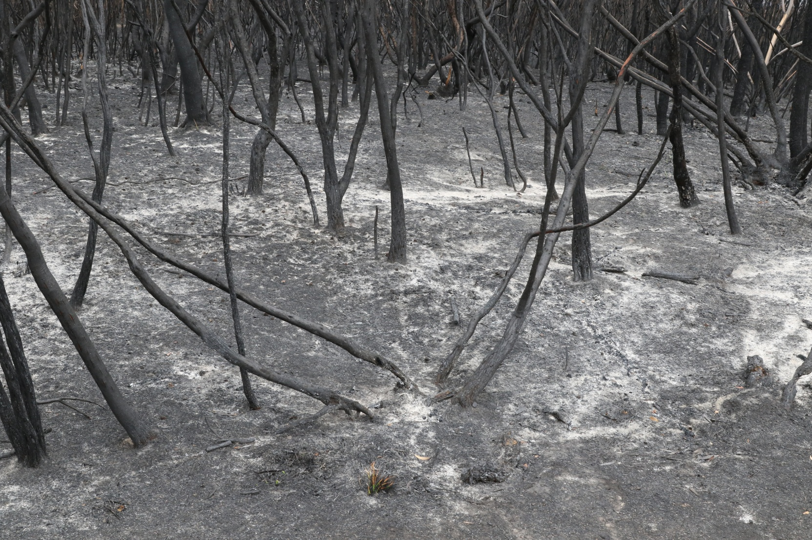

Slide 27
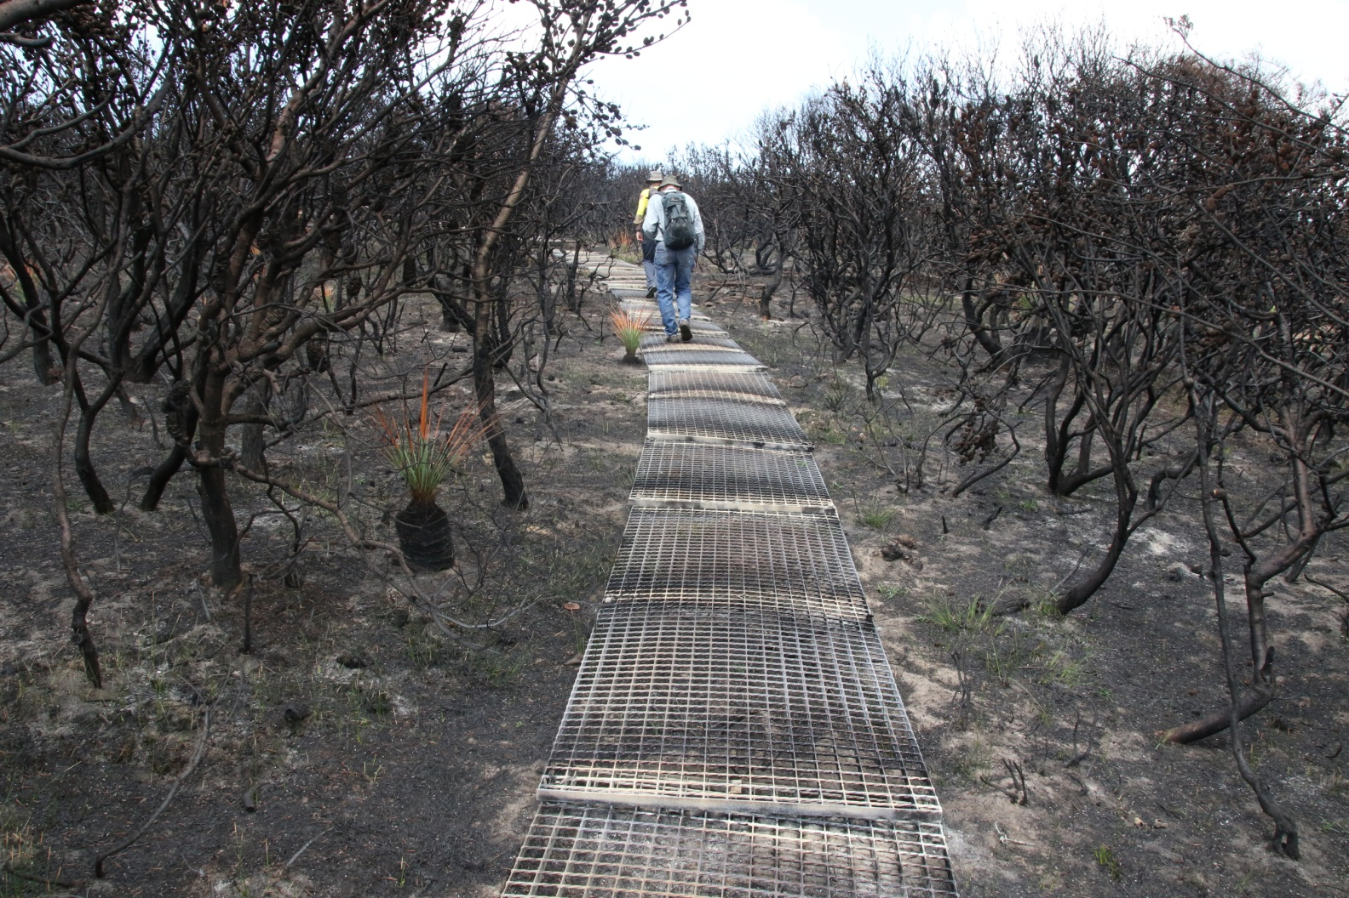
The old track was decimated along the coast

Slide 28
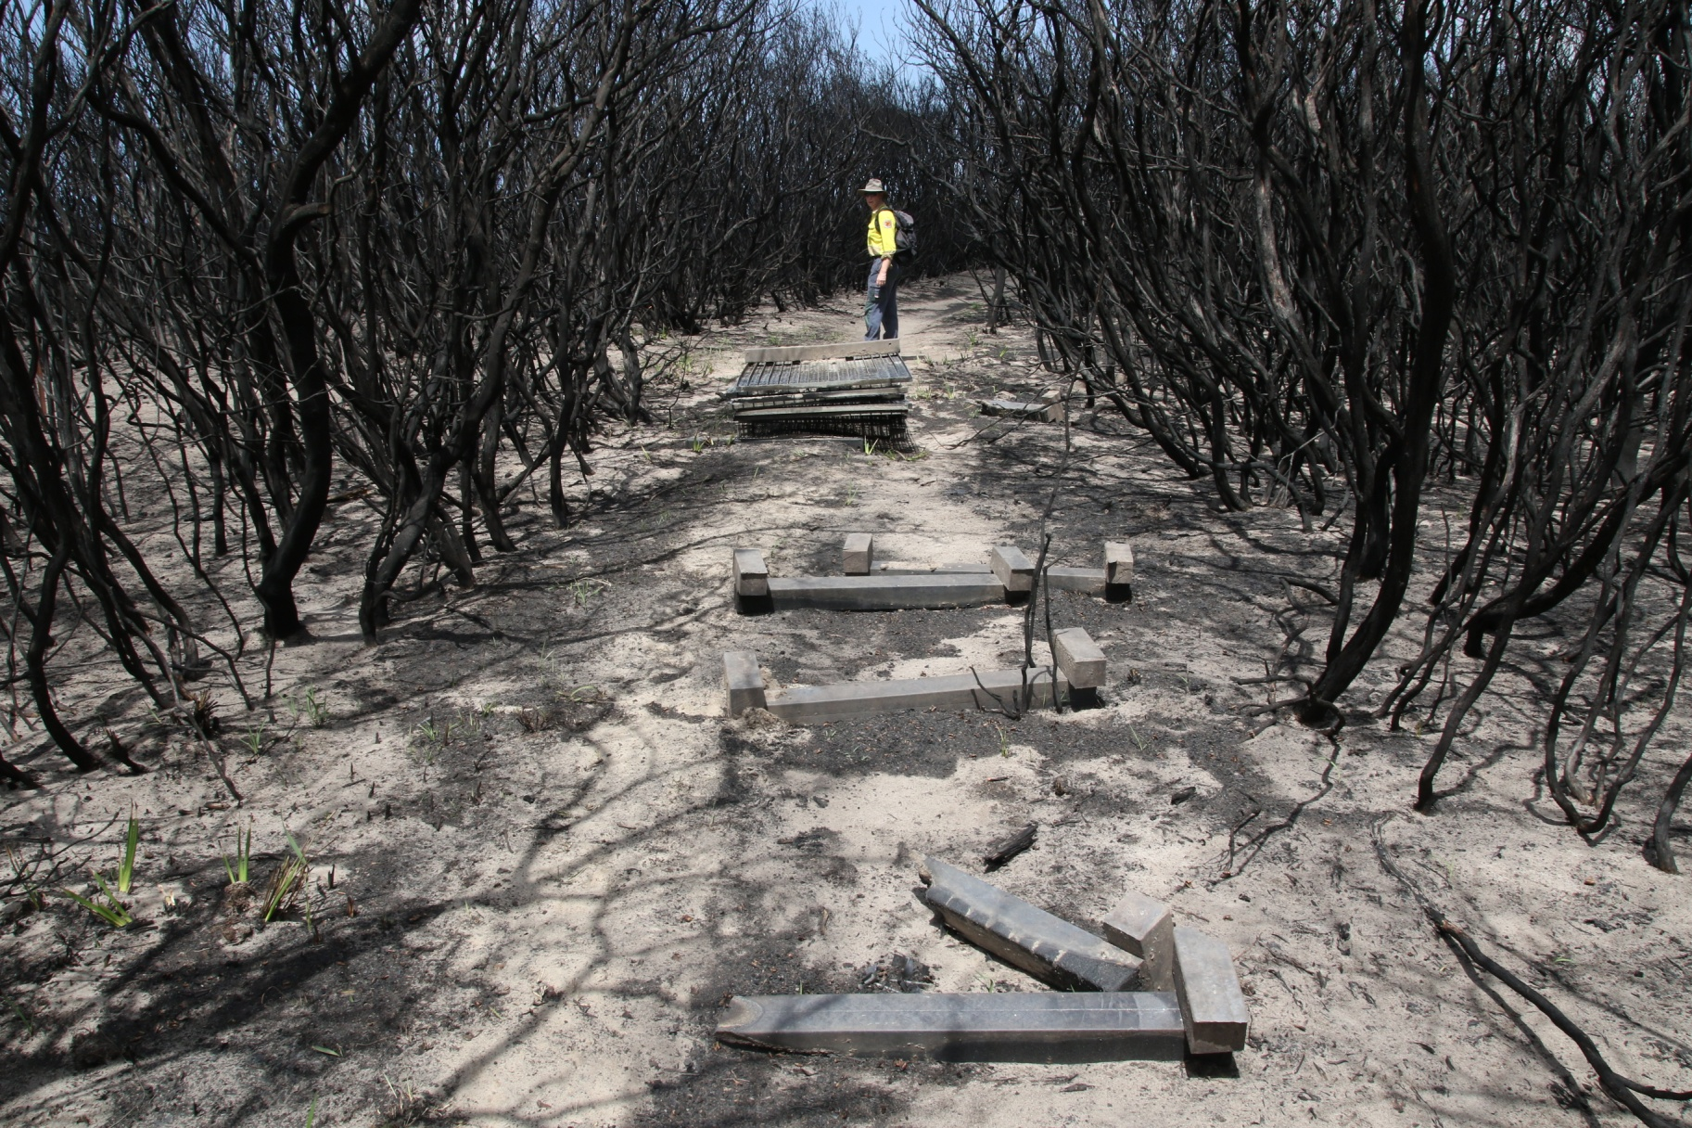

Slide 29
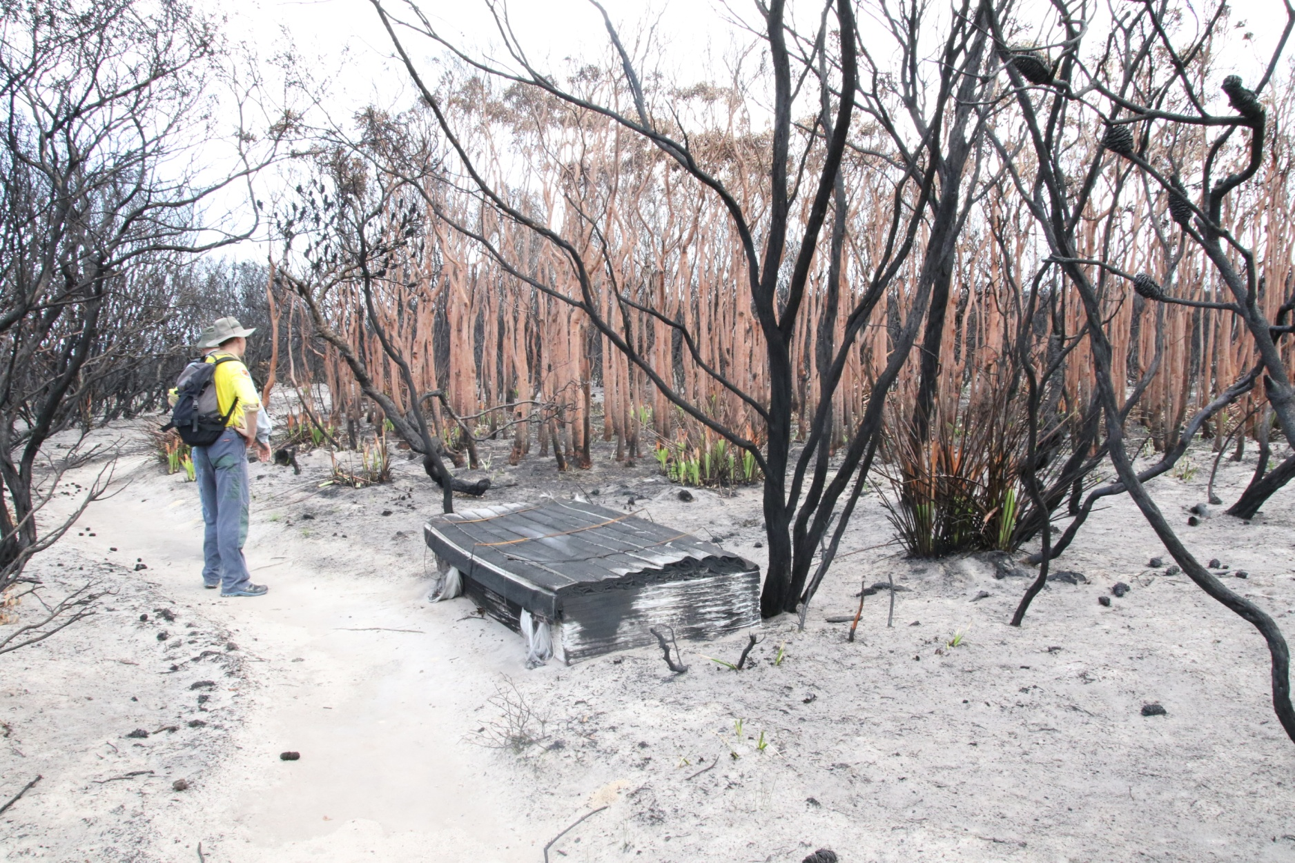

Slide 30
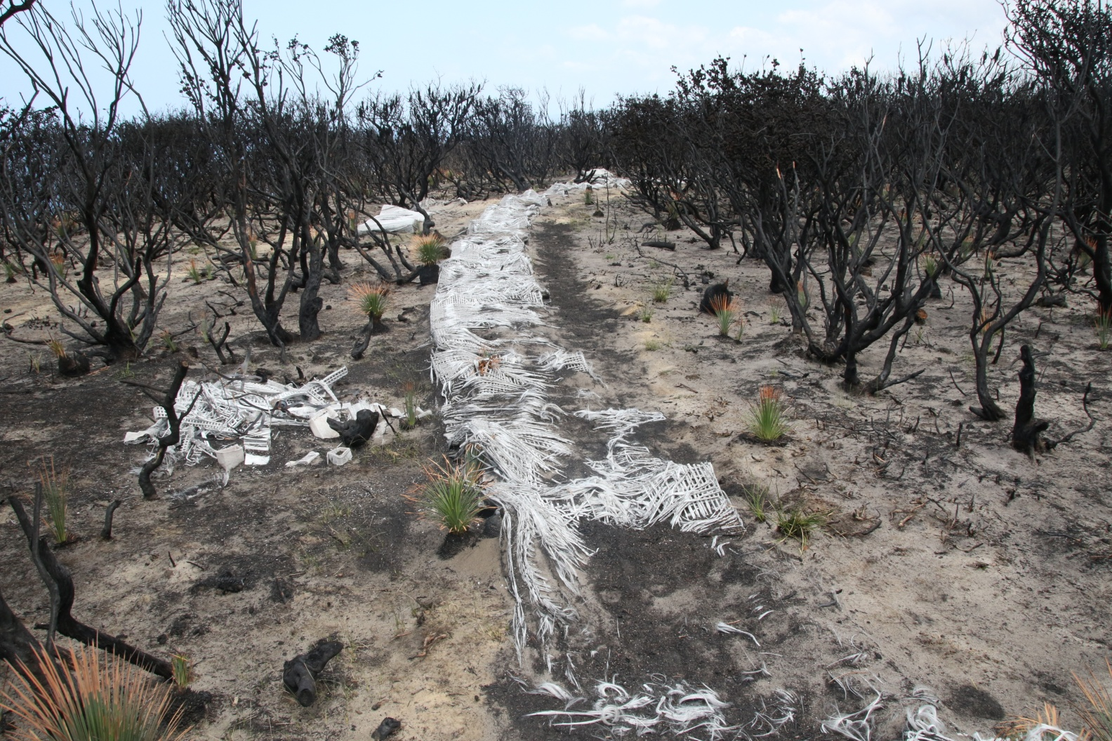

Slide 31
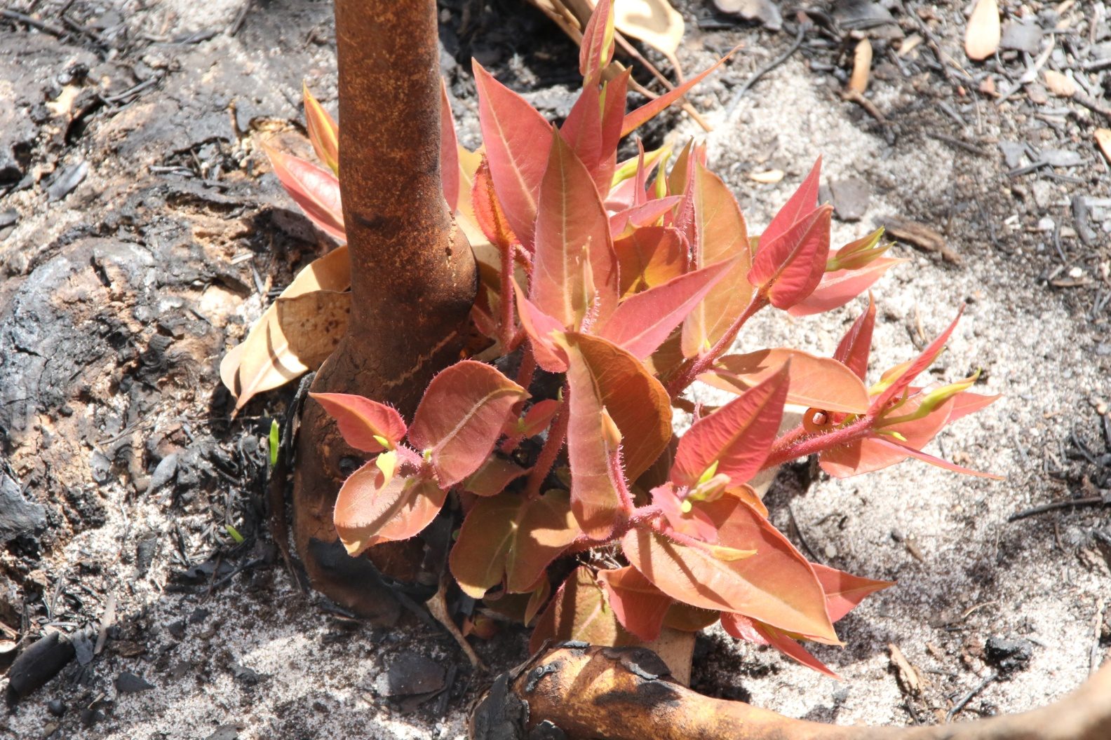
And yet… one month later

Slide 32
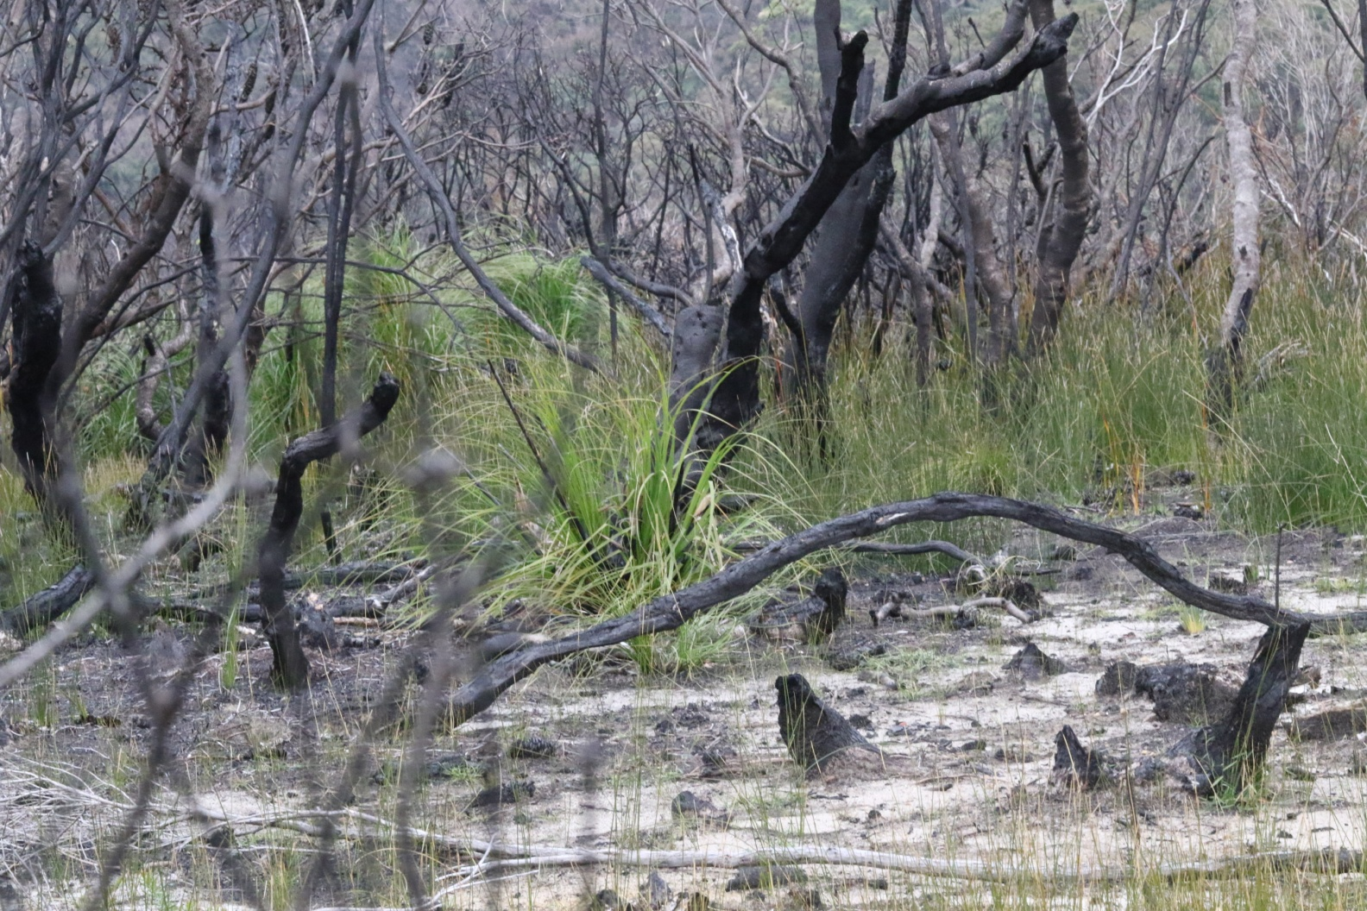
By August 2018

Slide 33
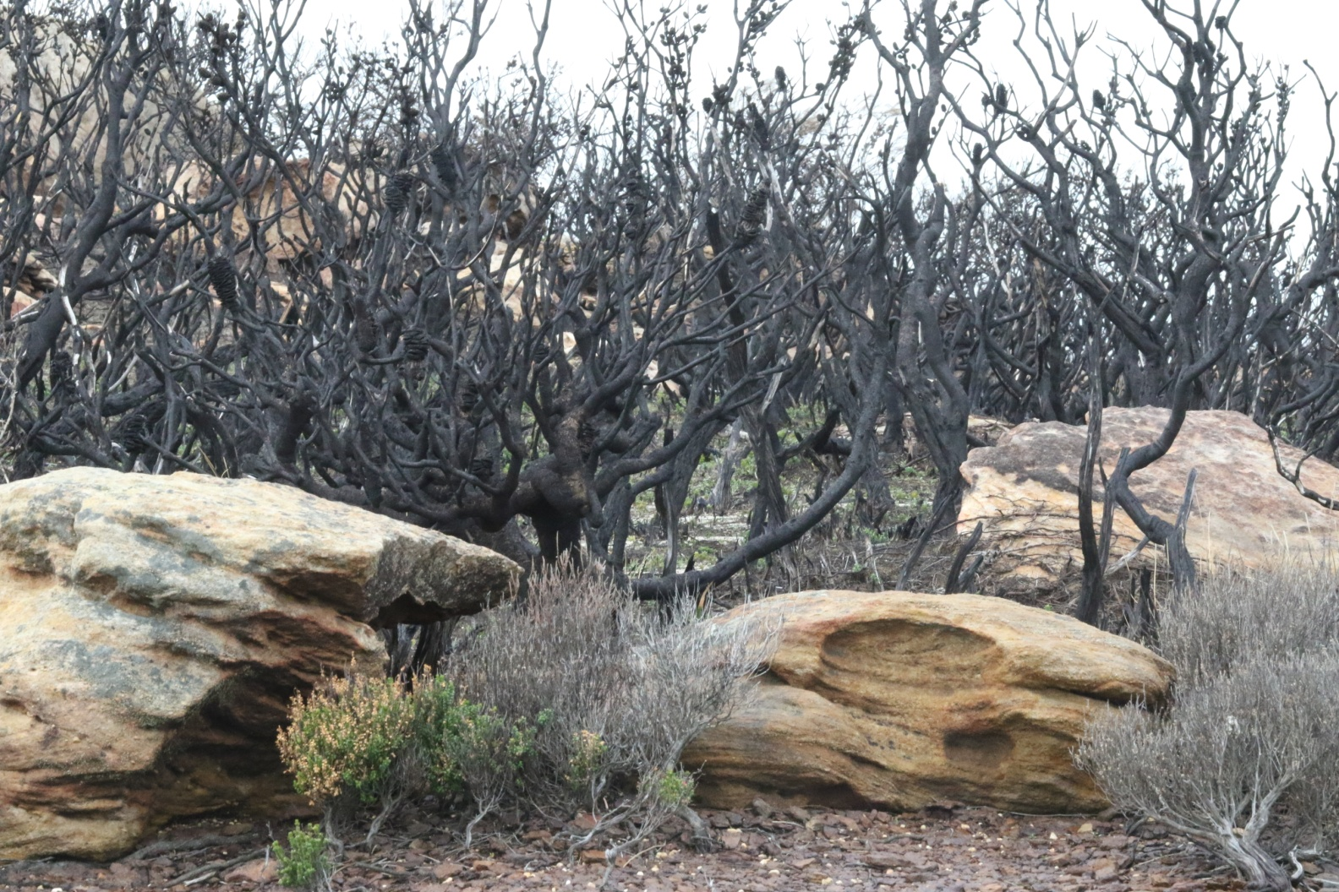

Slide 34
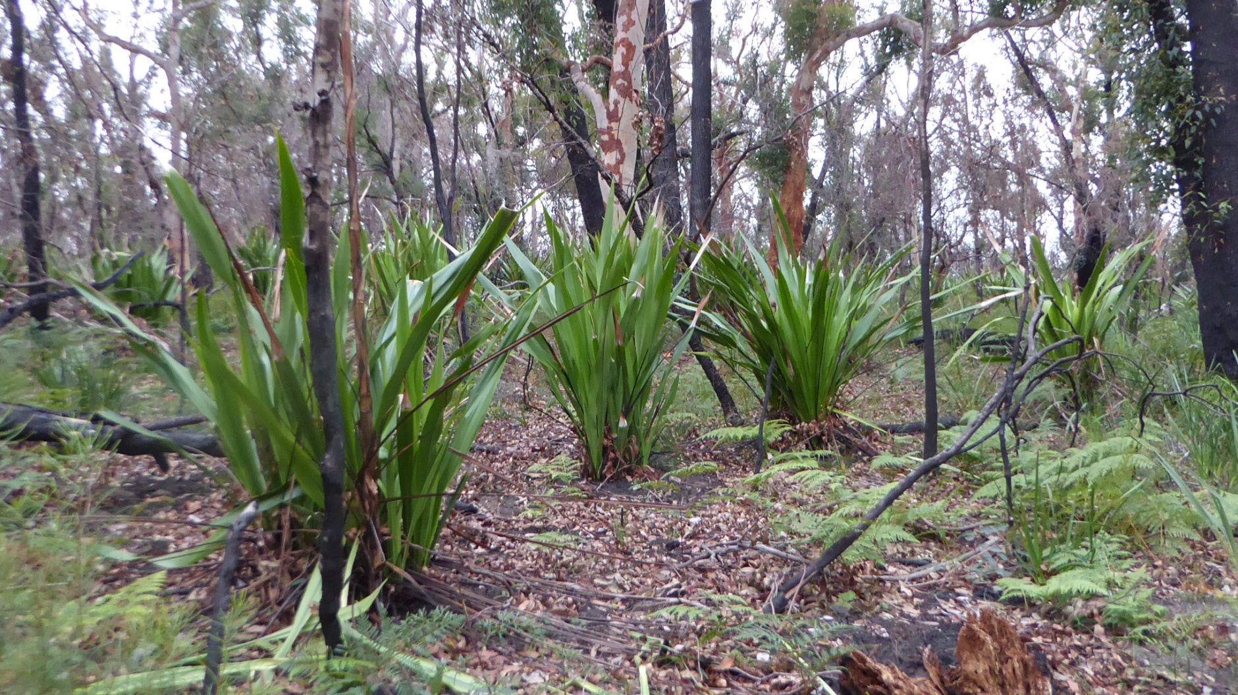

Slide 35
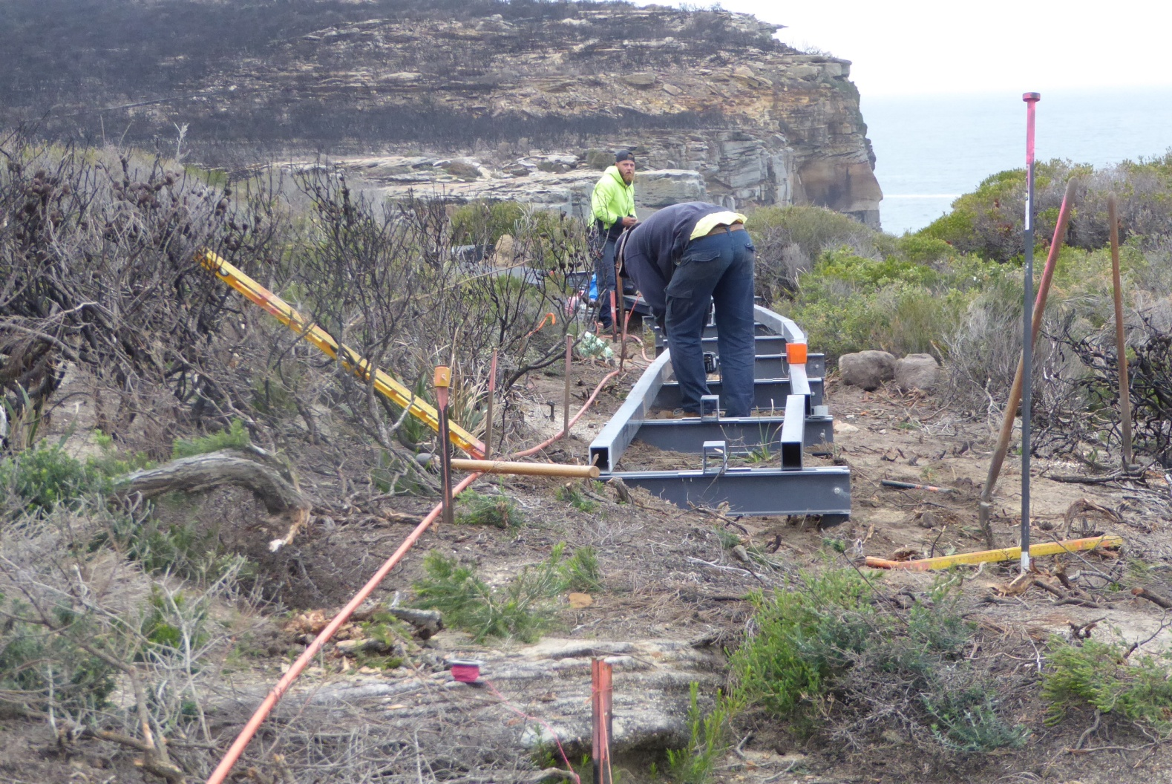
And tracks were being replaced and realigned

Slide 36
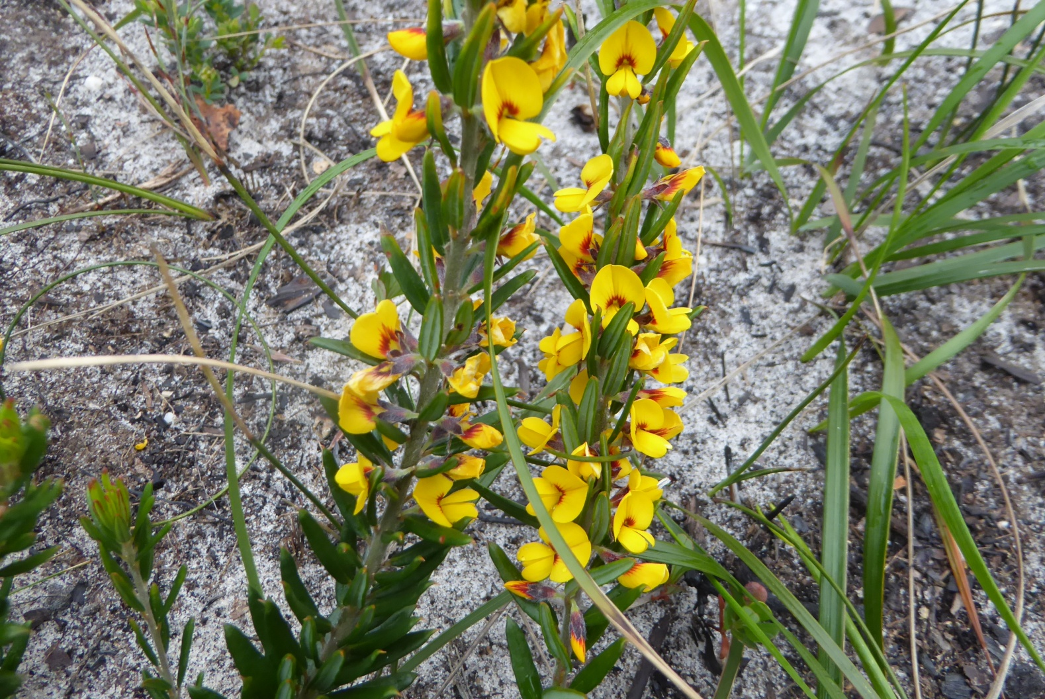

Slide 37
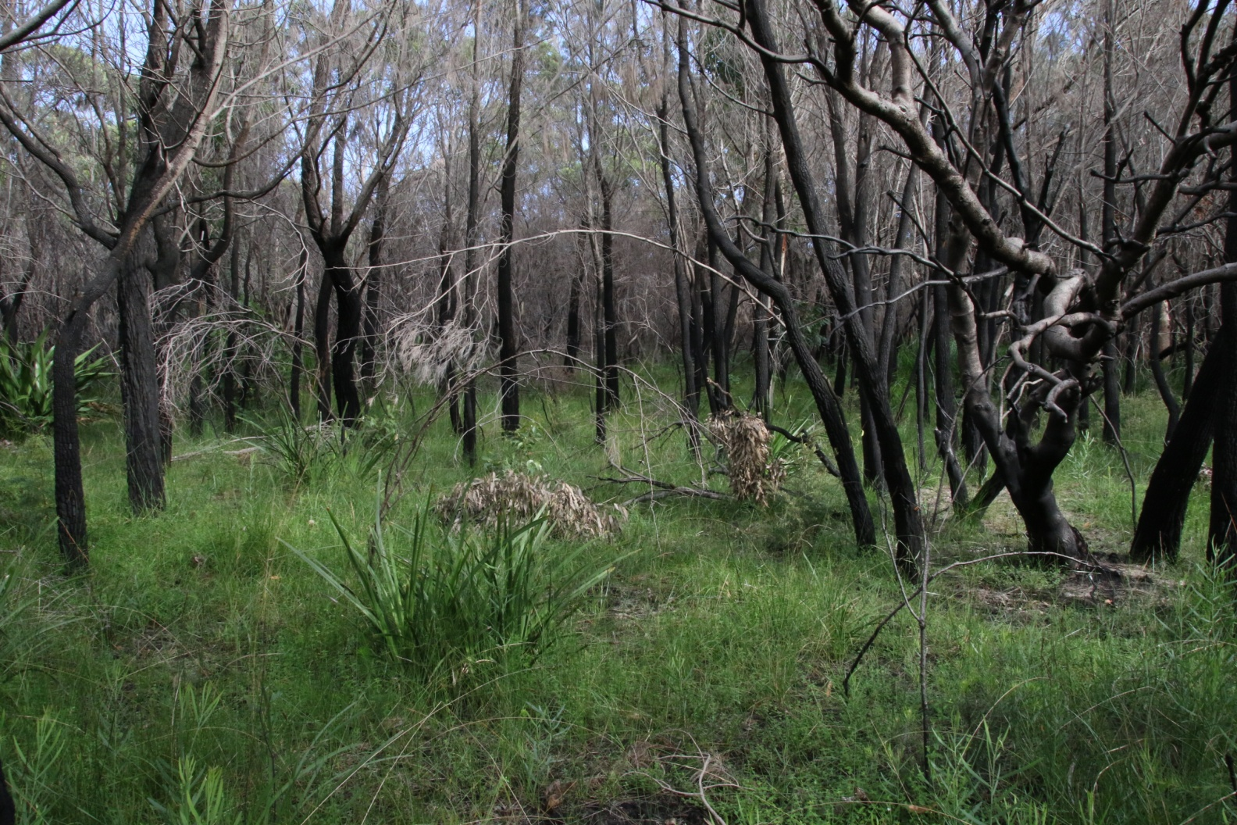
In March 2019

Slide 38
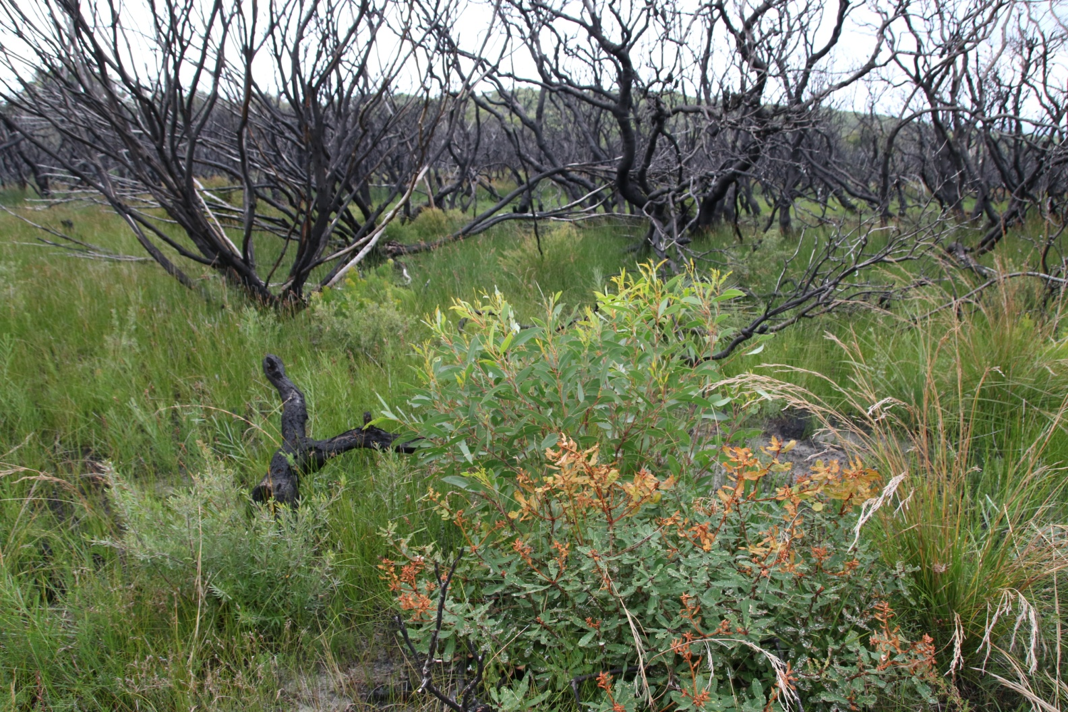

Slide 39
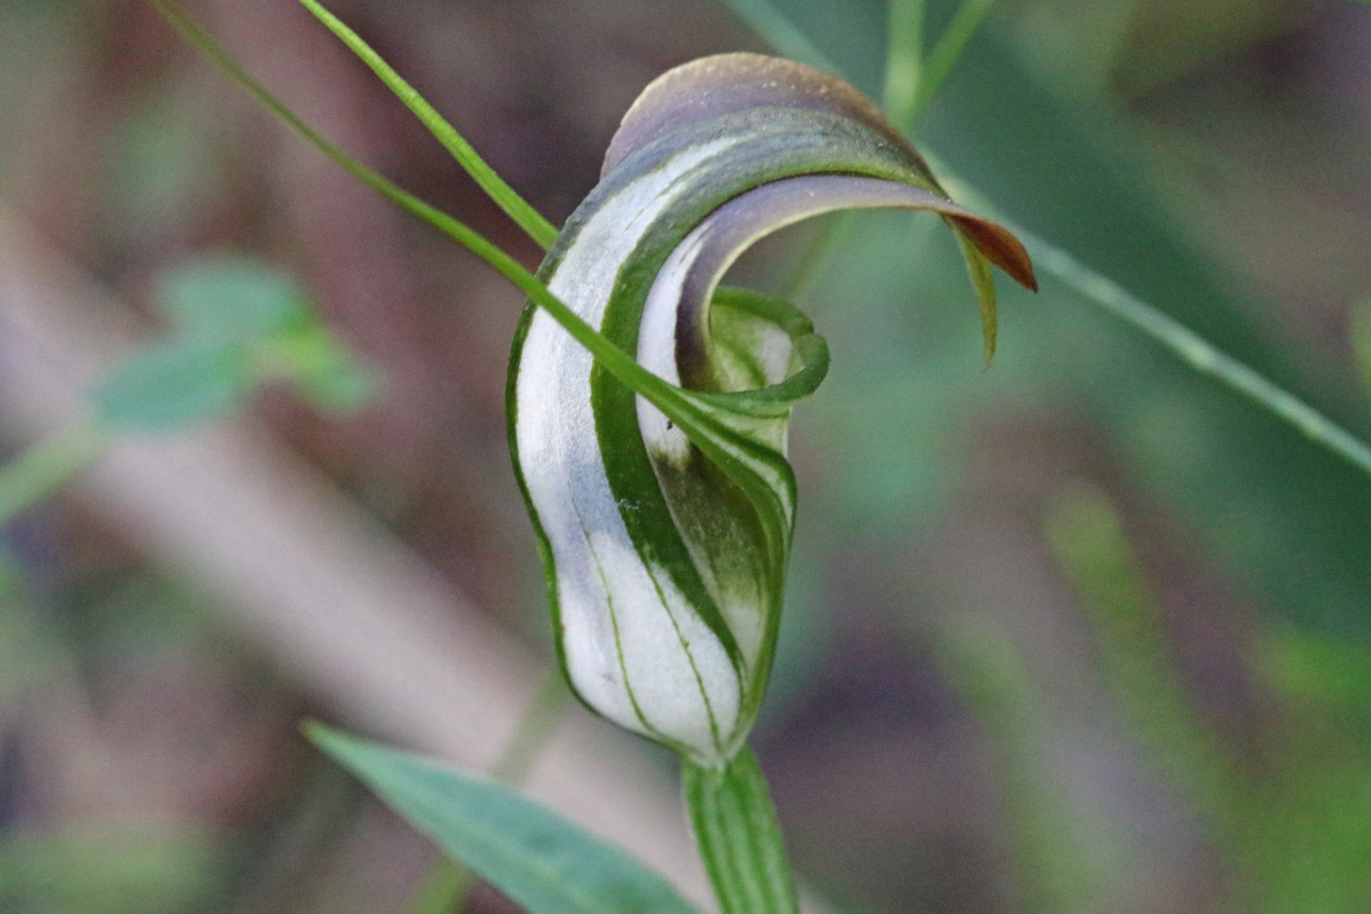
And by August 2019

Slide 40
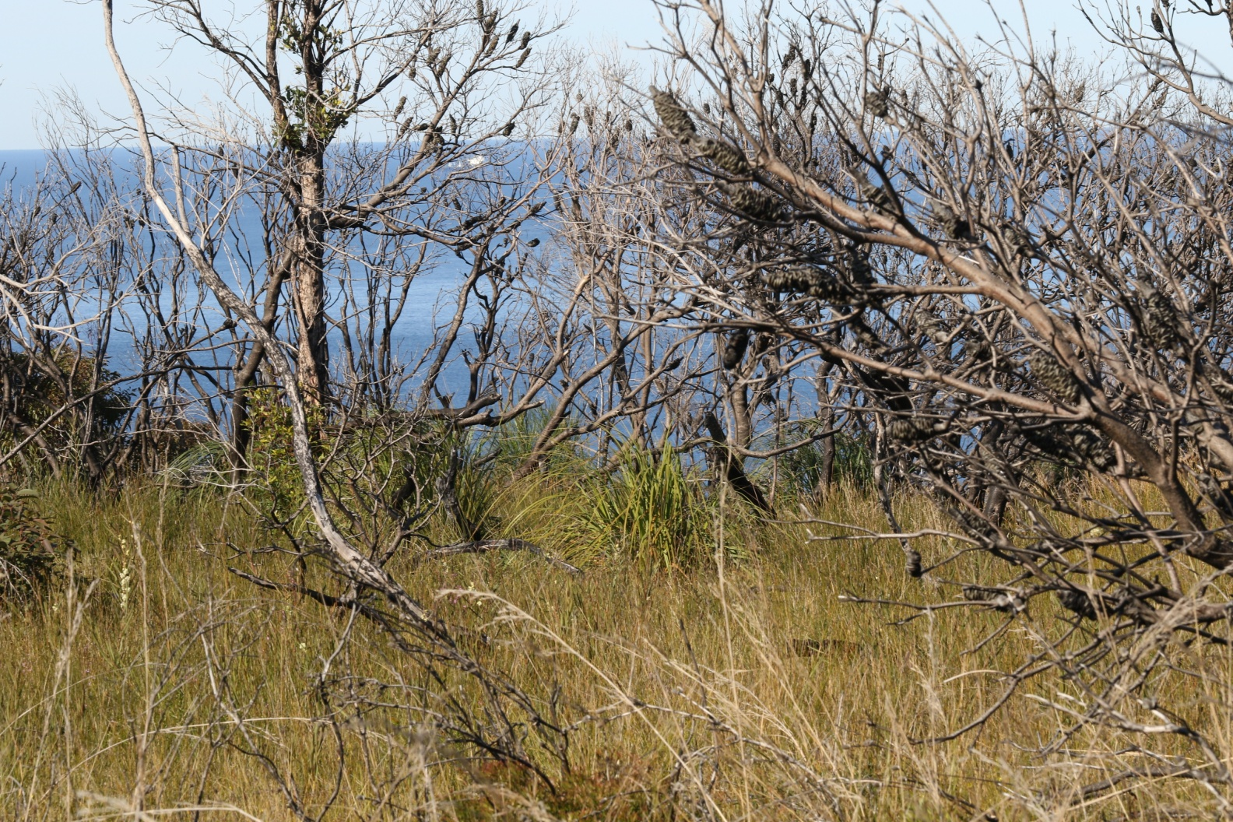

Slide 41
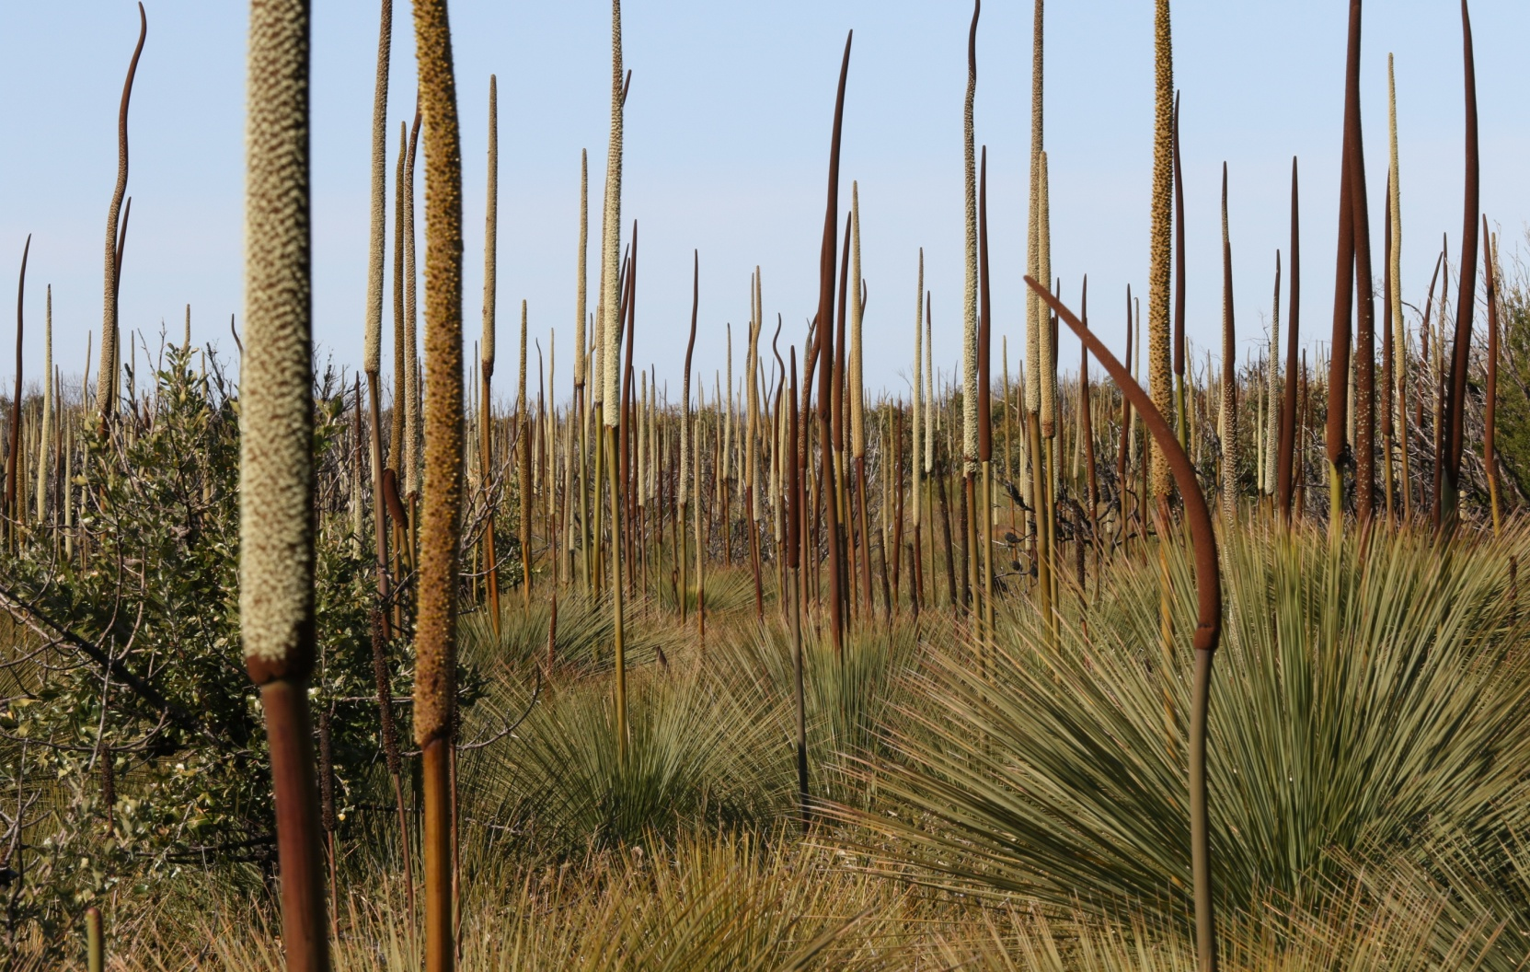

Slide 42
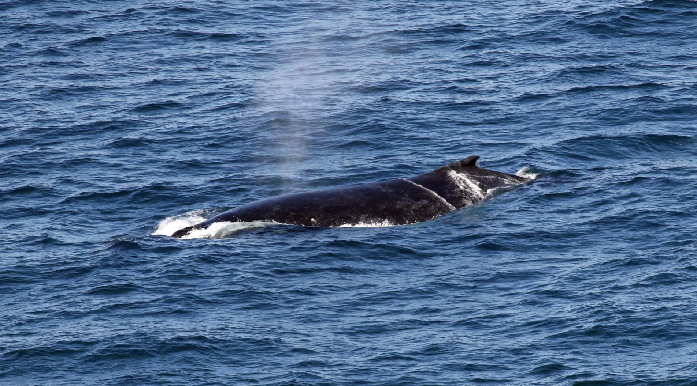
The same attractions

Slide 43
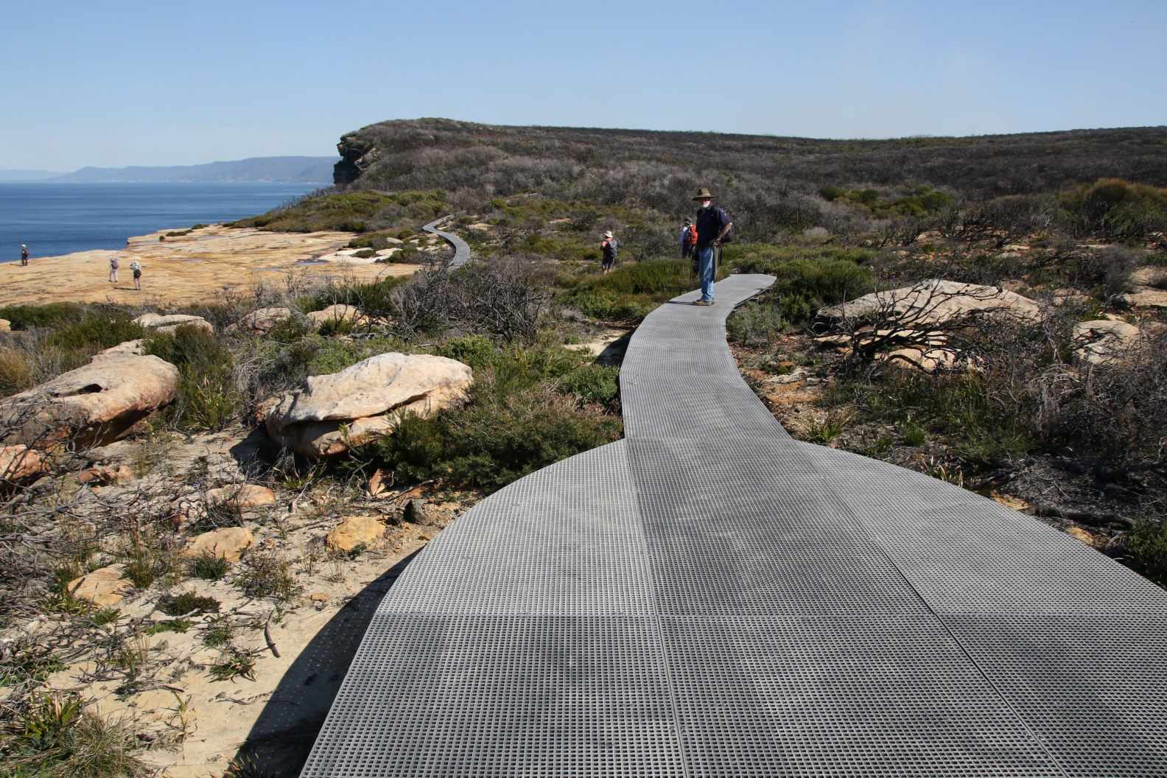
But with new tracks

Slide 44
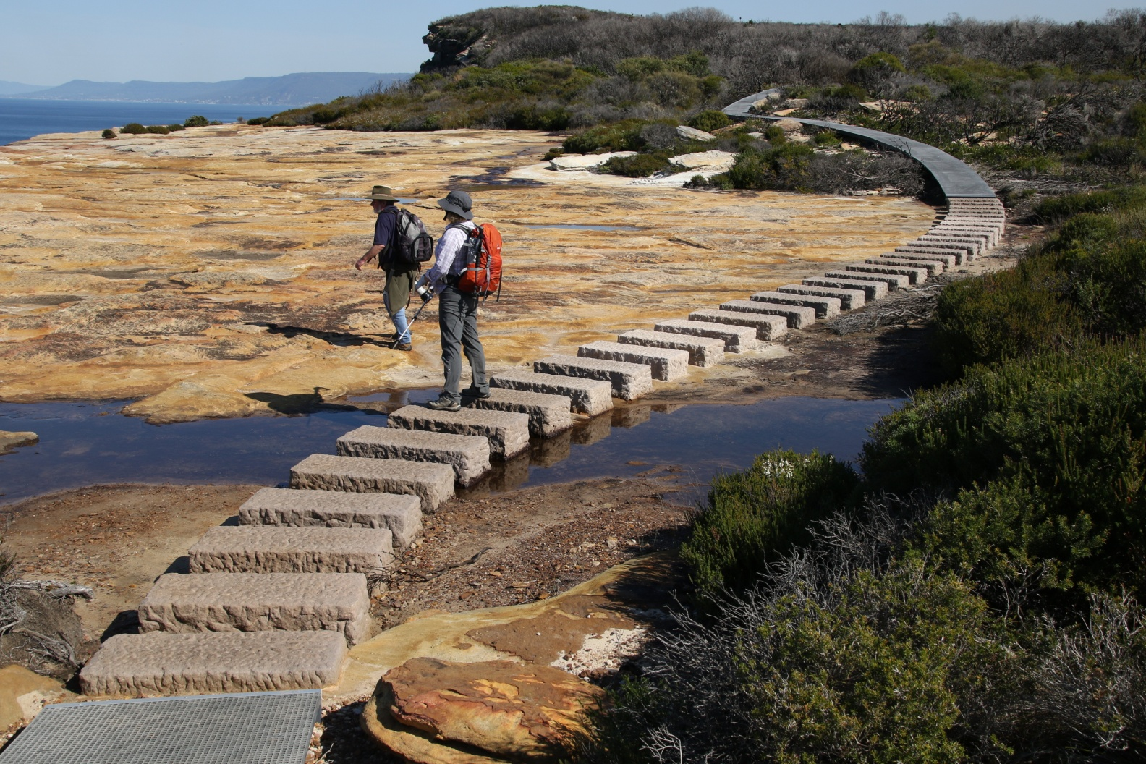
And a more pleasing alignment

Slide 45
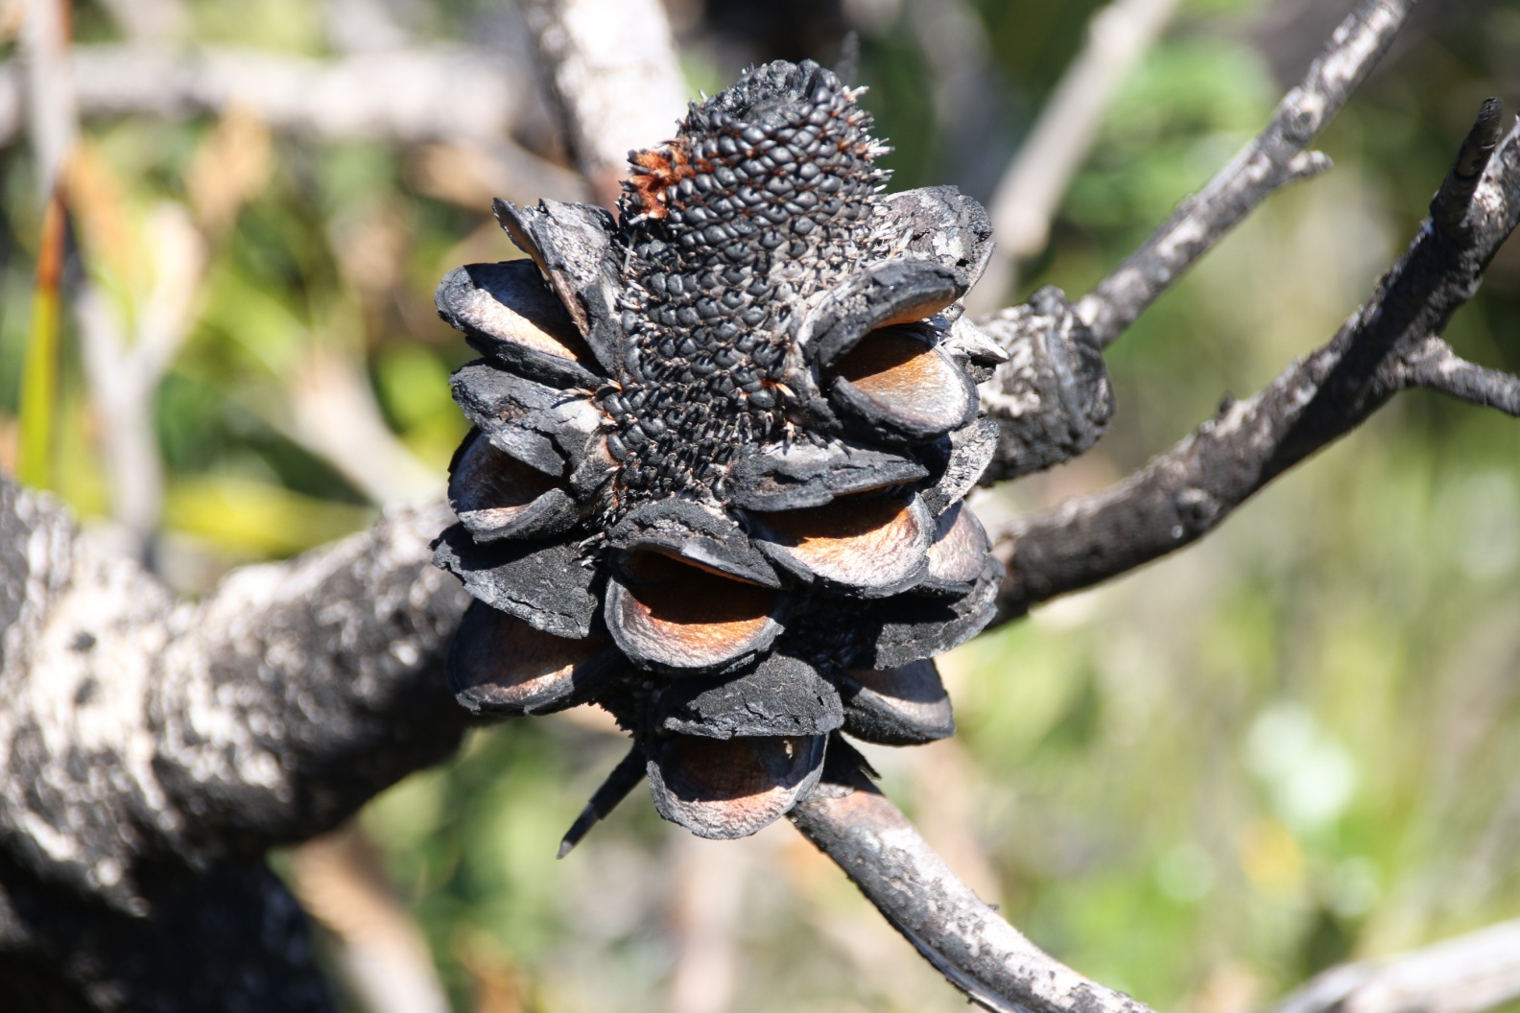

Slide 46
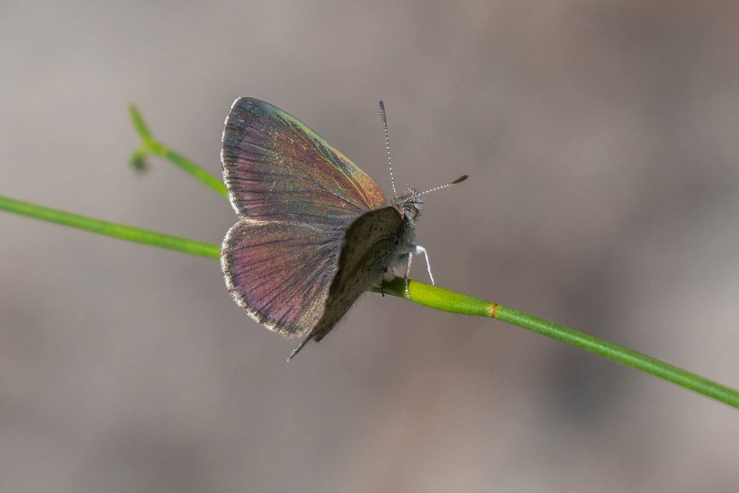

Slide 47
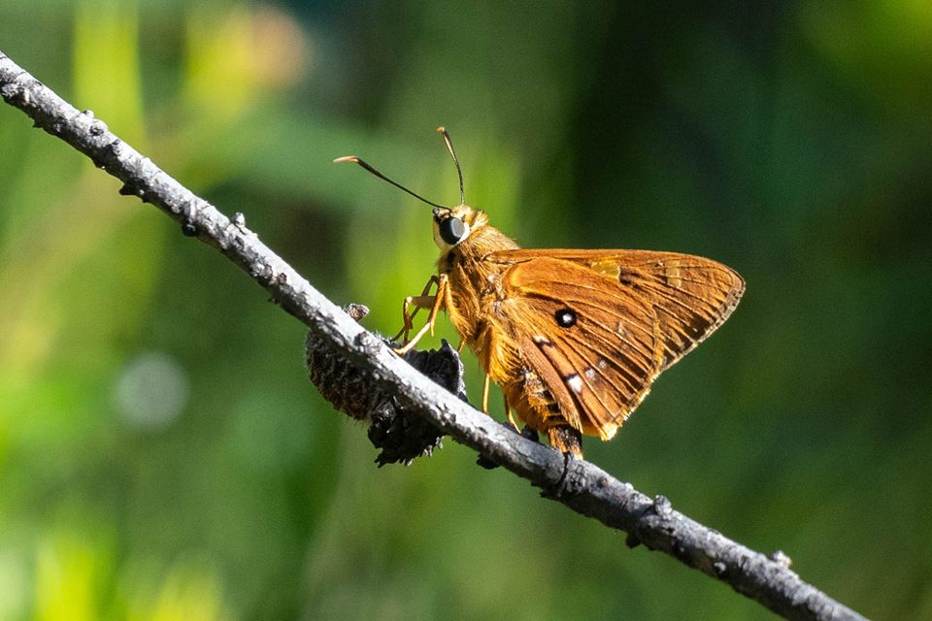

Slide 48
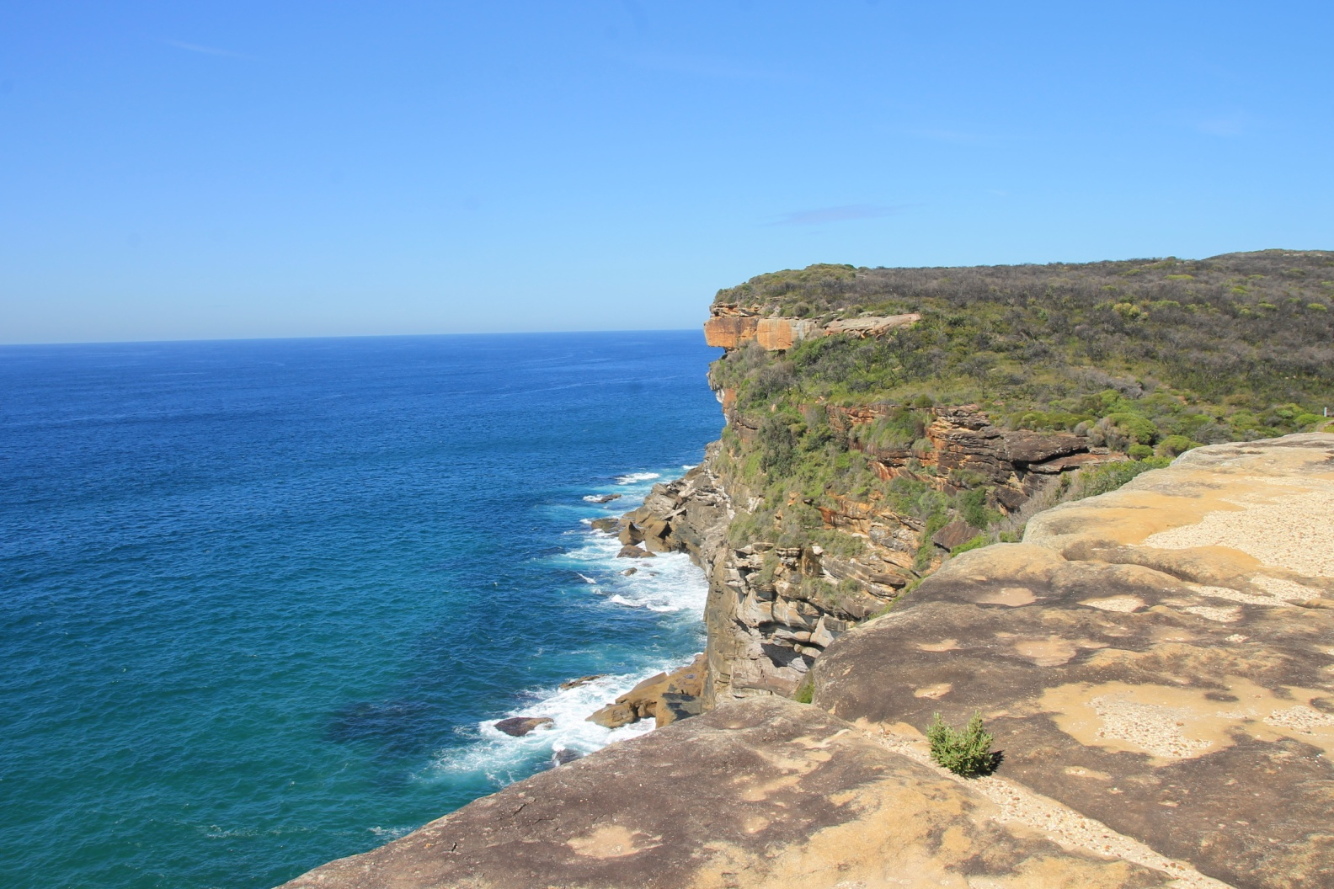

Slide 49
Recovering
The Moors is still there, though groups cannot walk it
But you can, in pairs, appropriately distanced
And soon you will be returning
And I hope you enjoyed a trip down memory lane, even if I have just gone back four years
Brian Everingham

Slide 50
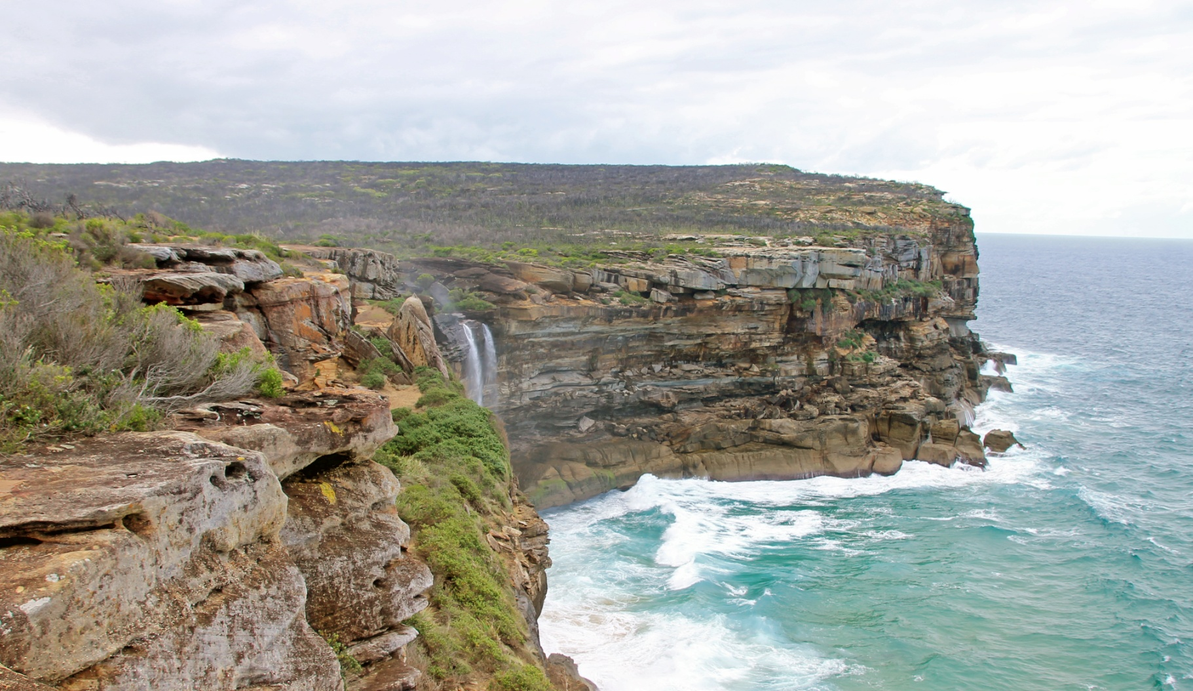
Take care everyone

