Slide 1
Royal National Park and the F6
Presentation to the Environment Forum of the Labor Party
August 16th 2017 by Brian Everingham, NPA

Slide 2
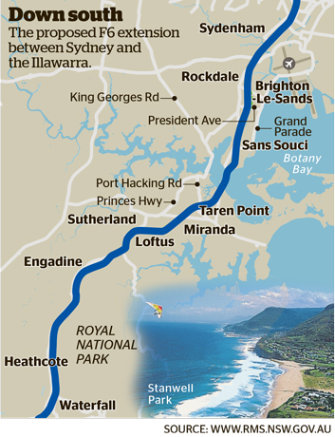

Slide 3
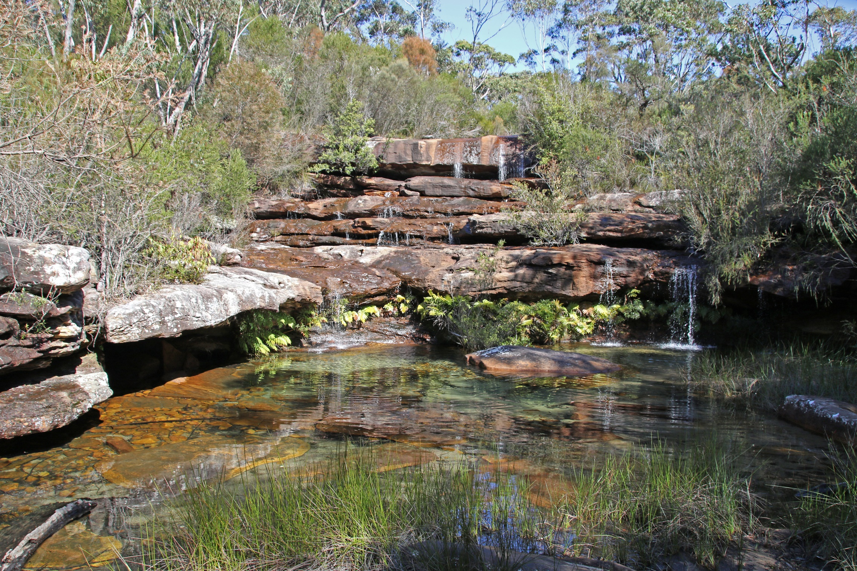

Slide 4
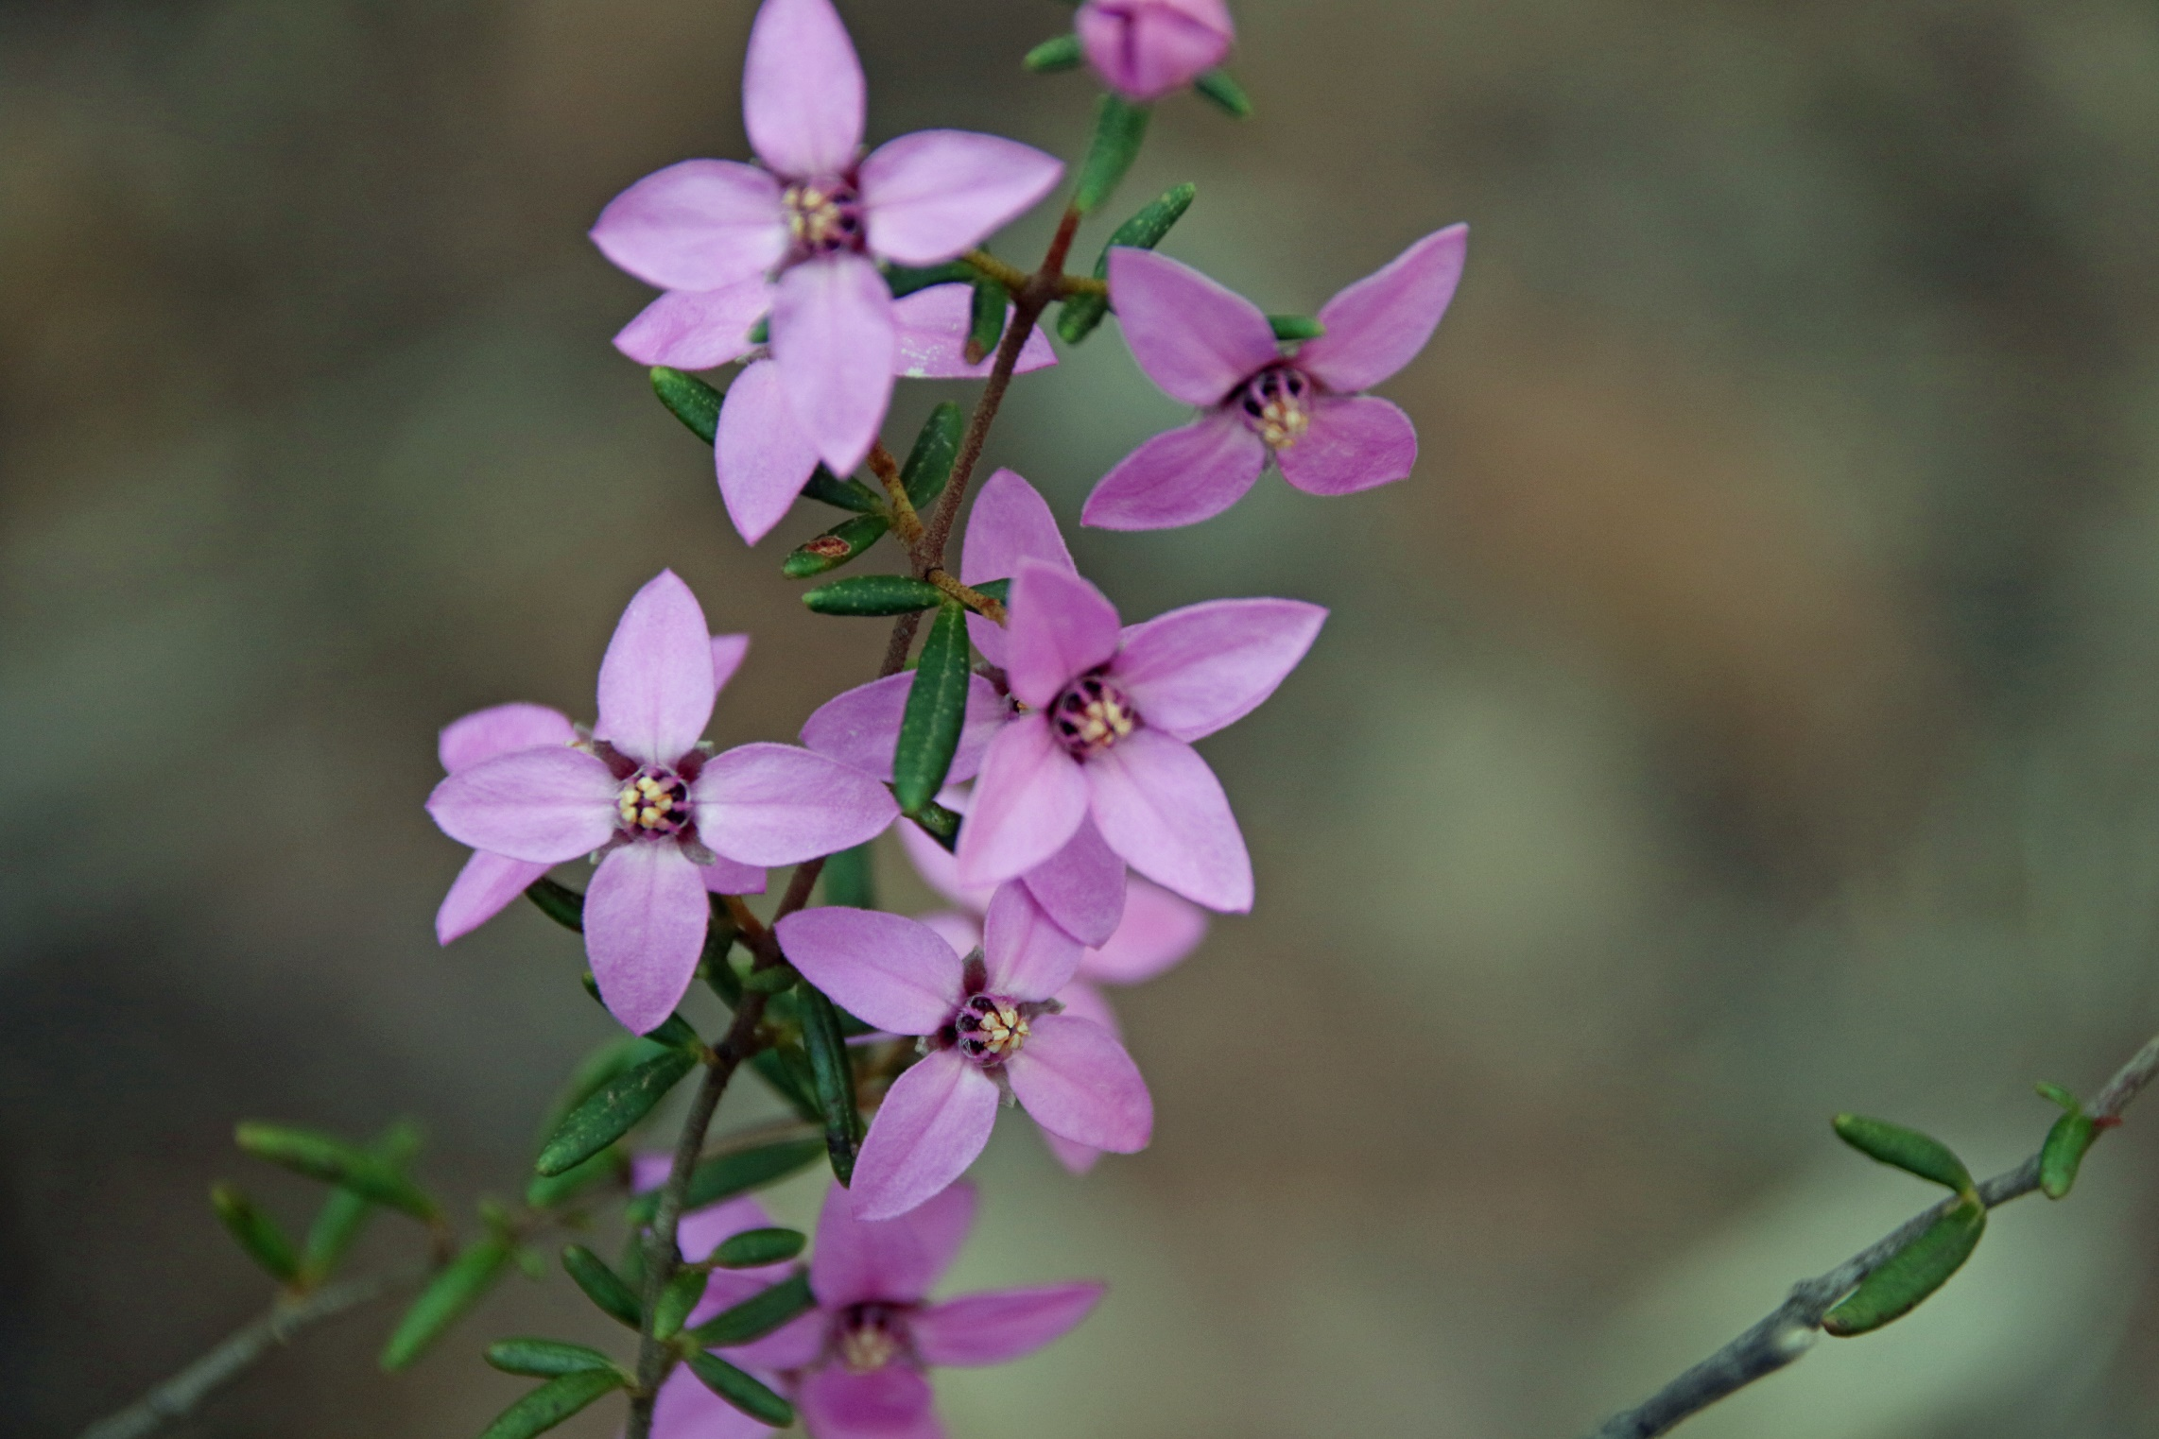

Slide 5
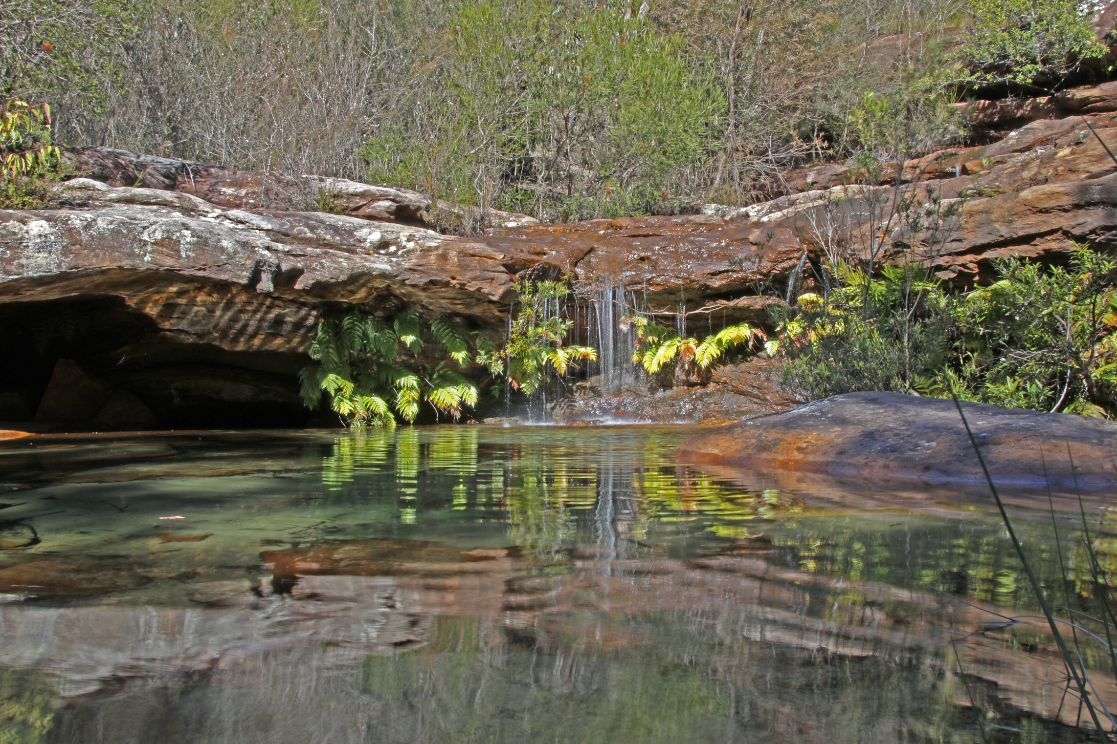

Slide 6
Royal National Park is Australia’s oldest national park and with 4 million visitors a year, one of our most beloved. It should have World Heritage status. It has been assessed as having those values and the irony is that it was this government and its Federal counterpart that was so enthusiastic in pushing for such a nomination.

Slide 7
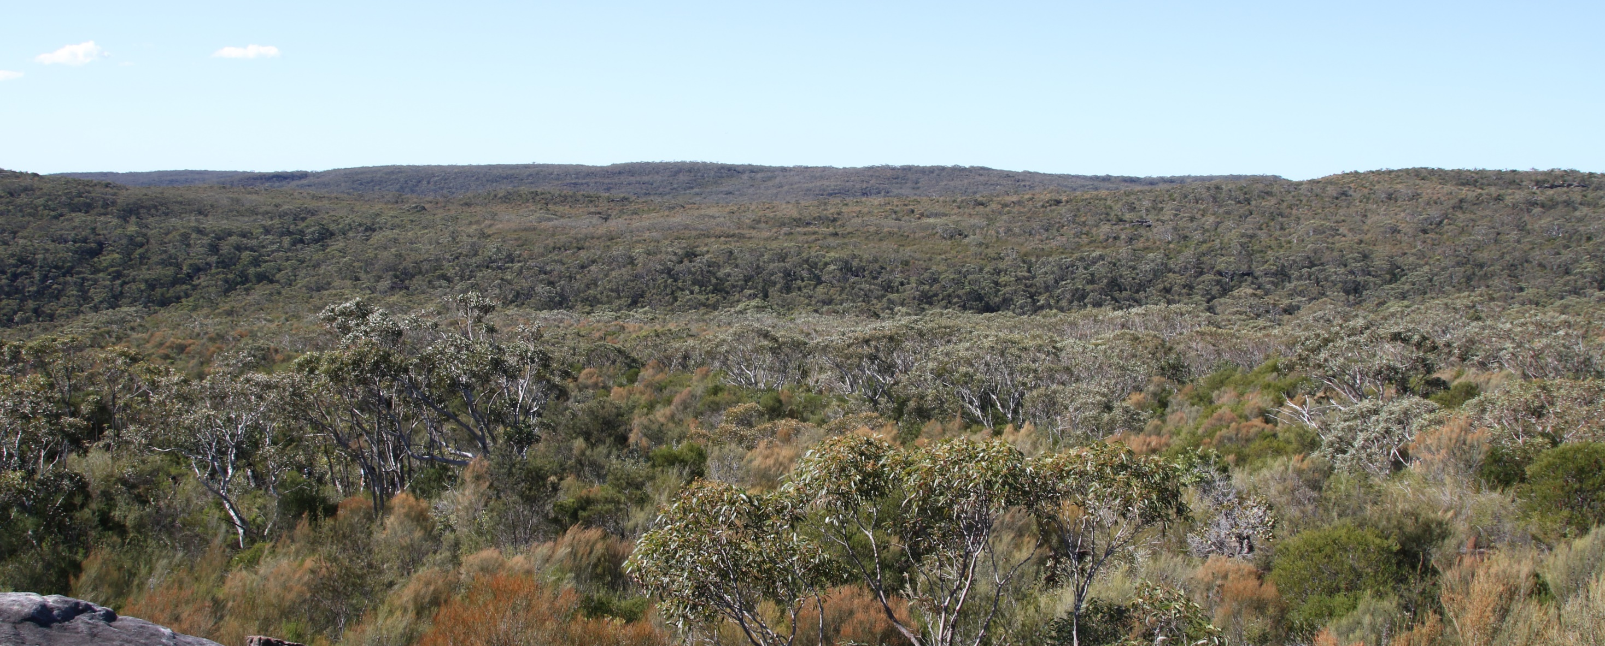
It’s a quiet haven, a place to escape, a natural world
Looking north into Kangaroo Creek: a creek that would be silted by any F6 expansion

Slide 8
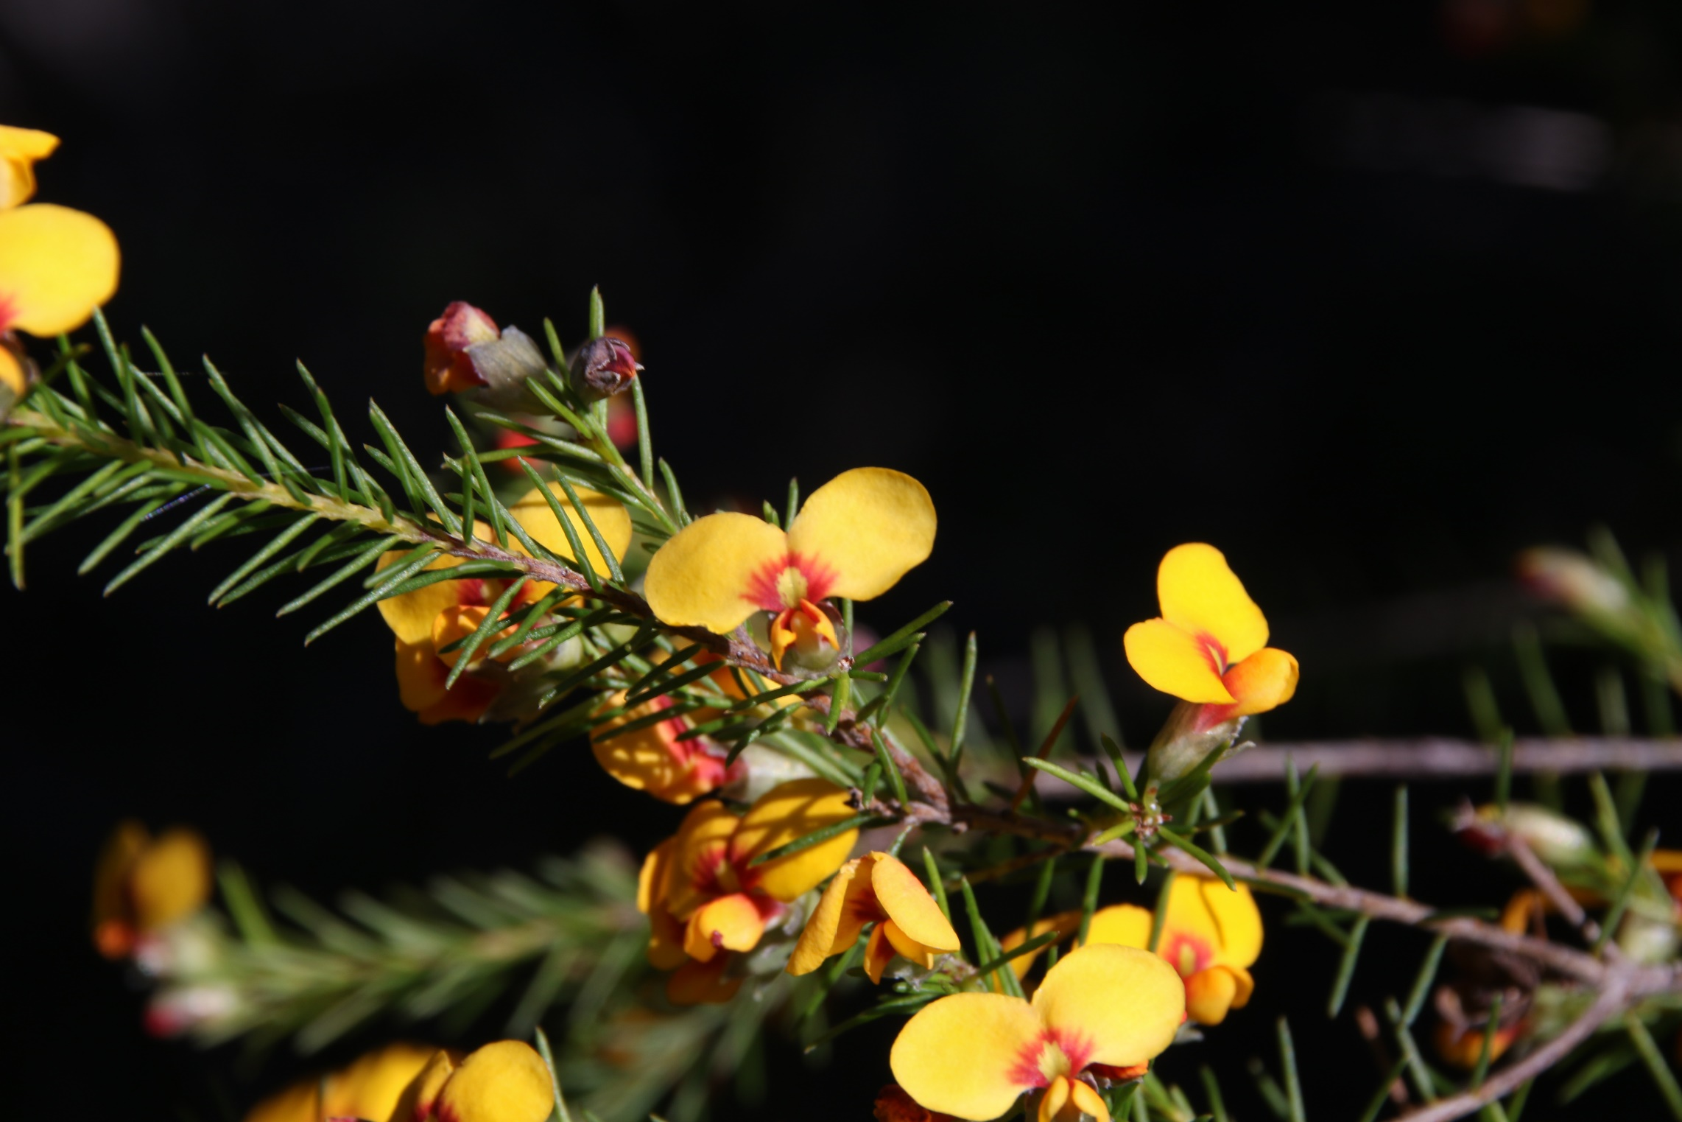

Slide 9
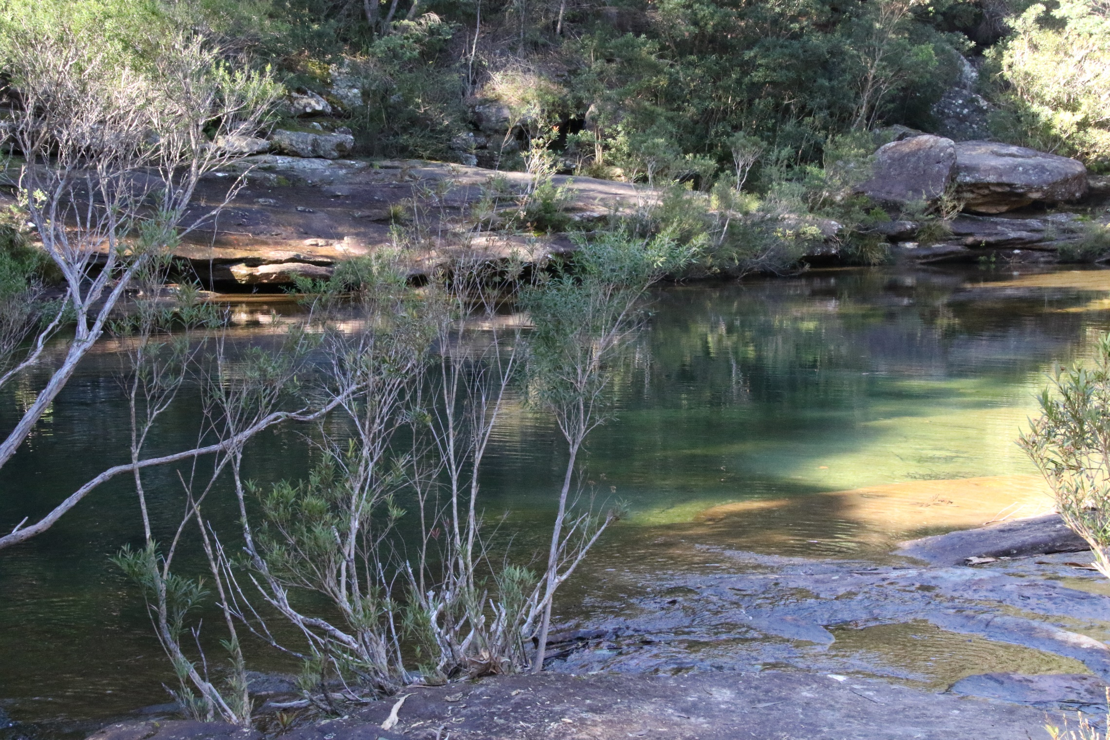

Slide 10
Instead the NSW government has set aside money to explore the option of extending the F6 motorway through this iconic national park.
Despite rapid reassurances from the government that no route for the F6 has been determined it has aside $15 million for planning work and a further $20 million to carry out geotechnical testing.

Slide 11
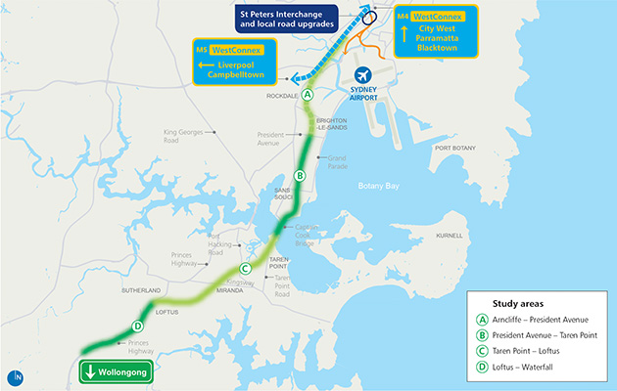

Slide 12
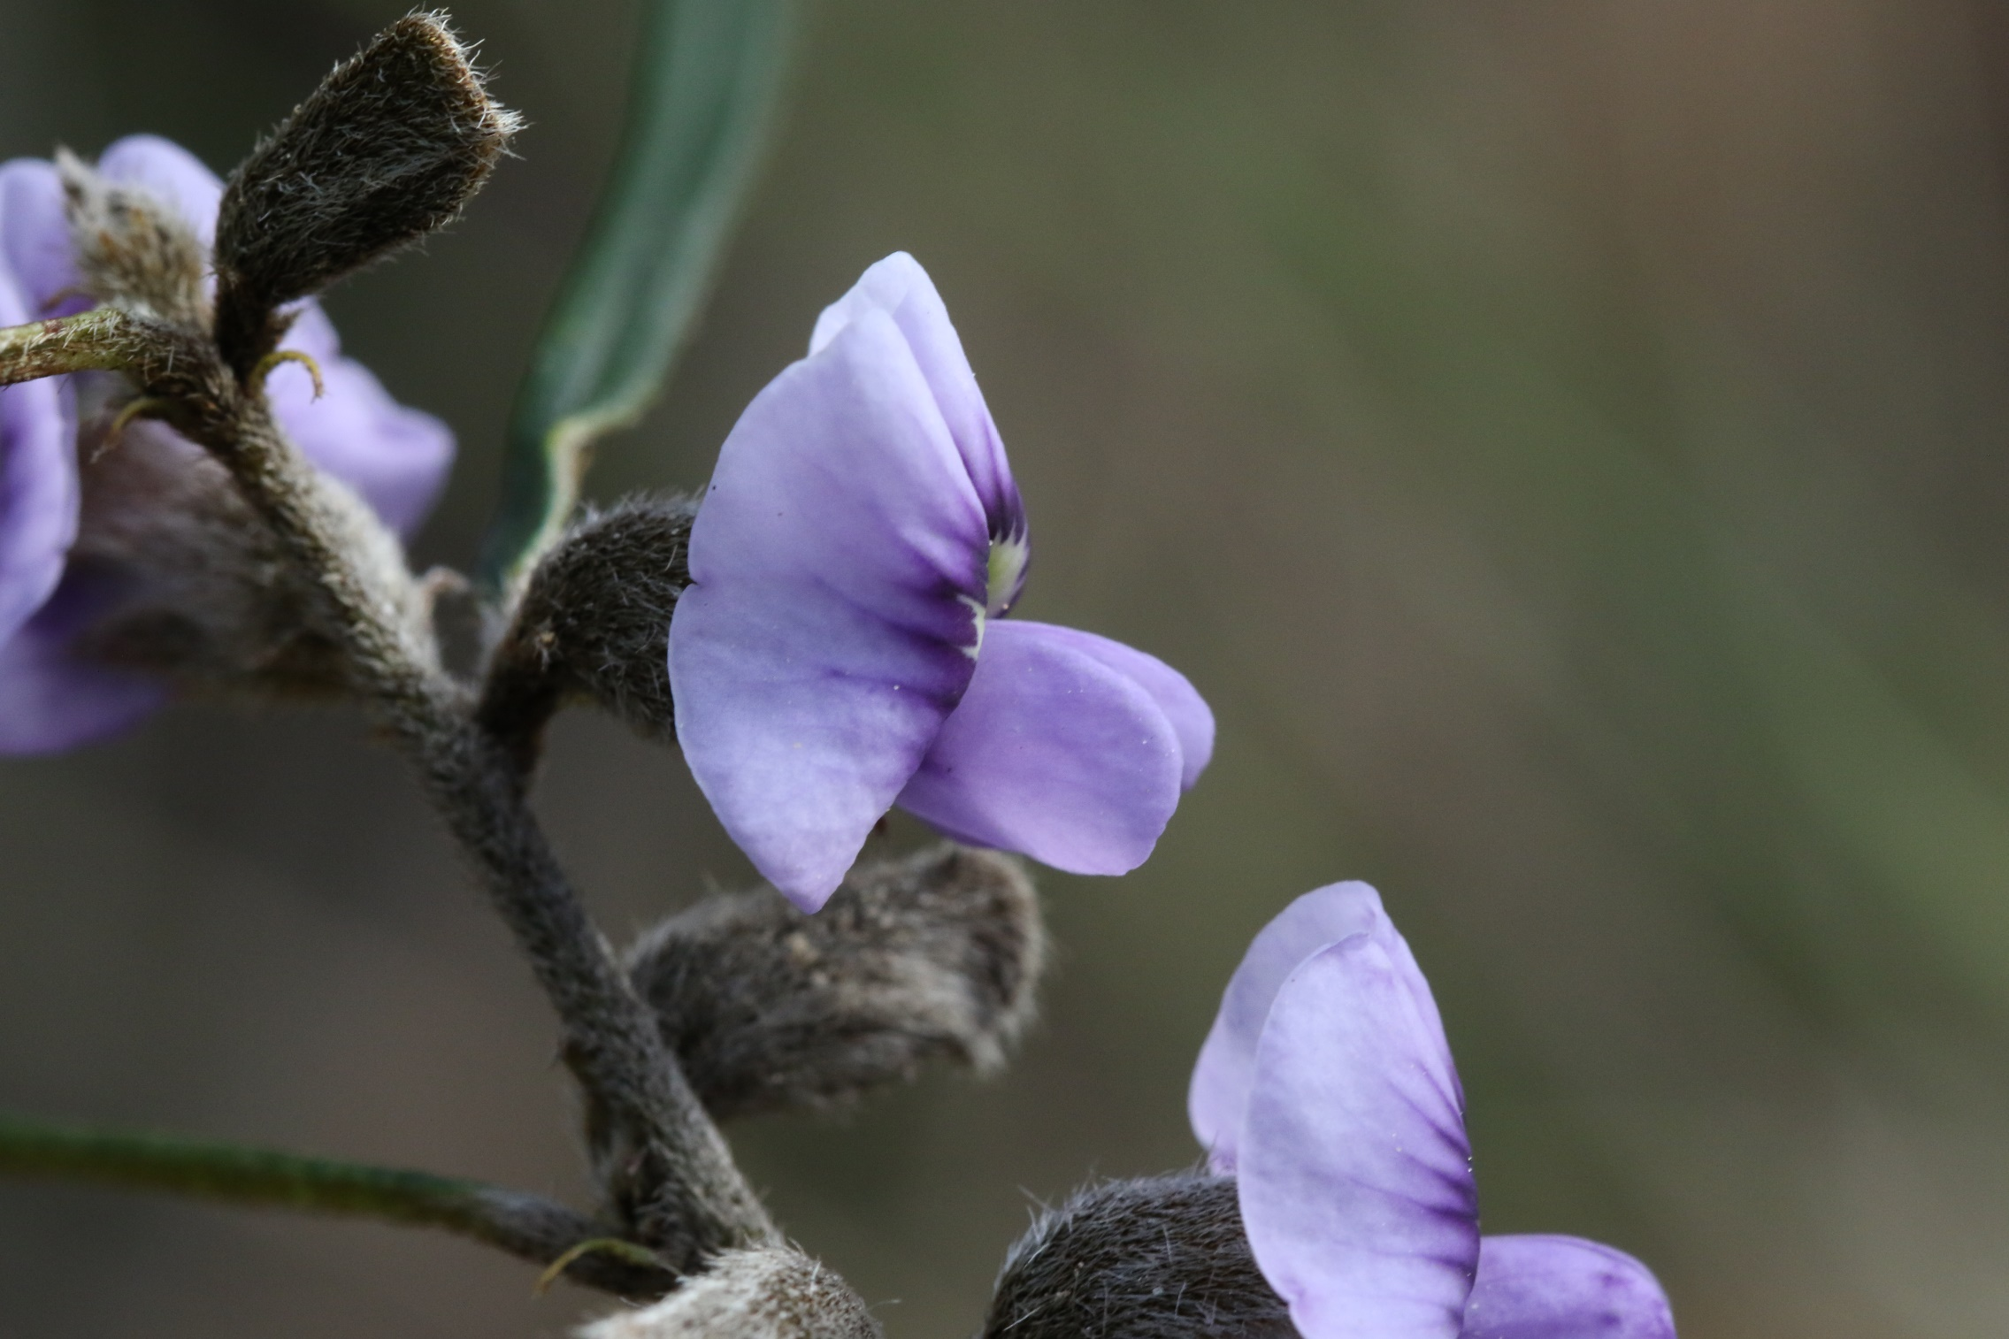

Slide 13
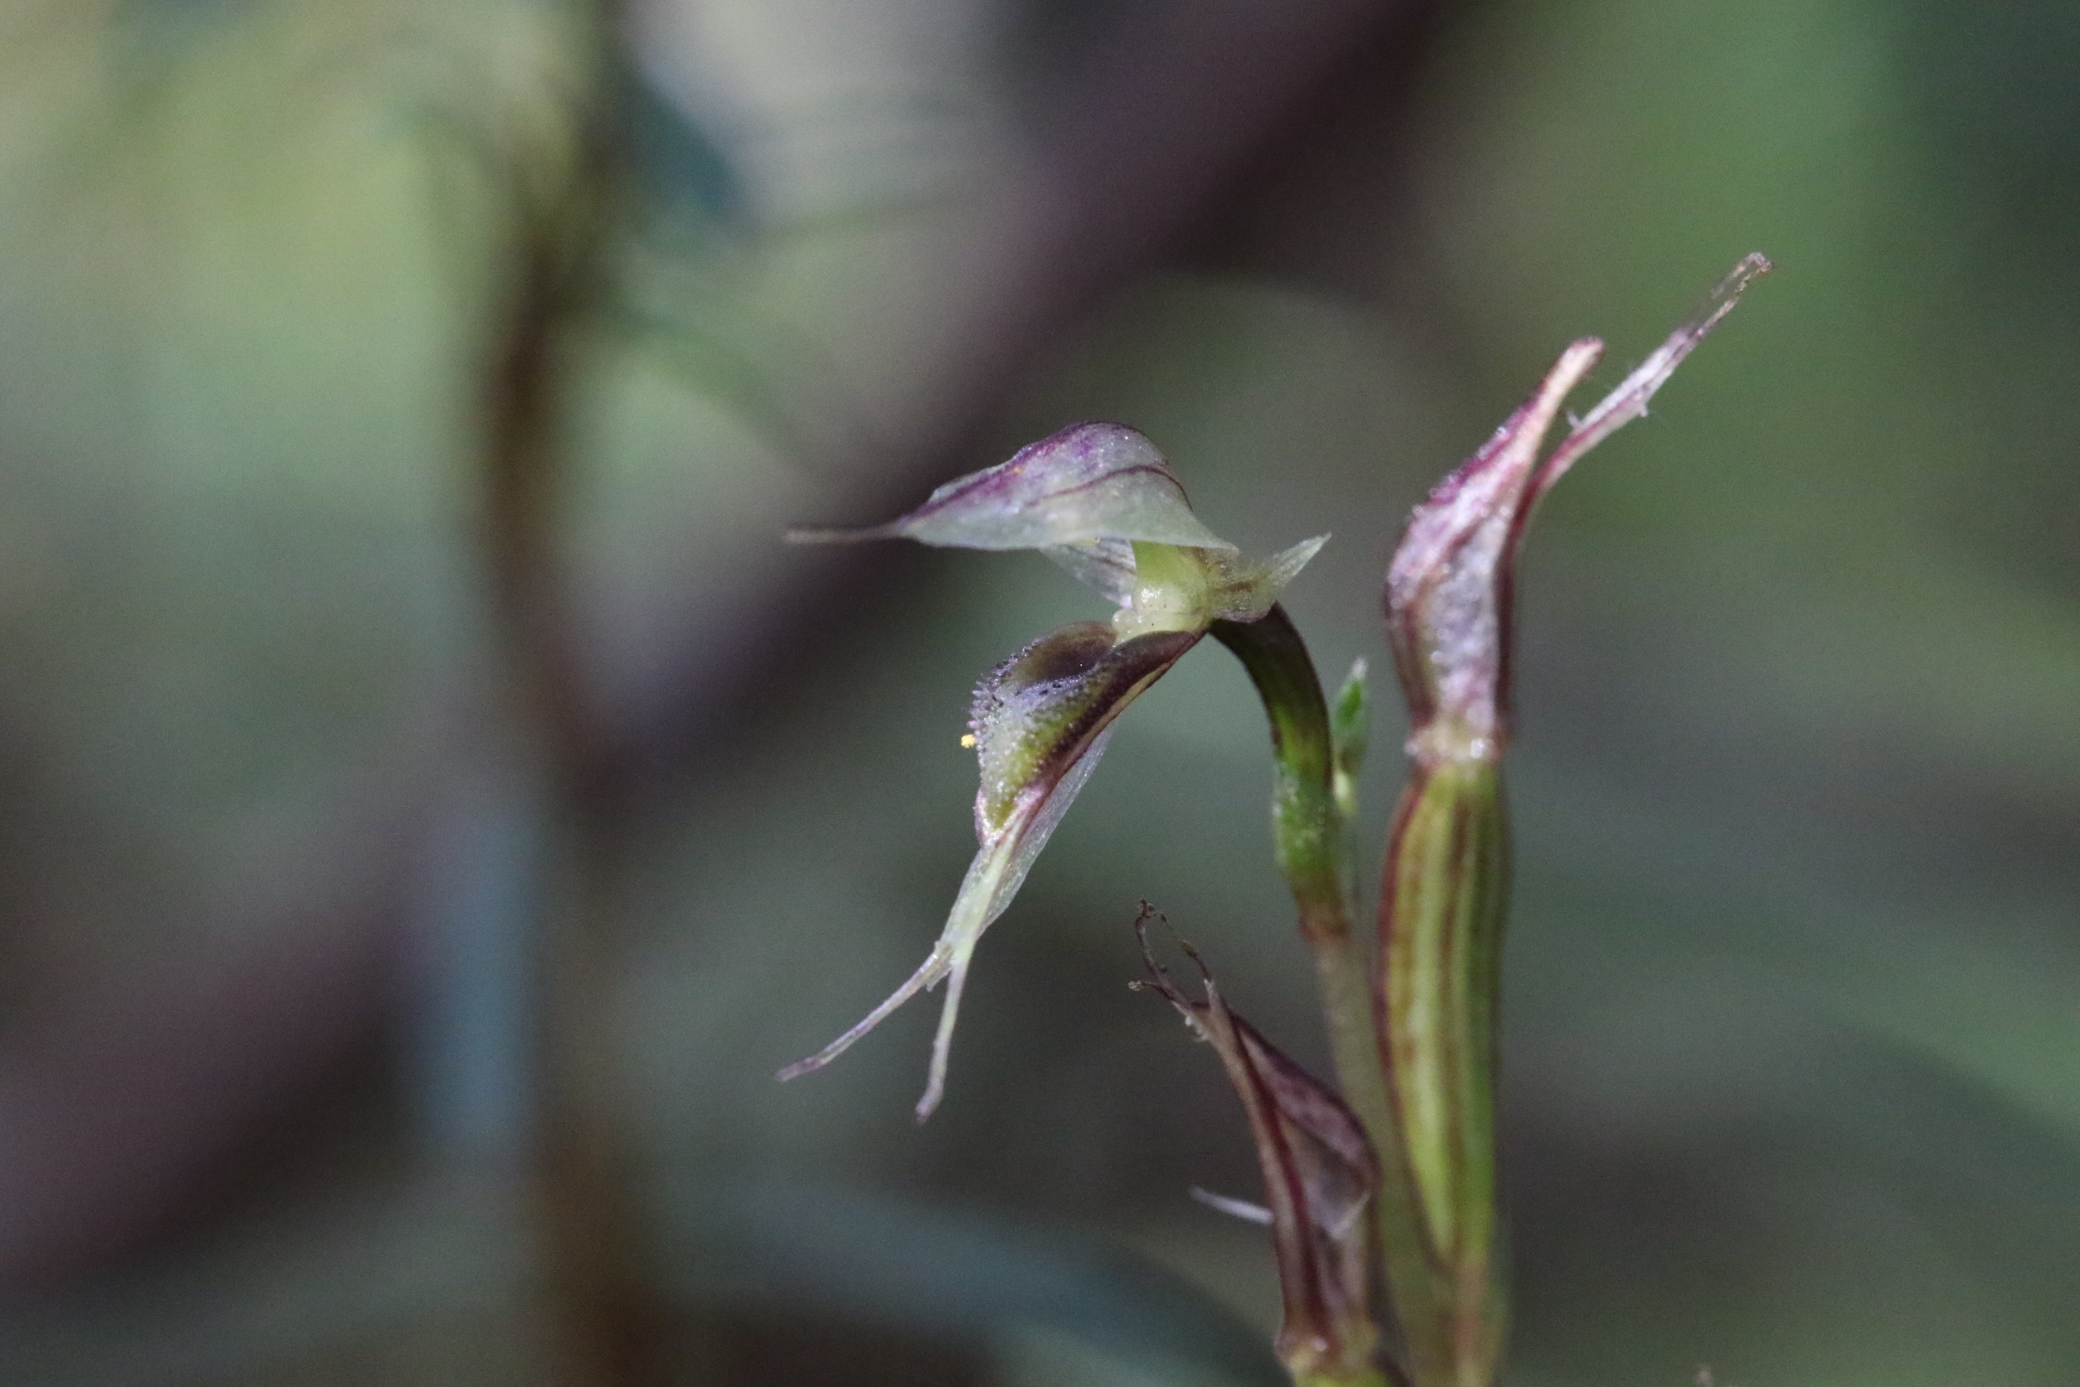

Slide 14
The Road: Potential impacts as NPA sees them:
Excision of 60 Ha of Royal National Park directly from Freeway extension footprint if all above ground.
Isolation of up to 230Ha of Land from Royal National Park if the former F6 Corridor (Removed by Liberals via Wal Murray, then Minister for Roads) and lower unknown amount depending on tunnelling options, and alignment of route through Temptation Creek and along Wilson Parade.
Macquarie University study alluded to the possibility of F6 extension crossing from Royal National Park to existing Princes Highway just south of Heathcote with minor upgrades needed to turn this 100km/hr zone into Freeway standard.
Sedimentation impacts on Kangaroo Creek down to Audley and hacking River

Slide 15
Compromising of 14 rare, threatened and locally significant plants as documented by Macquarie University and of a further locally significant species as documented by Alan Fairley. This cluster of such rare and locally significant plants is due to the presence of shale-influenced and podsolised lateritic soils along the watershed on ridgeline between Royal National Park and Heathcote National Park.
Compromising of Bushwalker access at Loftus, Engadine, Heathcote and Waterfall…possible Freeway flyovers etc. Or walking track crossing bridges. The impact will vary depending on route of F6 extension and any decisions to tunnel sections of extension
Visual compromising of many walking tracks over a large area within Royal National Park.
Increased air pollution with increased traffic capacity/cars on roads…hence Greenhouse Gas implications both directly and via exhaust stacks for residents if tunnelling.

Slide 16
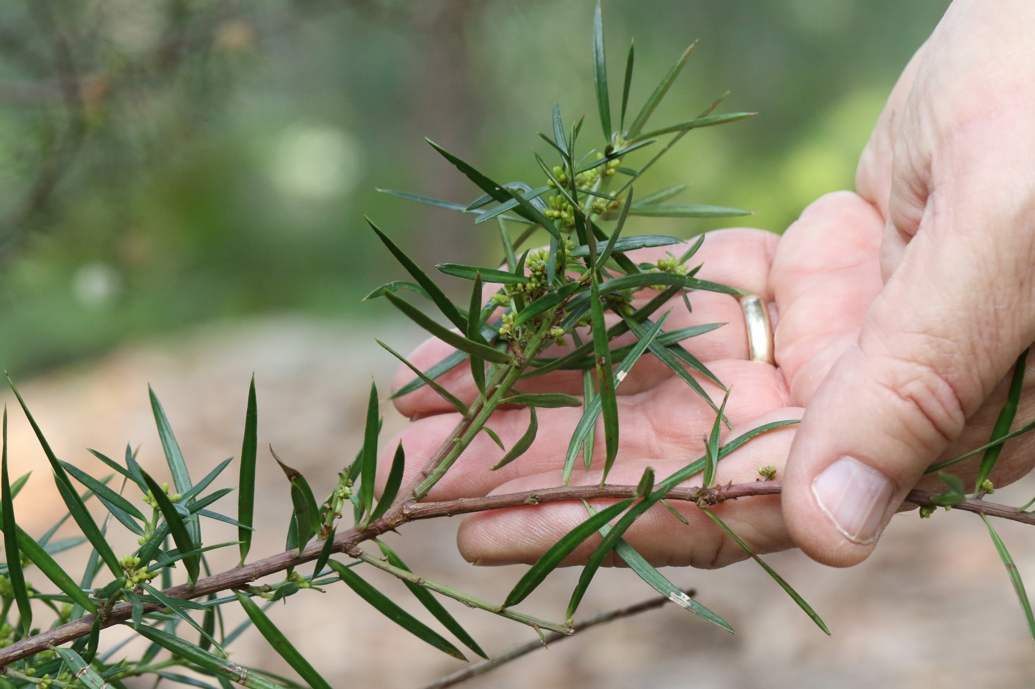

Slide 17
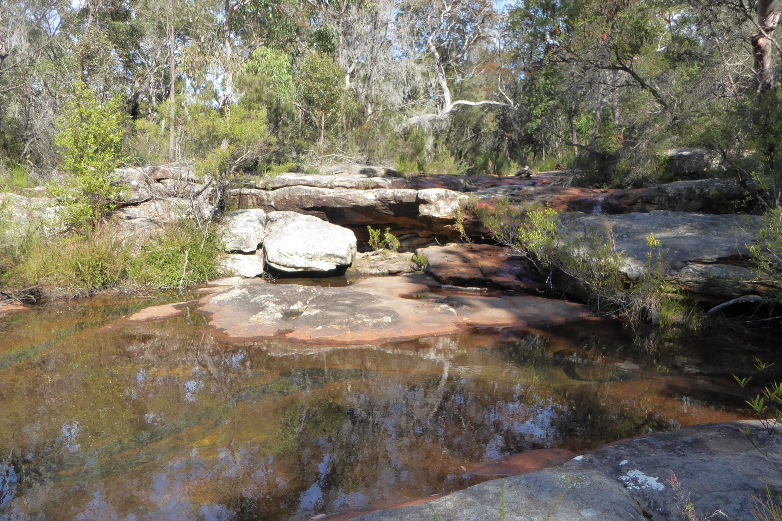

Slide 18
Questions to RMS
To what extent are Transport for NSW and RMS actually looking at integrated transport solutions, for example the expressway vs an upgrade to the highway vs/ as well as a tunnel from Waterfall to Thirroul. In other words, are alternatives being considered and if yes, to what extent?
You will remember that the SMH stories noted that RMS was told NOT to consider rail options!!!!!

Slide 19
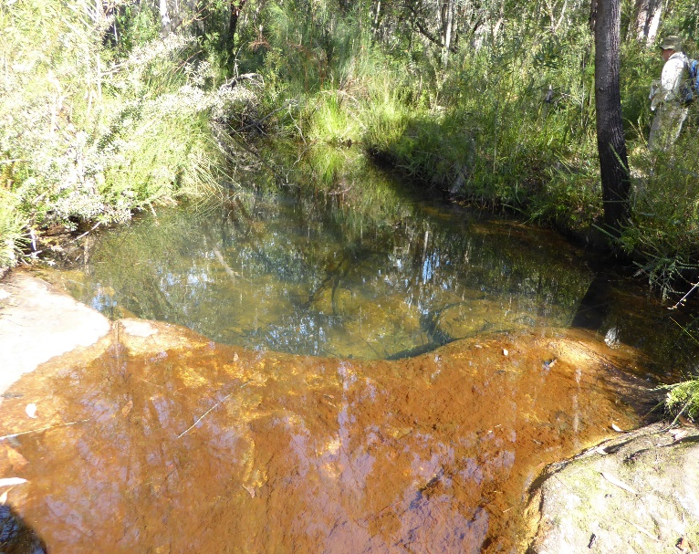
Questions to RMS
The letter we received from Mr McSweeney refers to the existing corridor. Does it exist legally and if yes, where is it? You might not know this but when the story broke RMS removed from its website all maps that referred to the F6. How much of the National Park will be affected? What are the alternative corridors being considered?
A colleague has pointed out that an indicative corridor section occurs in the UBD street directory of Sydney from near the city end of the Sutherland by-pass to Loftus, but no other. Sutherland LEP maps also show a slightly widened section of Sutherland Bypass finishing at Loftus, but detailed labelling is absent.
I might add that earlier iterations had it going East of Heathcote East!

Slide 20
How will engagement with the community occur to put them more in the picture well before any EIS release? If statements by local politicians are any indication, in the words of Joh, “don’t you worry about that!”
What requests for what sorts of geotechnical investigations have been placed with NPWS and for which locations?
We are concerned that the government is making decisions without giving the community indicative ideas for infrastructure. Could we please start to be consulted at early stages of indicative plans so that community input might inform what is proposed through discussions around the scoping of potential environmental, social and economic imports to better inform investigations?

Slide 21
The SMH reported that the RMS intended to soften the population with a message that included a step-by-step guide to managing community relations as it is planned and built. It will be interesting in the light of that revelation how RMS and the Government now handles community expectations

Slide 22
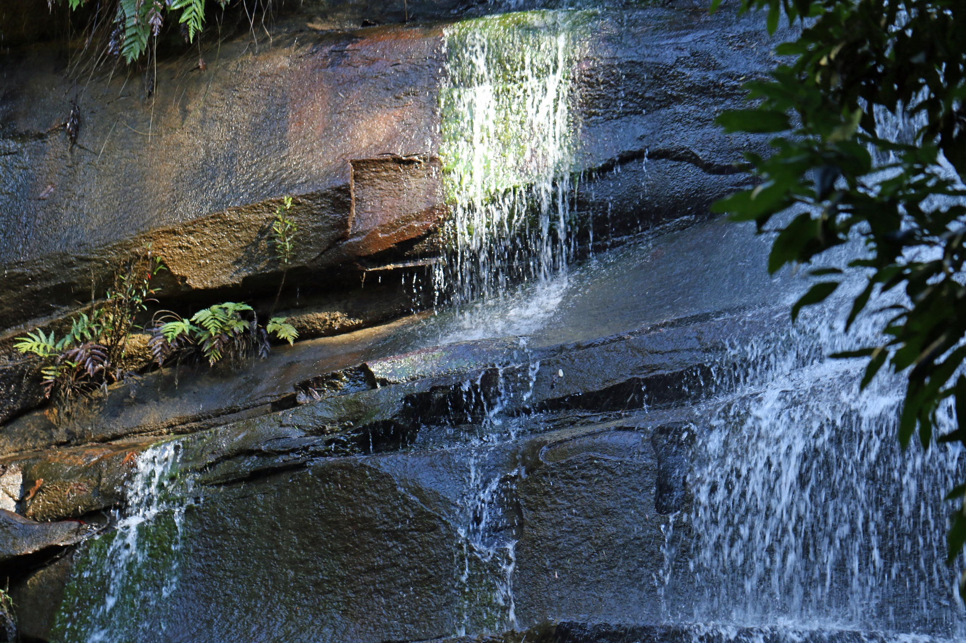

Slide 23
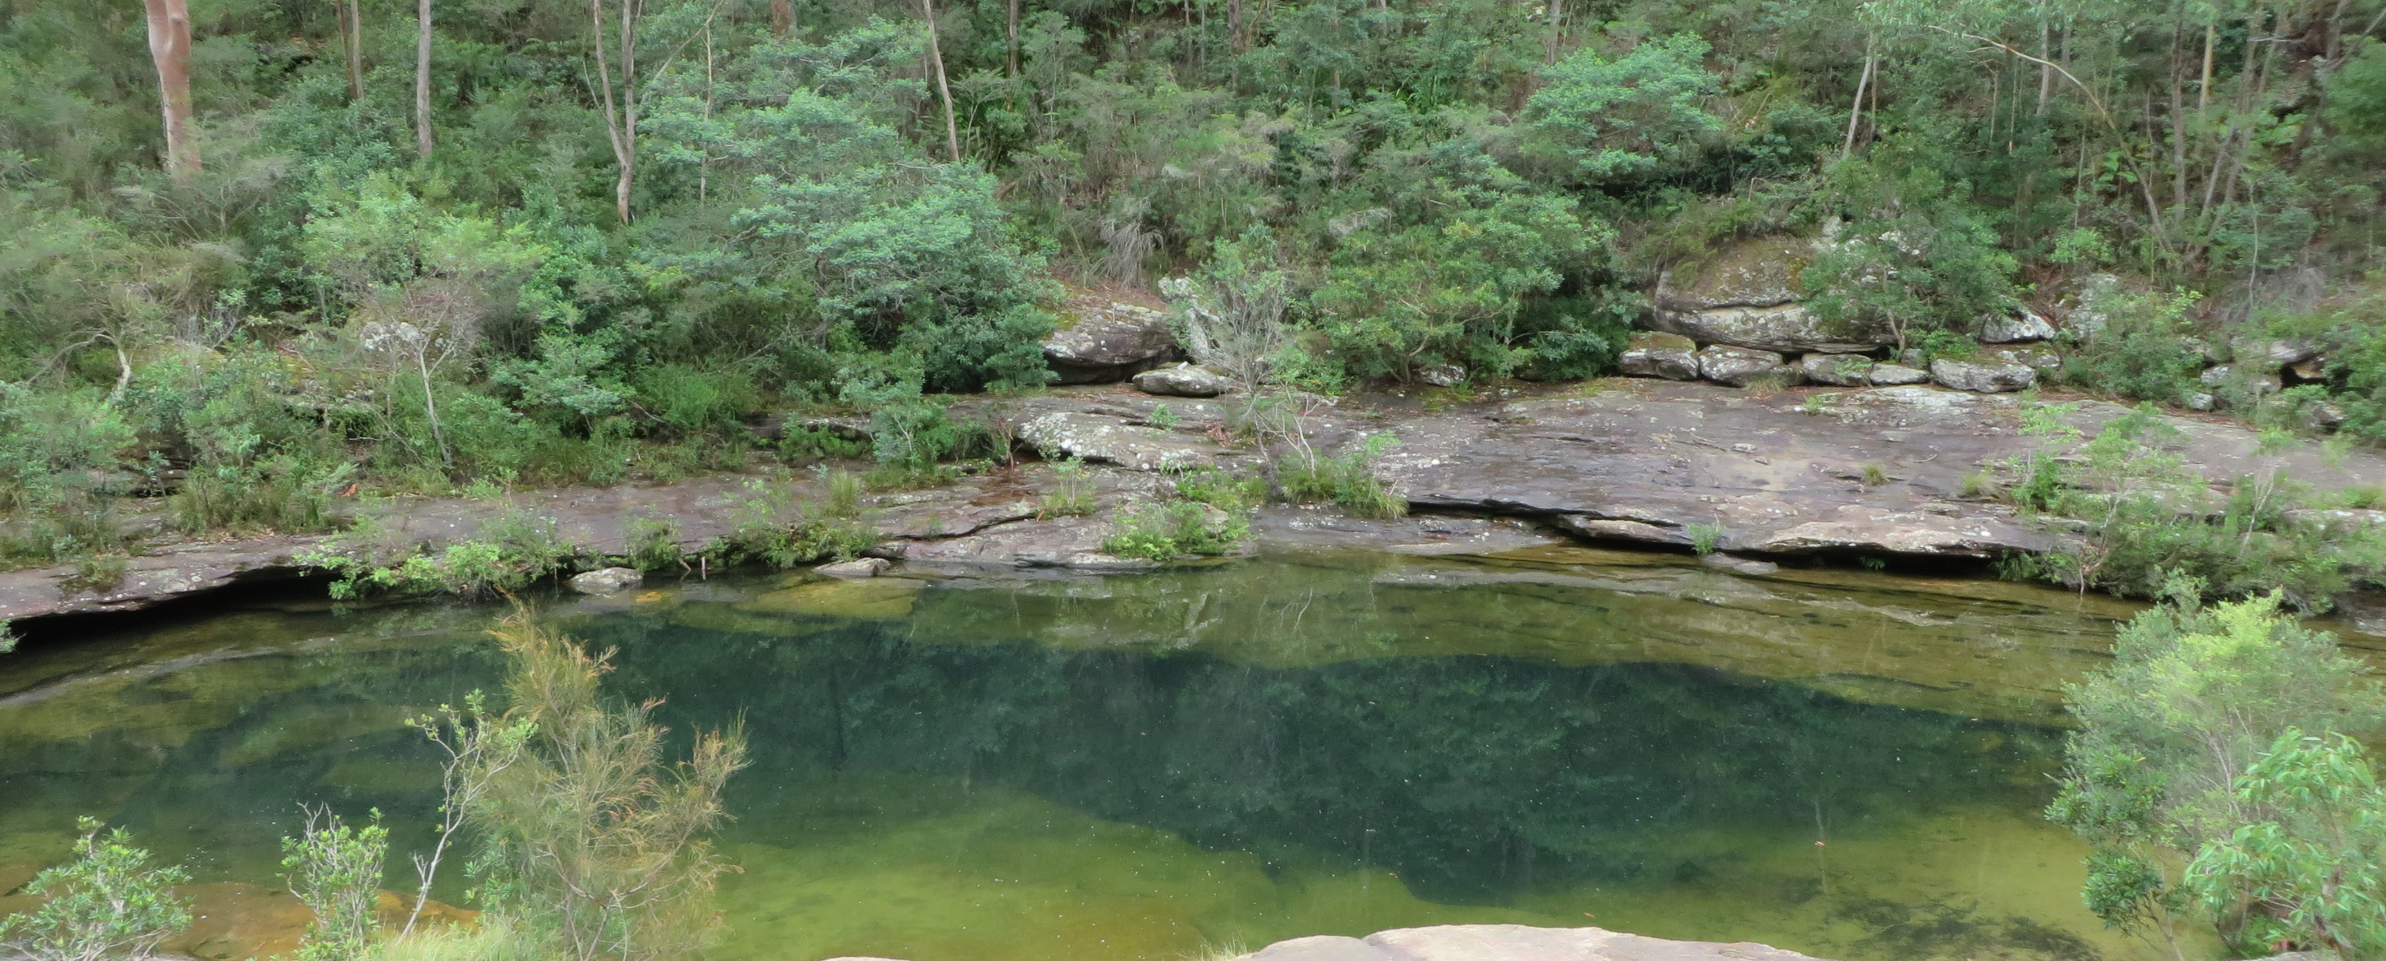
#StandUp4Royal

